Slide 1
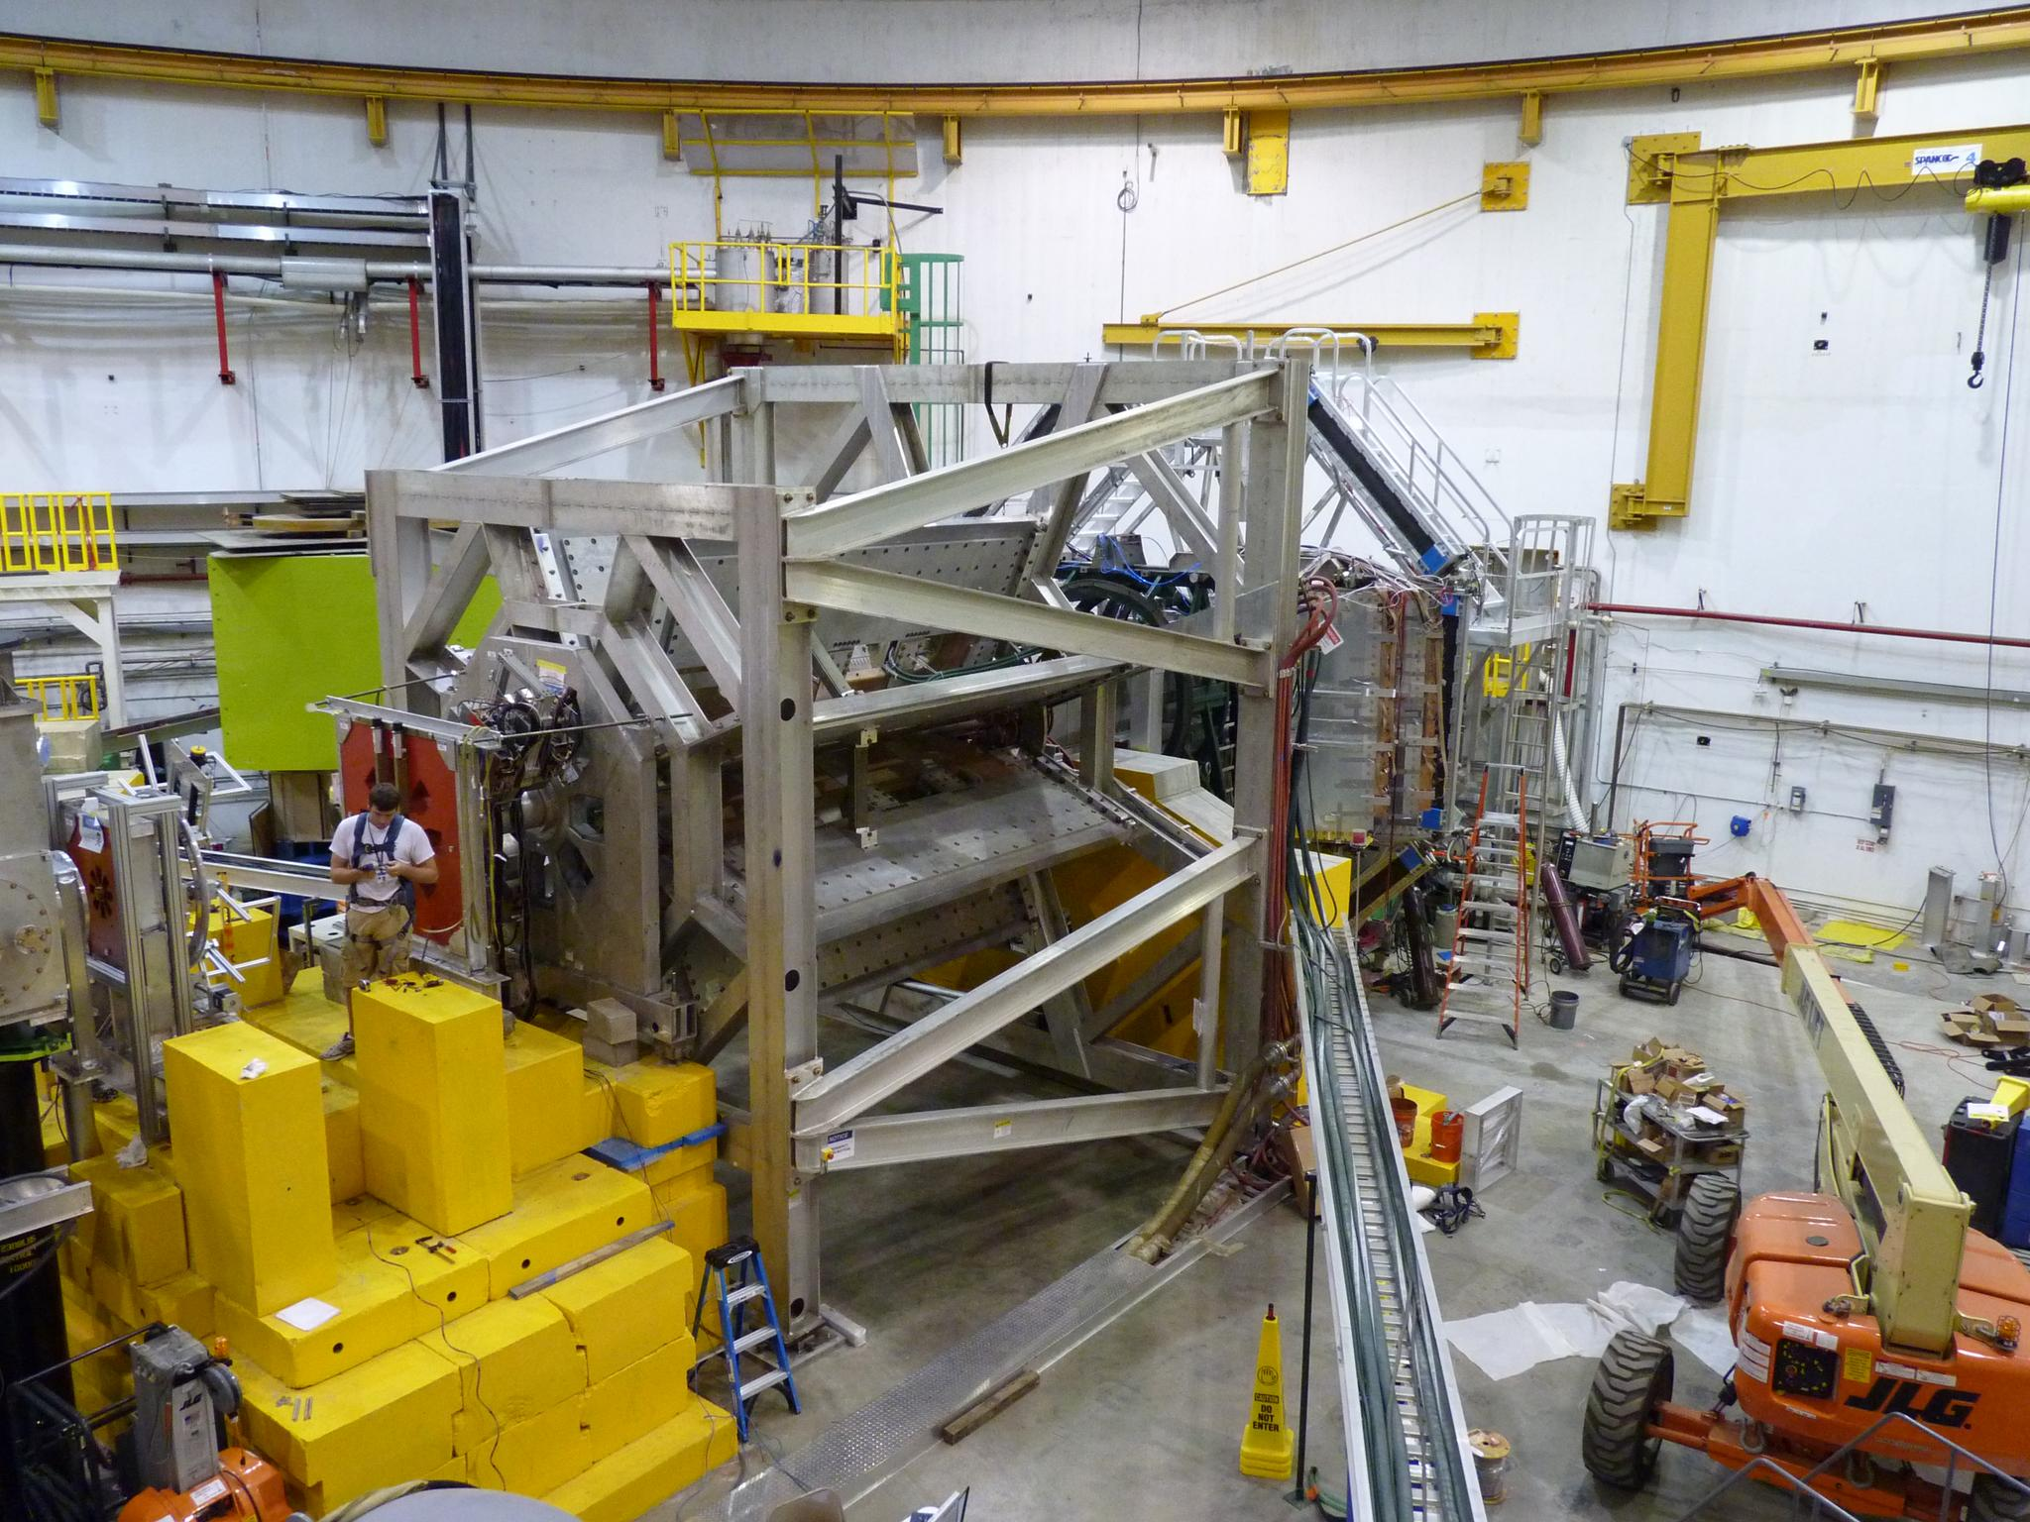

Hall C: Recent Results and 12 GeV Opportunities
Dave Mack (TJNAF)
5th Workshop on Hadron Physics in China and Opportunities in the U.S.
July 2, 2013
Huangshan, China

Slide 2
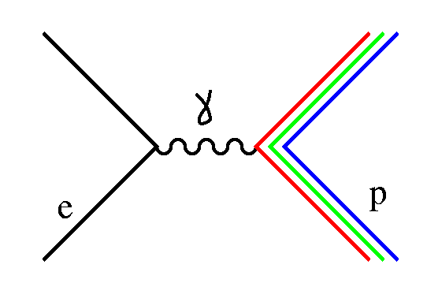
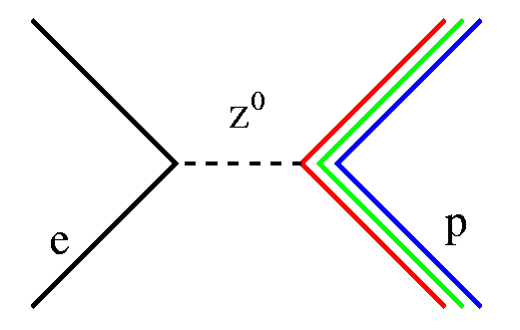
Interactions of Electrons
The well understood interactions of point-like electrons, and the high intensity and quality of modern electron beams, make them ideal for studying the charge and magnetization distributions in nuclear matter.
Because of the different isospin coupling of the γ and Z⁰, parity violating electron scattering provides an additional window on flavor.
In precision measurements of Standard Model-suppressed observables, the large mass of the Z⁰ even brings potential new physics at TeV-scales within reach.

Slide 3
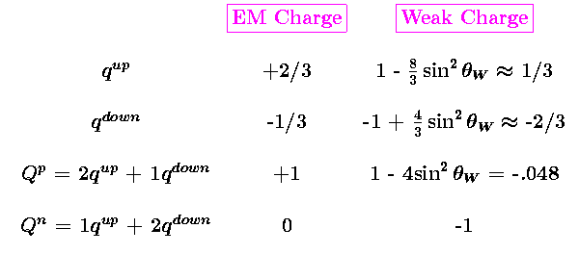
Weak Charges of Light Quarks
Note the roles of the proton and neutron are almost reversed:
ie, neutron weak charge is dominant, proton weak charge is almost zero.
This suppression of the proton weak charge in the SM makes it sensitive to sin²θ_{W} .
The Qweak experiment will yield the most accurate value of sin²θ_{W} at low energies .

Slide 4


Q^{p}weak from PV Elastic Electron Scattering
Parity violation in electron scattering arises from the interference of γ and Z exchange.
At our low energies, the ratio of Weak/EM propagators demands A ~ Q².
The Qweak experiment will measure the experimental asymmetry:
(-200 ppb)
In the limit of low momentum transfer and forward kinematics, the leading order electric term contains the weak charge, the next higher order term contains proton structure contributions.
contains G^{γ}E,M and G^{Z}E,M,
constrained by other expts
Our beam energy and angle acceptance were carefully optimized.
Q_{w}^{p} is responsible for the majority of the asymmetry (~2/3).

Slide 5
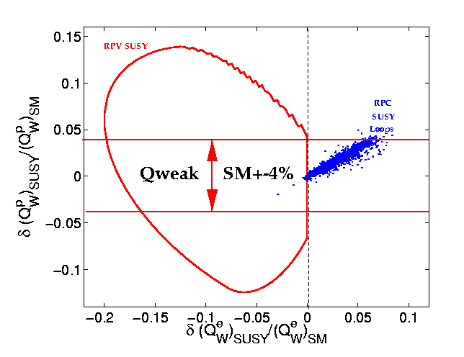
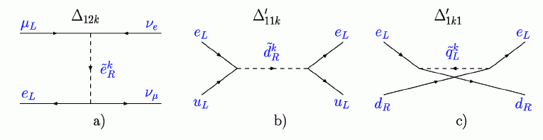
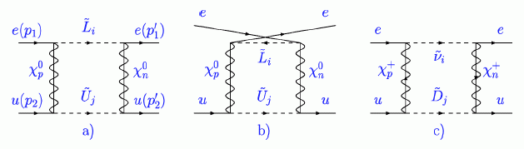
SUSY Sensitivities
R-parity Violating (tree-level) SUSY:
allowed pulls over 3σ
R-parity Conserving
(loop-level) SUSY:
allowed pull 1σ
No dark matter candidate (decayed)
Contour 95% CL
A. Kurylov et al., PRD 68, (2003) 035008
contour courtesy of Shufang Su (U. Arizona)

Slide 6
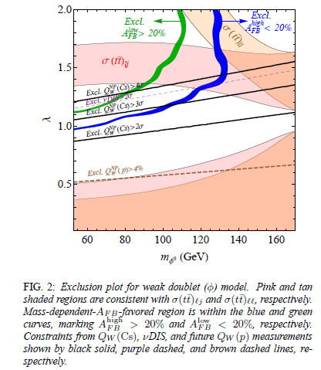
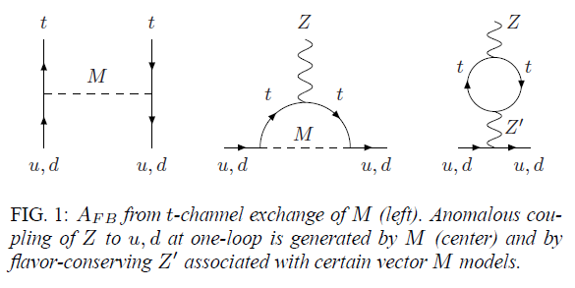
Low Energy PV and the Tevatron Top A_{FB} Anomaly
M. Gresham et al., arXiv:1203.1320v1 [hep-ph] 6 Mar 2012
Tevatron CF and D0 collaborations saw an excess in the t-tbar forward-backward asymmetry, A_{FB}.
(Precision measurements can also be made at the energy frontier!)
A possible explanation which avoided known constraints was
a new, not-too-massive, scalar or vector particle.
Sufficiently precise low energy PV experiments can constrain new physics models.

Slide 7
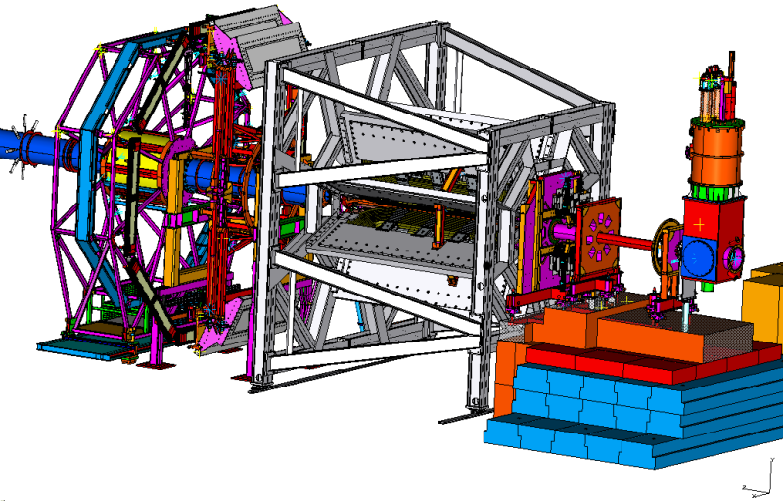
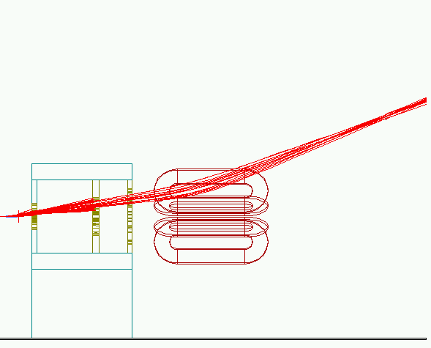
Spectrometer (Manitoba-MIT Bates-TRIUMF)
The Qweak spectrometer has to isolate elastic e+p events at small angles, with the largest acceptance possible, without tracking detectors.
(A new particle traverses each detector approximately every nsec.)
No ferromagnetic materials can be used, so a brute-force electromagnet was required.
(The PC asymmetry for pol e+ pol e scattering is a billion times larger than our level of comfort.)
Target
Detector
The mapping of QTOR was the subject of PeiQing Wang’s MS thesis.
(U. Manitoba)
Collimation/
Shielding
Toroidal
Magnet

Slide 8
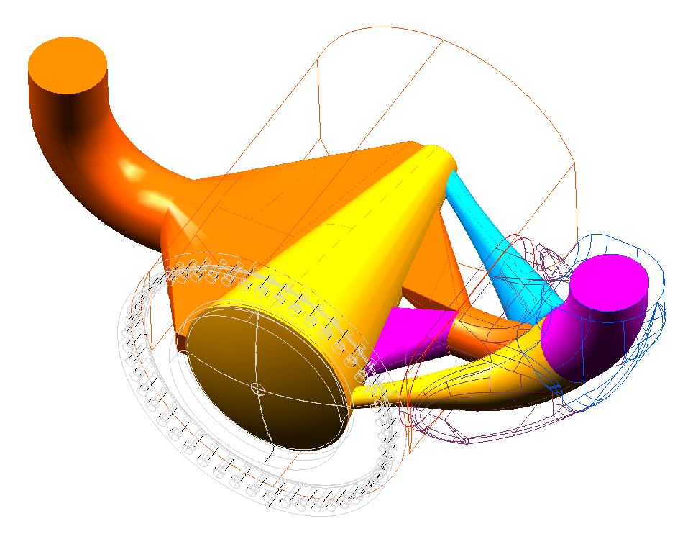
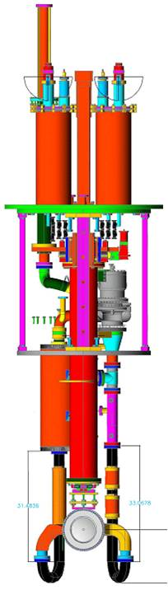
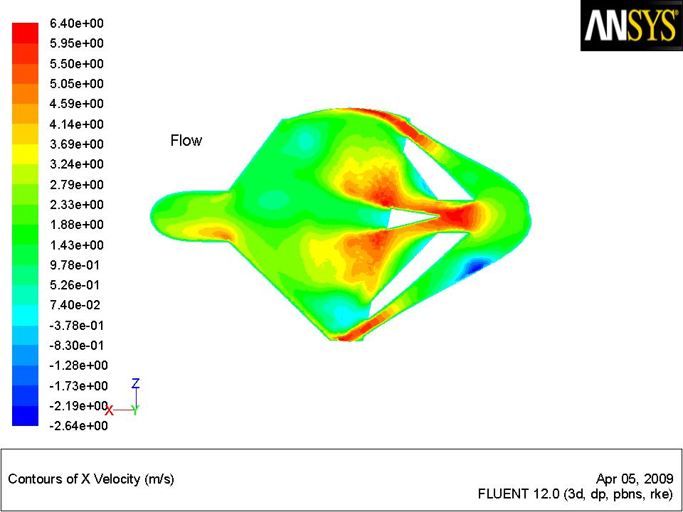
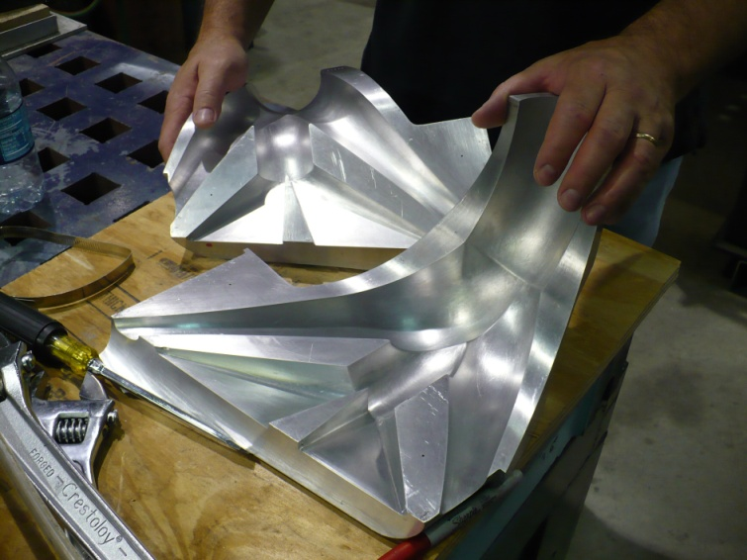
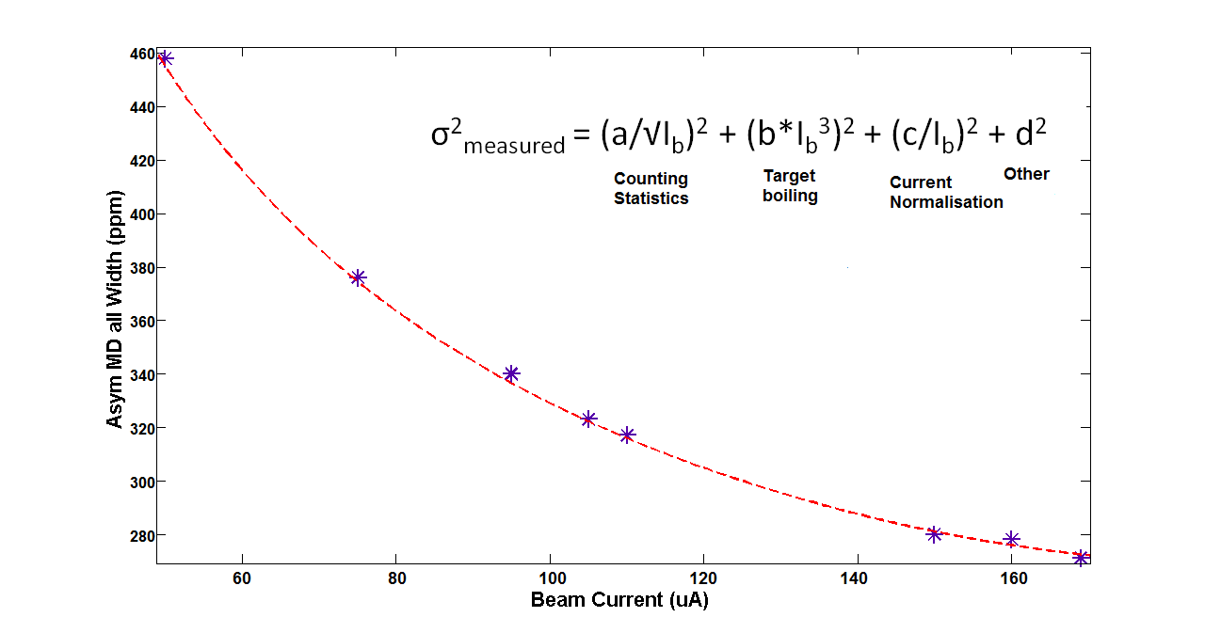
The World’s Highest Power LH₂ Target
(TJNAF-U. Mississippi)
This 2.5 kWatt target was designed using Computational Fluid Dynamics (CFD). Cell is 35cm long, operating at up to 180 μA, L = 1.8x10³⁹
beam
flow
LH2 Flow
beam
Target noise is only 50-60 ppm with 3.5mm x 3.5mm raster, almost negligible in quadrature with counting statistics.

Slide 9
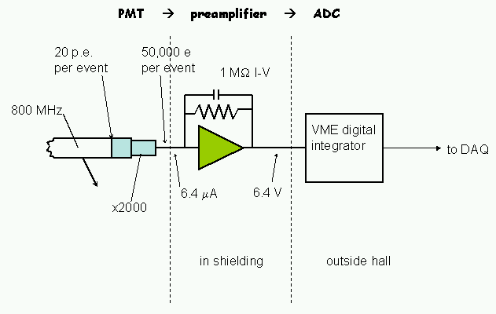
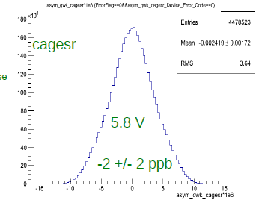
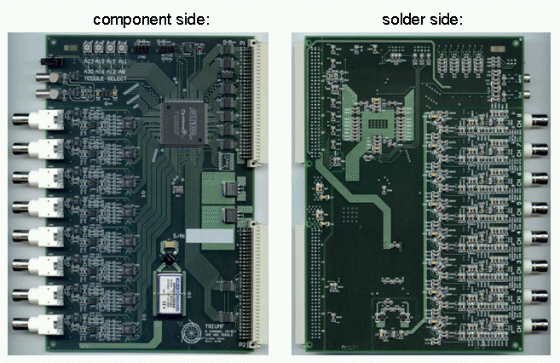
Custom Low Noise Electronics (TRIUMF)
Electronic noise is over two orders of magnitude smaller than counting statistics noise of electron tracks.
battery signal
VME integrator –
18 bit ADC sampling at 500 kHz
FPGA sums 500 samples into one data word
same resolution as a 26 bit ADC
This permits us to check for ppb-level false asymmetries from cross-talk in only one shift.
Notes:
The integrators will be upstairs in the electronics cage.

Slide 10
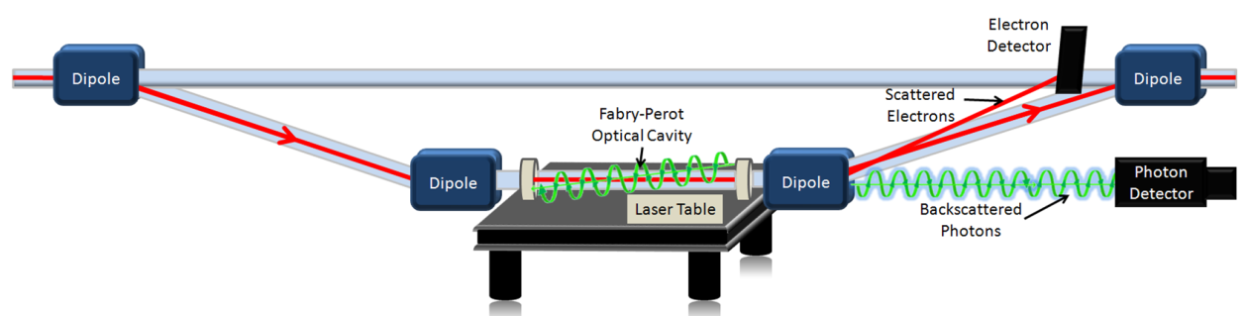
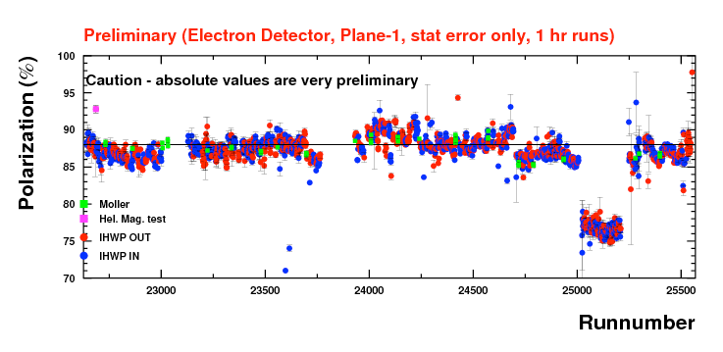
Compton Polarimeter (Hall C-MIT Bates-UVA)
( γ + e → γ + e )
A continuous monitor at full production current.
Non-invasive: perturbs the beam only at the part-per-trillion level.
Two independent detectors of Compton scattering:
1) integrating mode γ detector and 2) event mode electron detector.
Laser is cycled on and off to measure backgrounds.
In principle, the continuous Compton results can be used to interpolate the occasional Moeller results.

Slide 11
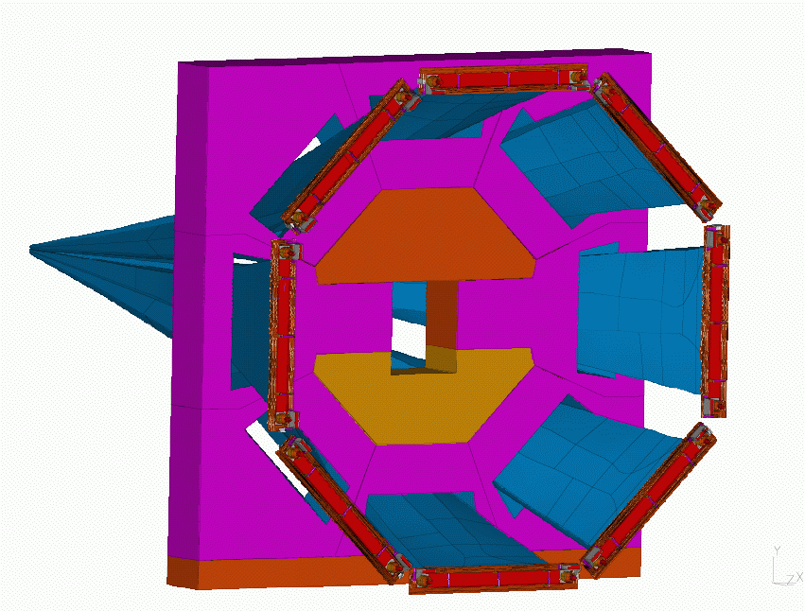
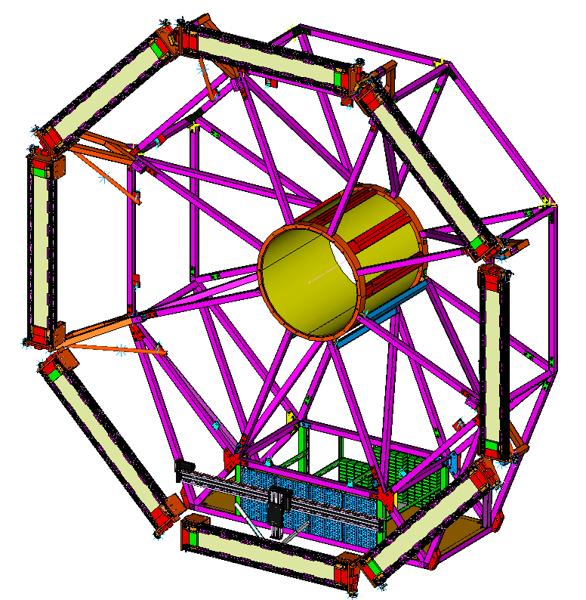
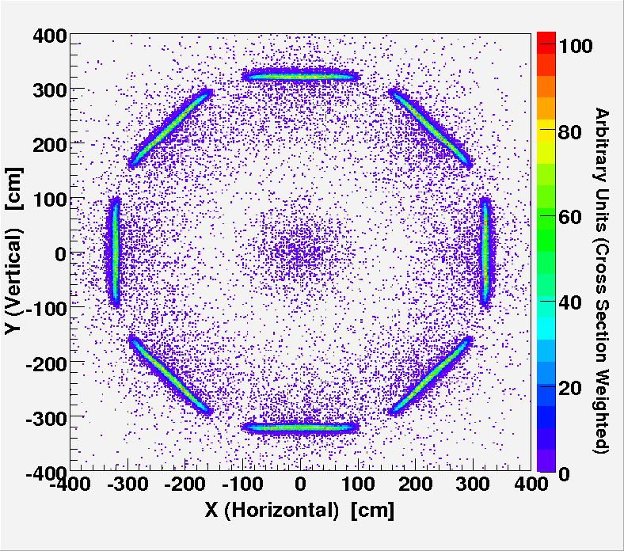
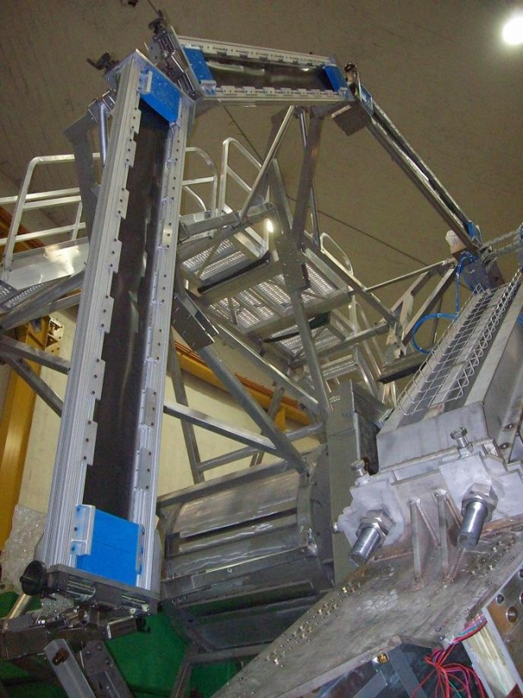
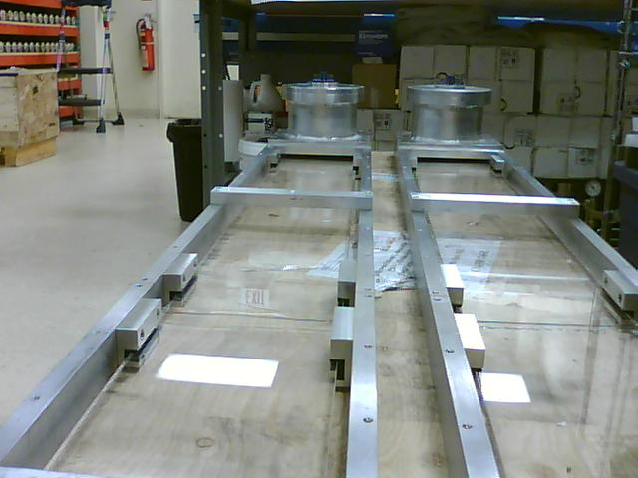
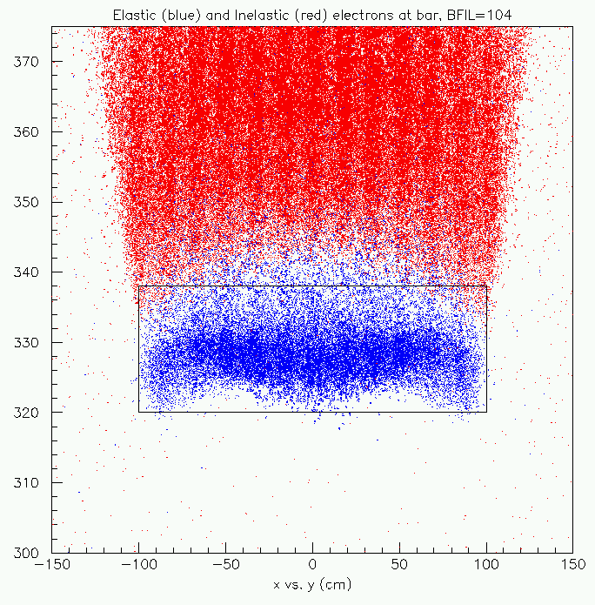
Main Detectors
(Manitoba-TJNAF)
Large array of eight Cerenkov radiator bars (each 200 x 18 x 1.25 cm³)
artificial fused silica for UV transmission, polished to 25Angstroms (rms)
Spectrosil 2000: rad-hard, non-scintillating, low-luminescence
Two 5” PMTs per bar, S20 cathodes for high light levels
Yield 100 pe’s/track with 2cm Pb pre-radiators
Inelastics
Elastics
The construction of the MD and commissioning of Qweak was the subject of PeiQing Wang’s PhD thesis. (U. Manitoba)

Slide 12
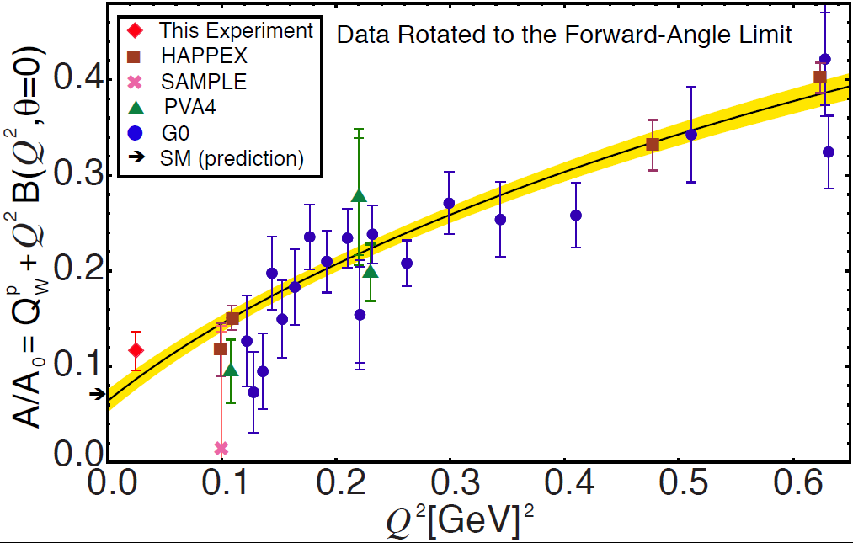
New Q-weak Datum (1/25 of dataset)
+ World PVES Results

Slide 13
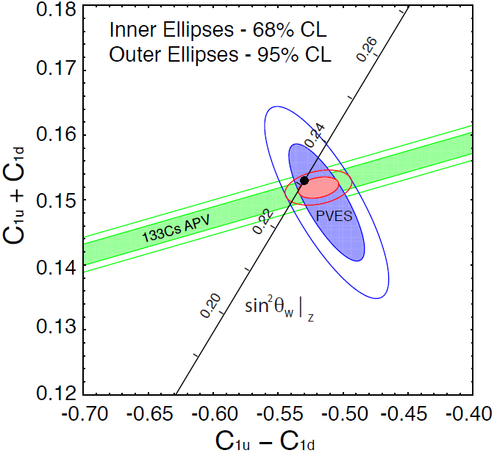
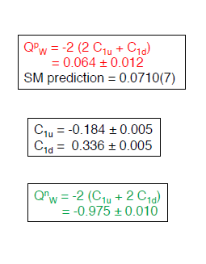
New Global Analysis Results
(publication in preparation)
Remainder of experiment being analyzed.

Slide 14
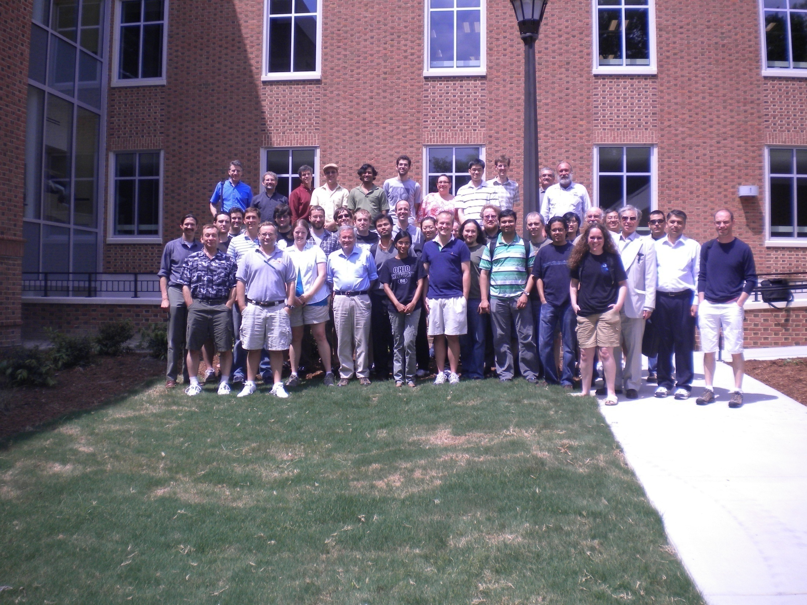
The Q-weak Collaboration
W&M meeting
A. Almasalha, D. Androic, D.S. Armstrong, A. Asaturyan, T. Averett, J. Balewski, R. Beminiwattha, J. Benesch, F. Benmokhtar, J. Birchall, R.D. Carlini¹ (Principal Investigator), G. Cates, J.C. Cornejo, S. Covrig, M. Dalton, C. A. Davis, W. Deconinck, J. Diefenbach, K. Dow, J. Dowd, J. Dunne, D. Dutta, R. Ent, J. Erler, W. Falk, J.M. Finn¹*, T.A. Forest, M. Furic, D. Gaskell, M. Gericke, J. Grames, K. Grimm, D. Higinbotham, M. Holtrop, J.R. Hoskins, E. Ihloff, K. Johnston, D. Jones, M. Jones, R. Jones, K. Joo, E. Kargiantoulakis, J. Kelsey, C. Keppel, M. Kohl, P. King, E. Korkmaz, S. Kowalski1, J. Leacock, J.P. Leckey, A. Lee, J.H. Lee, L. Lee, N. Luwani, S. MacEwan, D. Mack, J. Magee, R. Mahurin, J. Mammei, J. Martin, M. McHugh, D. Meekins, J. Mei, R. Michaels, A. Micherdzinska, A. Mkrtchyan, H. Mkrtchyan, N. Morgan, K.E. Myers, A. Narayan, Nuruzzaman, A.K. Opper, S.A. Page¹, J. Pan, K. Paschke, S.K. Phillips, M. Pitt, B.M. Poelker, J.F. Rajotte, W.D. Ramsay, M. Ramsey-Musolf, J. Roche, B. Sawatzky, T. Seva, R. Silwal, N. Simicevic, G. Smith², T. Smith, P. Solvignon, P. Souder, D. Spayde, A. Subedi, R. Subedi, R. Suleiman, E. Tsentalovich, V. Tvaskis, W.T.H. van Oers, B. Waidyawansa, P. Wang, S. Wells, S.A. Wood, S. Yang, R.D. Young, S. Zhamkochyan, D. Zou
¹Spokespersons *deceased ²Project Manager

Slide 15
Hall C 12 GeV Upgrade

Slide 16
Motivating Experiments for Hall C Upgrade
Pion and nucleon elastic form factors at high momentum transfer
Deep inelastic scattering at high Bjorken x
Semi-inclusive scattering at high hadron momenta
Polarized and unpolarized scattering on nuclei
The existing High Momentum Spectrometer (HMS) remains important. What was needed was a new spectrometer better suited for detecting charged particles close to the new beam energy:
Higher momentum capability (11 GeV/c)
Smaller angle capability (5.5 degrees)
Very good particle identification (e, π, k, p)
Accurate and reproducible angle and momentum settings
The SHMS (Super High Momentum Spectrometer) was designed to meet these requirements.

Slide 17
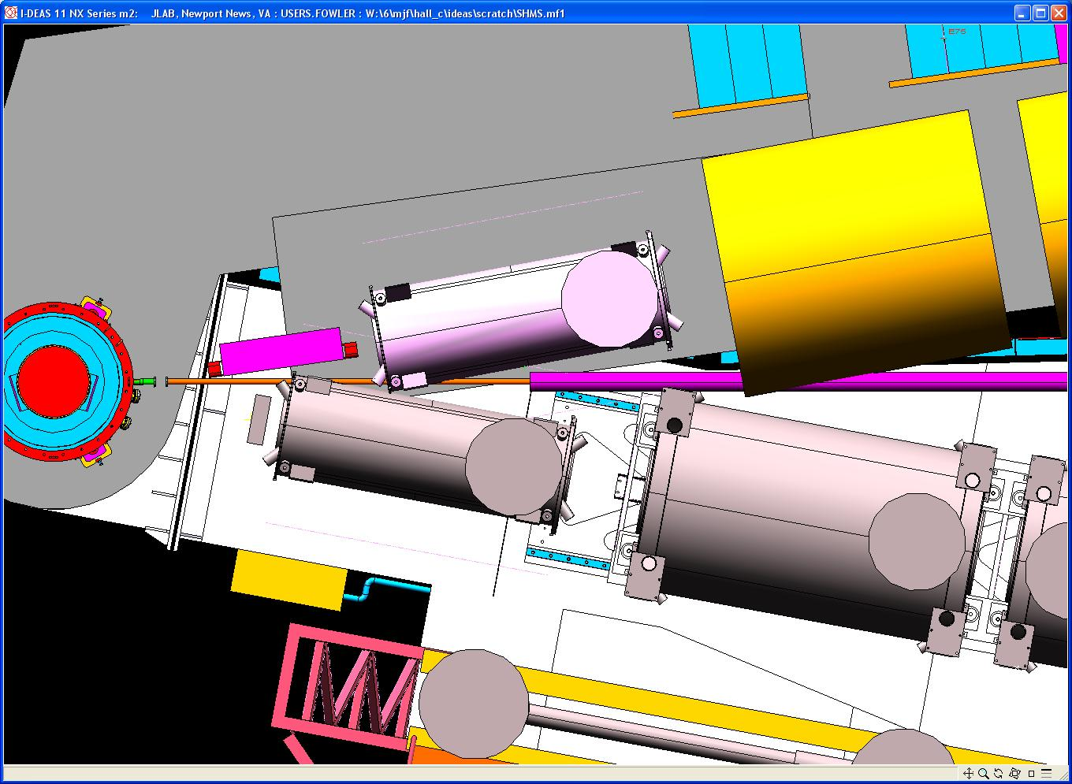
SHMS Small Angle Challenge
Horizontal bender
Q2
SHMS
5.5⁰
HB
Q1’
target
chamber
HMS
10.5⁰

Slide 18
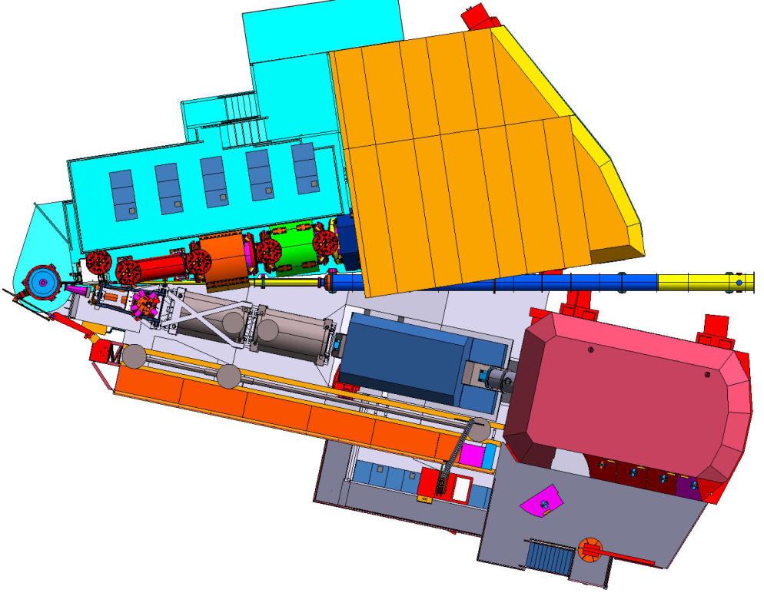
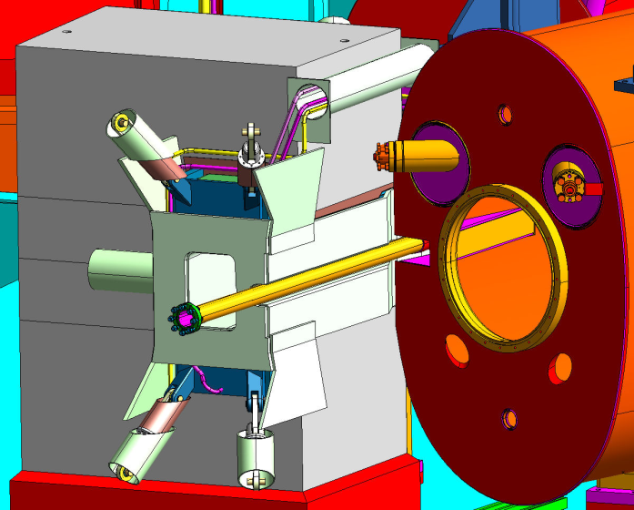
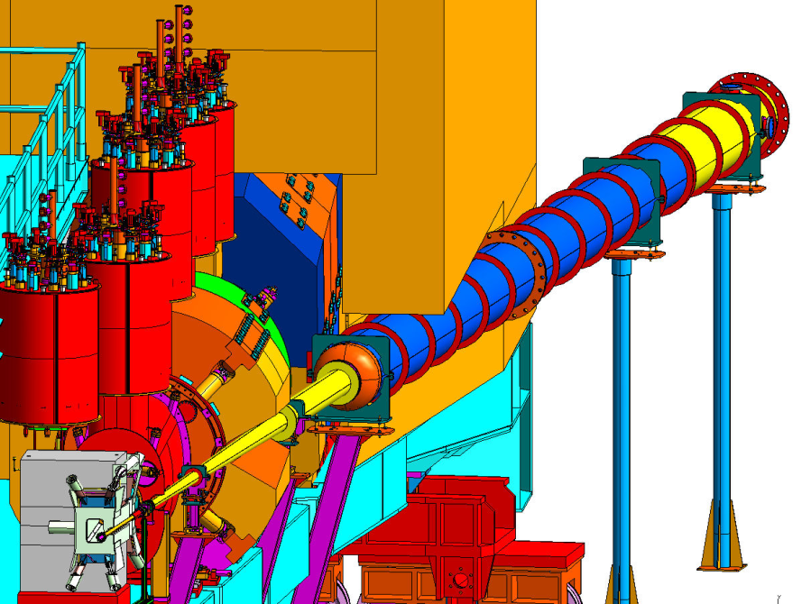
Getting Both Spectrometer to Small Separation Angles for Coincidence Studies

Slide 19
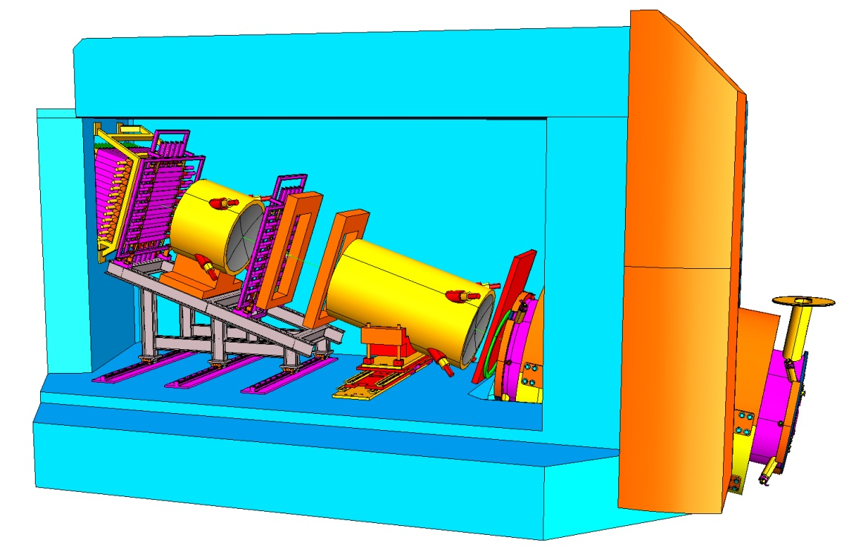
SHMS Detectors: Excellent PID
Trigger hodoscopes
(James Madison University and North Carolina A&T)
Lead Glass Calorimeter
(Yerevan/Jlab)
Heavy gas Cerenkov
(University of Regina)
Drift chambers
(Hampton University)
Noble gas Cerenkov
(University of Virginia)

Slide 20
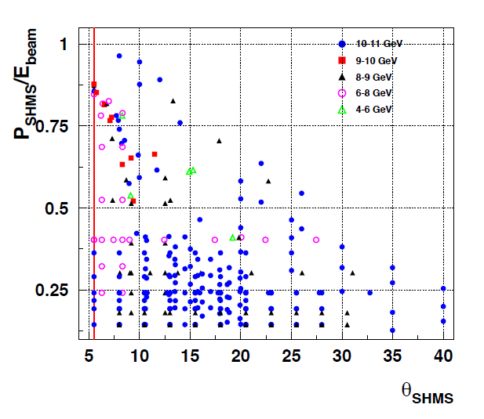
Kinematics of Some Approved
Hall C Proposals

Slide 21
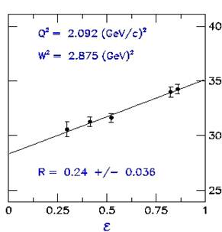
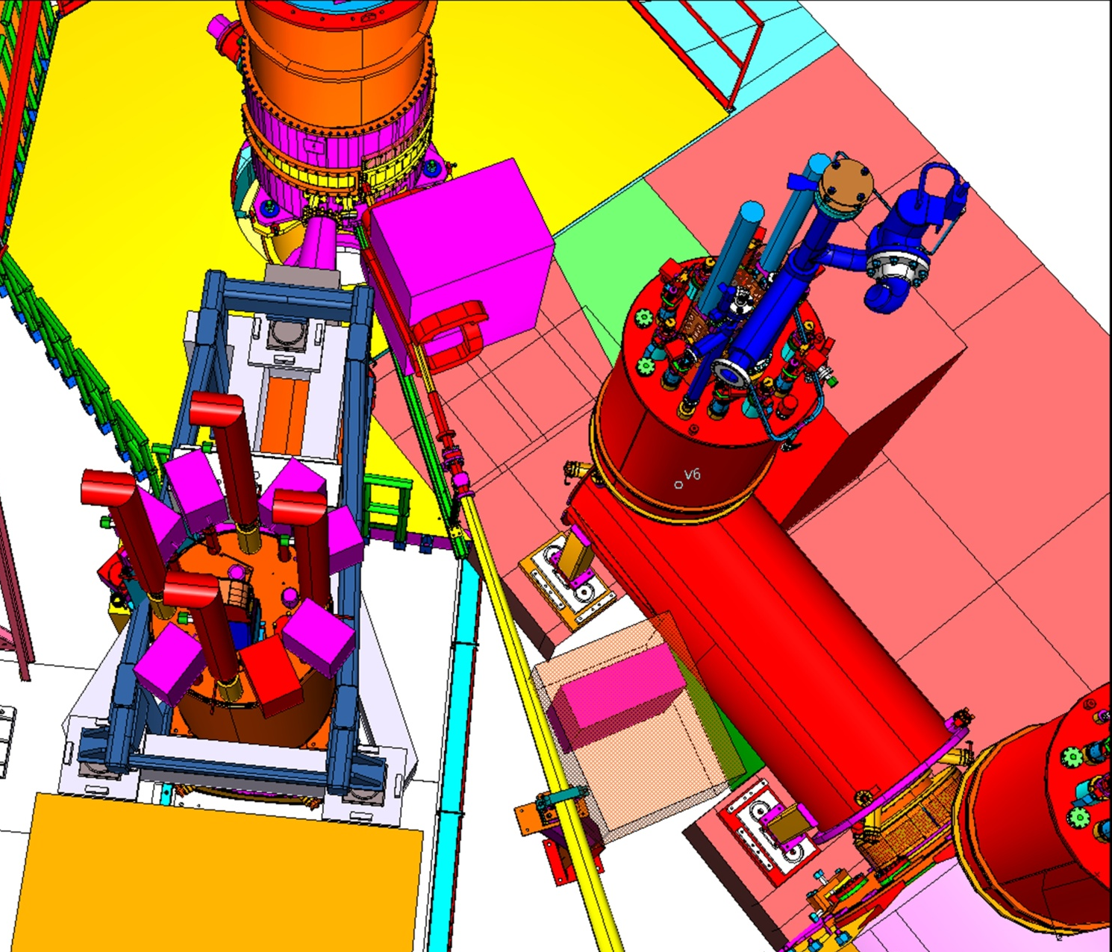
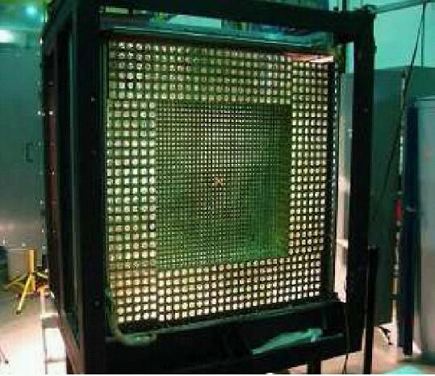
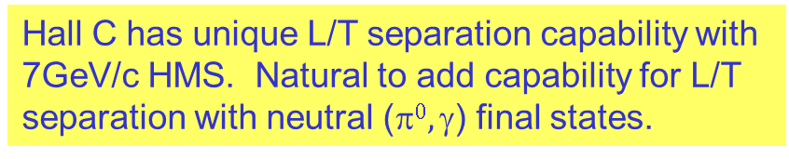
Proposed neutrals ( e.g. π⁰/γ ) detector facility
Hall C has unique L/T separation capability with 7GeV/c HMS. Natural to add capability for L/T separation with neutral ($0, $) final states.
Beam direction
target
Concept: Place ~1000 block PbWO₄ detector on SHMS carriage (currently under construction) with conventional sweeping magnet replacing SHMS horizontal bend.
Organizational meetings with Halls A, C & users to propose facility for program of DVCS, WACS, & (e,e’π⁰).
HMS
Notes:
Hall C: Established capability for L/T separation for (e,e’) and (e,e’X)
Requires SHMS superstructure, now under construction

Slide 22
Example Experiment:
Charge Symmetry Violation in PDF’s

Slide 23
Charge Symmetry: Low energy nuclear physics vs. QCD
Charge symmetry (CS) is a particular form of isospin symmetry (IS) that involves a rotation of
180° about the “2” axis in isospin space
Low energy
QCD
For nuclei:
CS operator interchanges neutrons and protons
CS appears to be more respected than IS:
pp and nn scattering lengths are almost equal
m_{p} = m_{n} (to 1%)
Binding energies of ³H and ³He are equal to 1%
Energy levels in mirror nuclei are equal to 1 %
After corrections for electromagnetic interactions
u^{p}(x,Q²) = d^{n}(x,Q²) and d^{p}(x,Q2) = u^{n}(x,Q²)
Origin:
Electromagnetic interactions
δm = m_{d} – m_{u}
Naively, one would expect that CSV would be
of the order of (m_{d} – m_{u})/<M>
Where <M> = 0.5 – 1 GeV
➔ CSV effect of 1%
CS has been universally assumed in parton distribution functions !
Notes:
Charge symmetry is a particular form of isospin symmetry. While IS requires invariance under all rotation in isospin space . CS is only related to one rotation. It requires invariance with respect to rotations of 180 deg about the T2 axis (where the charge corresponds to the third axis).
For nuclei, CS operator interchanges neutrons and proton. As charged symmetry is more restricted symmetry, it is generally conserved in strong interactions to a greater degree than isospin symmetry. Thus, while in many nuclear reactions isospin symmetry is violated at the few percent level, in most cases charge symmetry is obeyed to better than one percent as one can see in pp and nn scattering lengths….
For parton distributions, CS involves interchanging up and down quarks while simultaneously changing protons and neutrons.
In QCD, the only sources of CSV are electromagnetic interactions and the mass difference between up and down quarks. While EM should play a minor role at high energies, the light quark mass difference is believed to be the interesting feature of QCD view of CSV. (Mu = 4 MeV and Md = 7 MeV)
Since CS is well satisfied at lower energies, it is natural to assume that it holds for PDFs. Where it reduces to half the number of PDFs necessary to describe high energy data.

Slide 24
Charge Symmetry violation from MRST Global fits
(Eur. Phys. J. C35, 325 (2004))
CSV for sea quarks
Could be significant.
Given how fundamental pdf’s are, better constraints on CSV are needed.
CSV for valence quarks
Slide from JC Peng, “3rd International Workshop on Nucleon Structure at Large Bjorken X” Jefferson Lab, Newport News, Oct. 13-15, 2010

Slide 25
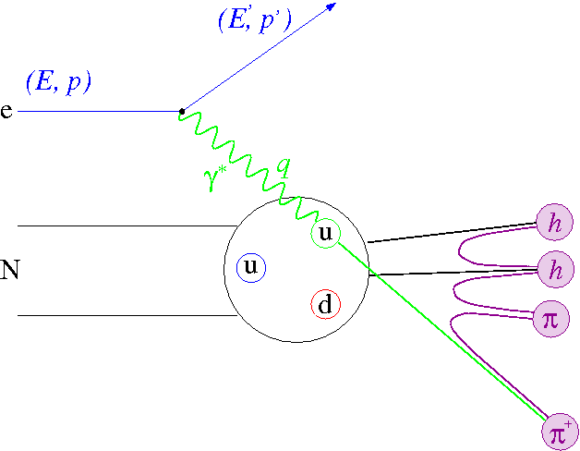
E12-09-002: Charge Symmetry Violating Quark Distributions via π⁺/π⁻ in SIDIS
Spokespersons: K. Hafidi, D. Dutta, and D. Gaskell
Experiment: Measure Charged pion electroproduction in semi-inclusive DIS off deuterium
Ratio of π⁺/π⁻ cross sections sensitive to CSV quark distributions
SHMS
δd-δu where
δd=d^{p}-u^{n} and δu=u^{p}-d^{n}
CSV measurements are important as a further step in studying the inner structure of the nucleon
extraction relies on the implicit assumption of charge symmetry (sea quarks)
Viable explanation for NuTeV anomaly →
CS is a necessary condition for many relations between structure functions
HMS
Precise cross sections and π⁺/π⁻ ratios will provide important information on SIDIS reaction mechanism at JLab energies
Beam time request = 22 days at 11 GeV
Notes:
Goal of E12-09-002 is to extract Charge Symmetry violating quark distributions via semi-inclusive production of charged pions from Deuterium. In particular – it has been shown that ratio of pi+/pi- yields is sensitive to \delta d - \delta u
CSV measurements an important step in studying structure of the nucleon
ubar .ne. dbar (866)could be partially explained if there were charge symmetry violation in quark sea
CSV put forward as a possible explanation for the NuTeV anomaly
CS is assumed for many between structure functions (F3 from isoscalar targets in neutrino scattering)
In addition to CSV quark distributions, experiment will provide information on SIDIS reaction mechanism via semi-inclusive cross sections and charge ratio measurements
Experiment will run in Hall C – electrons in SHMS, pions in HMS. We request 22 days at 11 GeV

Slide 26
Semi-Inclusive DIS
(e,e′) DIS probes sums of quarks and anti-quarks.
By tagging DIS with mesons, gain sensitivity to quark flavours.
At high energies the SIDIS process factorizes: cross section can be decomposed as a products of quark distribution functions f(x) and fragmentation functions D(z).
z = E_{m}/ν
: parton distribution function
: fragmentation function

Slide 27
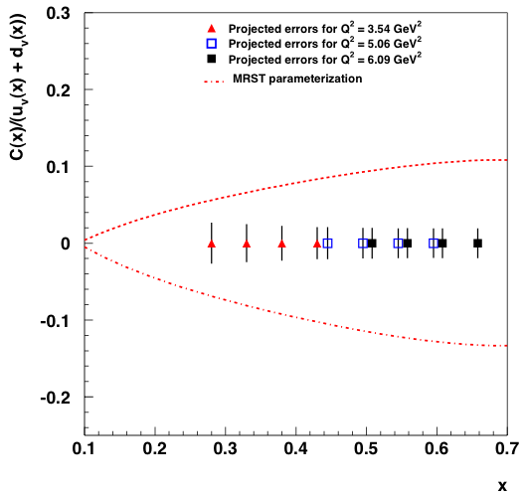
Charge Symmetry Violation Test with SIDIS
Measure d(e,e′π⁻) and d(e,e′π⁺) yields Y^{π-} and Y^{π+}
Measure R(x,z) over a grid in x and z to extract D(z) and CSV(x).
D(z) from favored/unfavored fragmentation function ratios.
B(x,y) calculated from sea quark PDFs
Formalism of Londergan, Pang and Thomas PRD54, 3154 (1996)
Notes:
C(x) = delta d – delta u

Slide 28
Charge symmetry violating
Drell-Yan is another way to access CSV (with very different systematics than SIDIS).
Charge-symmetric
R. Yang and JCP, preprint
Slide from JC Peng, “3rd International Workshop on Nucleon Structure at Large Bjorken X” Jefferson Lab, Newport News, Oct. 13-15, 2010

Slide 29
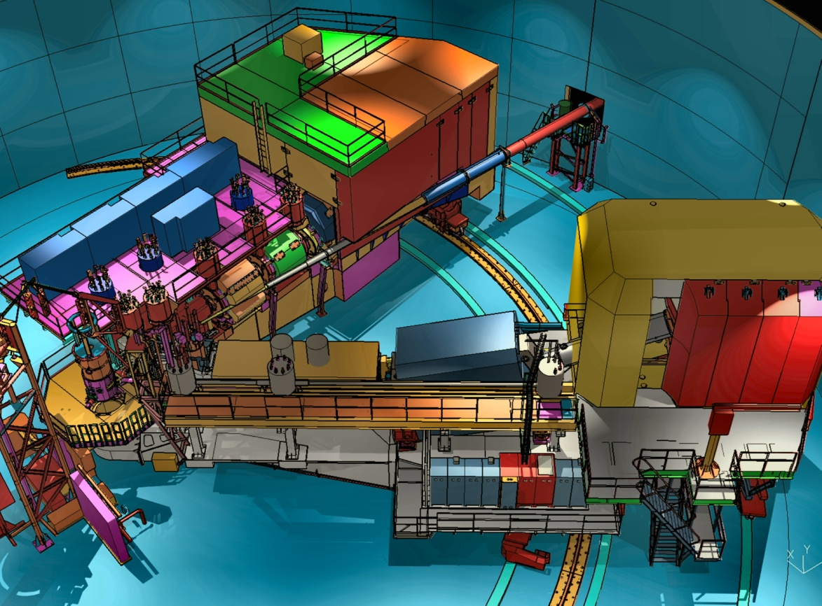
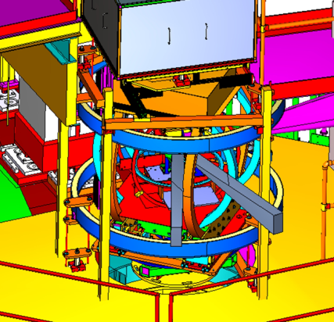
Preliminary plans for Early Beam in Hall C
Straightforward “commissioning experiments”
Basic SIDIS and easiest L/T separation
Base equipment in early years
SHMS Installation
12 GeV Commissioning
Early Experiments
p, d,A(e,e’), A(e,e’p), d(e,e’p)
d2n, A1n
High x nucleon structure
Short Range nuclear structure
Neutron Spin Structure
Pt, CSV, (e,e’K)
Polarized ³He Experiments
First 11 GeV Beam
Basic SIDIS
Charge Symm. Violation
Deep Exclusive Kaon Prod.
FY 2015
FY 2016
FY 2017
FY 2018
FY 2018

Slide 30
Acknowledgements
Hall C colleagues Steve Wood and Dave Gaskell for slides.
The organizers of this workshop and their support staff.
Jlab management for supporting this conference and my travel.

Slide 31
Extras

Slide 32
Charge symmetry violating
Charge-symmetric
R. Yang and JCP, preprint

Slide 33
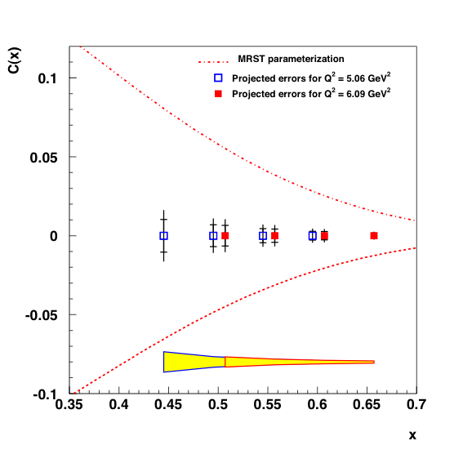
Projections - 1

Slide 34

Projections - 2

Slide 35
Formalism (Londergan, Pang and Thomas PRD54(1996)3154)
Assuming factorization
Impulse Approximation
D(z) R(x,z) + A(x) C(x) = B(x,z)
Extract simultaneously D(z) and C(x) in each Q² bin!

Slide 36
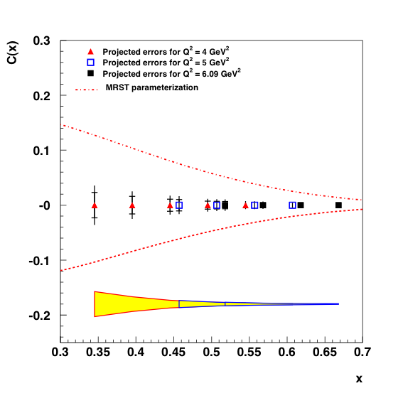
E12-09-002: Uncertainties and Projections
Source | Pion Yield (%) | Δ(R_{Y})/R_{Y} (%) per z bin
Statistics | 0.7 | 1
Luminosity | 0.4-0.8 | 0.3
Tracking efficiency | 0.1 - 1 | 0.2
Dead time | < 0.1 | < 0.1
Acceptance | 1 – 2 | 0.1
PID efficiency | < 0.5 | 0.2
ρ background | 0.5 – 3 | 0.2 – 0.7 (1.2)
Excl. Rad. tail | 0.2 – 1.3 | 0.1 – 0.6 (1.3)
Total systematics | 1.3 – 3.0 (4.1) | 0.5 – 1.0 (1.8)
Total uncertainty | 1.5 – 3.1 (4.2) | 1.1 – 1.4 (2.1)
δd-δu
Unc. due to PDFs
Kinematics: P_{T} ~ 0 z=0.4, 0.5, 0.6, and 0.7
Q² = 4.0 GeV² x=0.35, 0.40, 0.45, 0.50
Q² = 5.0 GeV² x=0.45, 0.50, 0.55, 0.60
Q² = 6.1 GeV² x=0.50, 0.55, 0.60, 0.65
Also extract D⁻(z)/D⁺(z) at each Q²
Target = LD2 for all
→ LH2 data at Q²=4, 5 GeV²
Notes:
Table shows dominant systematic uncertainties on both the charged pion yields (middle column) and ratios. Statistics are tuned to give 1% uncertainty on the ratios. Total error on ratio varies from 1.1 to 2.1%. The uncertainty on the yield (i.e.) cross section ranges from 1.5 to 4.2% → note that at the largest z, subtraction of backgrounds from exclusive rho production grow – experimental uncertainties excluding this contribution are smaller. As more data on rho cross sections becomes available, we will be better able to control this.
Experiment will measure pion production in parallel kinematics for a range of z=0.4 to 0.7 at 3 Q2 settings (4, 5, 6.1). We will cover a range of x at each Q2.
At all settings take deuterium data, Q2=4,5 hydrogen data for factorization tests
Plot on the right shows expected precision on the CSV quark distributions – red triangle Q2=4, Blue square, Q2=5, Black square Q2=6.1. Red dashed curve comes from constraints from MRST parameterization. Yellow band = uncertainty due to PDFs.
We will also extract D-/D+, ratio of unfavored to favored fragmentation functions.

Slide 37
E00-108: Verifying factorization, p/d(e,e′π±)
Z-Dependence of cross section
σ~Σe_{q}²q(x) D_{q}^{π}(z)
Δ region
factorization
Good agreement between data and simple quark-parton model for z< 0.65 (assuming factorization, CTEQ5M pdfs, Binnweiss fragmentation)
• Excess in the data at z > 0.7 reflects the Δ resonance in unobserved fragments
M_{x}² directly related to z:
Q² = 2.3 GeV²
Phys. Rev. C 85, 015202 (2012)
(m∆²≈1.5 GeV²)
Notes:
37

Slide 38
Proposing Experiments at
Jlab 12 GeV
Jlab is an open laboratory. By this I mean that, if you have a great idea for one of our end-stations, you can propose it to our Program Advisory Committee (PAC) of mostly outside experts. Your proposal will be judged on the merit of the physics as well as the technical feasibility. An internal co-spokesperson may be helpful but is not required.
A tremendous amount of information can be gain from our website at
http://www.jlab.org/
and looking under topics such as “Nuclear Physics”, “Experiment Research”, and “12 GeV Upgrade”.
Proposals now mostly fall into two categories: standard 12 GeV equipment, or major new apparatus. Proponents are expected to help build or commission standard 12 GeV equipment as well as new apparatus.
Of course, funding, manpower (both collaboration and Jlab), and multi-endstation scheduling issues will eventually be looked at carefully.

Slide 39

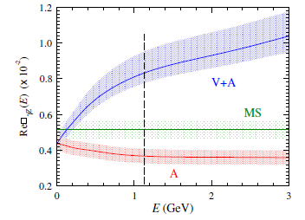
γZ Box Corrections near 1.16 GeV
In 2009, Gorchtein and Horowitz showed the vector hadronic contribution to be significant and energy dependent.
This soon led to more refined calculations with corrections of ~8% and error bars ranging from +-1.1% to +-2.8%.
It will probably also spark a refit of the global PVES database used to constrain G_{E}^{s}, G_{M}^{s}, G_{A}.
Rislow and Carlson
PV Amplitude | Authors | Correction* @ E=1.165 (GeV)
A^{e}xV^{p} (vanishes as E→0) | MS | -
 | GH | 0.0026
 | SBMT | 0.0047 ^{+0.0011} ^{-0.0004}
 | RC | 0.0057+-0.0009
 | GHR-M | 0.0054+-0.0020
VexA^{p} (finite as E→0) | EKR-M | 0.0052+-0.0005**
 | BMT | 0.0037+-0.0004
BMT and references
(V and A are hadronic couplings)
Qweak correction
Old axial
at E=0
only
New axial vs E
After significant theoretical effort, the correction is under control. Now theorists have to agree about the uncertainty.
*This does not include a small contribution from the elastic.
**Included in Q_{w}^{p}. For reference, Q_{w}^{p} =0.0713(8).

Slide 40

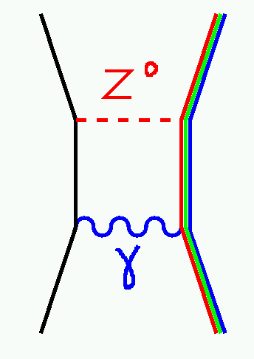
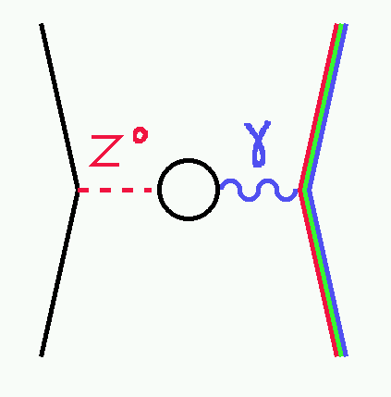
The Running of sin²θ_{W}
Electroweak radiative corrections shift the effective
neutral weak couplings in an energy- and reaction-
dependent manner.
After regressing out the EW box diagrams, like
the only remaining correction is γ-Z mixing:
One could remove the γ-Z mixing as well, but it is a useful convention to leave it.
The shift from γ-Z mixing is energy-dependent but universal (a property of the vacuum) and so causes sin²θ_{W} to “run”.
(The real story is a more complicated due to factors of sin²θ_{W}(Q) in the EW radiative corrections. Global fits incorporate these properly. )

Slide 41



Backward nucleon detector – EMC effect
Hall C/Tel Aviv/ODU
d(e, e′N_{backward})
Detect spectator proton or neutron to tag in-medium structure function on off-shell nucleon.
User labor (& some JLab resources) applied to preserve Hall B detectors.
Recycled CLAS6 (Hall B) TOF detectors

Slide 42
SHMS Design Parameters
Parameter | SHMS Design
Range of Central Momentum | 2 to 11 GeV/c for all angles
Momentum Acceptance δ | -10% to +22%
Momentum Resolution | 0.03-0.08% (SRD: “<0.2%”)
Scattering Angle Range | 5.5 to 40 degrees
Solid Angle Acceptance | >4.5 msr for all angles (SRD: “>4.0 msr”)
Horizontal Angle Resolution | 0.5 - 1.2 mrad
Vertical Angle Resolution | 0.3 - 1.1 mrad
Vertex Length Resolution | 0.1 - 0.3 cm

Slide 43

Hall C Upgrade Costs
By Subsystem…
As part of the entire 12GeV upgrade…

Slide 44

Shield House Fit to Beamline
Shield House
Dipole
Beamline
Q3
Q2
Q1
Shield House notch
Bender

Slide 45

Bender Fit to HMS Q1
SHMS Bender
HMS Q1

Slide 46

Getting Both Spectrometer to Small Angles
Top View
Bottom View
SHMS
SHMS
… an incredible 3-dimensional jigsaw puzzle for our engineers and designers.

Slide 47

SHMS Elements
Dipole
18.4 Degree Bend
Max Field: 4.76 T
EFL: 2.85 m
Q2 Q3
Max Gradient:
14.4 T/m
EFL: 1.61 m
Bender
3 Degree Bend
Max Field: 3.11 T
EFL: 0.75 m
Q1
Max Gradient: 10.63 T/m
EFL: 1.86m

Slide 48

SHMS
Shield House
Electronics Room
Cryo Transfer Line
Power Supplies
Target
Bender
Q1
Q2
Q3
Dipole
Detectors

Slide 49

SHMS All Dressed Up
Key Features:
  3 quadrupole magnets,
  1 dipole magnet
    Provides easily calibrated
    optics and wide acceptance
    Uses magnets very similar
    to existing ones
  1 horizontal bend magnet
    Allows forward
      acceptance
    New design,
    developed in
    collaboration
    w/MSU
        6 element detector package
        Drift Chambers / Hodoscopes / Cerenkovs / Calorimeter
        All derived from existing HMS/SOS detector designs
    Rigid Support Structure / Well-Shielded Detector Enclosure
    Reproduces Pointing Accuracy & Reproducibility demonstrated in HMS

Slide 50

Particle ID: Limitations of TOF
TOF over the short ~2.2m baseline inside the SHMS hut will be of little use for most of the momentum range anticipated for the SHMS.
Even over a 22.5m distance from the target to the SHMS detector stack, TOF is of limited use.
Effect of finite timing resolution
(±1.5σ with σ=200ps).
Separation <3σ to the right of where lines intersect.

Slide 51

SHMS Particle Identification: +hadrons
TOF
Heavy Gas Cerenkov
Aerogels
Rejection
Power
known experiments
Momentum (GeV/c)

Slide 52
Summary
I’ve tried to introduce some of the standard apparatus for Hall C at 12 GeV. More detailed information on the SHMS can be obtained at
http://www.jlab.org/Hall-C/upgrade/index.html

Slide 53



SHMS Experiment Resolution Requirements
Experiment | p (GeV/c) | Δp/p (%) | Δθ (rad) | Δφ (rad)
Pion Form Factor (12-06-101) | 2.2-8.1 | 2x10⁻³ | 1.5x10⁻³ | 1.5x10⁻³
Transition Form Factors* | 1.0-8.5 | 1x10⁻³ | 1.0x10⁻³ | 1.0x10⁻³
* Not yet submitted to PAC
Δp/p (%)
Δφ (radians)
Δθ (radians)
2x Spec’d Resolution & MCS
Spec’d Resolution & MCS
Spec’d Resolution
-10%
+22%

Slide 54


Calorimeter (NSL Yerevan)
Shower made from 250 blocks from Hermes
Refurbished and tested
Preshower made from 30 blocks from Hall C SOS
Each 10x10x70 cm³
GEANT4 simulation
of π⁻ suppression
250:1 at all momentum

Slide 55


Noble Gas Cerenkov (U. of Virginia)
e/π⁻ PID 50:1 discrimination
Operate at STP
Placed in front of drift chamber
  Use only at high momentum so multiple scattering is reduced
When not is use replace by vacuum pipe
Momentum
Final tank
design
Argon π threshold at 6 GeV/c
Add Neon to extend reach to 11

Slide 56


Heavy Gas Cerenkov (U. of Regina)
π⁺/K separation above 3.4 GeV/c
Rejection factor of 1000:1
Vary gas pressure with momentum to keep π⁺/K separation
Front view

Slide 57

Aerogel Detector
K/p PID in 2-6 GeV/C range 1000:1
Need two indices of refraction to cover different momentum regions
Using aerogel and PMTs from
BLAST at MIT-BATES
Index: 1.03
Kaon
Np.e.
Proton
Index: 1.015
Np.e.
Kaon
Proton
Momentum (GeV/c)

Slide 58
The SHMS Detector System
Trigger Hodoscopes
Mechanical Design is a re-scaling of existing HMS/SOS design
0.5cm paddle overlap – all paddles

Slide 59



The SHMS Detector System
Trigger Hodoscopes - design drawings from JMU group.

Slide 60

The SHMS Detector System
Trigger Hodoscopes: basic trigger; efficiency determination.
  3 Planes Scintillator Paddles + 1 Plane Quartz Bars
S1X: 12 bars 8cm x 110 cm x 5mm
S1Y: 14 bars 8cm x 90cm x 5mm
S2X: 14 bars 8cm x 105cm x 5mm
S2Y: 10 quartz bars: 11cm 115cm x 2.5 cm
0.5 cm overlap / 2 PMTs on each bar

Slide 61


Approved 12-GeV Experiment
12-06-101 | C | Measurement of the Charged Pion Form Factor to High Q² | G. Huber, D. Gaskell
Example of an electron-hadron coincidence experiment
Continuation of successful F_{π}
program to dramatically higher Q²
Requires:
small forward angle capability
Kinematic control for L/T separation
resolution to distinguish p(e,e’π⁺)n events from
p(e,e’π ⁺)n+π

Slide 62
Some Contact Persons
The easiest way to get involved is to join an existing collaboration on an experiment you find interesting. With a nominal “beam on” date of October 2014, most Hall C 12 GeV collaborations are still forming and are eager for new people.
12 GeV Experiment | Some Contact Persons | E mail addresses
Charged Pion Form Factor and Scaling in Meson Electroproduction | Garth Huberg (U. Regina), Dave Gaskell (Jlab), Tanja Horn (Catholic U.) | huberg@uregina.ca, gaskelld@jlab.org, hornt@jlab.org
Color Transparency and Hadronization in Nuclei | Dipangkar Dutta (Mississippi), Rolf Ent (Jlab), Blaine Norum (U. of Virginia) | d.dutta@msstate.edu ent@jlab.org, ben@Virginia.edu
Neutron Spin Structure | JianPing Chen, Zein Eddine Meziani , Brad Sawatzsky | jpchen@jlab.org, meziani@temple.edu, brads@jlab.org
J/Psi Production in Nuclei | Jim Dunne (Mississippi) Eugene Chudakov (Jlab) | dunne@ra.msstate.edu, gen@jlab.org
Hall C Group Leader | Steve Wood | saw@jlab.org

Slide 63
Hall-C 12-GeV Experiments
Exp. # | Hall | Title | Spokespersons | Status
12-06-101 | C | Measurement of the Charged Pion Form Factor to High Q^2 | G. Huber, D. Gaskell | A
12-06-104 | C | Measurement of the Ratio R = sigma_L/sigma_T in Semi-Inclusive DIS | R. Ent, P. Bosted, H. Mkrtchyan | A
12-06-105 | C | Inclusive Scattering from Nuclei at x > 1 in the quasi-elastic and deep-inelastic regimes | D. Day, J. Arrington | A
12-06-121 | C | A Path to “Color Polarizabilities” in the Neutron: A Precision Measurement of the Neutron g_2 and d_2 at High Q^2 in Hall C | B. Sawatzky, T. Averett, W. Korsch, Z.E. Meziani | A
12-07-105 | C | Scaling Study of the L-T Separated Pion Electroproduction Cross-Section at 11 GeV | T. Horn, G. Huber | A
12-06-107 | C | The Search for Color Transparency at 12 GeV | D. Dutta, R. Ent | CA
12-06-110 | C | Measurement of the Neutron Spin Asymmetry A1n in the Valence Quark Region Using an 11 GeV Beam in Hall C | X. Zheng, J.P. Chen, G. Cates, Z.E. Meziani | CA
12-07-101 | C | Hadronization in Nuclei by Deep Inelastic Electron Scattering | B.E. Norum, J.P. Chen, H. Lu, K. Wang | CA
12-07-102 | C | Precision Measurement of the Parity-Violating Asymmetry in DIS off Deuterium Using baseline 12-GeV Equipment in Hall C | P. Reimer, X. Zheng, K. Paschke | CA
12-07-106 | C | The A-Dependence of J/Psi Photoproduction near Threshold | E. Chudakov, P. Bosted, J. Dunne | CA

