Slide 1
What can we learn from a snapshot of SHMS Rates? (while it was serving as the hadron arm in C(e,e’p) at 3-pass)
Dave Mack
2/1/18
V2 Corrections in red, in body and below.
I just quickly checked the 5-pass xscaler hodo rates. No big change from 3-pass. The S1X rate is similar, near 1 MHz. The other hodo rates are 10%-20% higher, so the z-dependent fall off of the hodo rates is not as steep. DD said the S/B is expected to be lower at 5-pass, so HODO 3 out of 4 could be dirtier.

Slide 2
Motivation and Overview
In hadron detection, where we often use a 3 out of 4 hodoscope trigger, the triggers can be significantly contaminated with accidental coincidences from soft backgrounds.
This is not an insurmountable problem since we have a large number of offline cuts available. But it does makes it harder to find quickly find small signals and to measure the tracking efficiency, especially in the single-arm detection of hadrons.
The SHMS is brand-new, and its bend angle is small, so it’s important to see if there are unexpected problems.
The xscalers information on the following slides is from the 3-pass, SHMS setting for the CT experiment. These data should be a low S/B challenge for the SHMS:
the relatively high Q2 ensures a small QF e+p signal, and
the combination of thick carbon target, downstream beamline, and a beam current of 50 muA should provide large soft photon and neutron backgrounds.

Slide 3
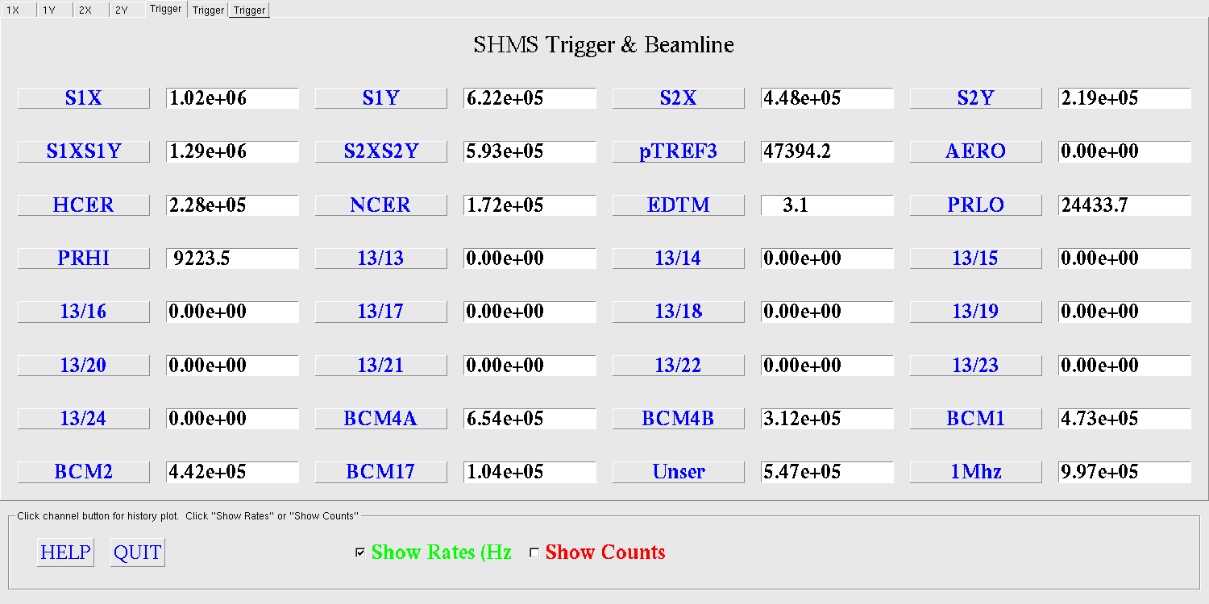
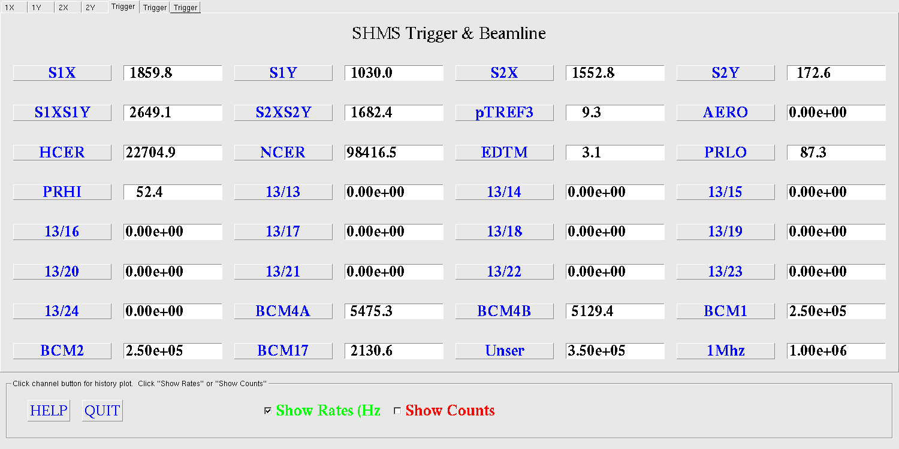
https://logbooks.jlab.org/entry/3522729
Beam on
Beam off
I think I can safely ignore these beam off scaler rates. But I noticed:
S2Y is nice and quiet.
NCER rate is quite high with beam off.
HCER looks quieter . (It was noted in the meeting that both Cerenkovs have 4 pmt’s, so the rates are apples to apples.)
I don’t know if this is their usual dark rates, or activation due to the carbon target.

Slide 4
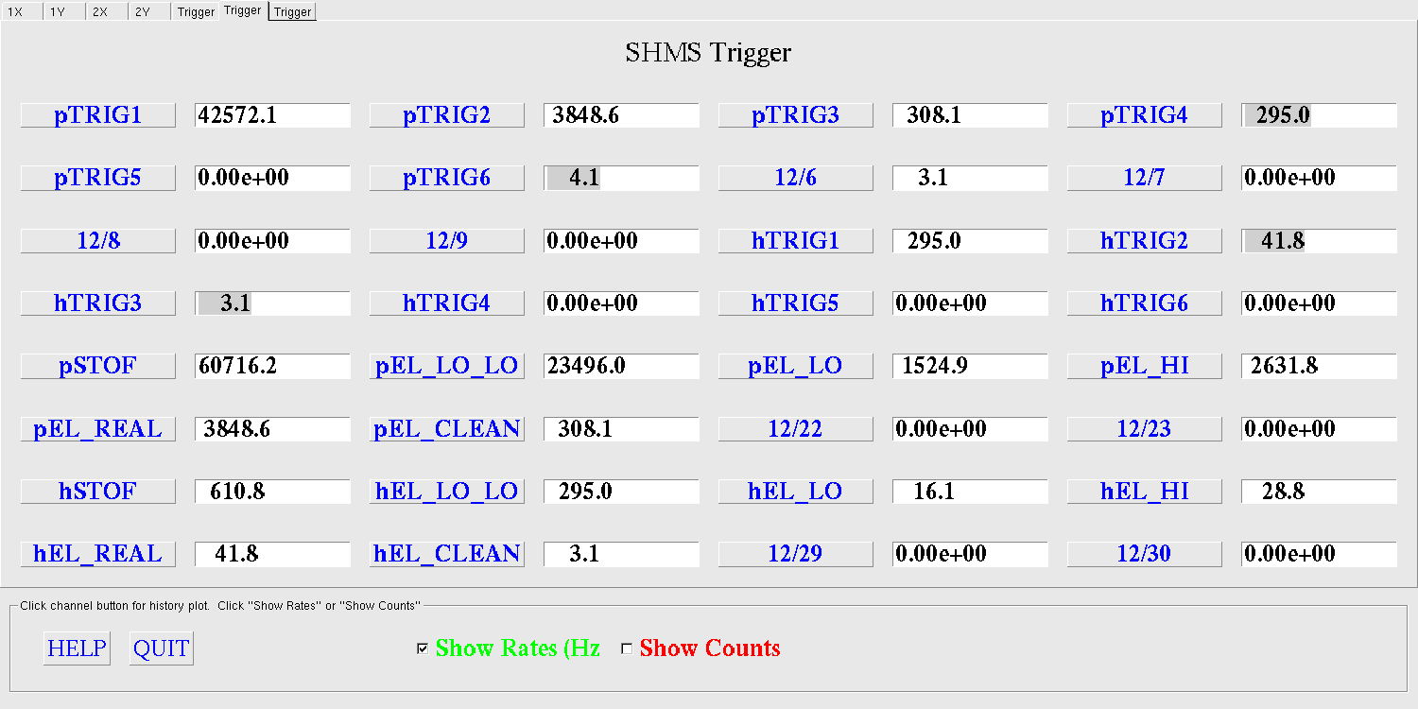
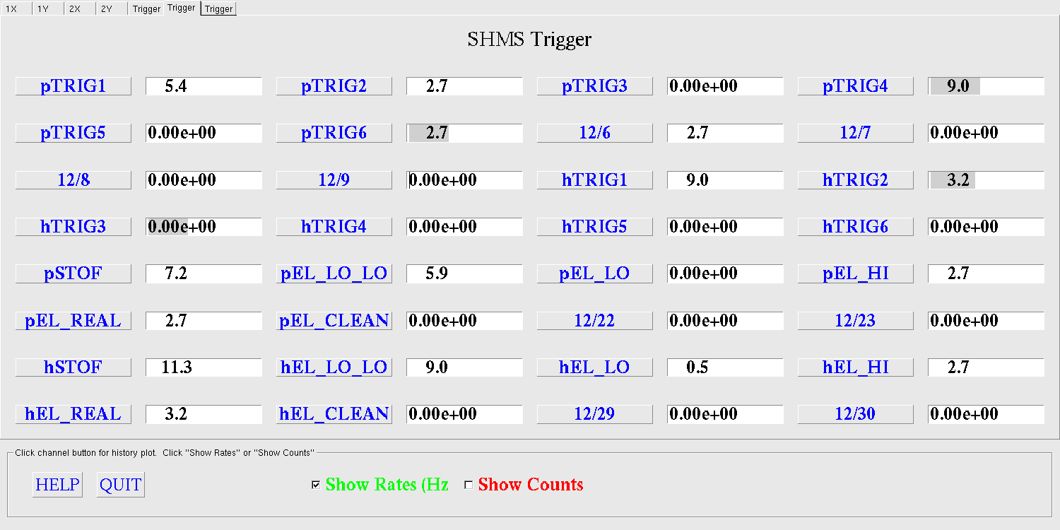

Slide 5
Same plot as on left, but expressed
as percentages of S1X rate:
Takeaway:
The S1X rate was ~ 1 MHz .
Most of the hodoscope paddle rate is background (ie, it is 0.5 to 1.5 orders of magnitude larger than the HODO 3 out of 4 rate).
The hodo background drops as one gets away from the dipole exit.
The above is not completely unexpected, but the steep increase toward S1X is a surprise. It raises questions S1X pmt lifetime and whether we’ll be making significant corrections for electronic deadtime.

Slide 6
Same plot on a log scale to emphasize the lower and cleaner rates.
The lower and cleaner rates, normalized to the HODO 3 out of 4 rate.
Takeaway:
The HODO 3 out of 4 rate is not far from the sum of PRLO and PRHI. (Remember, these tracks are mostly pi+ and protons, and there may still be some accidentals in the hodo trigger.)
An optimistic interpretation of the above is:
The HODO 3 out of 4 is a not-too-dirty estimate of the rate of tracks in the acceptance, and
low threshold calorimeter information is efficient enough to use in a robust, single-arm wire chamber efficiency for hadrons.

Slide 7
Now emphasizing more of the logical signals:
I infer a local track rate from
(S1X+S1Y) – (S1X.or.S1Y), etc.
I added HODO 2 out of 4.

Slide 8
Same plot as on previous page, but normalized to S1X.or.S1Y rate.

Slide 9
Emphasizing the rates naively with the potential to be associated with a good track:
Takeaway:
Most of the inferred track rate in S1 doesn’t make it to S2. Either the bkg tracks in the S1 region are too soft, or too large an angle.
By contrast, the majority of the inferred track rate at S2 does show up in the HODO triggers. They are mostly in the acceptance, and clearly hard enough to fire at least one S1 counter.
The HODO 2 out of 4 looks promising: its rate is only ~40% larger than the 3 out of 4.
Without additional cuts on HODO 3 out of 4, I would conservatively assume it has O(10)% accidentals.

Slide 10
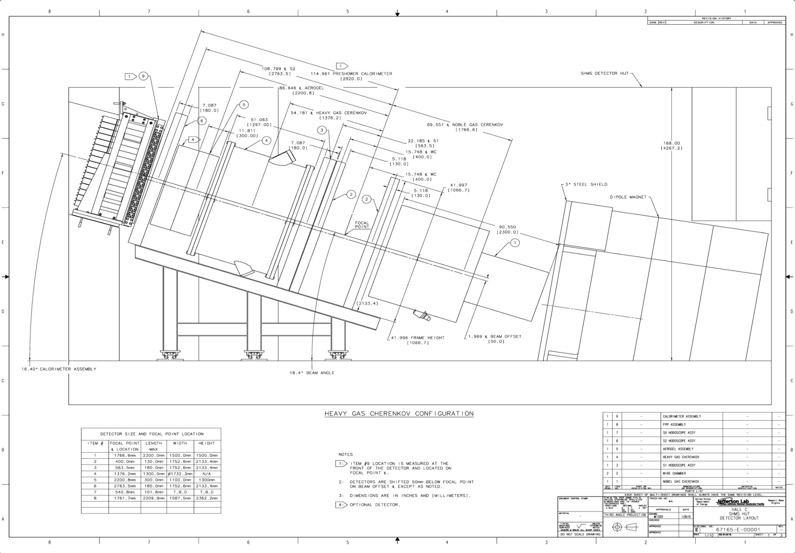
Good tracks
Gamma
Beam?
Detector Dimensions No Change

Slide 11
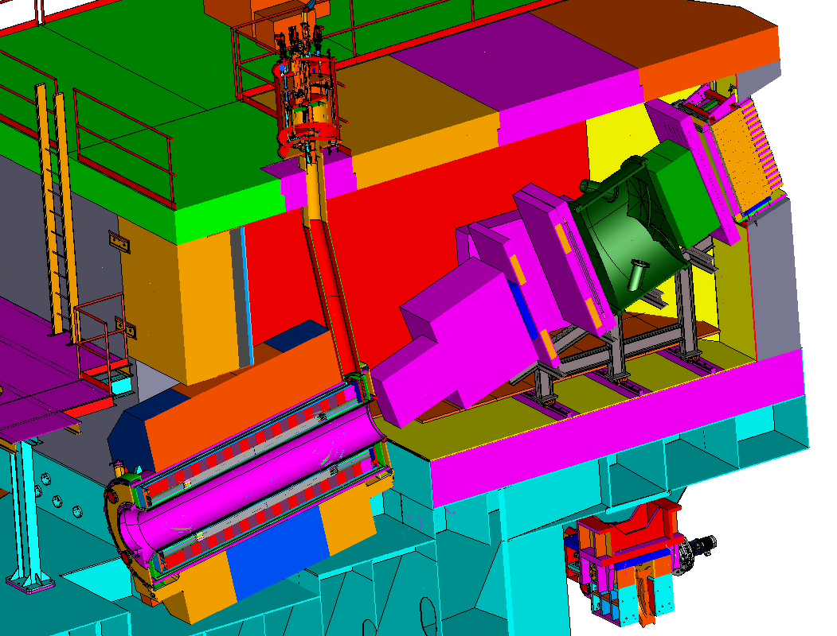

Slide 12
Summary
Hodo rates were O(1) MHz near the SHMS dipole exit. The background appears to be a soft and/or highly angled.
Only roughly 5% of the rate in S1 is due to tracks in the acceptance. This is actually not so unusual. What is surprising is how the background grows exponentially as one draws near the dipole exit.
We need to think about whether we’re OK wrt electronic deadtime and PMT lifetime in S1.
It looks like there’s often enough energy in the calorimeter from a typical hadron (eg, in PRLO) to help clean up the HODO 3 out of 4 triggers to help determine an accurate tracking efficiency. (A loose beta cut could should also help remove uncorrelated hits in the hodoscopes.) Just remember: we can’t use cut quantities that use SHMS wire chamber information.

Slide 13
backups

Slide 14
Log scale

Slide 15
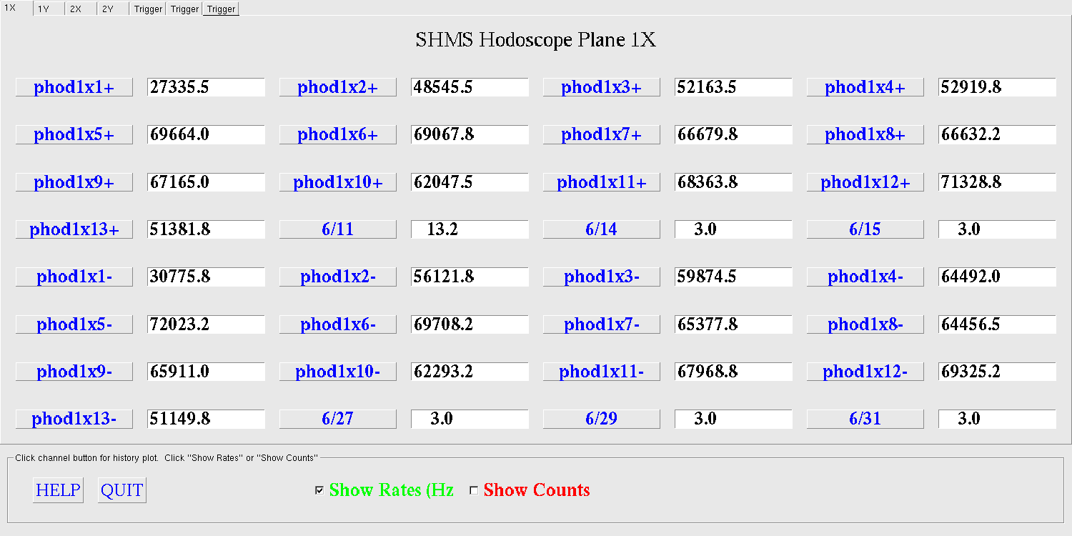
I didn’t bother to histograms rates for individual paddles. The rate varies only a factor of ~2.5 from the super-elastic(?) side of S1 on the bottom (eg, phod1x1+) to the inelastic side on the top (phod1x13+).

