Slide 1
Joint Hall A&C Data Analysis Workshop
Introduction to Python
Eric Pooser
Jefferson Lab
06/25/2018

Slide 2
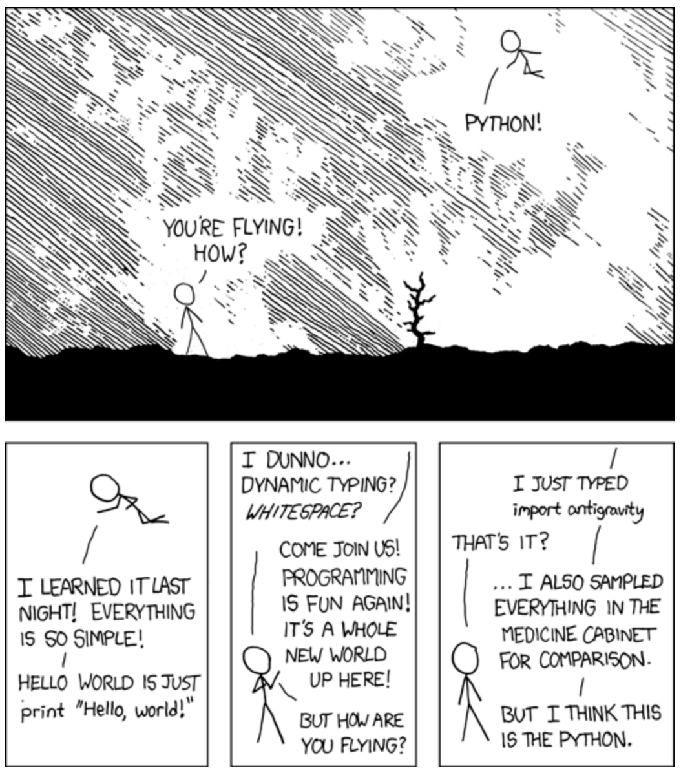
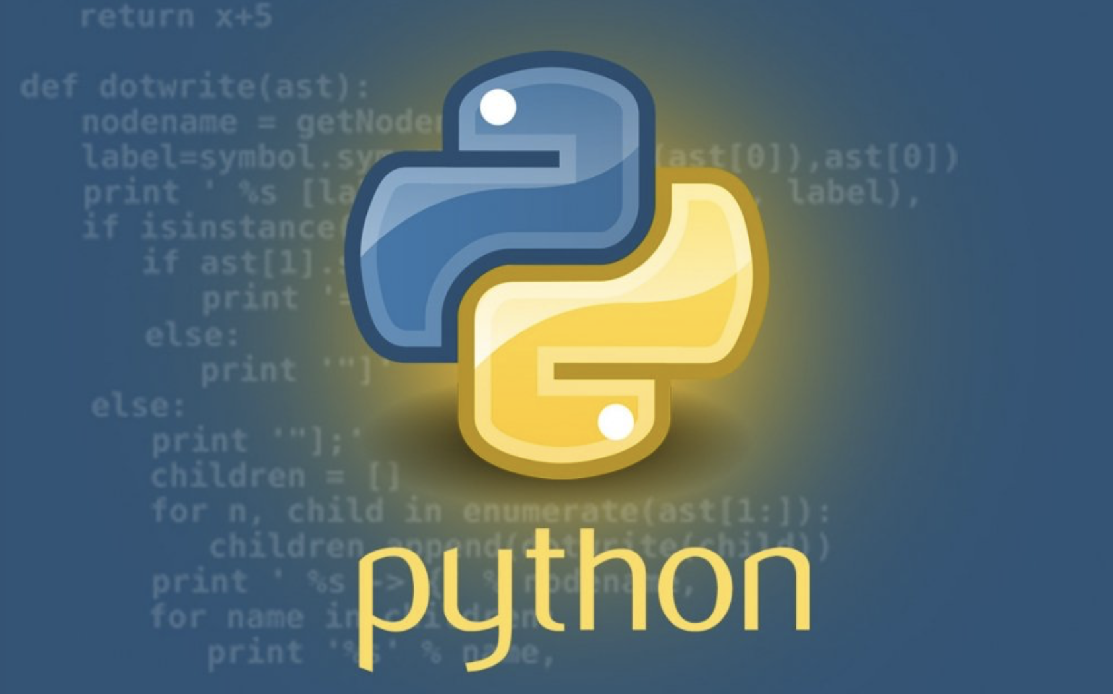
What is Python?
Dynamic, high level programming language
Interpreted & object oriented
Powerful standard library
Suited for a multitude of tasks
Simple, easy to learn syntax
Supports modules and packages
06/25/2018
Eric Pooser
Hall A/C Data Analysis Workshop

Slide 3
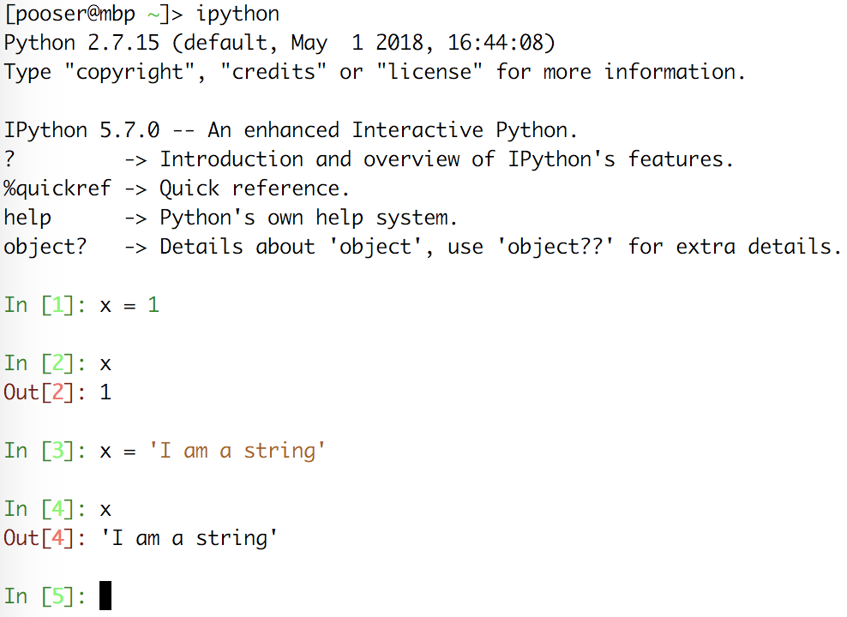
Why Python?
Python’s object oriented structure supports such concepts as polymorphism, operation overloading, and multiple inheritance
Indentation yields tidy, easily readable code
Automatic memory management
Vast array of third party utilities (NumPy, SciPy, Numeric, etc.)
Built in types and tools
Runs on virtually every major platform used today
Python programs run in exact same manner irrespective of platform
06/25/2018
Eric Pooser
Hall A/C Data Analysis Workshop

Slide 4
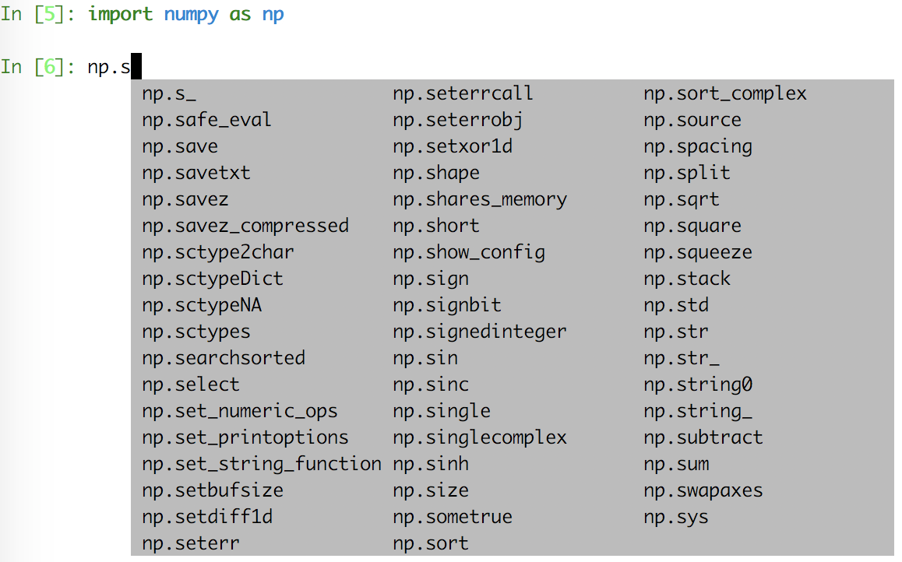
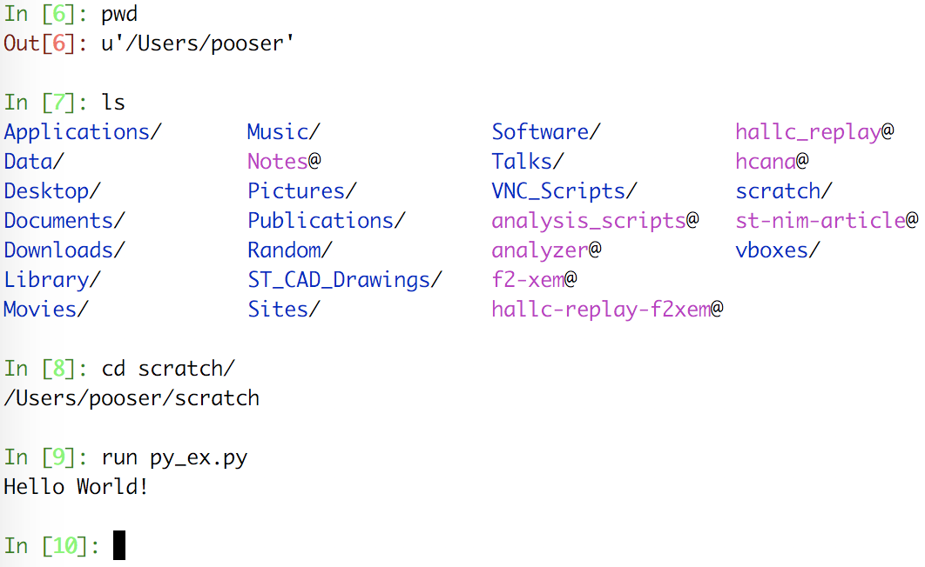
iPython
A powerful interactive shell
A kernel for Jupyter
Support for interactive data visualizations and use of GUI toolkits
Provides auto-complete feature with modules and utilities
Supports most Linux commands
Run python scripts interactively
Tracks variable definitions
06/25/2018
Eric Pooser
Hall A/C Data Analysis Workshop

Slide 5
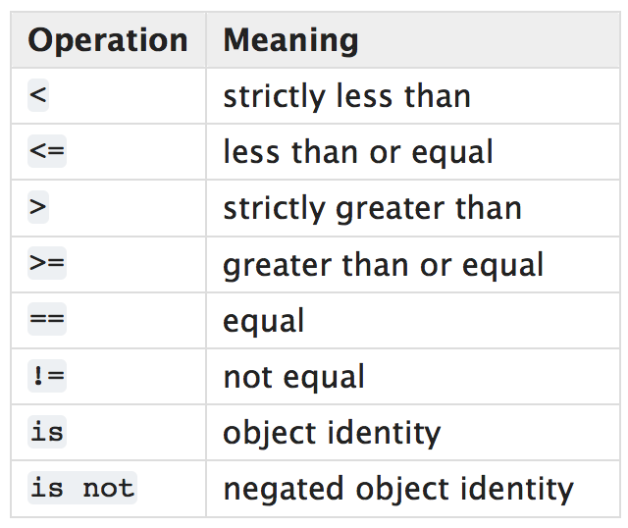
Python Built-in Types
The principal built-in types are numerics, sequences, mappings, classes, instances and exceptions
Any object can be tested for truth value, for use in an if or while condition or as operand of the Boolean operations
There are eight comparison operations in Python
They all have the same priority (which is higher than that of the Boolean operations)
Comparisons can be chained arbitrarily
06/25/2018
Eric Pooser
Hall A/C Data Analysis Workshop

Slide 6
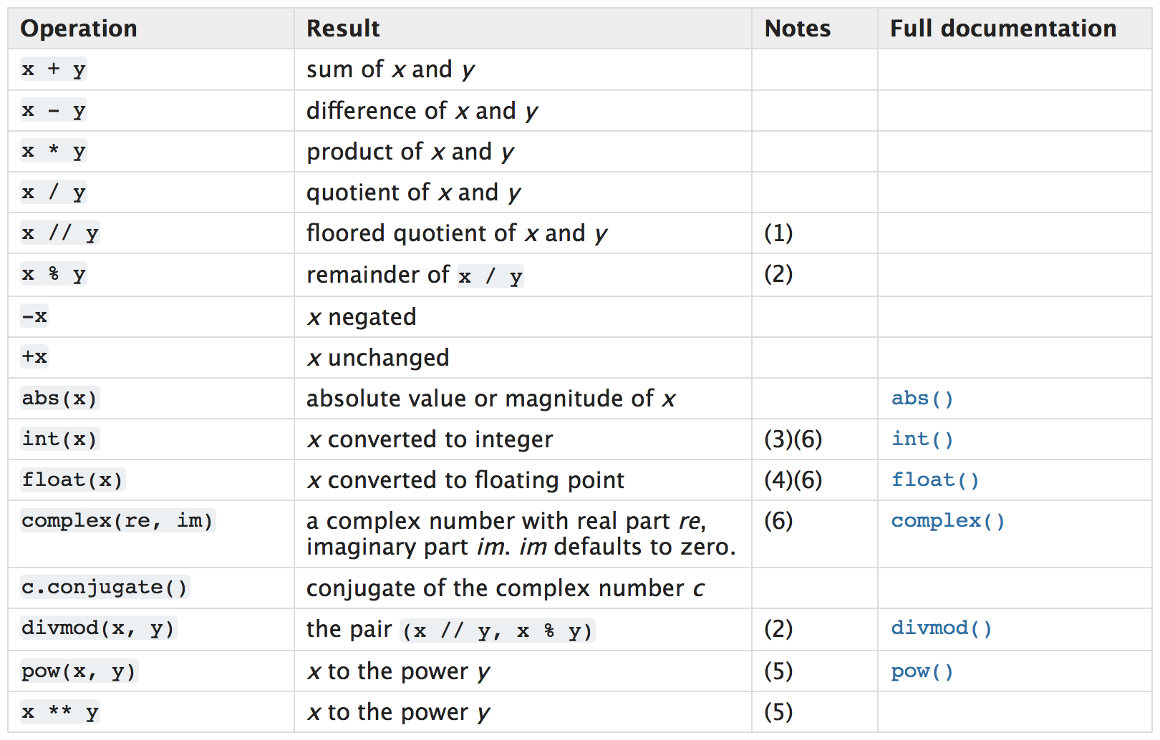
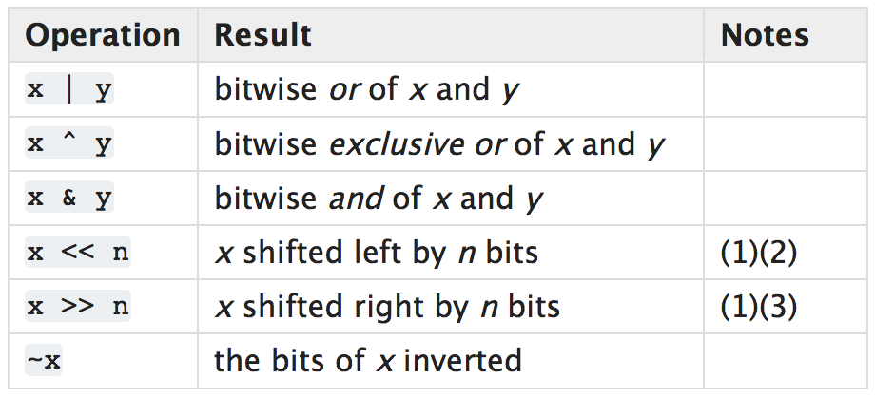
Python Built-in Types
There are three distinct numeric types: integers, floating point numbers, and complex numbers
All numeric types (except complex) support these operations, sorted by ascending priority
Booleans are a subtype of integers
Integers have unlimited precision
Floating point numbers are usually implemented using double in C
Complex numbers have a real and imaginary part, which are each a floating point number
The priorities of the binary bitwise operations are all lower than the numeric operations and higher than the comparisons
06/25/2018
Eric Pooser
Hall A/C Data Analysis Workshop

Slide 7
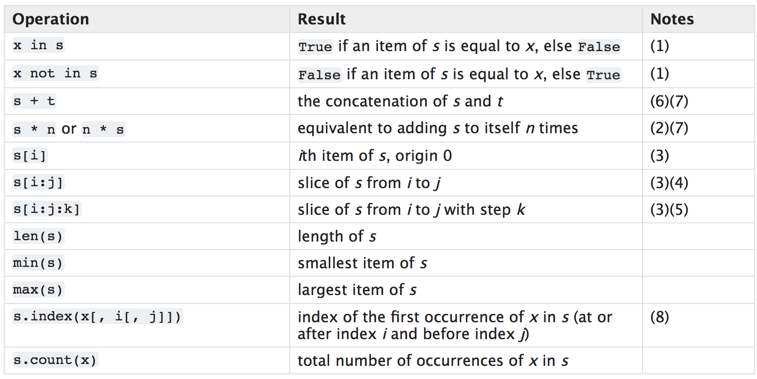
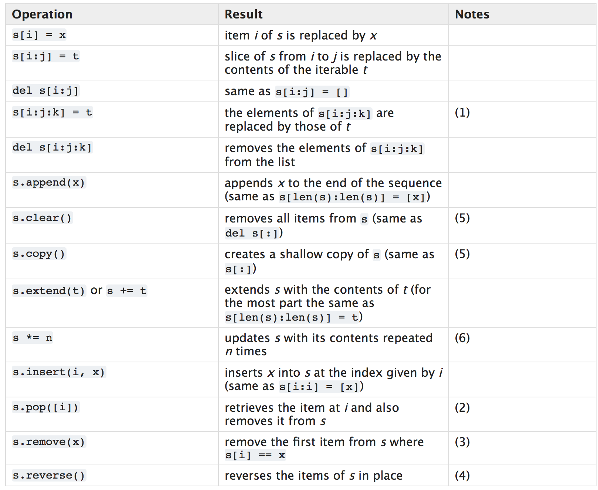
Python Built-in Types
There are three basic sequence types: lists, tuples, and range objects
Sequences of the same type also support comparisons
Tuples and lists are compared lexicographically by comparing corresponding elements
To compare equal, every element must compare equal and the two sequences must be of the same type and have the same length
Concatenating immutable sequences always results in a new object
06/25/2018
Eric Pooser
Hall A/C Data Analysis Workshop

Slide 8
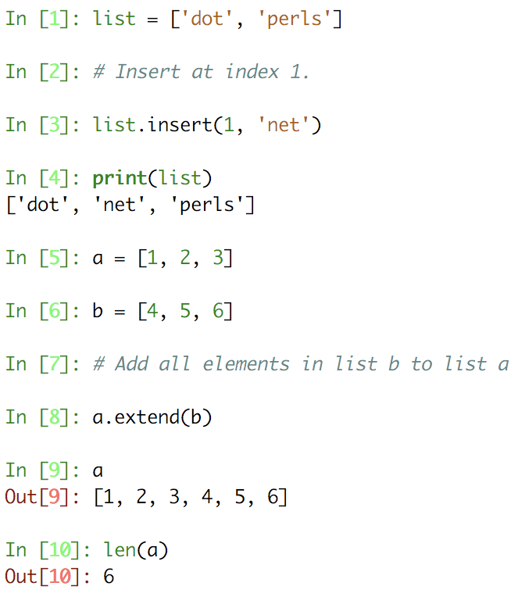
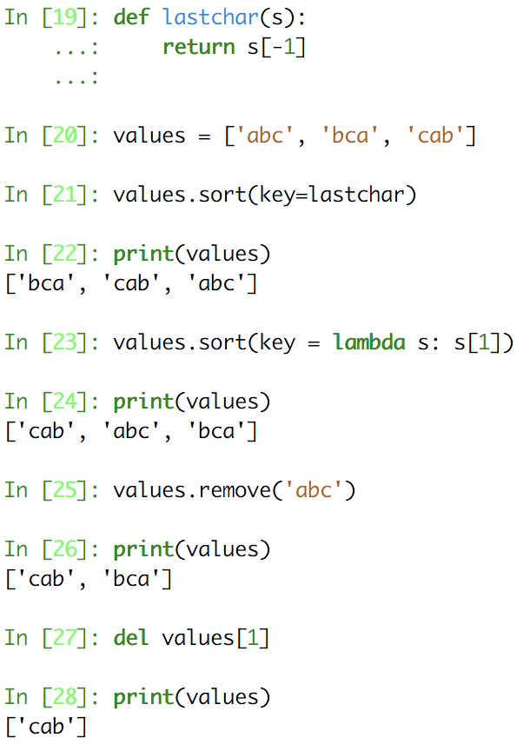
Python Lists
Lists are mutable sequences, typically used to store collections of homogeneous items
06/25/2018
Eric Pooser
Hall A/C Data Analysis Workshop

Slide 9
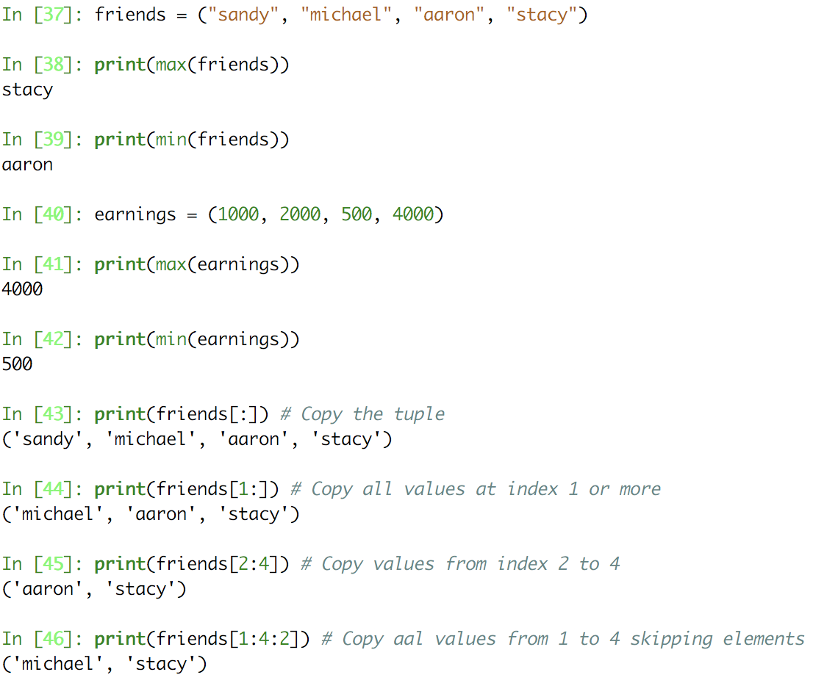
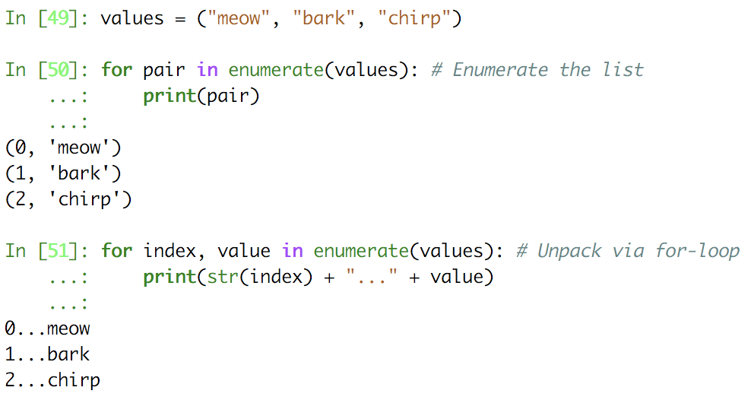
Python Tuples
Tuples are immutable sequences, typically used to store collections of heterogeneous data
06/25/2018
Eric Pooser
Hall A/C Data Analysis Workshop

Slide 10
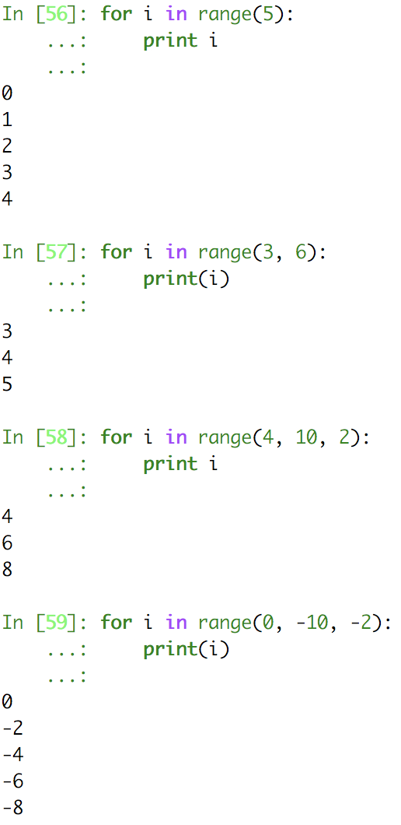
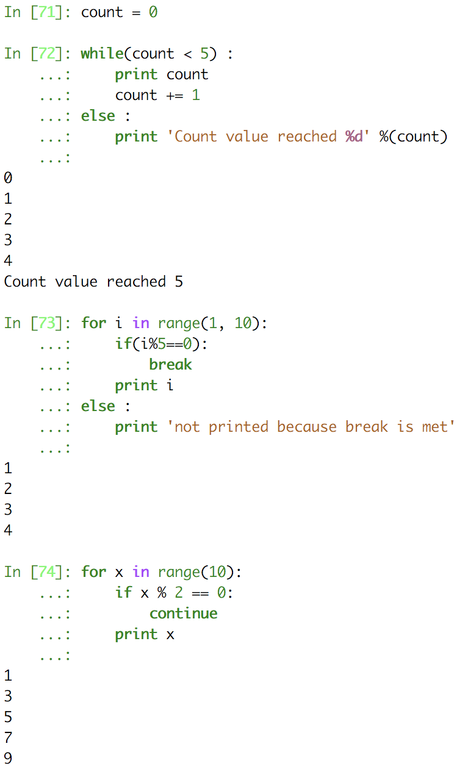
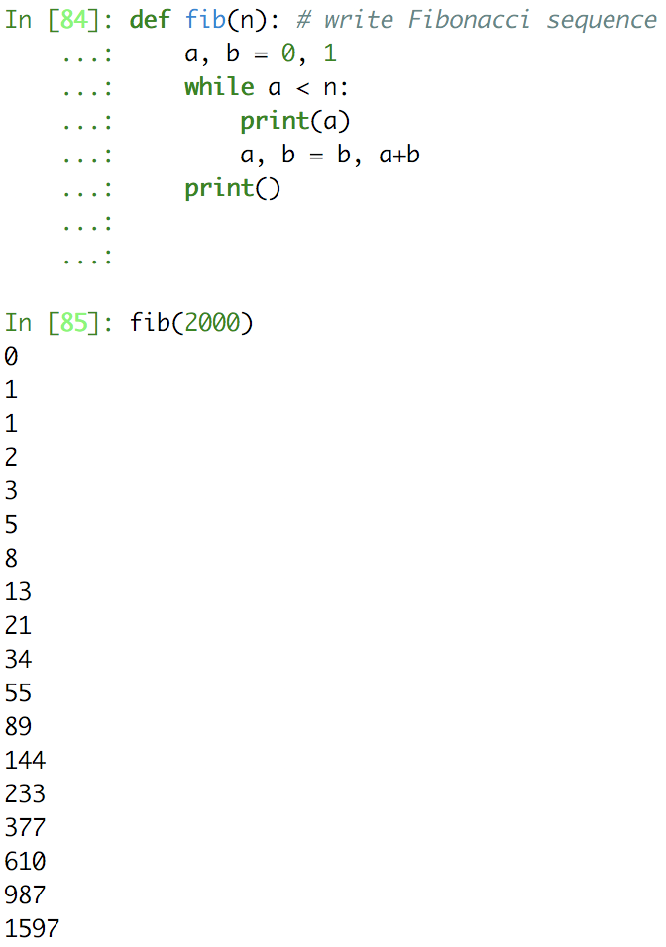
Python Ranges
The range type represents an immutable sequence of numbers and is commonly used for looping a specific number of times in for loops
06/25/2018
Eric Pooser
Hall A/C Data Analysis Workshop

Slide 11
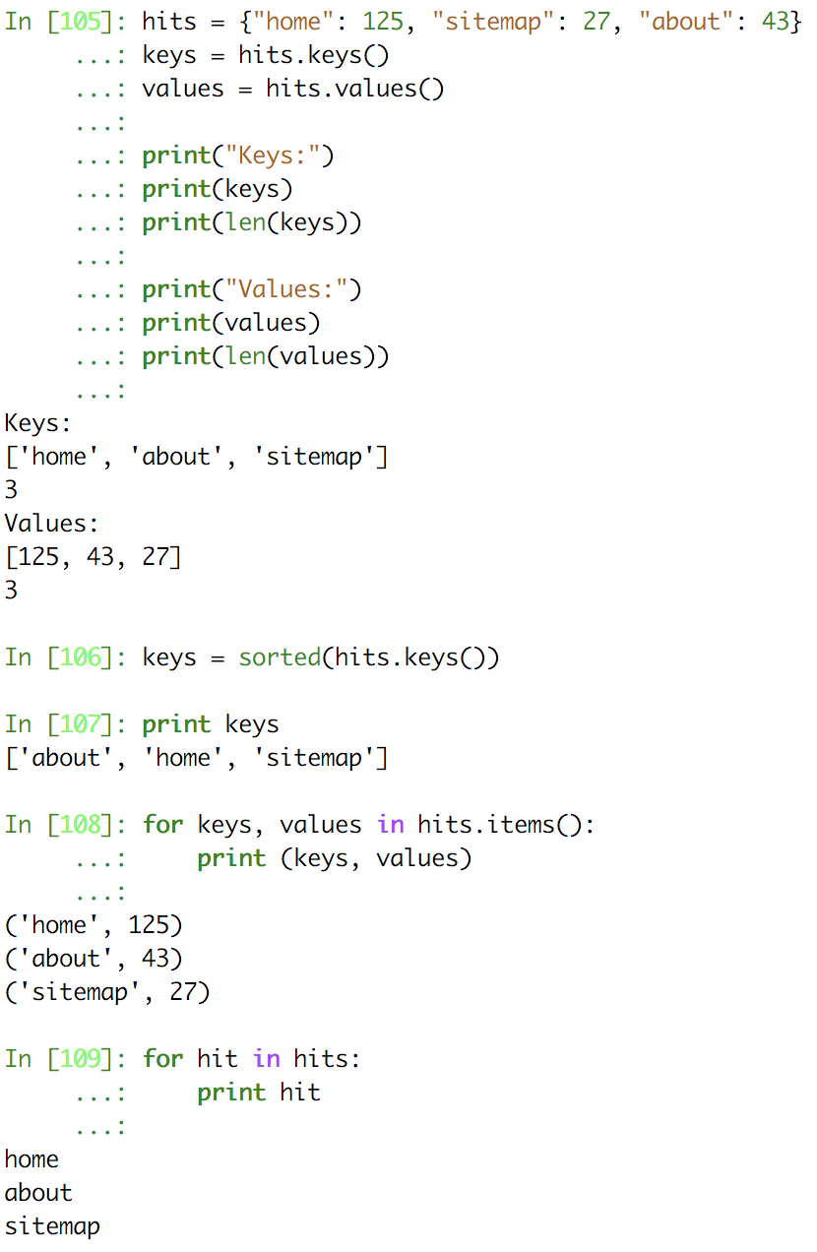
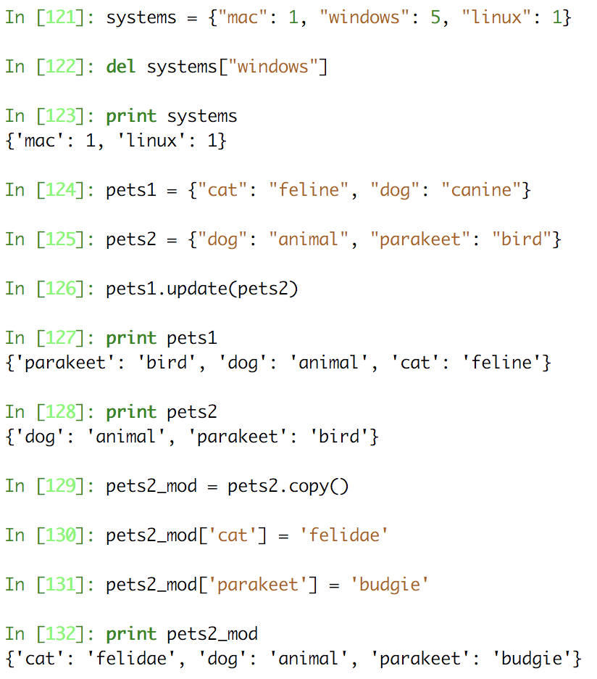
Python Dictionaries
A Python dictionary is a mutable, unordered, mapping of unique keys to values of any value
06/25/2018
Eric Pooser
Hall A/C Data Analysis Workshop

Slide 12
Python Third Party Utilities
Numpy: is the foundational library for scientific computing in Python. NumPy introduces objects for multidimensional arrays and matrices, as well as routines that allow developers to perform advanced mathematical and statistical functions on those arrays
SciPy: builds on NumPy by adding a collection of algorithms and high-level commands for manipulating and visualizing data. Includes functions for computing integrals numerically, solving differential equations, optimization, and much more…
Matplotlib: is the standard Python library for creating plots and graphs
Pandas: adds data structures and tools that are designed for practical data analysis in finance, statistics, social sciences, and engineering
06/25/2018
Eric Pooser
Hall A/C Data Analysis Workshop

Slide 13
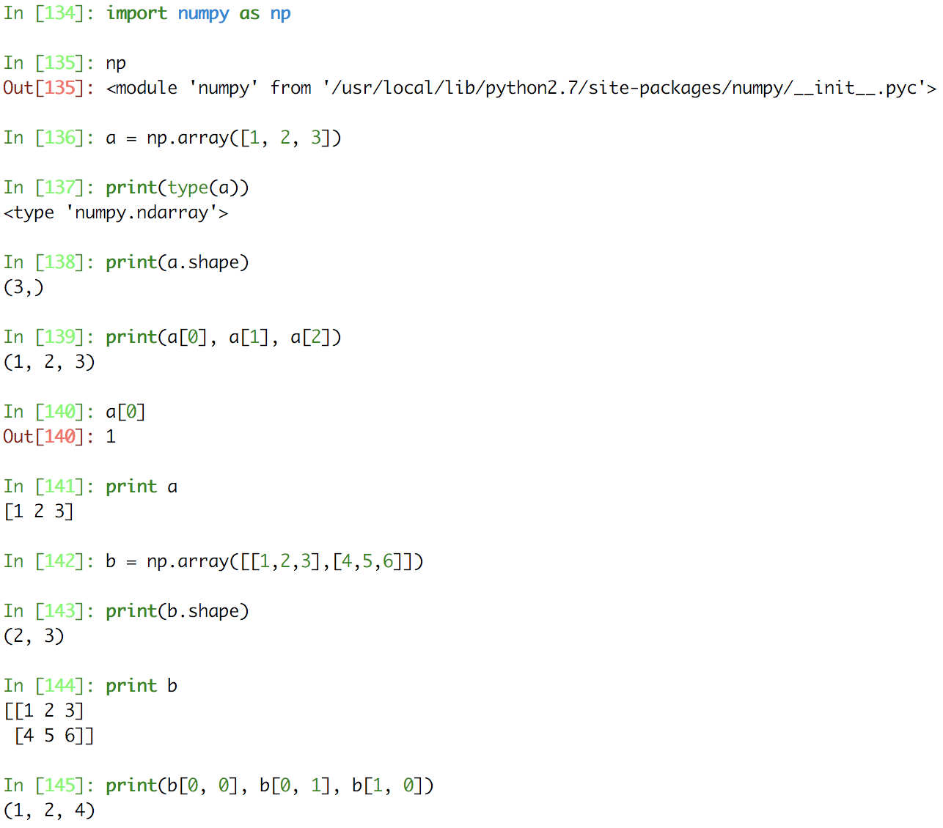
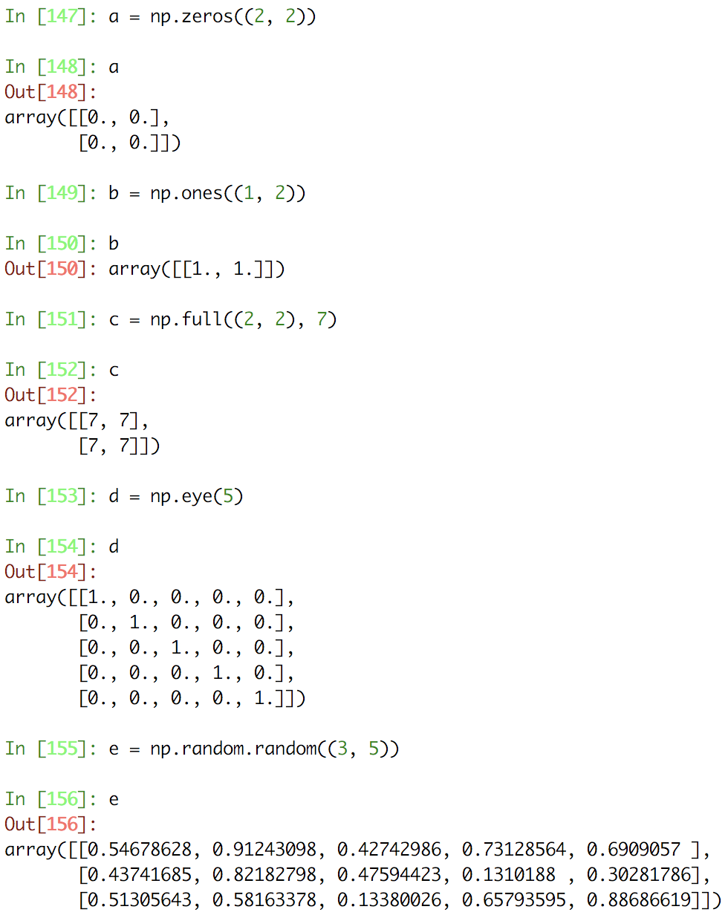
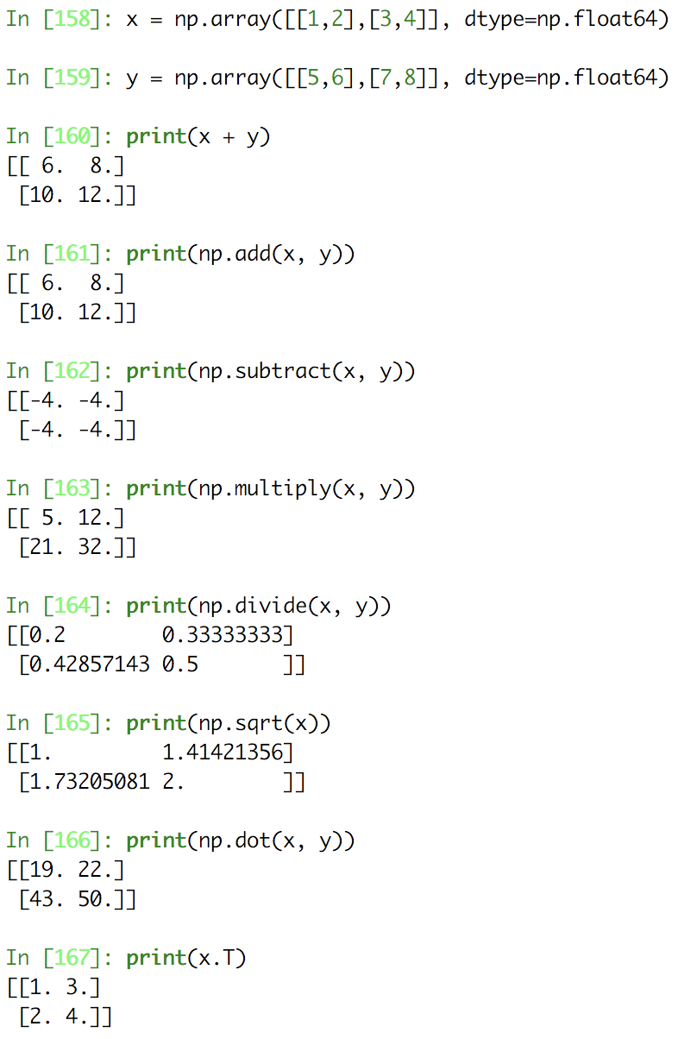
Numpy
Numpy is the core library for scientific computing in Python. It provides a high-performance multidimensional array object, and tools for working with these arrays
06/25/2018
Eric Pooser
Hall A/C Data Analysis Workshop

Slide 14
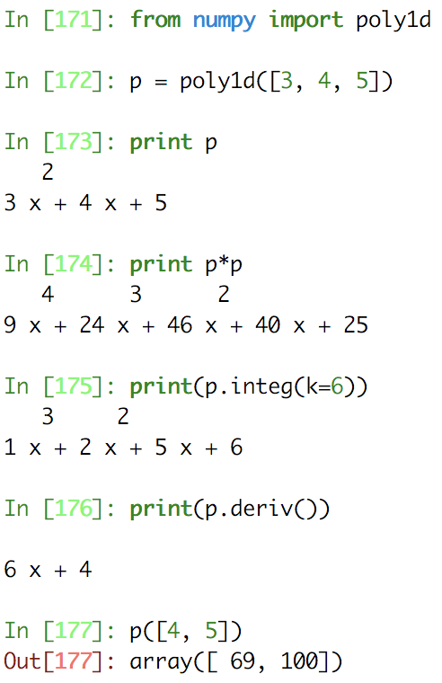
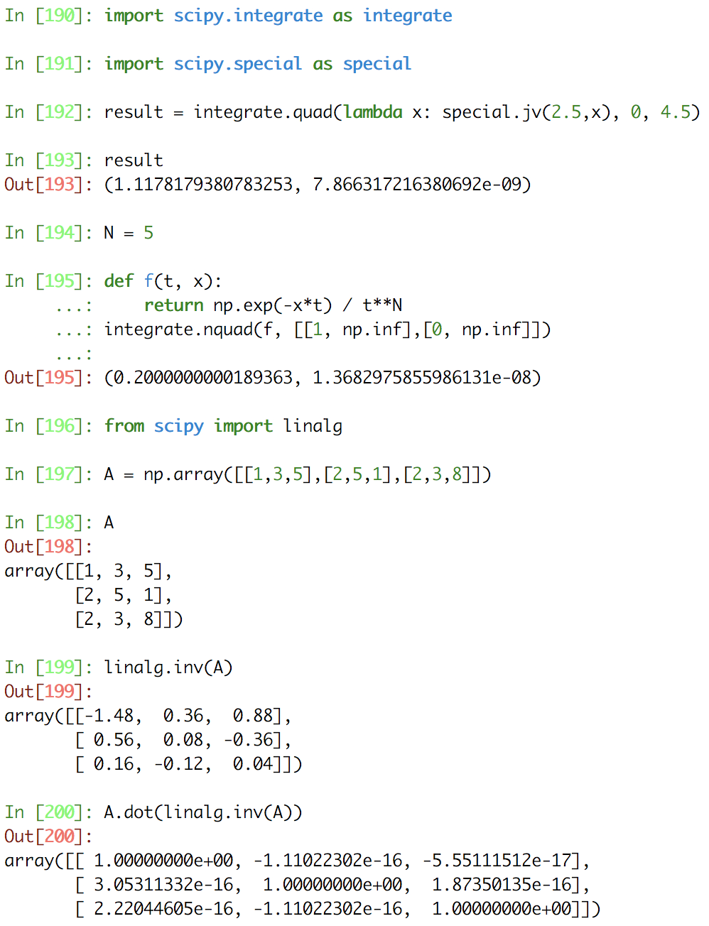
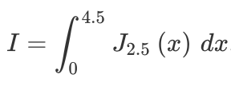
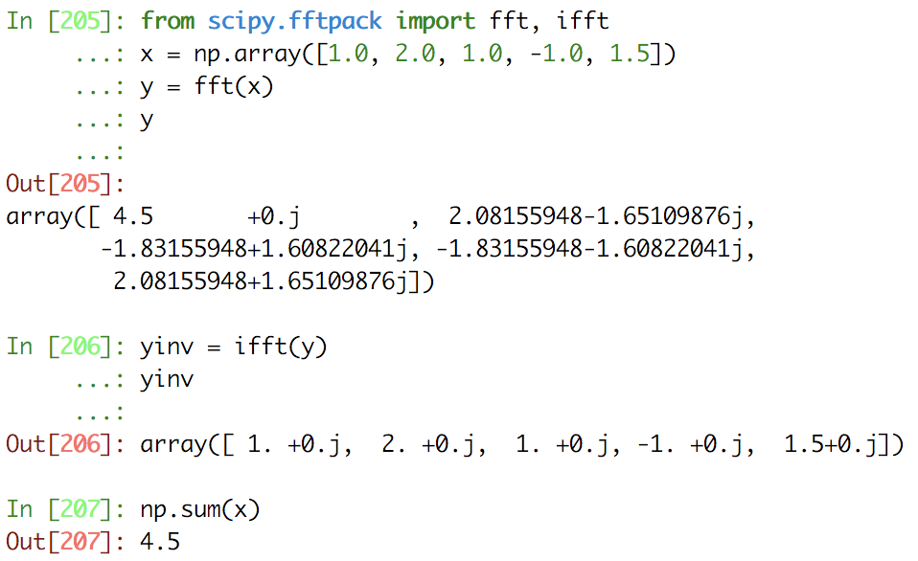
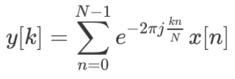
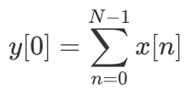
SciPy
SciPy builds onNumPy, and provides a large number of functions that operate on numpy arrays and are useful for different types of scientific and engineering applications
06/25/2018
Eric Pooser
Hall A/C Data Analysis Workshop

Slide 15
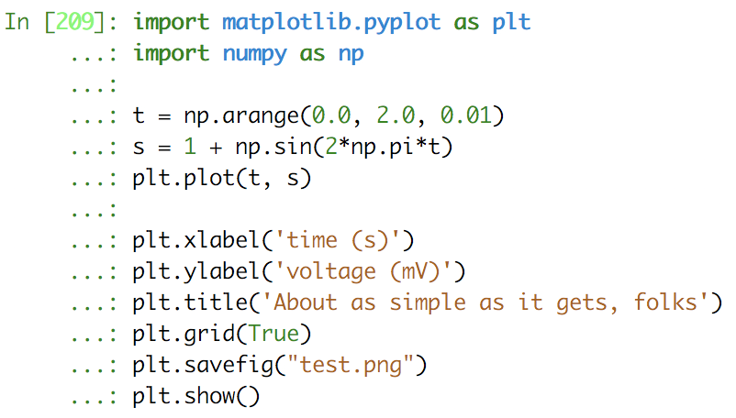
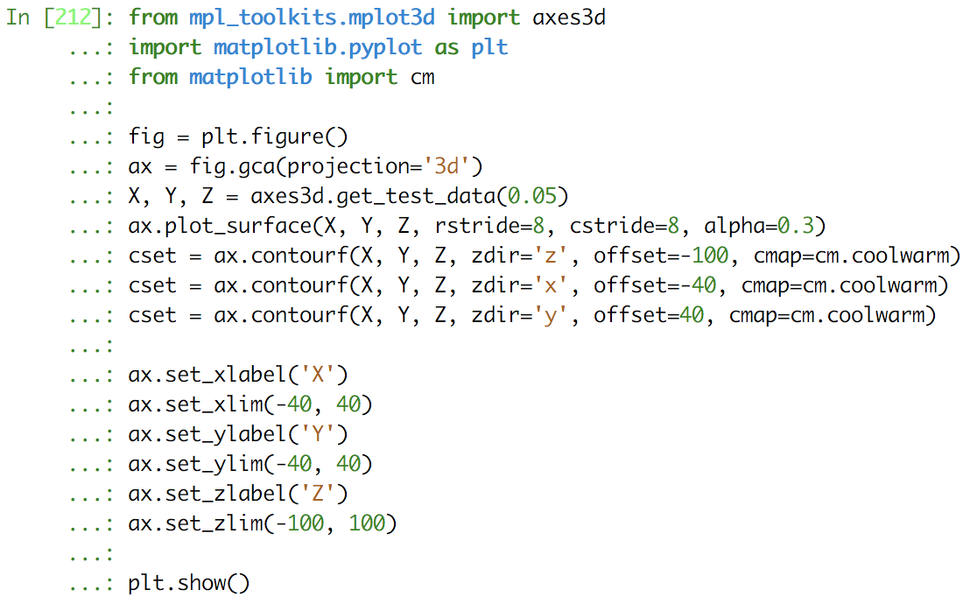
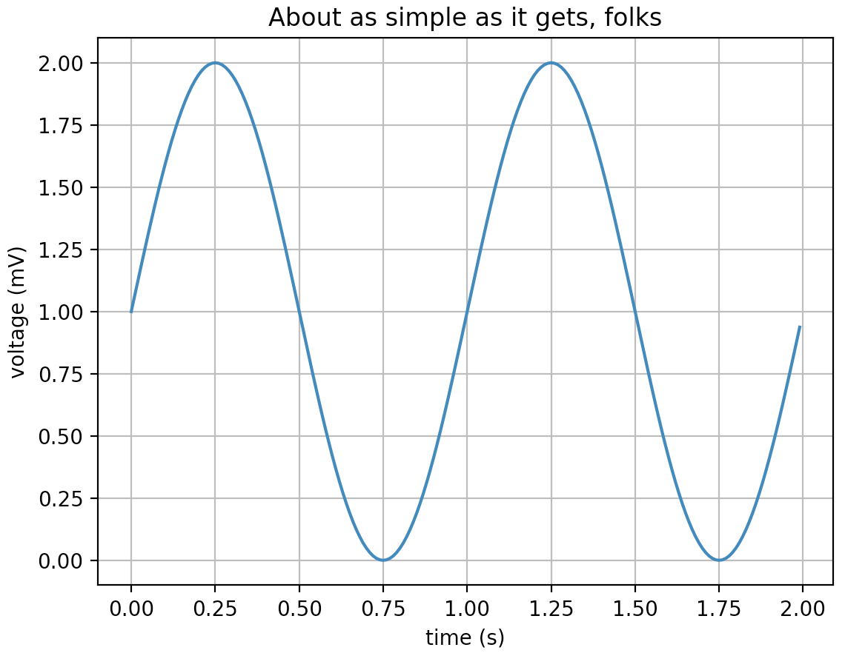
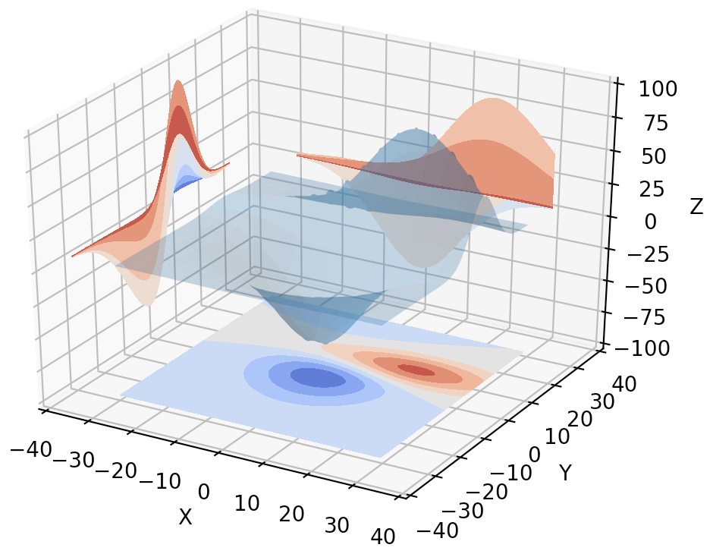
Matplotlib
Matplotlib is a Python 2D plotting library which produces publication quality figures in a variety of hardcopy formats and interactive environments across platforms. Matplotlib can be used in Python scripts, the Python and IPython shells, the Jupyter notebook, web application servers, and four graphical user interface toolkits.
06/25/2018
Eric Pooser
Hall A/C Data Analysis Workshop

Slide 16
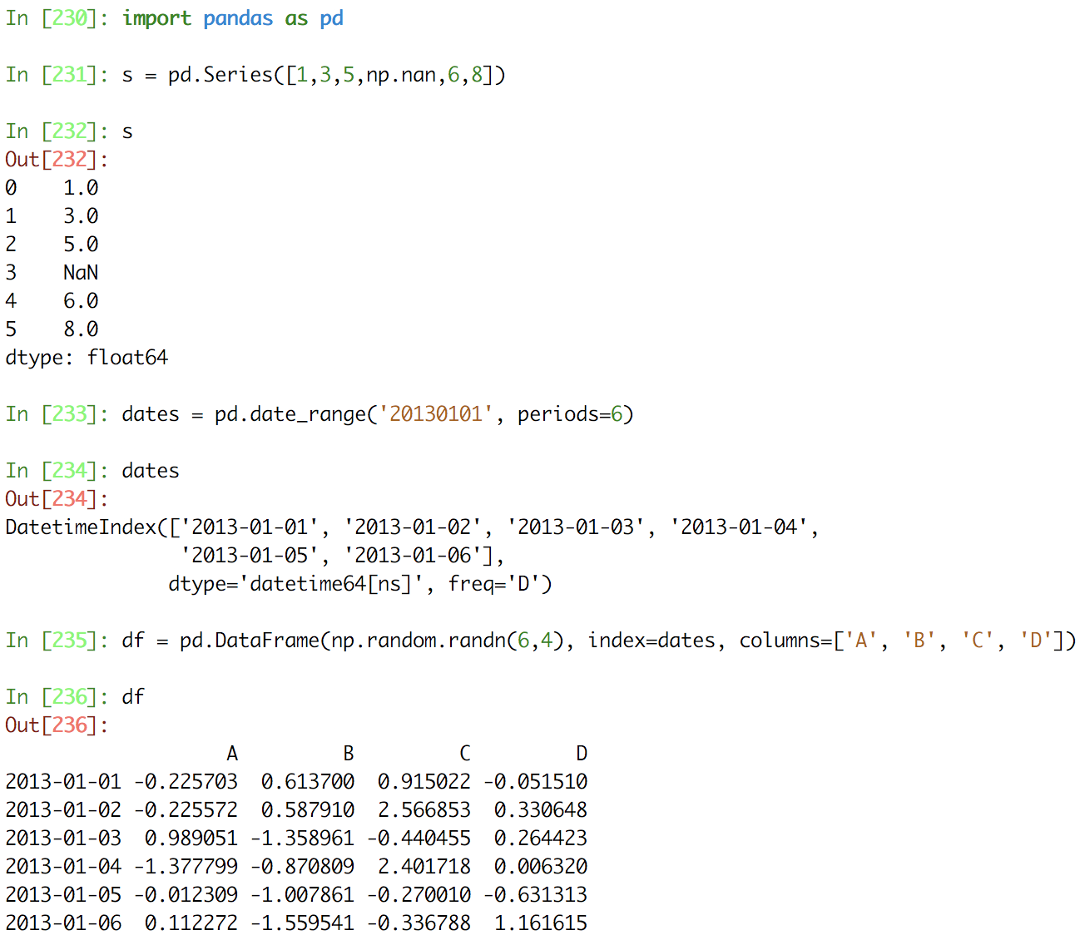
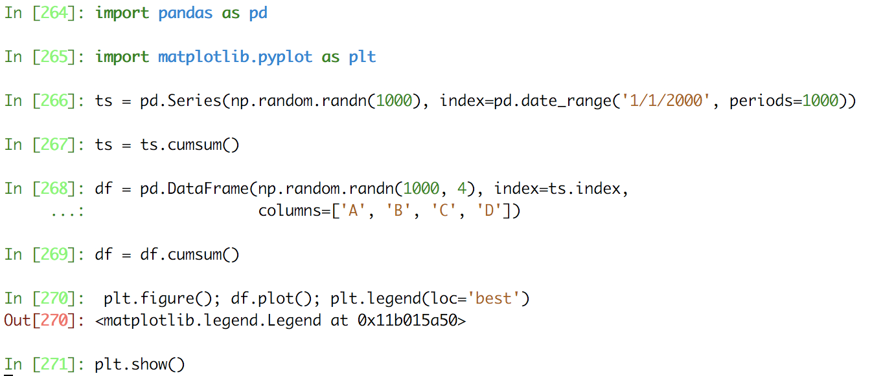
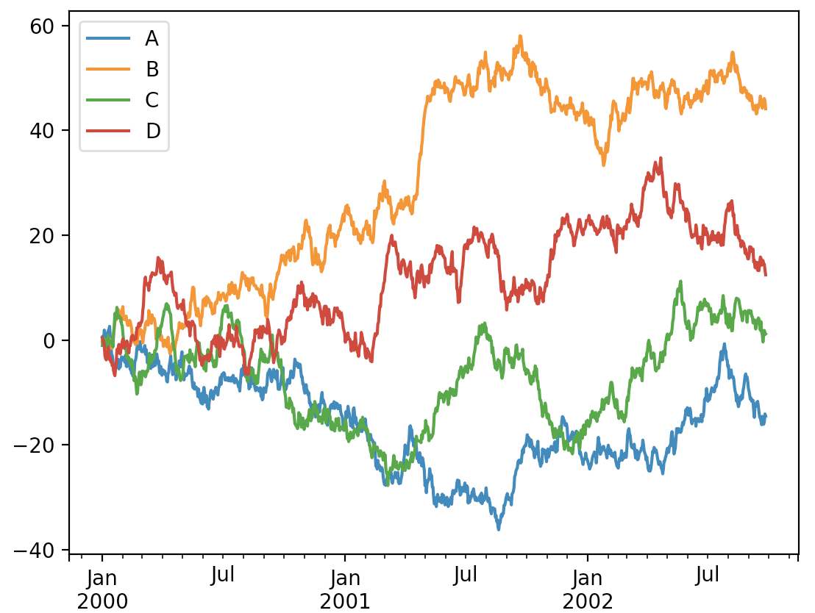
Pandas
Pandas is a Python package providing fast, flexible, and expressive data structures designed to make working with “relational” or “labeled” data both easy and intuitive. It aims to be the fundamental high-level building block for doing practical, real world data analysis in Python
06/25/2018
Eric Pooser
Hall A/C Data Analysis Workshop

Slide 17
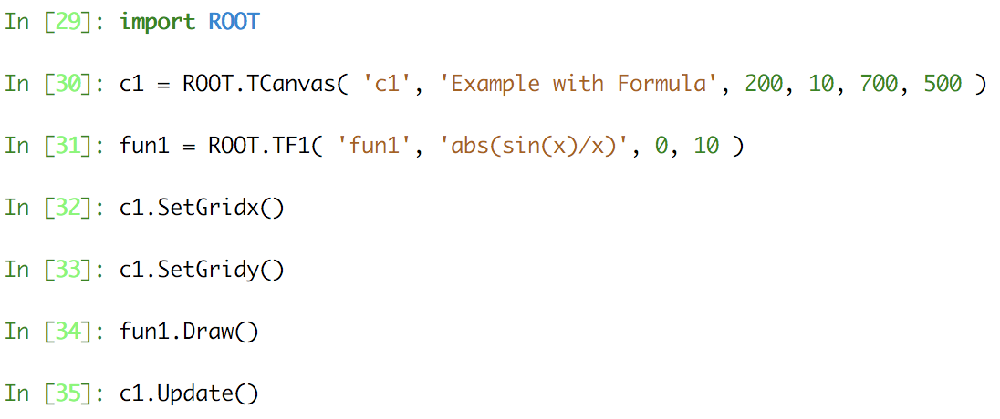
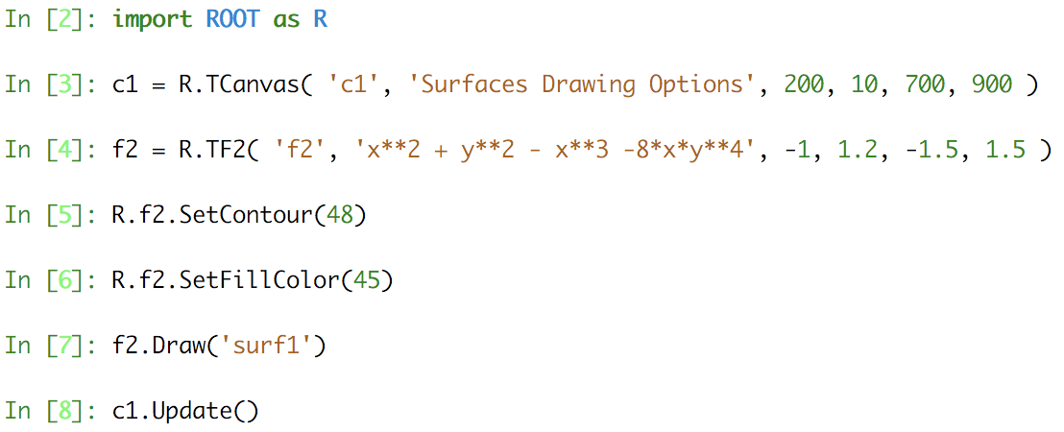
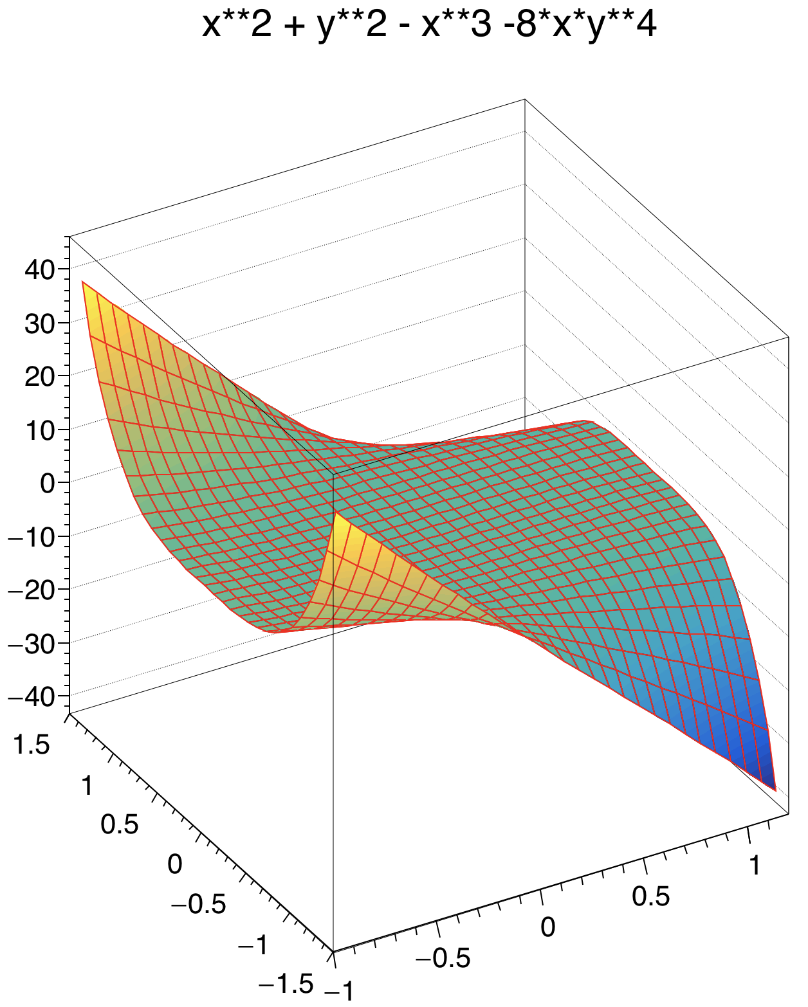
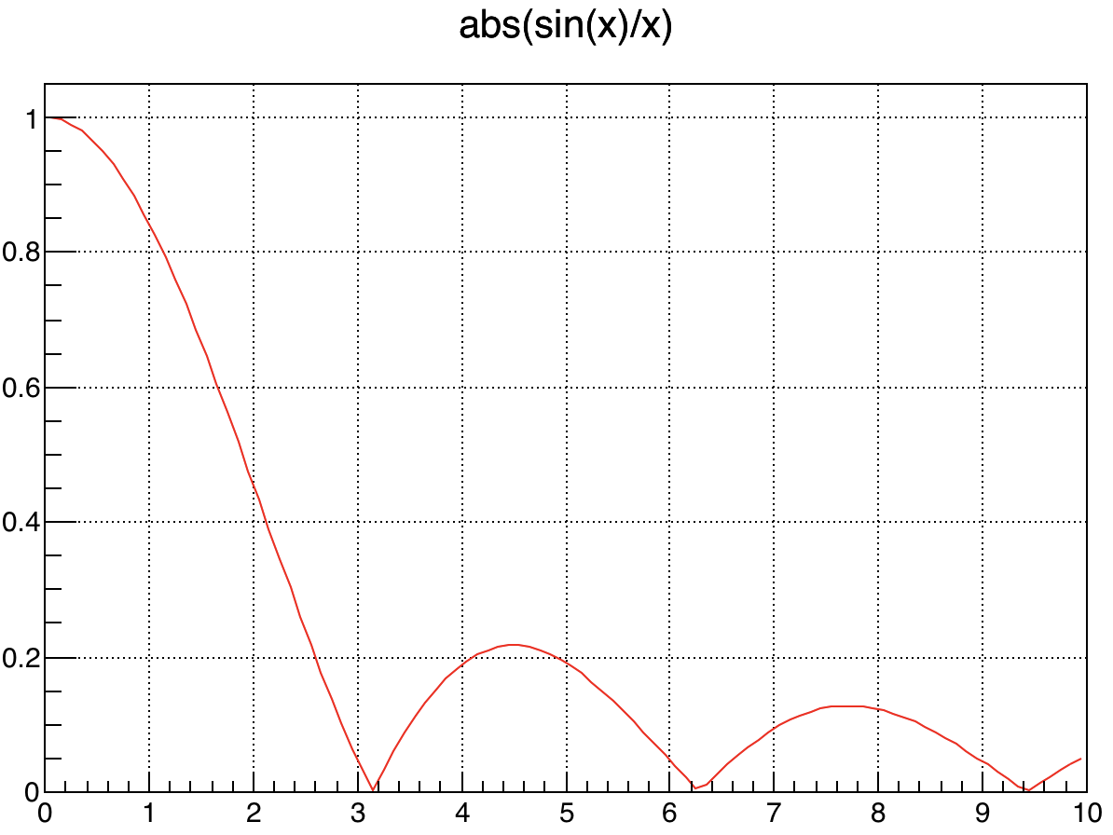
PyROOT
PyROOT is a Python extension module that allows the user to interact with any ROOT class from the Python interpreter. PyROOT offers the possibility to execute and evaluate any Python command or start a Python shell from the ROOT/CLING prompt
06/25/2018
Eric Pooser
Hall A/C Data Analysis Workshop

Slide 18
Joint Hall A&C Data Analysis Workshop
Questions?

Slide 19
Backup Slides
06/25/2018
Eric Pooser
Hall A/C Data Analysis Workshop

Slide 20
Slide Title
06/25/2018
Eric Pooser
Hall A/C Data Analysis Workshop

