Slide 1
Hall C Winter Collaboration Meeting
Hall C Software: Status & Outlook
Eric Pooser
Jefferson Lab
1/28/2019
On Behalf of the Hall C Software Working Group

Slide 2
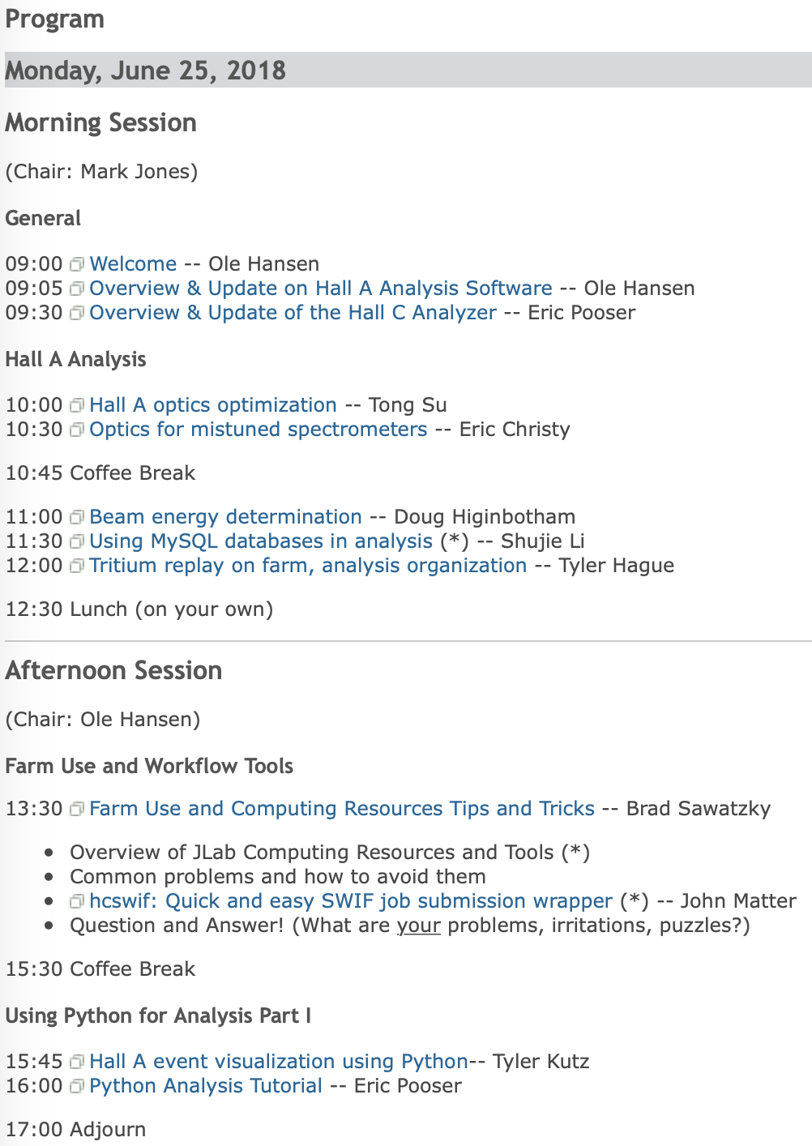
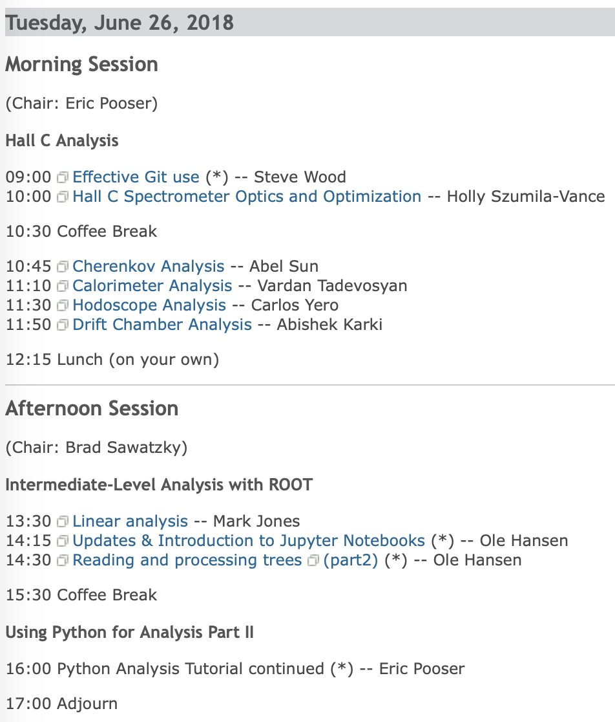
Joint Hall A & C Data Analysis Workshop
Analysis Workshop held June 25-26, 2018
Great starting point for new users unfamiliar to the software
Git Repo for interactive sessions covering wide range of topics
01/28/2019
Eric Pooser
Hall C Winter Collaboration Meeting

Slide 3
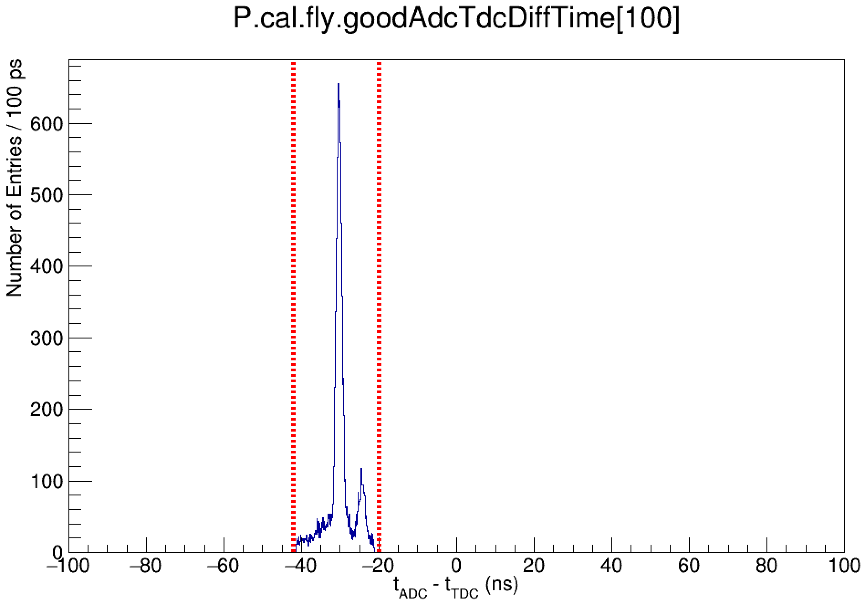
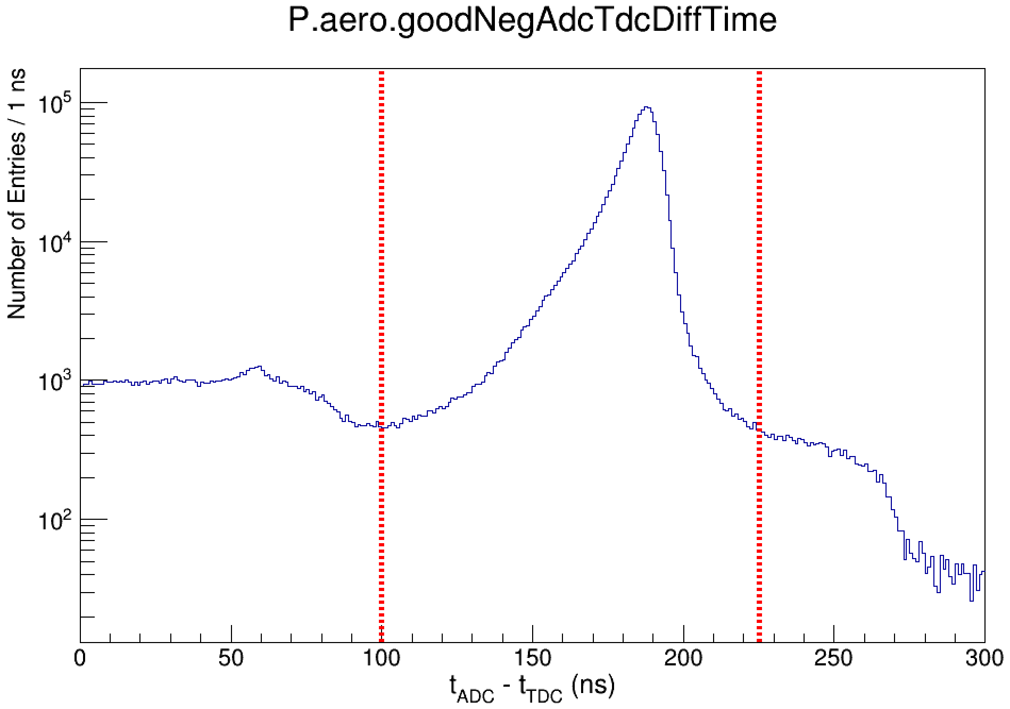
Updates to HCANA: b1ad79e & 66771fa
Per PMT timing cuts have been integrated into both calorimeter and aerogel detector classes
HMS Calorimeter (THcShower)
cal_pos(neg)_adcTimeWindowMin(Max)
SHMS Calorimeter (THcShowerArray)
cal_arr_adcTimeWindowMin(Max)
SHMS Pre-Shower (THcShower)
cal_pos(neg)_adcTimeWindowMin(Max)
Aerogel (THcAerogel)
aero_adcPos(Neg)TimeWindowMin(Max)
Determines 'Good' FADC hit for each detector channel
One hit per event
01/28/2019
Eric Pooser
Hall C Winter Collaboration Meeting

Slide 4
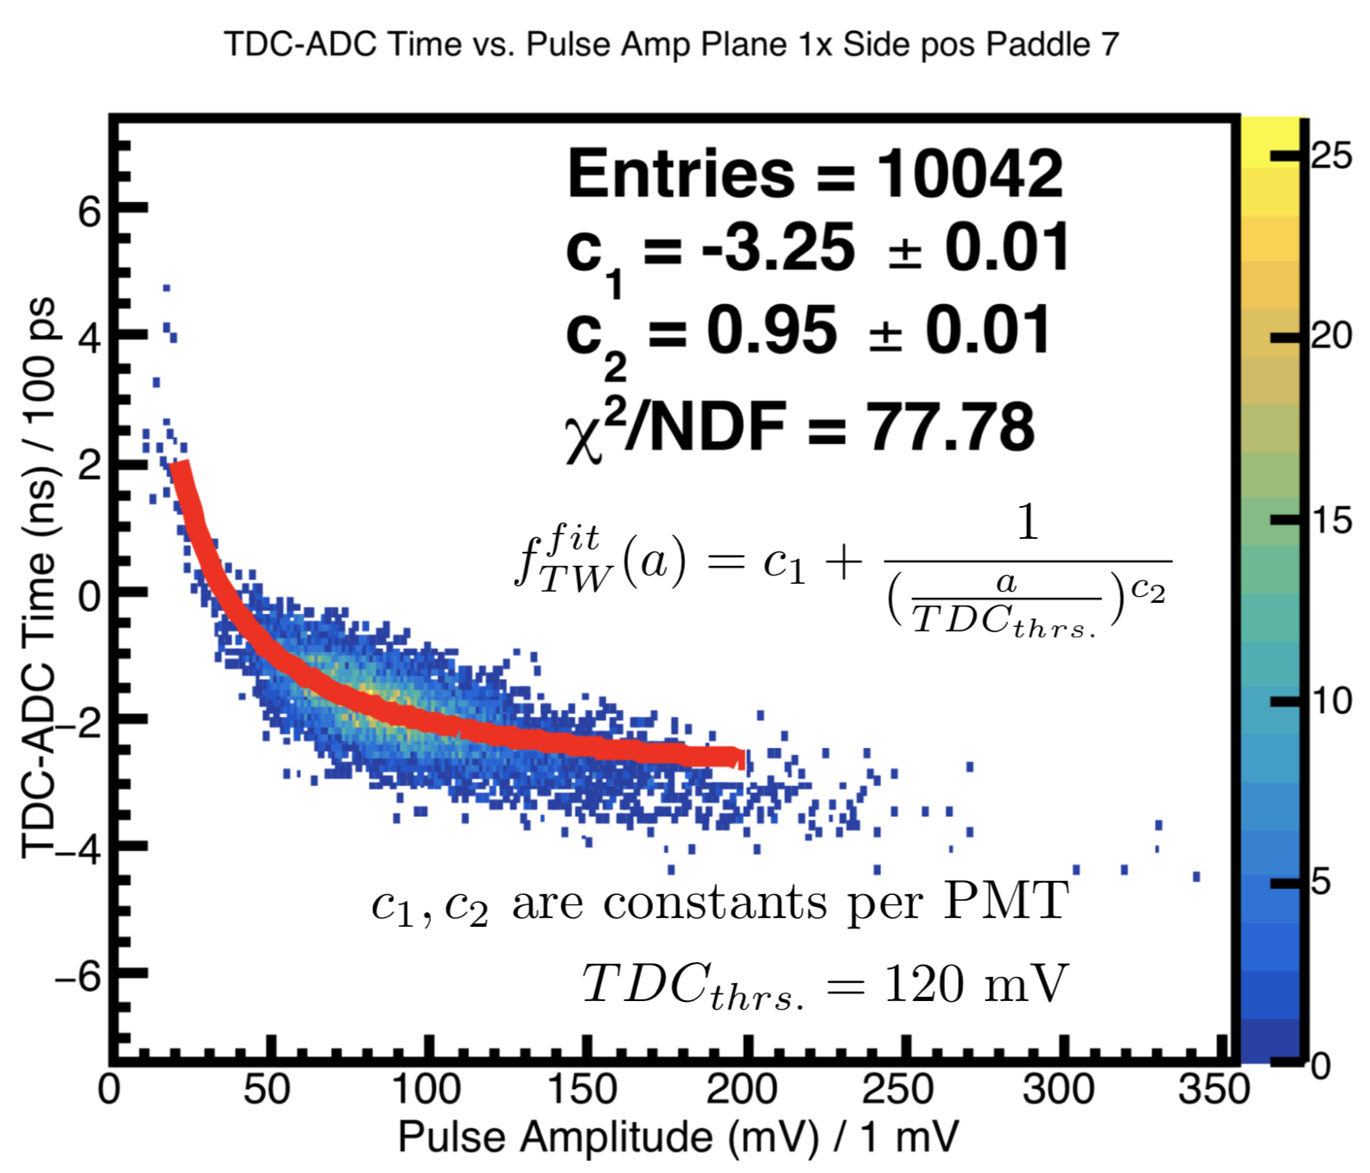
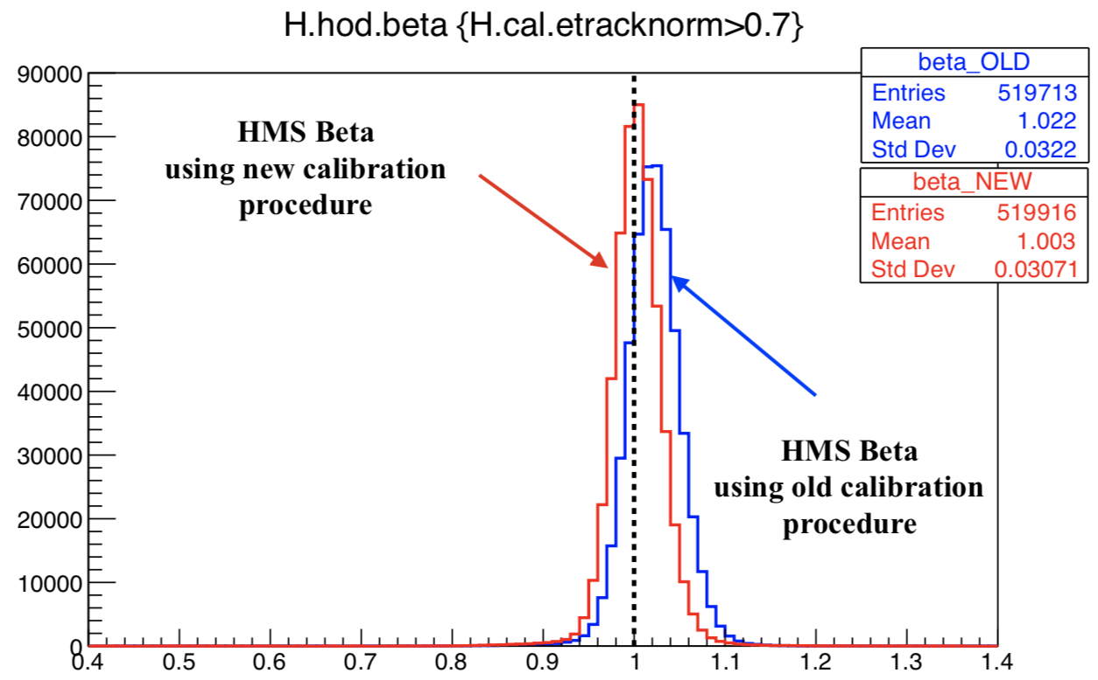
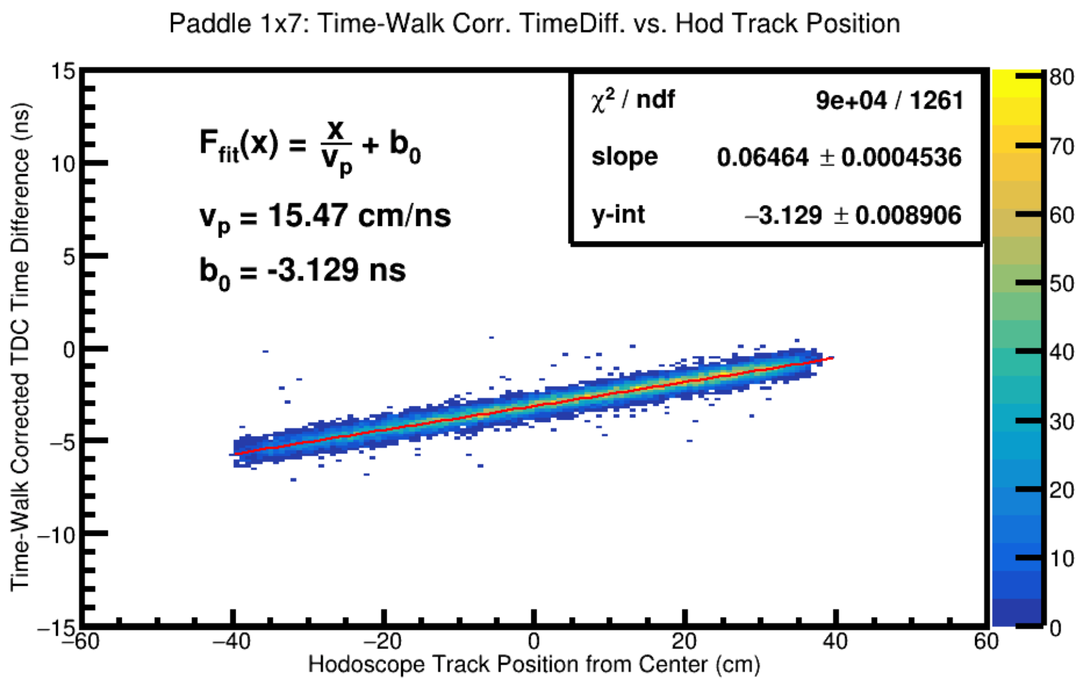
Updates to HCANA: a0d4684
New hodoscope calibration procedure
Utilizes FADC timing and pulse amplitude information to perform the time-walk calibration for each PMT
Decouples calibration procedures into individual components
Plots courtesy of Carlos Yero
01/28/2019
Eric Pooser
Hall C Winter Collaboration Meeting

Slide 5
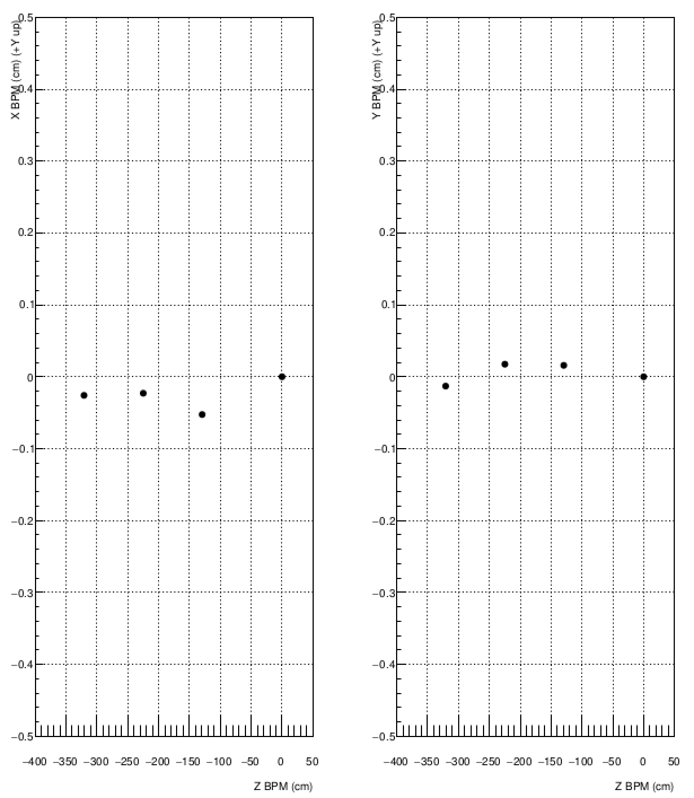
Updates to HCANA: 7b883c0 & 7837f27
THcRaster has been updated to utilize the BPM information from EPICS
Calculates the beam position and direction at the target as inferred from the BPMs
Tree variables for the three BPMs and projection to the target in the EPICS coordinate system have been added
The calculation of beam at the target utilizes A & C
Raster variables are now in the EPICS coordinate system as it makes it easier to interpret the carbon hole runs
01/28/2019
Eric Pooser
Hall C Winter Collaboration Meeting

Slide 6
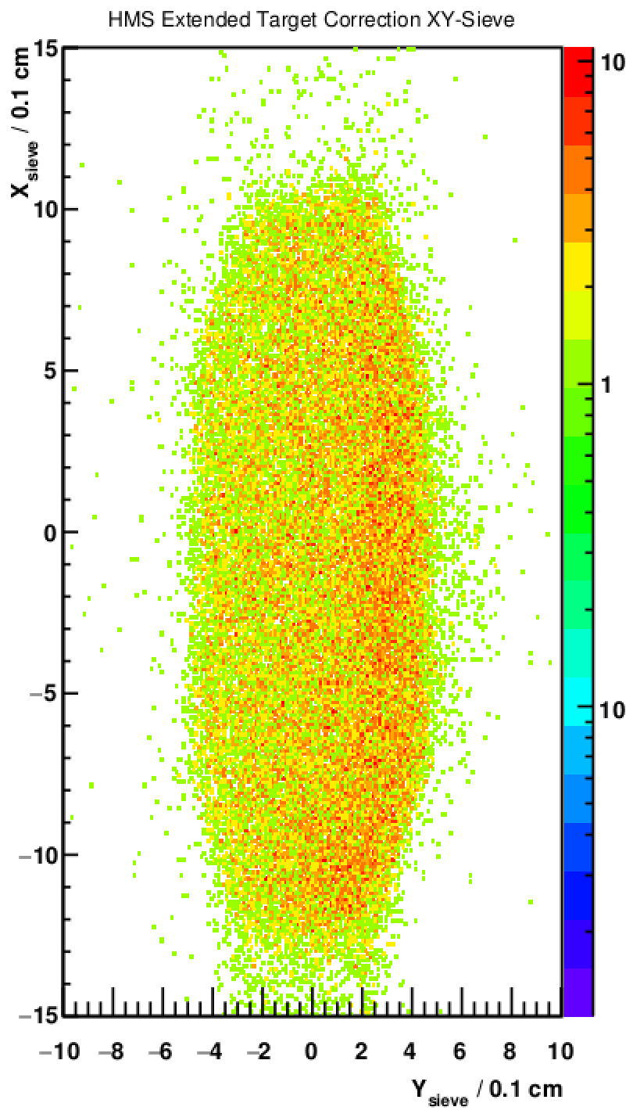
Updates to HCANA: aa5b54c & 5a55867
THcExtTarCor now has tree variables that calculate xsieve and ysieve for the spectrometer
Both xsieve and ysieve variables are also calculated for the golden track
The calculations depend on the spectrometer i.e. the SHMS calculation includes a delta dependence when calculating sieve
THcHallCSpectromoter now handles mispointing according to the input angle if the mispointing is not set by a parameter
The formula for mispointing comes from fits to surveys
It is possible to set custom mispointings via (p)hmisspointing_x(y) in standard.kinematics
01/28/2019
Eric Pooser
Hall C Winter Collaboration Meeting

Slide 7
Updates to HCANA: 4a7af64 & 4d4418d
Drift chamber classes updated to include a per wire sigma parameter
(p)h_using_sigma_per_wire is optional and turned off by default
When the per wire configuration is not being utilized then the sigma per plane parameters are utilized
THcTrigDet and THcCoinTime updated to take in a vector<string> to identify which of the trigger detector TDC signals to use for the coincidence timing
Names must be in order of SHMS ROC1, HMS ROC1, SHMS ROC2, HMS ROC2
tcoin_trigNames = pTRIG1_ROC1 pTRIG4_ROC1 pTRIG1_ROC2 pTRIG4_ROC2
Raw TDC to time conversion factor is no longer hard coded in THcCoinTime and instead utilizes the fTdcChanperNS parameter
If more than one hit within window, the last hit is selected
If no hit is found in the window then the time is set to zero
01/28/2019
Eric Pooser
Hall C Winter Collaboration Meeting

Slide 8
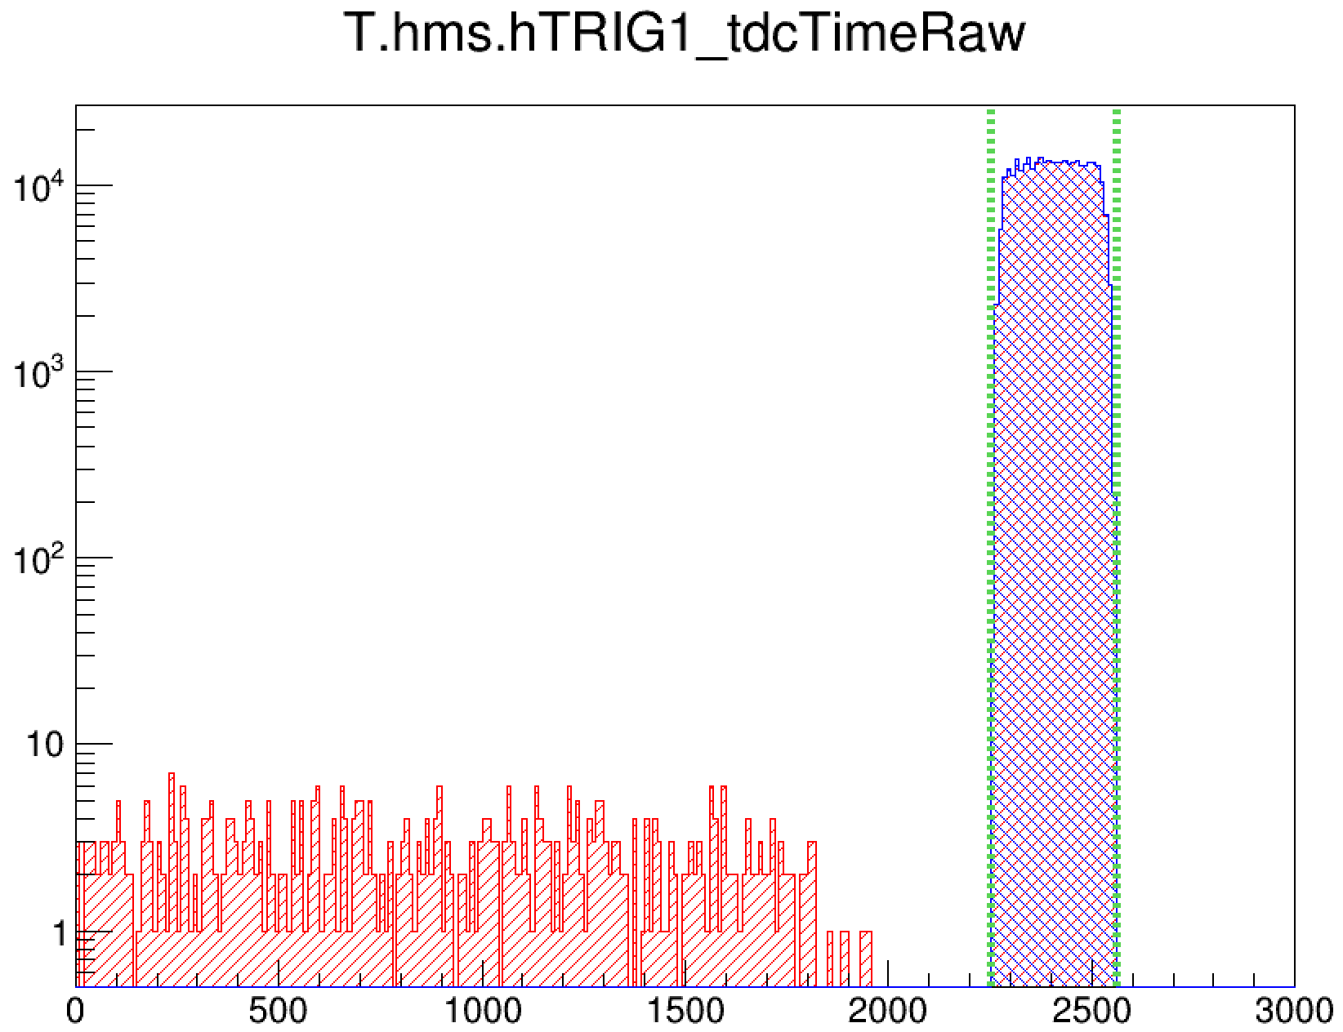
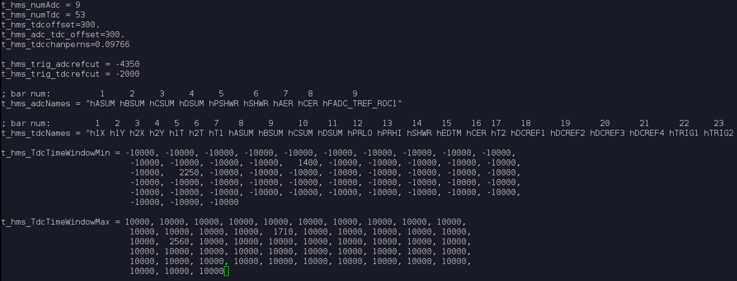
Updates to HCANA: 24235e0
THcTrigDet modified to select good TDC hits within some time window
Hit selection windows exist for all trigger apparatus variables
(p)hVARX_tdcTimeRaw
No Window Cuts
With Window Cuts
PARAM/TRIG/t(p)hms.param
Eric Pooser
01/28/2019
Hall C Winter Collaboration Meeting

Slide 9
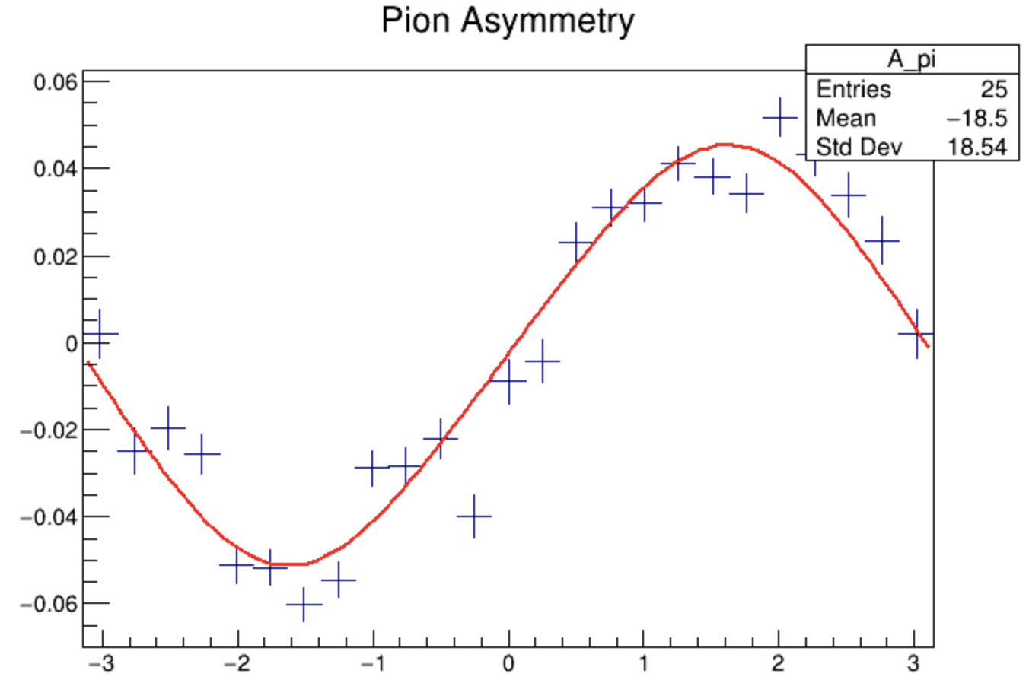
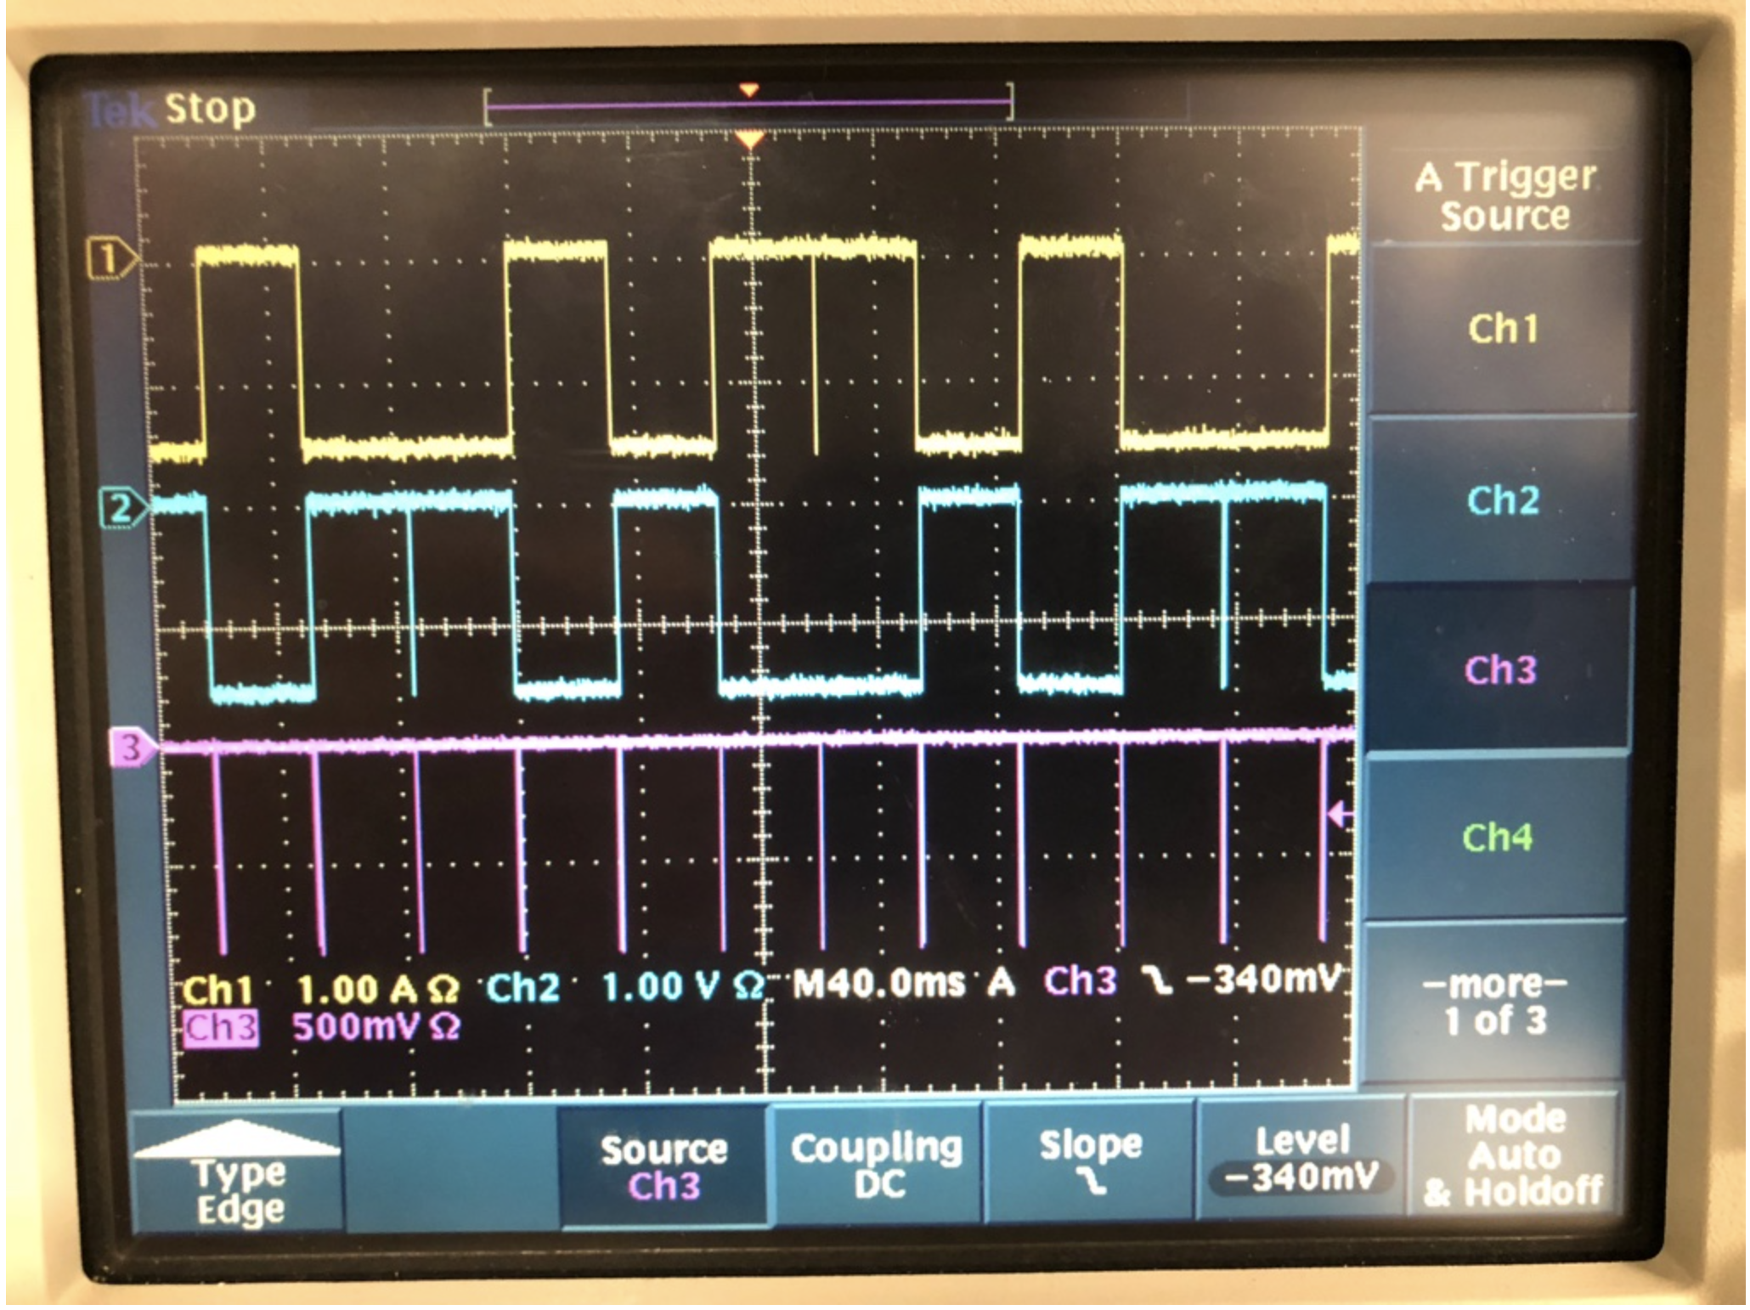
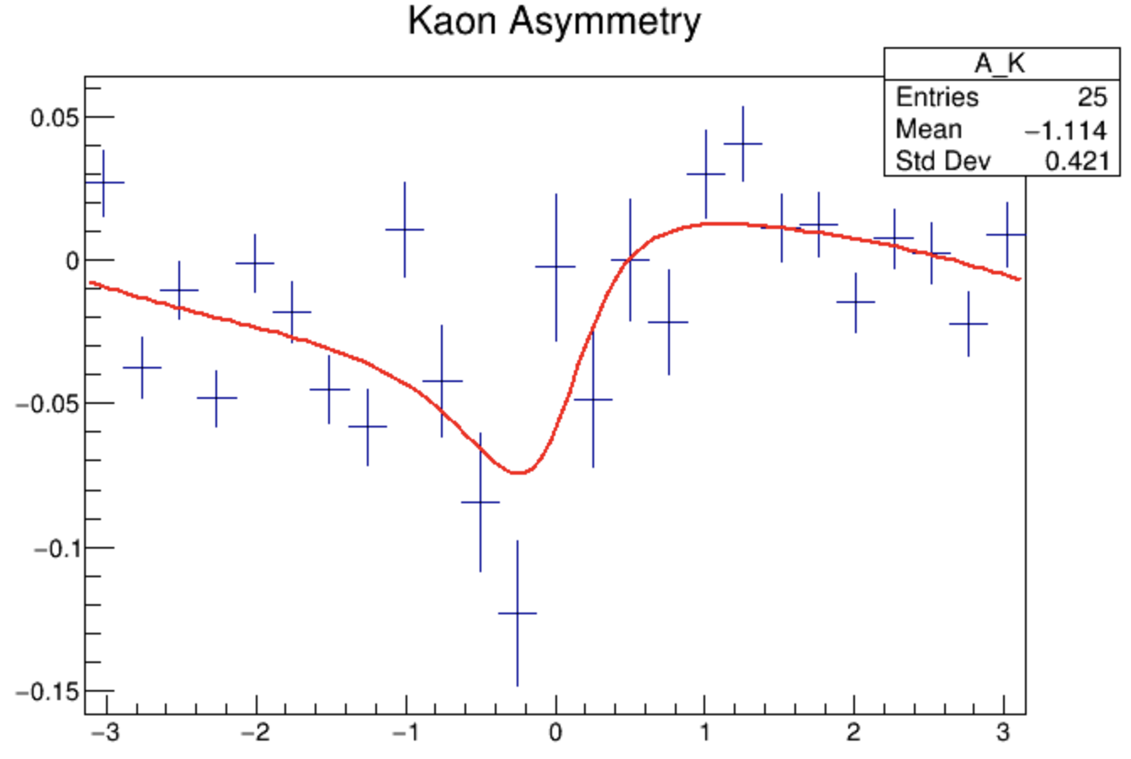
Updates to HCANA: 47c908b
THcHelcity determines the beam helicity for each event
By default it is assumed that there is a delayed reporting of 8 cycles and that quartets are used
See Steve’s talk @ 1400!
01/28/2019
Eric Pooser
Hall C Winter Collaboration Meeting

Slide 10
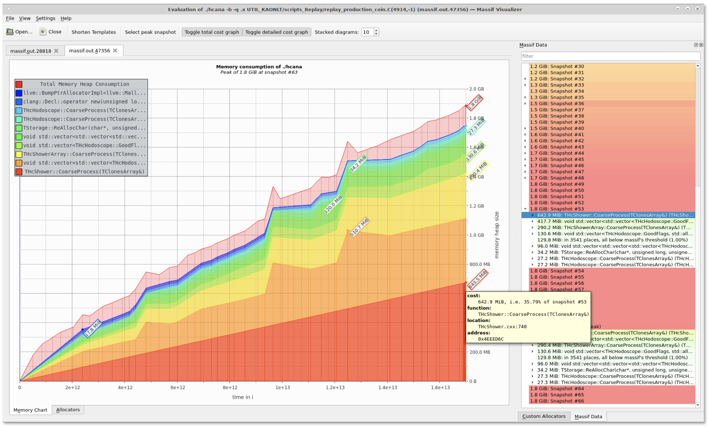
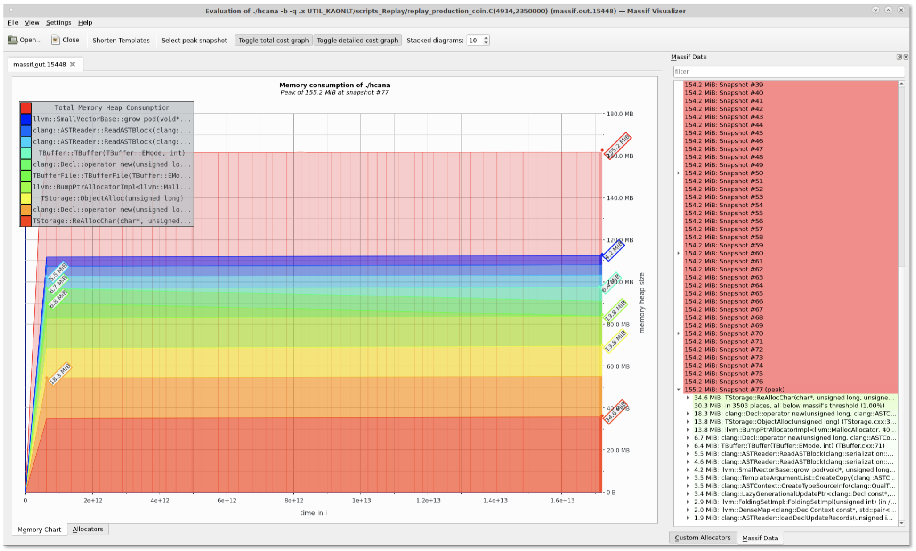
Updates to HCANA: e1f461e
Large number of memory leaks have been corrected (Ole’s talk)
Large memory leaks found in THcShower, THcShowerArray, and THcShowerHit
On average these leaks caused a loss in memory of 420 bytes/event (840 MB / 2M events)
Many more smaller memory leaks addressed in variety of classes
Various access errors in THcHodoscope and THcHitList addressed as well
Infinitely growing array found in THcHodoscope
Once all fixes were implemented, a flat heap profile is observed
1.8 GB
200 MB
01/28/2019
Eric Pooser
Hall C Winter Collaboration Meeting

Slide 11
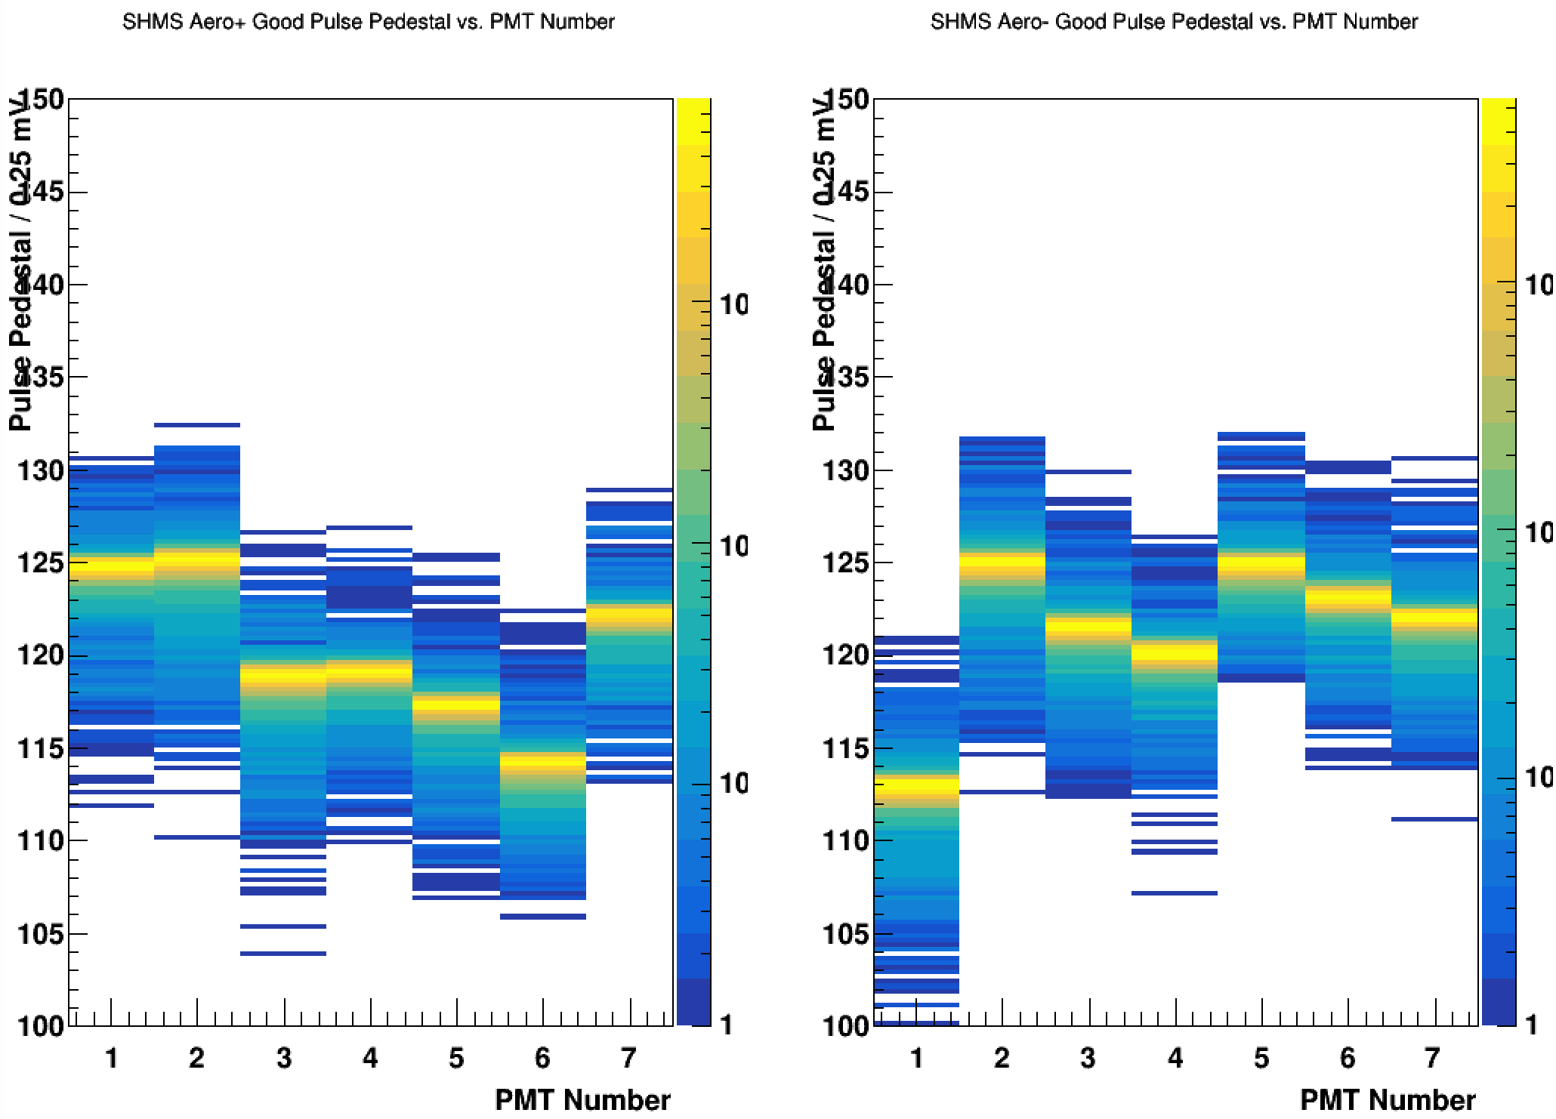
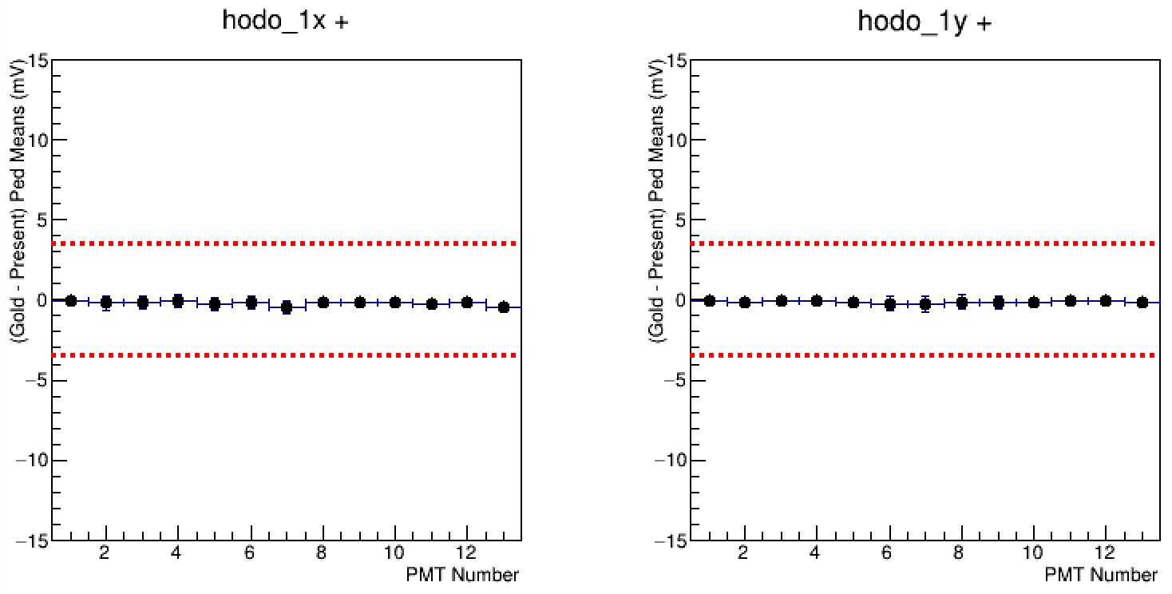
FADC Thresholds & Pedestal Golden Runs
Thresholds for each FADC channel must be determined on an per channel basis (expert driven task)
By default all thresholds are set to 10 mV unless request is made
When new thresholds are set, 'golden runs' for each spectrometer must be symbolically linked to a specific run of choice in the replay ROOTfiles directory
(s)hms_coin_replay_production_golden.root
The 'golden' run utilized in the 50k online monitoring to monitor pedestal drifts of all FADC channels
Critical path item in order to ensure quality of FADC data
01/28/2019
Eric Pooser
Hall C Winter Collaboration Meeting

Slide 12
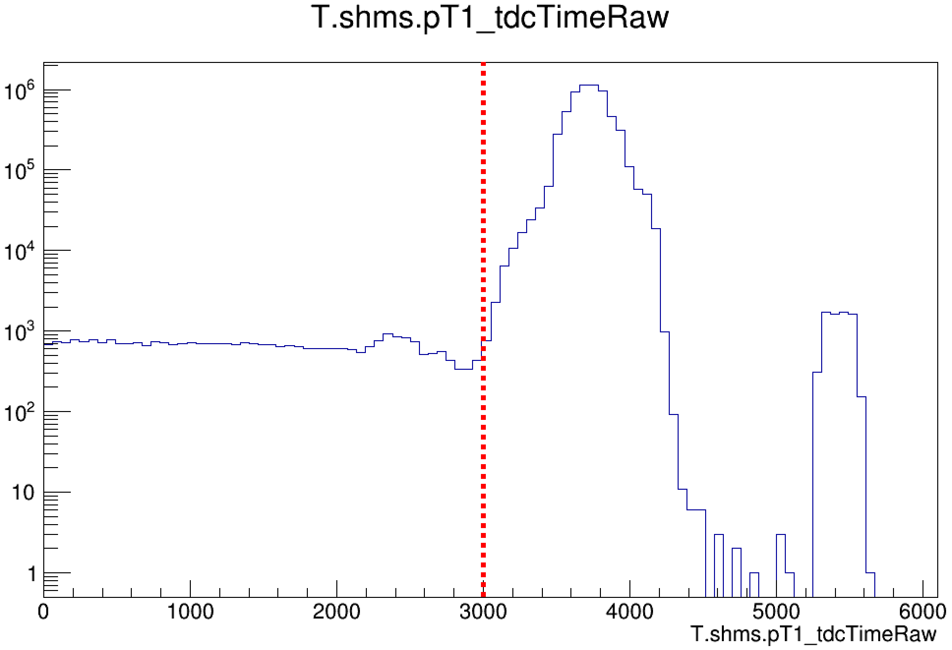
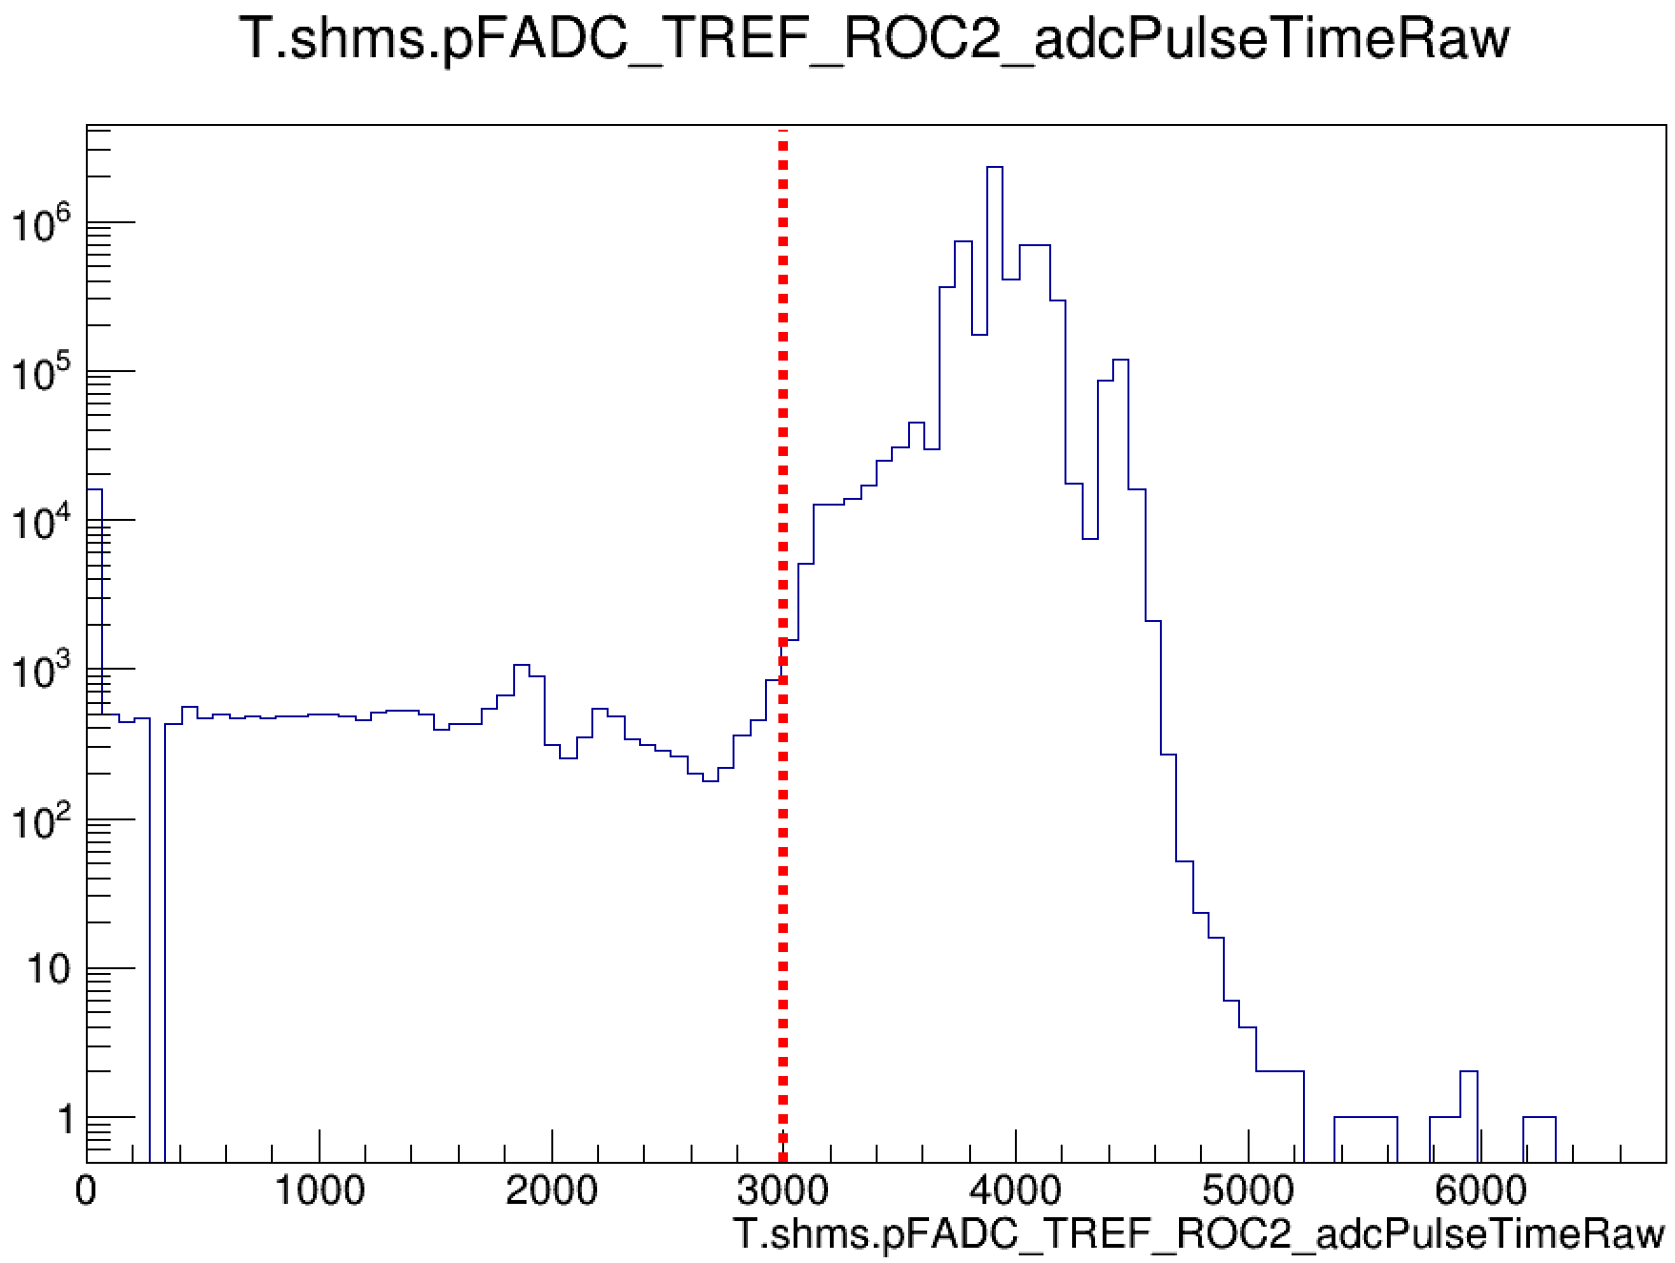
Reference Time Selection
Prior to any meaningful analysis being conducted, proper reference time selection cuts must be determined and incorporated into the replay
Reference time selection is dependent on the first TDC/FADC hit in the window which is greater than the associated cut
X_t(a)dcrefcut
If no hit is found, then the first hit relative to the beginning of the window will be selected
TDC cuts are required for both drift chambers and hodoscopes
ADC cuts are required for all detectors except for the drift chambers
Which reference time is being utilized for each detector is visible in the detector maps
TDC
ADC
Simona’s Detailed Talk
01/28/2019
Eric Pooser
Hall C Winter Collaboration Meeting

Slide 13
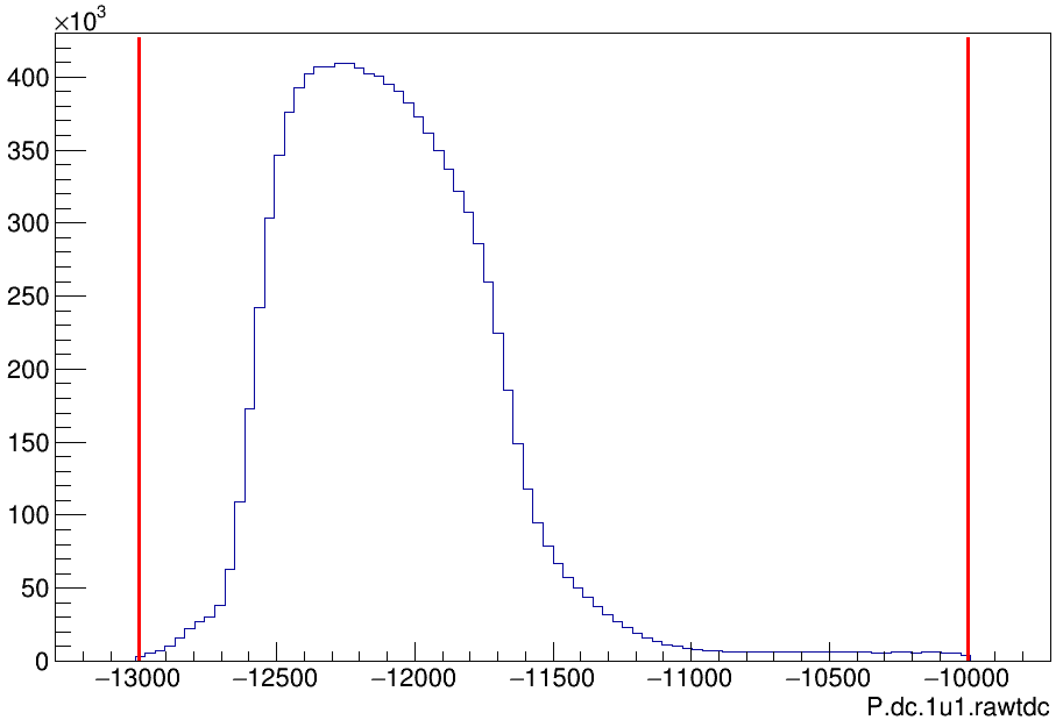
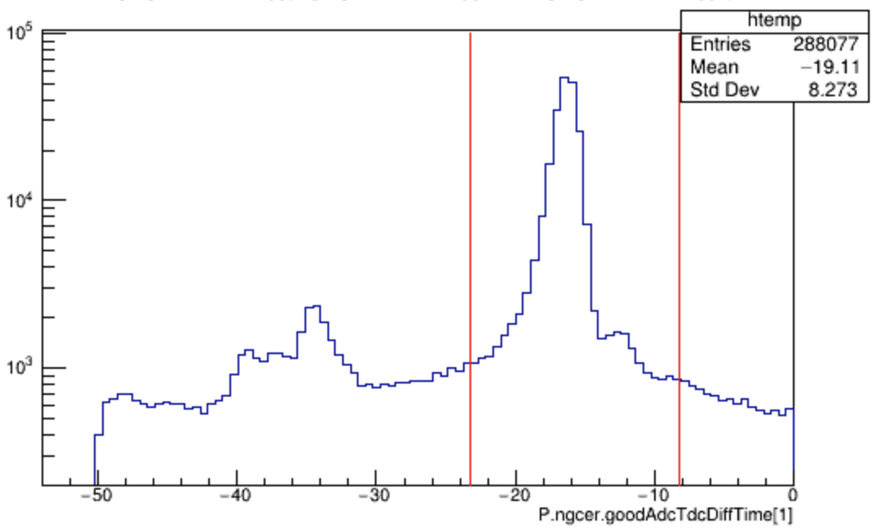
TDC & FADC Time Window Cuts
Prior to interpreting any higher order physics related quantities, both TDC & ADC timing windows must be determined and configured into the replay
TDC window limits for both the drift chambers and hodoscopes must be set appropriately
Xscin_tdc_min(max)
Xdc_tdc_min(max)_win
ADC window limits for each PMT in the stack must be set appropriately so that the analyzer can determine 'good' hits which are utilized in determining physics quantities
'goodAdcTdcDiffTime' variables
tpulse - tref - tstart
X_adcTimeWindowMin(Max)
DC
NGC
Simona’s Detailed Talk
01/28/2019
Eric Pooser
Hall C Winter Collaboration Meeting

Slide 14
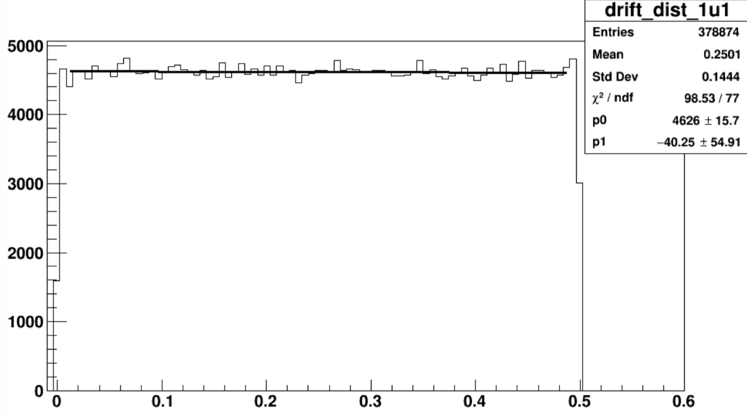
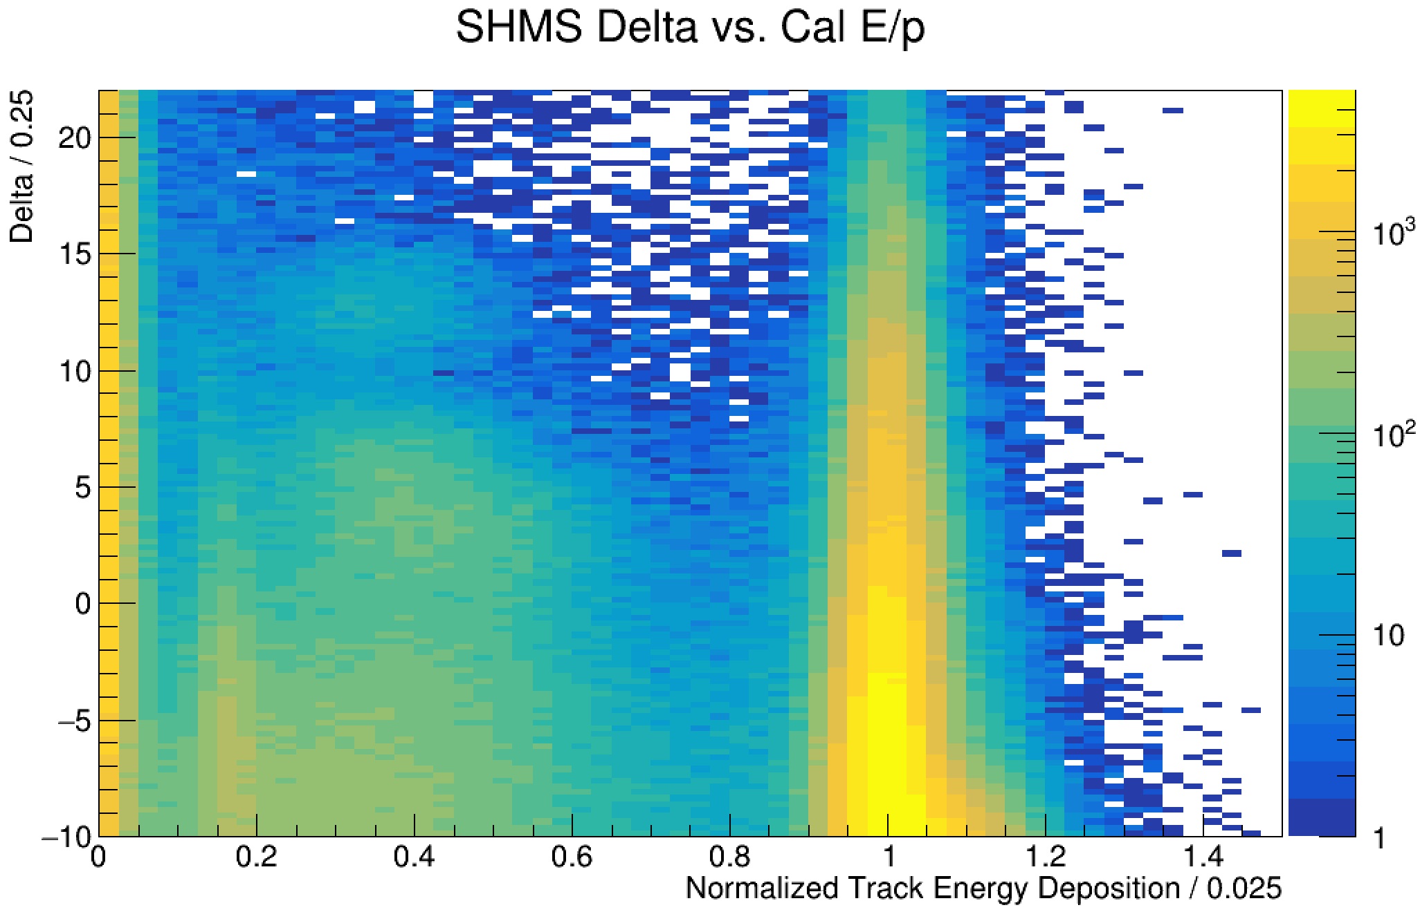
Detector Calibrations
With the all of the appropriate reference time selection cuts and timing cuts in place, detector calibrations are required
The hodoscope and Cherenkov detectors do not require new calibrations unless the HV settings have been modified
The calorimeter and drift chambers will most likely require a new calibration
These calibrations are dependent on the kinematic settings
The calorimeter calibration is required for properly determining the trigger PID thresholds
01/28/2019
Eric Pooser
Hall C Winter Collaboration Meeting

Slide 15
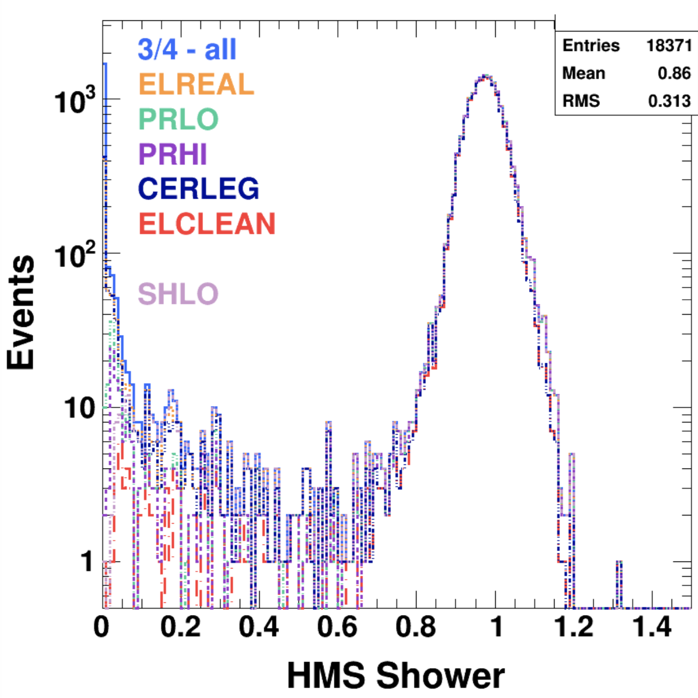
Setting Trigger PID Thresholds
Setting the hardware thresholds for the various trigger PID legs must be done prior to utilizing the PID triggers i.e. EL-REAL & EL-CLEAN
Determining the thresholds can be done in a variety of ways
The current 'online’ method:
Take 3/4 runs in both spectrometers and check the electron efficiency and the pion rejection by placing cuts on the TDC PID legs
Take one run with low pi/e and one run with high pi/e
An 'offline' method can also be done utilizing the FADC’s
Simona’s Detailed Talk
01/28/2019
Eric Pooser
Hall C Winter Collaboration Meeting

Slide 16
Hall C Replay: Current Design
Configuration Files
Analysis Files
Results
RUN
HMS
PARAM
SHMS
DEF
FILES
DBASE
HMS
SHMS
ROOT
TREE
STD
DETEC
KINEM
TRIG
DEF-FILE
HISTOS
HMS
REPLAY SCRIPTS
HMS
SHMS
PARAM
SHMS
MAPS
ONLINE
GUI
GEN
COIN
CRATE
TRIG
01/28/2019
Eric Pooser
Hall C Winter Collaboration Meeting

Slide 17
Current Workflow for Online Analysis
Each run group maintains their own replay repository and workflow
Copy of the pre-existing hallc-replay repository
Copy of previous run groups replay
Custom replay set-up
The replay repository lives on the cdaq cluster and is run on cdaql1
e.g. /home/cdaq/hallc-online/hallc_replay_jpsi
It is highly recommended that changes in the repo be committed and pushed often (minimum once per day)
Every user is 'cdaq' and 'rm -rf *' will happen again!
The shell command 'go_analysis' will put the user in the appropriate replay directory and setup the associated environment variables for the experiment currently on the floor
The analyzer is actively maintained in hallc-online/hcana
This too could be run group specific if there is a need
01/28/2019
Eric Pooser
Hall C Winter Collaboration Meeting

Slide 18
Current Workflow for Online Analysis
The current 50k replay and online monitoring is actively maintained by Hall-C staff
The histograms that are displayed via the online GUI are critical to ensuring that the detectors and track reconstruction are functioning nominally
The 50k replay infrastructure (analysis scripts & DEF-files) and online GUI is maintained in the hallc-replay repository
The current structure to the hallc-replay repo will likely change in the near future
Changes to the current 50k replay and/or online monitoring histograms are subject to the hallc-replay gate keepers
Monitoring histograms are able to be added but not removed unless discussed
Online monitoring is posted to the web automagically
Hall-C Live Page
50k Replay
Online Monitoring
Report File Summary
01/28/2019
Eric Pooser
Hall C Winter Collaboration Meeting

Slide 19
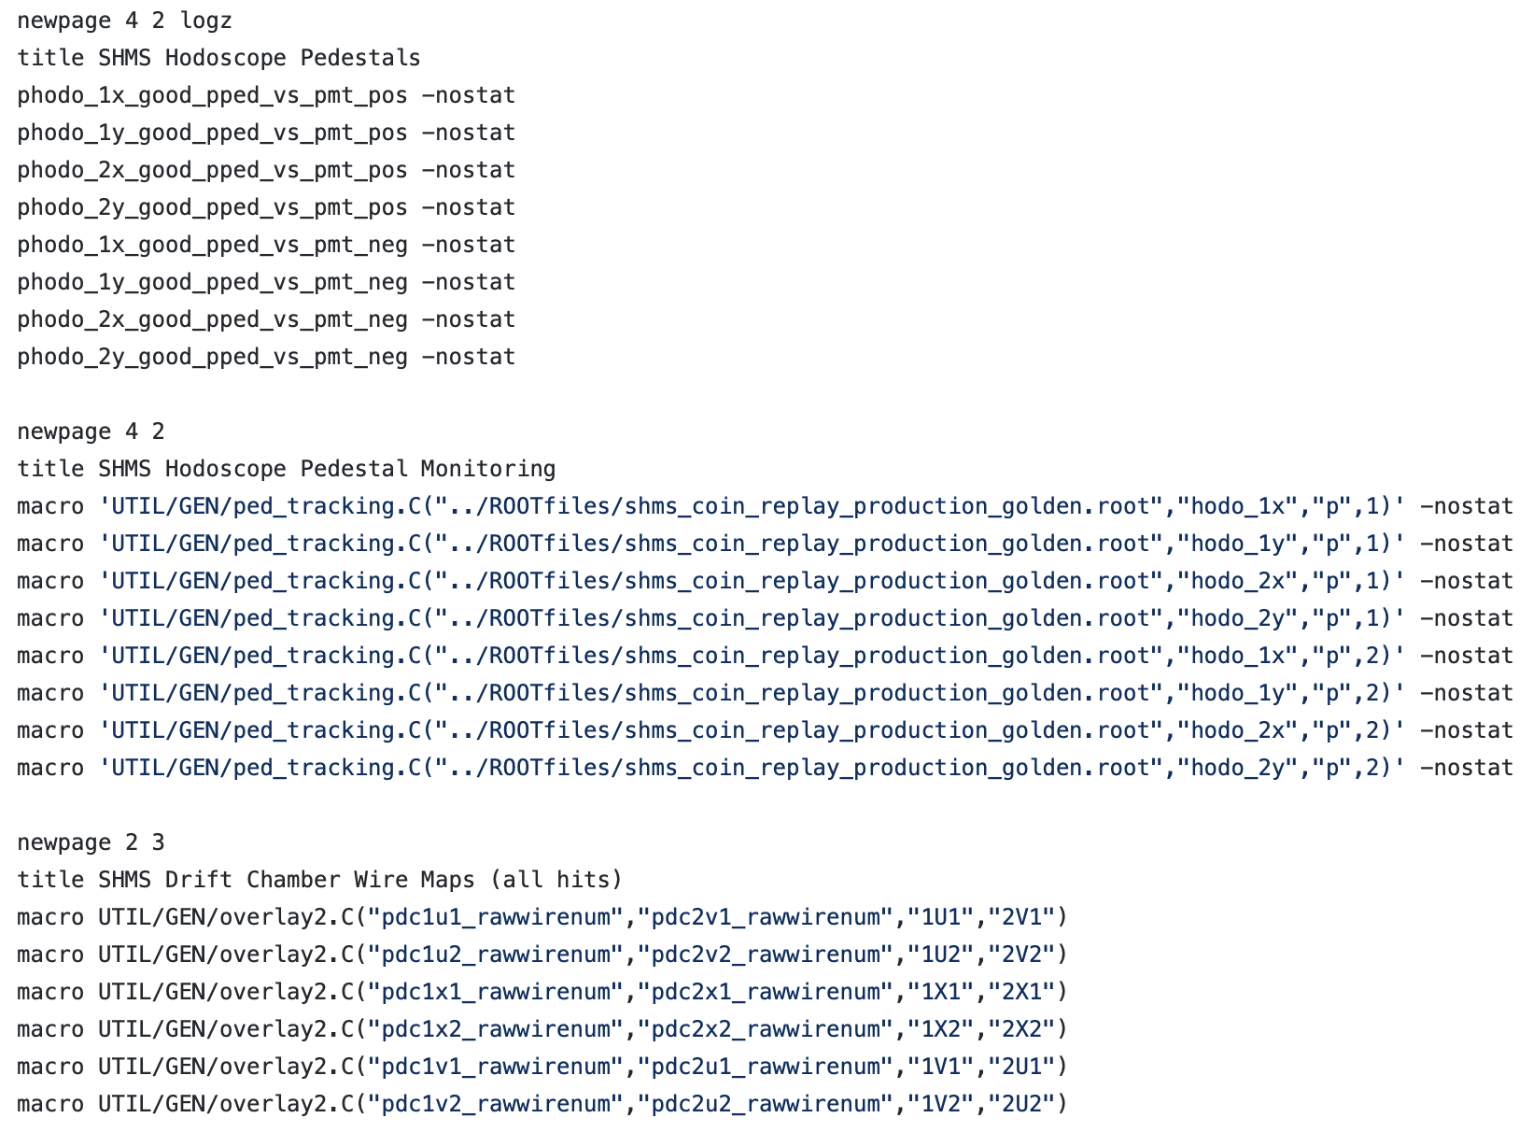
Online GUI
The online GUI is a useful tool that interacts nicely with the hallc-replay infrastructure
Plots the histograms defined in the DEF-files that are filled via the analyzer on an event by event basis
Executes macros that interact with the ROOT file data
Can be utilized in the online scaler/full replays in order to display information of interest
'How-To' PDF
01/28/2019
Eric Pooser
Hall C Winter Collaboration Meeting

Slide 20
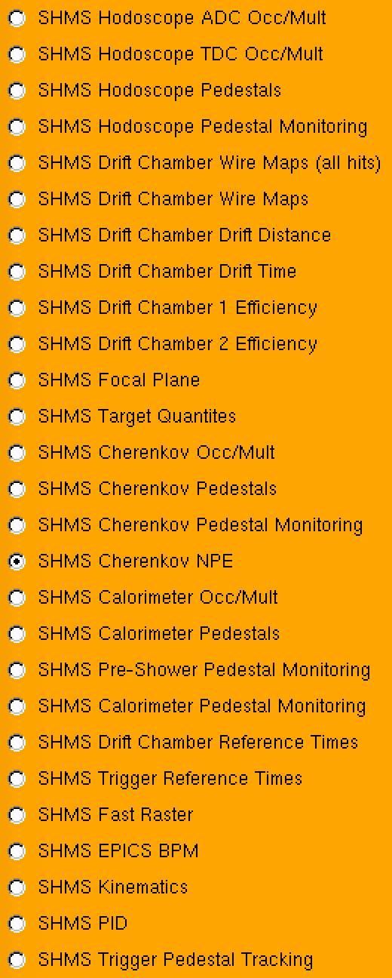
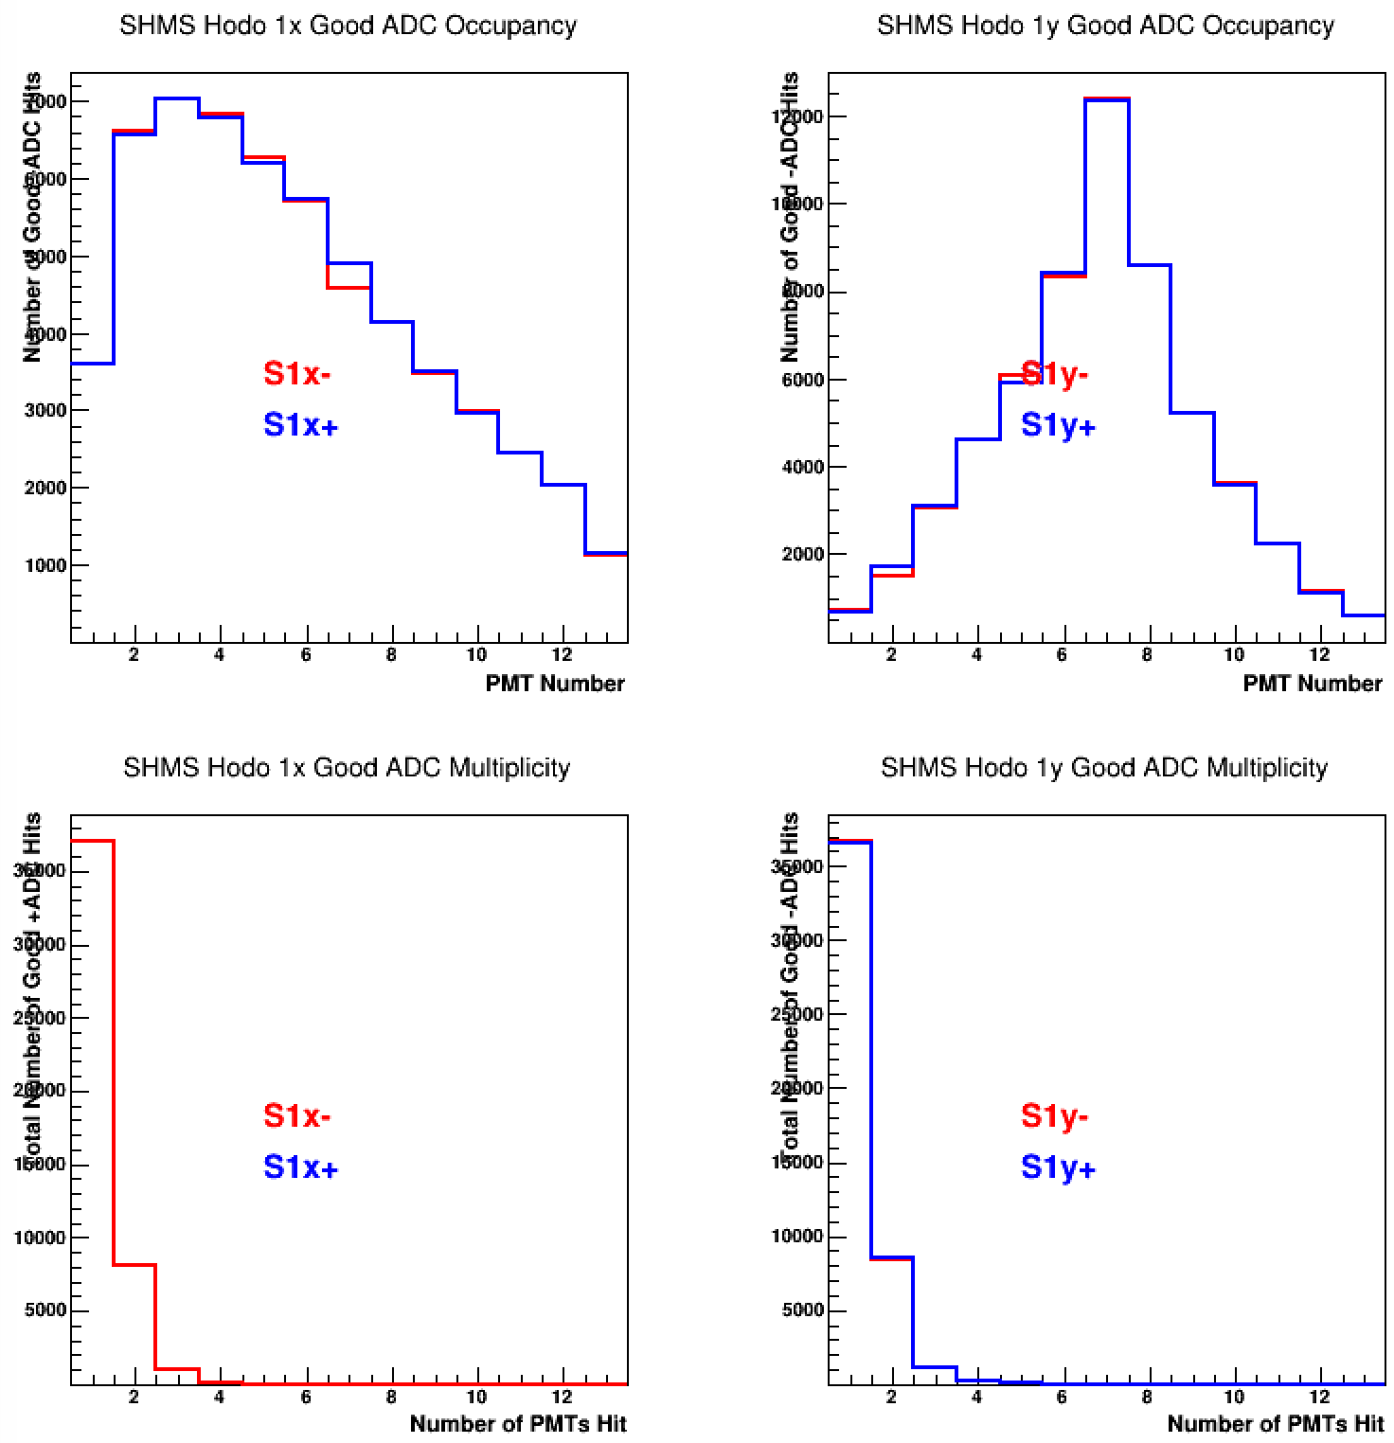
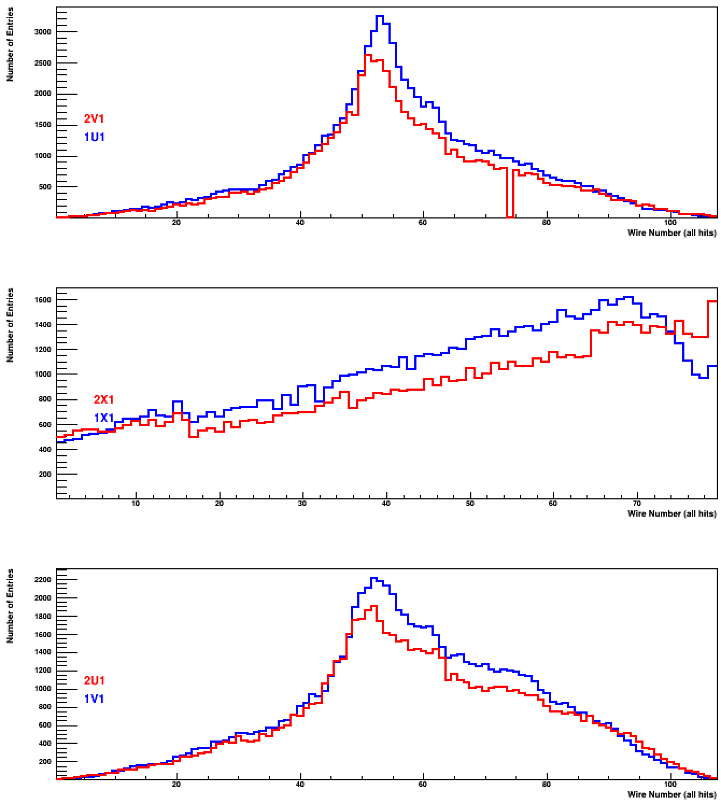
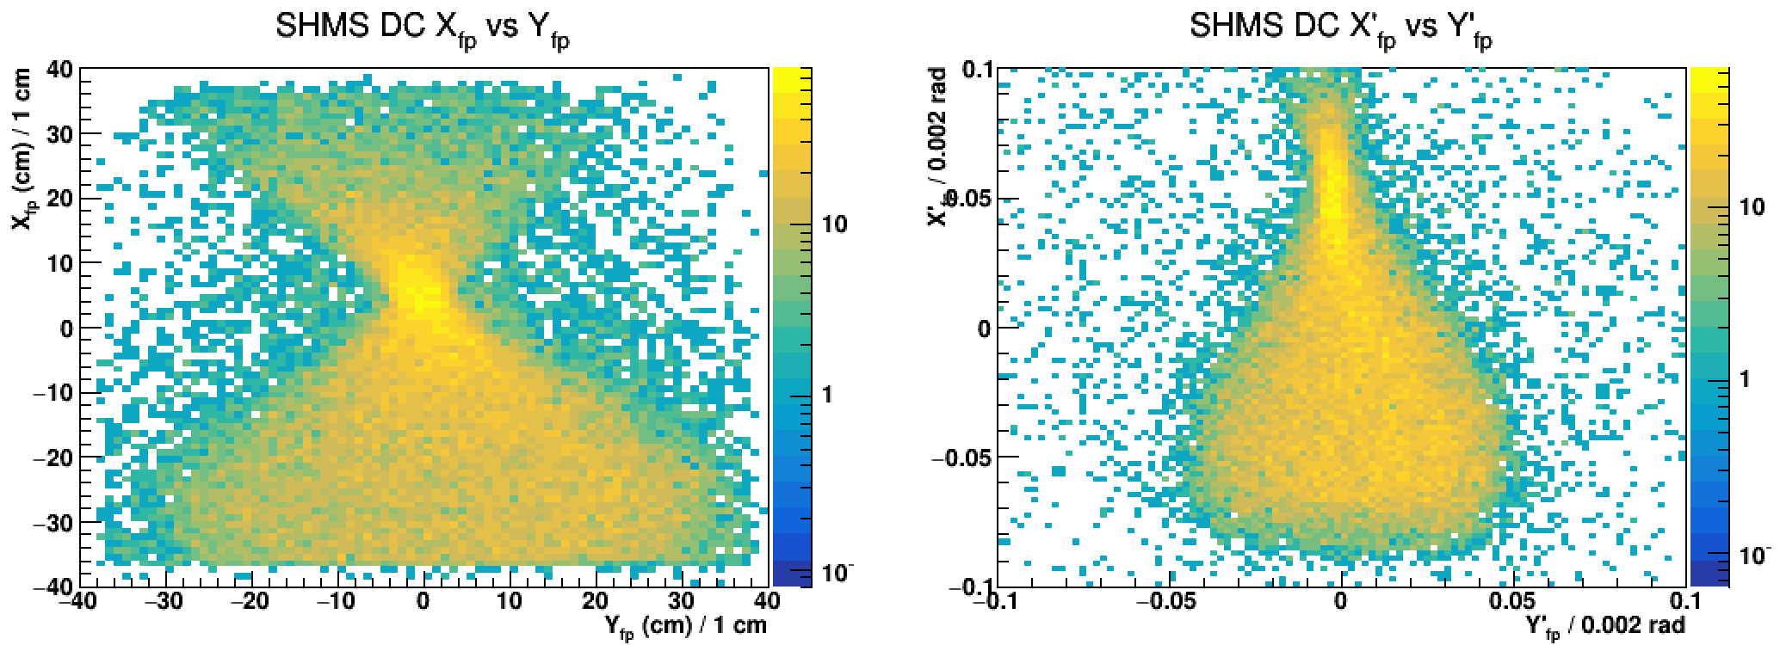
50k Replay Online Monitoring
01/28/2019
Eric Pooser
Hall C Winter Collaboration Meeting

Slide 21
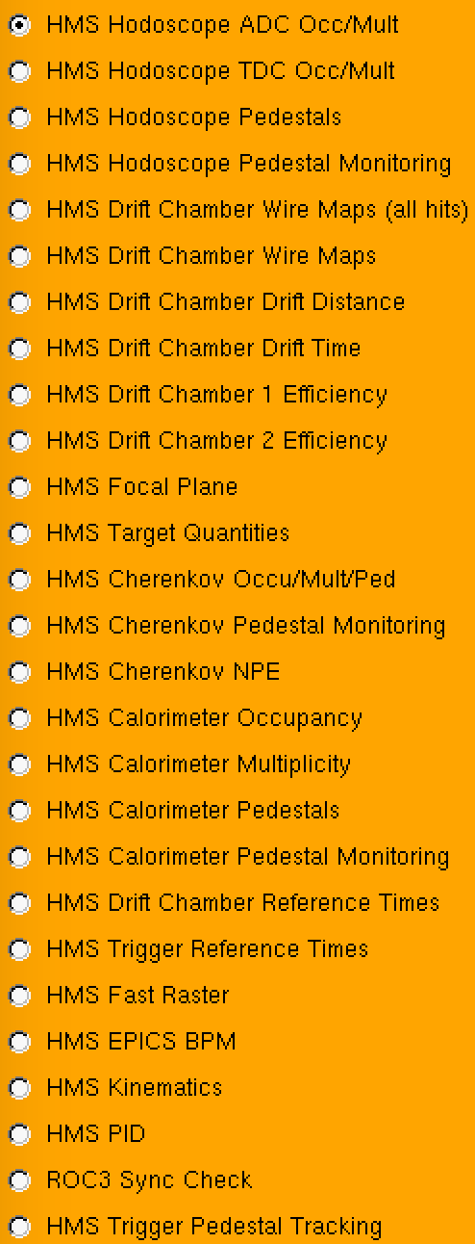
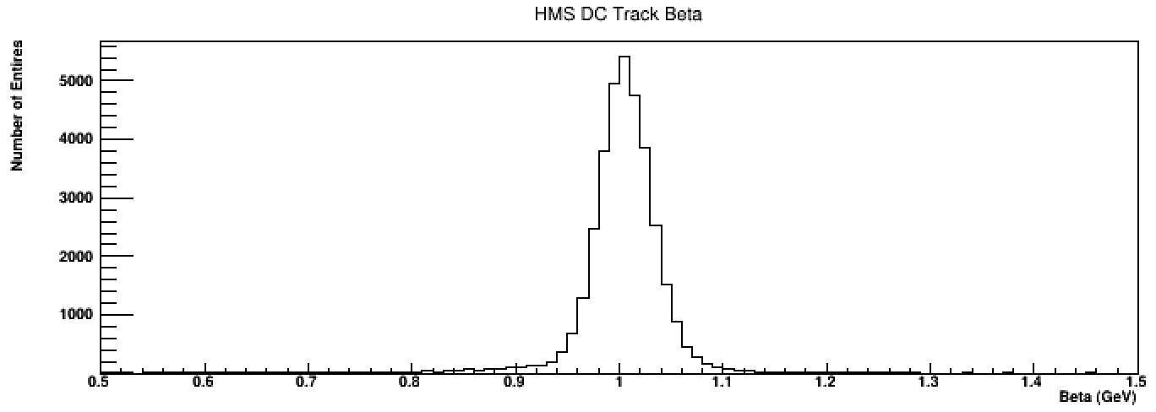
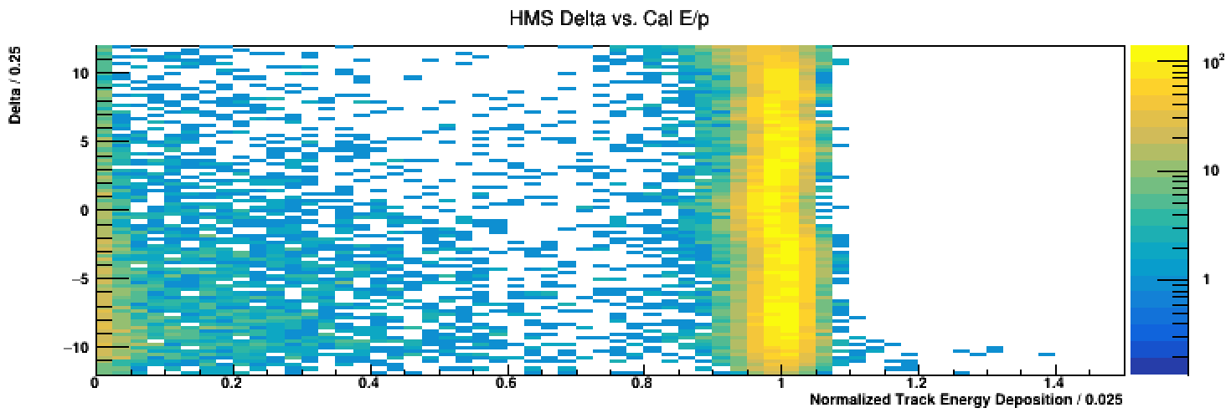
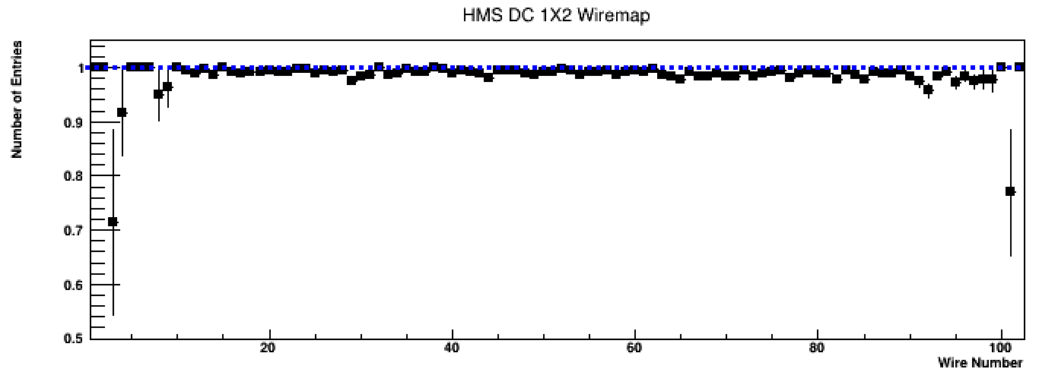
50k Replay Online Monitoring
01/28/2019
Eric Pooser
Hall C Winter Collaboration Meeting

Slide 22
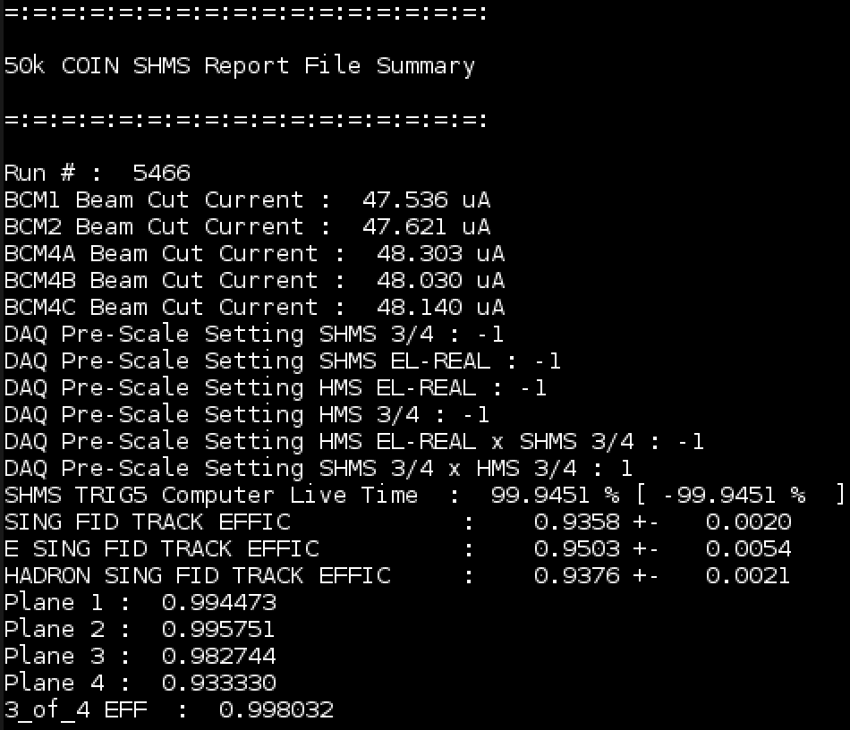
Tools for Online Analysis
Various tools that facilitate online operations live in the UTIL_OL repository
Script to extract the angle camera photos for each run
Script to monitor total accumulated charge in live time
Script to parse relevant report file data to display to shift crew
Shell scripts that handle the 50k replay utilized for detector checkout
'run_(s)hms.sh'
'run_coin_(s)hms.sh'
01/28/2019
Eric Pooser
Hall C Winter Collaboration Meeting

Slide 23
Current Workflow for Online Analysis
Once the 50k detector checkout analysis has concluded, further online analysis is entirely up to the run group
Previous groups have conducted full replays of each run by analyzing both scaler replays (fast) and physics analyses (slow)
Scaler replays for things like accumulated charge, dead time calculations, etc.
Physics replays for 'bean counting' and kinematic checks (t vs. ϕ)
Files corresponding to these analyses MUST live on the RAID disk under an experiment specific directory
e.g. /net/cdaq/cdaql1data/cdaq/jpsizzle/
Directories containing analysis files should symlink to common prefix which points to experiment specific location on the RAID disk
OUTPUT -> net/cdaq/cdaql1data/cdaq/jpsizzle/
ROOTfiles -> OUTPUT/ROOTfiles/
HISTOGRAMS -> OUTPUT/HISOGRAMS/
01/28/2019
Eric Pooser
Hall C Winter Collaboration Meeting

Slide 24
Hall-C Counting House Systems
Individual users can/should create (and work in) their own workspace on cdaql1 e.g. /home/cdaq/user
Quick replays and sanity checks can be performed here
All common file systems on the farm are mounted on the cdaq cluster
/site, /apps, /mss, /cache, /work, /group, …
Large files (CODA, ROOT, etc.) should not be written to /home
When shared file systems fill, many things break!
Analysis not critical to daily operations should be conducted on the farm
Backups on the cdaq cluster are automagically conducted each day
Everything on the cdaq files system (/home) are backed up daily at 2300 hrs
Identical copy of files system is made
No history is saved hence why subversion control via git is so important
/home/cdaq/hallc-online/ is backed up in its entirety with time stamps 12 hours out pf phase with the file system backup
7 days of history is saved however large files are omitted
01/28/2019
Eric Pooser
Hall C Winter Collaboration Meeting

Slide 25
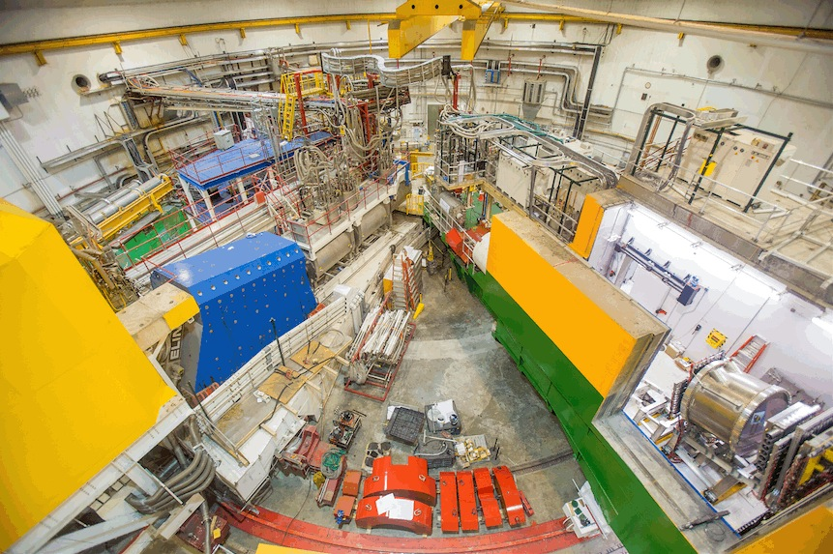
Hall C Winter Collaboration Meeting
Questions?

Slide 26
Backup Slides
01/28/2019
Eric Pooser
Hall C Winter Collaboration Meeting

Slide 27
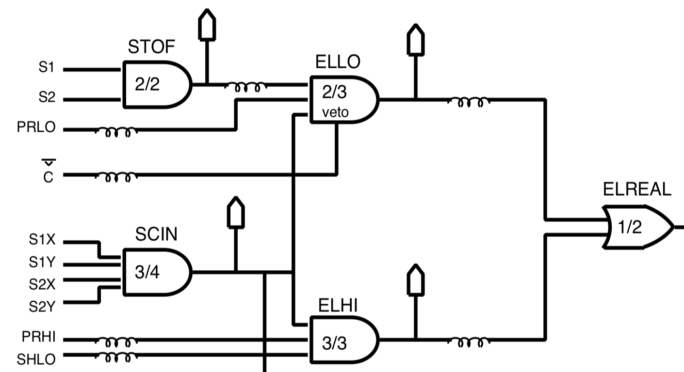
Setting Trigger PID Thresholds
01/28/2019
Eric Pooser
Hall C Winter Collaboration Meeting

Slide 28
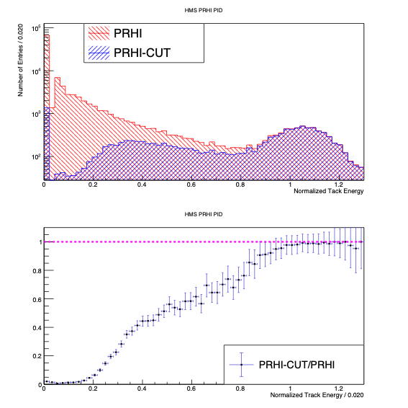
Setting Trigger PID Thresholds
All trigger PID components reside in scalers, TDC’s, and FADC’s (where appropriate)
One can study off-line the effects of imposing hardware discriminator threshold cuts via software cuts
Consider an example for HMS:
E/P in calorimeter
Select pions via Cherenkov
Cut on PRHI TDC channel
Calculate ratio to determine appropriate threshold for pion suppression
01/28/2019
Eric Pooser
Hall C Winter Collaboration Meeting

Slide 29
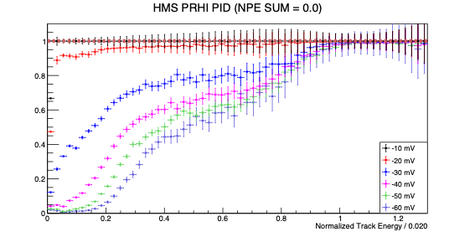
Setting Trigger PID Thresholds
Perform hardware threshold scan of PRHI leg
01/28/2019
Eric Pooser
Hall C Winter Collaboration Meeting

Slide 30
Setting Trigger PID Thresholds
Perform software threshold scan of PRHI leg
01/28/2019
Eric Pooser
Hall C Winter Collaboration Meeting

