Slide 1
Magnetic fields and gradients at the ³He target
March 19, 2018
Presentation: Gordon Cates
Tosca modeling: Steve Lassiter
Gradient calculations: Vladimir Nelyubin

Slide 2
Addressing magnetic-field issues for the target.
Steve Lassiter is developing a Tosca model for the Hall C A1n experiment. In addition to supplying summaries of field directions to the collaboration, he is also supplying field maps to Vladimir Nelyubin for further calculations.
Vladimir Nelyubin is using packages he has developed in connection with the Hall A GEn experiments that allow us to obtain maps of the relevant magnetic field gradient components for both static conditions and NMR measurements.
We present the implications of the gradients for specific cases, as well as making a few comments for future optimization.

Slide 3
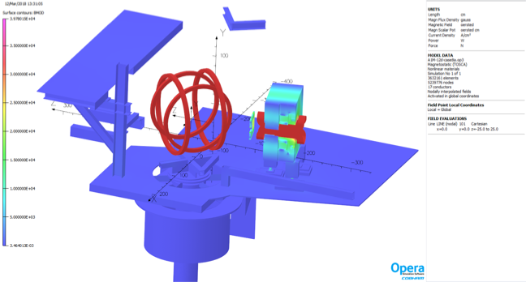
Components in Steve’s Tosca Model
(not shown here is the HB correction coil)

Slide 4
Field components along beam line
(without HB correction coil)
Field is reasonably constant even in the absence of any correction coils, nevertheless….
It is important to evaluate certain combinations of the (nine component) gradient tensor to insure target performance.

Slide 5
Spin relaxation due to magnetic field inhomogeneities under static conditions
High polarization requires limiting spin-relaxation due to all mechanisms well below the spin-exchange rate.
Spin relaxation due to magnetic field inhomogeneities under static conditions (that is, not during polarimetry measurements) is due to specific components of the magnetic field inhomogeneities, as described below.
Here 1/T1 is the spin relaxation rate, D is the self-diffusion coefficient of ³He, and the magnetic field is assumed to be in the z-direction.
For simplicity, we will assume that a ³He density of 10 atm STP. Under this assumption, D = 0.2 cm²/s. For example:
A good cell, in the absence of beam, might have an intrinsic value of 1/T1 = 1/40 hrs. Thus, a value of 10⁻⁵ cm⁻² would certainly impact performance, but would not be the dominant factor. At a value of 10⁻⁶ cm⁻², the effects of the inhomogeneities are insignificant.

Slide 6
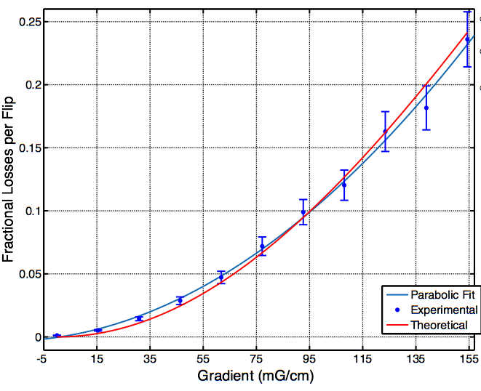
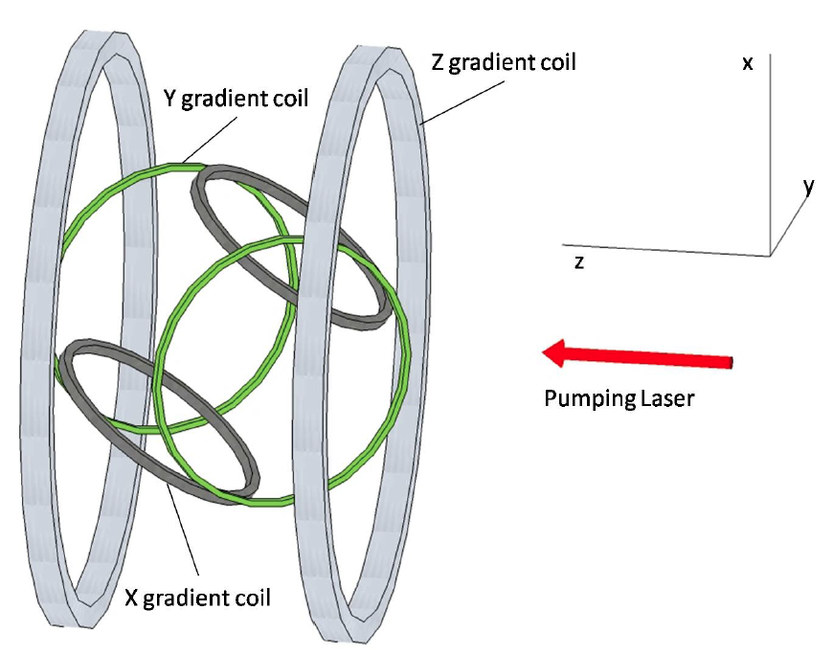
Spin relaxation during NMR AFP
(used during polarimetry)
During an “AFP sweep”, all spins in the target are flipped by 180 degrees. The key issue here is the fractional loss of polarization per flip.
Good agreement between theory and measured losses.
Coils used for test
For a value of 10⁻² G²/cm², the loss would be 5%, which would be an extreme, possibly livable, condition.

Slide 7
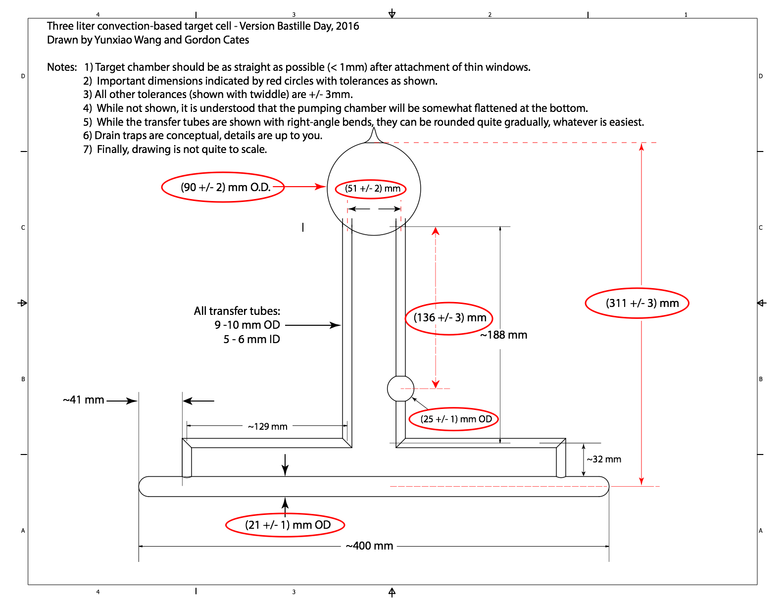
Design of the Hall C convection target
Note that the pumping chamber extends from roughly 22.1cm to 31.1 cm above the center of the target chamber.

Slide 8
Tosca models evaluated for gradients
As a first step, a simplified magnetic model was prepared in which separate files for each of the HB magnet, the Helmholtz coils and the compensation coils were generated and subsequently combined to provide an approximate field map.
Gradients in the simplified model where generally fairly acceptable.
A full Tosca solution (at least containing the most important elements) is now being developed.
In what follows, we evaluate gradients for the configuration in which the Helmholtz Coils are at 45 degrees, and the field is along the longitudinal direction.
The effects of the iron in Hall C are seen to be significant but livable. Some optimization of the compensation coils is desirable.

Slide 9
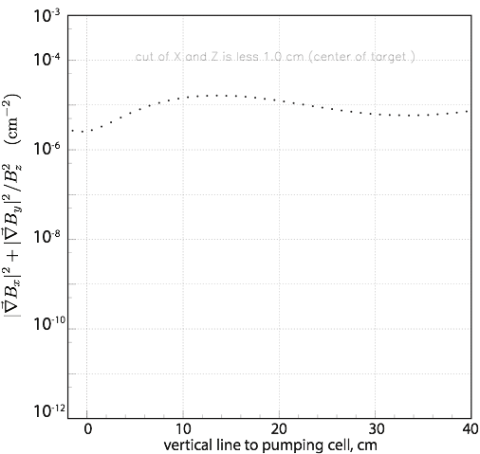
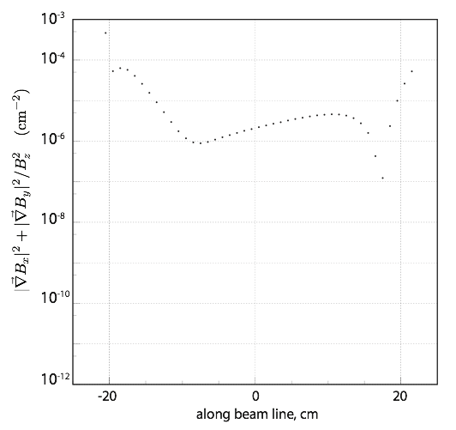
Gradients relevant to static conditions
The dashed green line shows the gradient at which the relaxation rate is 1/139hrs.
The gradients for this configuration are seen to be marginally okay for static conditions. Some optimizing on the compensation coil design would be useful. Note: most of the gas is in the pumping chamber between 22 - 31 cm.

Slide 10
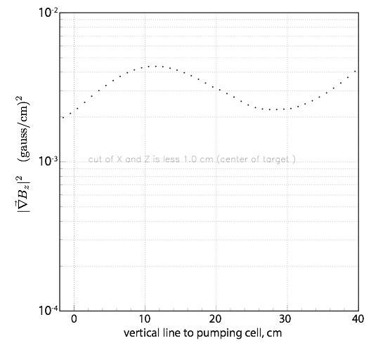
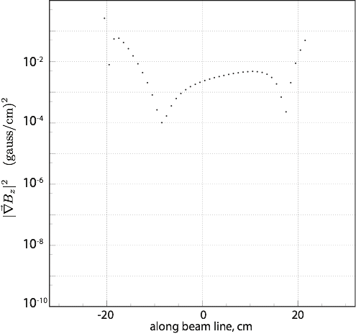
Gradients relevant to AFP sweeps
The dashed green line shows the gradient at which losses are 0.5%.
The gradients for this configuration are seen to result in 1-2% losses in the pumping chamber, and over 5% for parts of the pumping chamber. Again, some optimizing of the compensation coil(s) is desirable.

Slide 11
Summary
The new (to the polarized 3He target) magnetic-field environment in Hall C is seen to be challenging, but livable.
Magnetic-field studies with the existing compensation-coil design will yield only somewhat-compromised performance under static conditions, but marginal performance under certain polarimetry conditions.
We note finally that we have not addressed conditions for pulsed NMR, but because such measurements are localized to one part of the target, it is fairly trivial (and standard practice) to use shim coils if necessary.
The basic design of the magnetics for the polarized 3He target are sound, but we anticipate additional studies to optimize the compensation coils.

