Slide 1
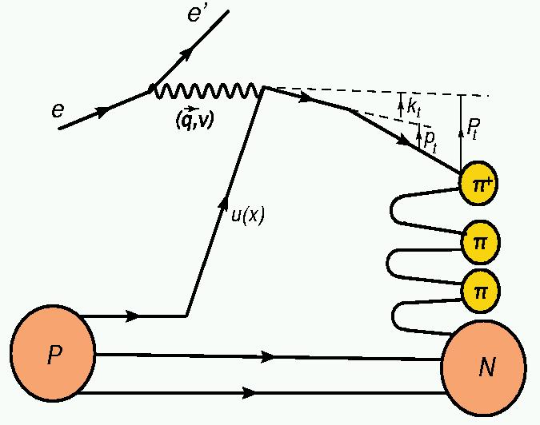
Transverse Momentum Dependence of Semi-Inclusive Pion and Kaon Production
E12-09-017: Spokespersons Peter Bosted, Rolf Ent, Ed Kinney, Hamlet Mkrtchyan
25.5 days at 11.0 GeV & 6.5 days at 8.8 GeV = 32 days total
Not much is known about the orbital motion of partons
Significant net orbital angular momentum of valence quarks implies significant transverse momentum of quarks
Final transverse momentum of the detected pion P_{T} arises from convolution of the struck quark transverse momentum k_{t} with the transverse momentum generated during the fragmentation p_{t}.
P_{T} = p_{t} + z k_{t} + O(k_{t}²/Q²)
Goal: Map the P_{T} dependence (P_{T} ~ Λ < 0.5 GeV) of π⁺ and π⁻ production off proton and deuteron targets to study⁽*⁾ the k_{T} dependence of (unpolarized) up and down quarks
⁽*⁾ Can only be done using spectrometer setup capable of %-type measurements (an essential ingredient of the global SIDIS program!)

Slide 2
Semi-Inclusive Deep-Inelastic Scattering
Use advantages of multi-hall approach!
Hall B: Large acceptance (CLAS12), polarized H and D targets
→ azimuthal distributions of final-state particles
→ cross sections, single & double-spin asymmetries
→ start kaon SIDIS program with RICH detector
Hall A: Large acceptance in forward region (SoLID), polarized 3He target
→ longitudinal & transversely polarized 3He
→ pion & kaon run with BigBite and SBS
→ Access to n structure at high-x and high-Q²
Hall C: Precision magnetic-spectrometer setup, π and K, high luminosity
→ L/T separations in SIDIS
→ precision cross sections and ratios of π⁺ and π⁻ (and K⁺, K⁻)
PAC37: “… the cross sections are such basic tests of the understanding of SIDIS at 11 GeV kinematics that they will play a critical role in establishing the entire SIDIS program of studying the partonic structure of the nucleon. In particular they complement the CLAS12 measurements in areas where the precision of spectrometer experiments is essential, being able to separate P_{T} and φ-dependence for small P_{T}. The PAC strongly recommends that these measurements occur in the early years of 12 GeV operation.”

Slide 3
E12-09-017 Kinematics & Requirements
Map of P_{T} dependence in x and z, and in Q² to determine (p_{T}/Q) and (p_{T}²/Q²) behavior
In all cases:
10 cm LH2 & LD2
Typ. 50 μA
π⁺ (K⁺) & π⁻ (K⁻)
Order | Kin | E | x | Q² (GeV²) | z | P_{π} (GeV) | Θ_{π} (deg) | Days
1 | II | 11.0 | 0.3 | 3.0 | 0.3-0.65 | 1.7 – 3.3 | 8.0 – 23.0 | 5.8
2 | VI | 11.0 | 0.3 | 4.5 | 0.3 -0.65 | 1.7 – 3.4 | 5.5 – 25.5 | 4.0
3 | IV | 11.0 | 0.5 | 5.0 | 0.3 -0.65 | 1.7 – 3.4 | 5.5 – 25.5 | 5.3
4 | V | 8.8 | 0.3 | 1.8 | 0.3 -0.65 | 1.7 – 3.5 | 8.0 – 28.0 | 6.9
5 | III | 11.0 | 0.4 | 4.0 | 0.3 -0.65 | 1.1 – 2.1 | 8.0 – 30.5 | 5.3
6 | I | 11.0 | 0.2 | 2.0 | 0.3 -0.65 | 2.5 – 5.0 | 5.5 – 20.5 | 4.5
Kinematics I and III are considered phase-II and were moved after E12-09-011
Spin-offs: Radiative correction modeling for (e,e’π)
Single-spin asymmetries at low p_{T} (< 0.2 GeV)
Low-energy (x,z) factorization for kaons⁽*⁾
Simultaneous accumulation, with about factor of three less statistics, of charged-kaon data using aerogel detector system constructed with support of NSF/MRI funds (CUA, USC, MSU & FIU, with ANSL and JLab)

Slide 4
E12-09-017 Collaboration
ANSL/Yerevan, Catholic, Colorado, Duke, Hampton, JLab, James Madison, Mississippi State, NC A&T, Regina, Virginia, William & Mary, Xavier
Includes all the institutions who built the new SHMS detectors
Collaboration extended with ANL, CMU, CNU, FIU, NSU, VUU
Approved for 32 PAC days, or 64 calendar days, or 192 shifts
Split in phase-I (22 days – before E12-09-002 & E12-09-011) and phase-II (10 days)
About 60+ collaborators → at most 10 shifts per person
Will work with E12-09-002 and E12-09-011 as one experiment
Expect 3-4 Ph.D. students
W&M – likely
ANSL – albeit dependent on visa situation
CMU - inquiry for possible Ph.D. student
Colorado - TBD
Expect one of the Hall C postdocs to be heavily involved

Slide 5
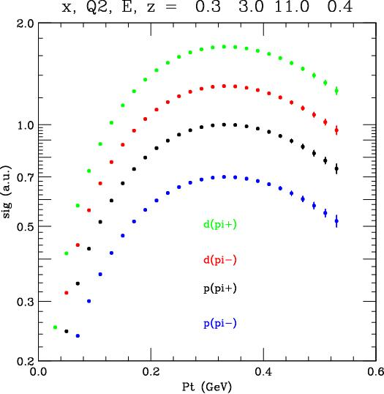
E12-09-017 Analysis Readiness
Builds on expertise gained with E00-108 in 6-GeV era: Duality in Meson Electroproduction
This was the first approved semi-inclusive DIS proposal @ JLab, and laid the foundation for an explosion of SIDIS experiments
Results were published in
- Nucl. Instrum. Meth. A458 (2005) 364 (HMS aerogel)
- Phys. Rev. Lett. 98 (2007) 022001 (duality)
- Phys. Lett. B665 (2008) 20 (p_{T} dependence)
- Phys. Rev. C 85 (2012) 015202 (cross sections and ratios)
x = 0.32
z = 0.55
Example
(Kinematics II, z = 0.4 bin only)
<p_{t}²> (favored)
Cross Section (a.u.)
<k_{t}²> (up)

