Slide 1
Q2Q3D Specifications, Requirements and Scope
Paul Brindza

Slide 2
Q2Q3D Outline
Q2Q3 and Dipole Specifications
Q2Q3D Status
Q2Q3 and Dipole Contracts
Scope of Work JLAB
Scope of Work SigmaPhi
Contract Reviews
Contract Documentation

Slide 3
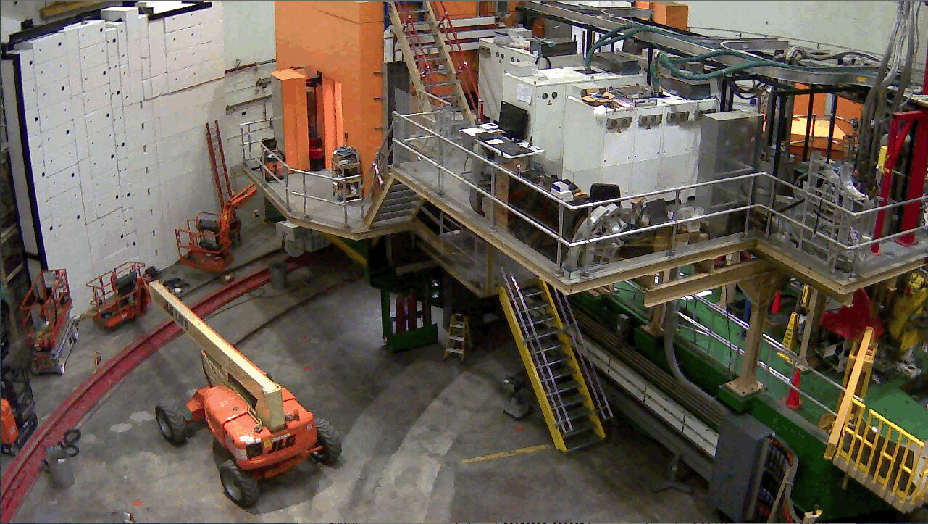
SHMS 11 GeV/c Spectrometer Hall C- June 2016
New companion to the 25 Year old HMS 7.4 GeV/c spectrometer
11 GeV/c
5 x 10^-4 dP/P resolution
4 mStr. Acceptance
5.5 to 40 degrees
Momentum bite 20%

Slide 4
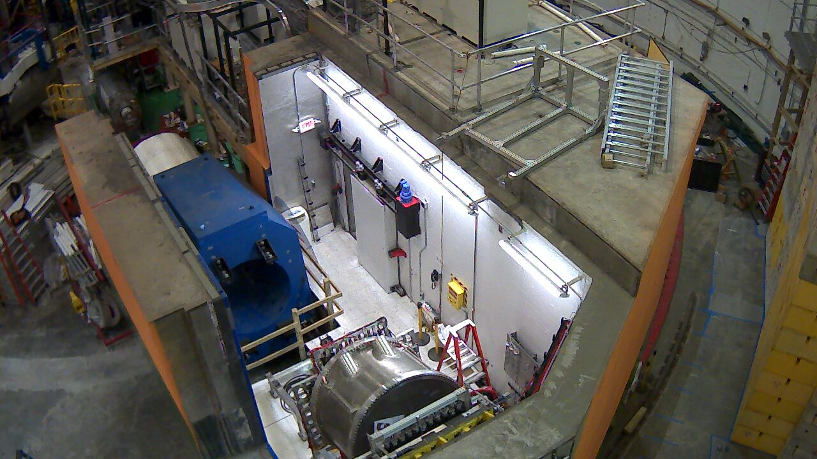
SHMS Spectrometer- June 2016 detectors and magnet yokes

Slide 5
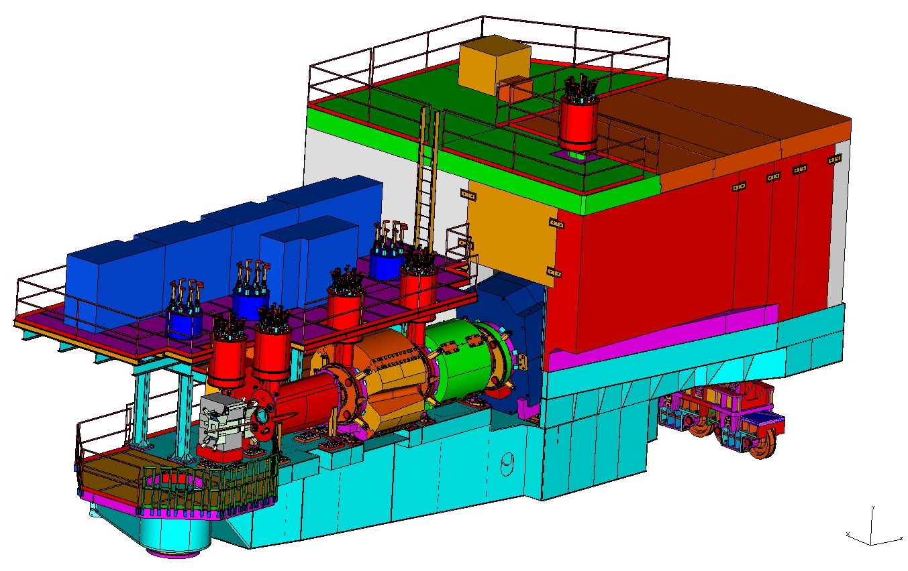
SHMS Magnets and Systems
Cryo-Control Reservoirs
Cryogenics Infrastructure
Cryo-Control Reservoirs
Cryogenics Infrastructure
Power Supplies & Controls
D
Q3
Q2
Q1
HB
This talk:
Q2, Q3 & Dipole
Vendor = Sigma Phi
1 x 10⁻³ dP/P Resolution
4 mSr Acceptance
1 to 11 GeV/c
Warm Yoke steel
Magnet Supports

Slide 6
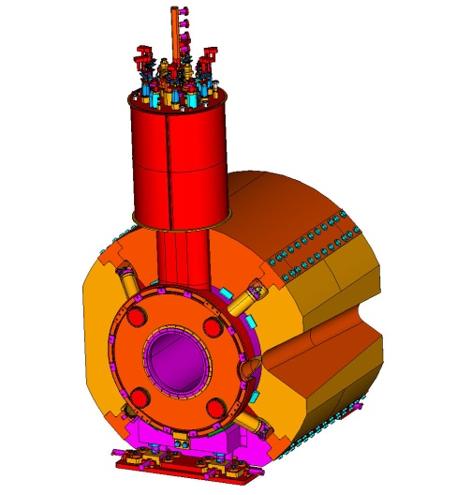
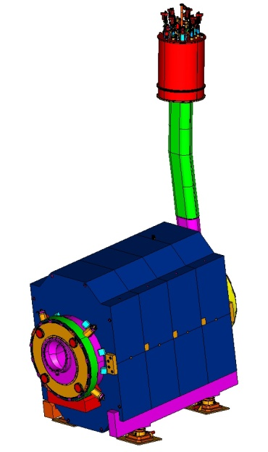
SHMS Dipole/Q2/Q3
Q2 (shown):
11.8 T/m cos(2Θ) Quad
Bath Cooled
1.2 Atm., 4.42K
60 cm. warm bore
1.64 m EFL
7.6 MJ stored Energy
Warm Iron Yoke: 72 Tons
Q3:
Identical to Q2 but runs at 7.9 T/m
Warm Iron Yoke: 18 Tons
Both use same conductor as dipole (Cu + SSC outer)
DIPOLE:
3.86 Tesla Cosine(Θ) dipole
Bath Cooled 1.2 Atm, 4.42K
60 cm warm bore
2.85 m EFL
11.2 Tm Integral B.dL
17 MJ stored Energy
11 GeV/c
Warm Iron Yoke: 126 Tons
Dipole field joint

Slide 7
SHMS Dipole Q2/Q3 Specifications @ 11 GeV/c
 | Q2 | Q3 | Dipole
Type | Cos 2θ | Cos 2θ | Cos θ
Field/grad | 11.8 T/M | 7.9 T/M | 3.9 T
EFL | 1.64 M | 1.64 M | 2.85 M
Energy | 7.6 MJ | 3.5 MJ | 17 MJ
Inductance | 1.14 H | 1.14 H | 2.86 H
Current | 3660 A | 2480 A | 3450 A
NI | 6.3 MAT | 4.2 MAT | 4.2 MAT
aperture | 60 cm Φ | 60 cm Φ | 60 cm Φ
Dump Volts | 270 V | 180 V | 240 V
Dump R | 0.075 Ω ( 50 msec delay) | 0.075 Ω ( 50 msec delay) | 0.075 Ω ( 50 msec delay)
Conductor Soldered cable in channel | 0.3x1.9 cm^2+ SSC outer | 0.3x1.9 cm^2+ SSC outer | 0.3x1.9 cm^2+ SSC outer
AHS Temp | 45 K ( 1.02E8 miits) | 34 K (4.8 E7 miits) | 70 K ( 2.3 E8 miits)

Slide 8
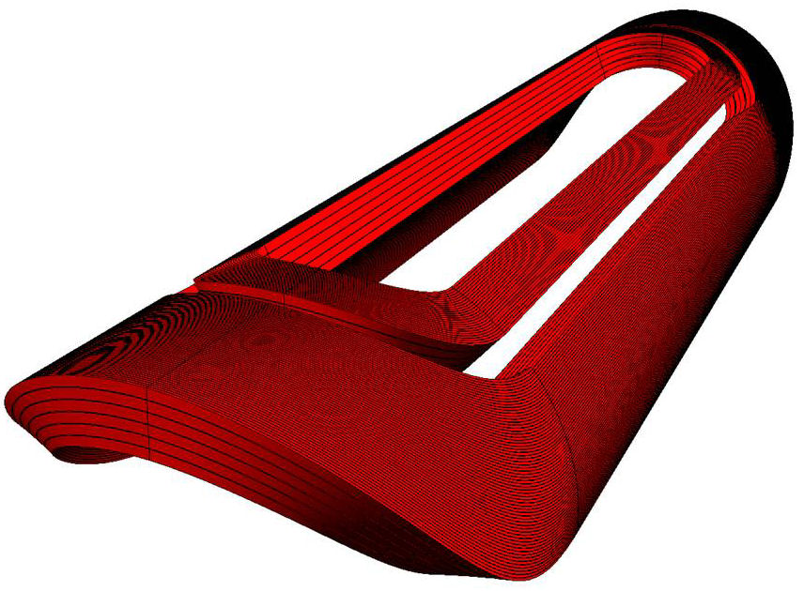
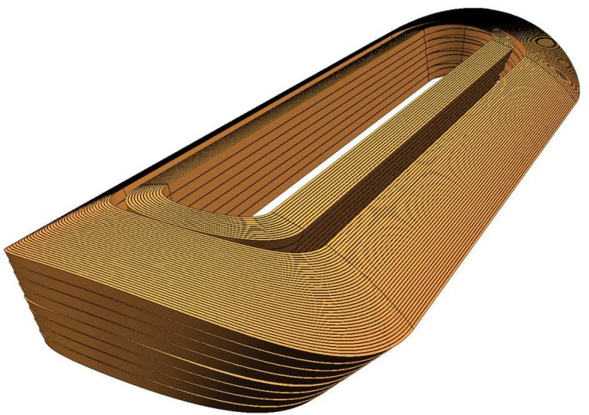
SHMS Dipole and Quad Magnet Coils
SHMS Quad 2/3
8 Layer, 4 Dbl. Pancake
2 sector Cos. 2 Theta coil
Constant Perimeter ends
427 Turns/pole
SHMS Dipole
6 Layer, 3 Dbl. Pancake
2 sector Cos. Theta coil
Constant Perimeter ends
606 Turns/pole

Slide 9
Q2Q3D Interface Specifications
JLAB Specified and provided the interface for:
  Cryogenics- Cryo Control Reservoir
  DC Power Supply- Danfysik ( 6 V, 4000 Amps)
  QD/QP- DF quench detector and energy dump
  Controls – Hall C PLC
  External Instrumentation- Pressure, LL, Vac, lead flow
  Internal sensors- detailed spec and wiring in Tech Spec
  Magnet operating conditions- 4.4 K 1.2 Bar

Slide 10
ASME, Pressure, Leak, VCL and Cryo Spec’s
ASME BPV Section VIII design, fab, test, material certs, welders certs and documentation required- No U Stamp
Pressure Max HE 75 PSIG, Max LN2 75 PSIG
Pressure test – 90 PSIG He & LN2
Leak Test Spec- none at 1 x 10^-9 Atm cc/sec
Cryogenic QHe < 40 W, QN2 < 100 W
VCL 5 KA burnout resistant (1.8 LL/Hr/KA, 80mV)
VCL TESTED conduction limit ~ 3700 A > Q2Q3D Iop

Slide 11
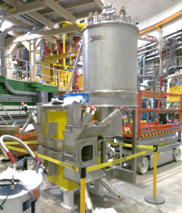
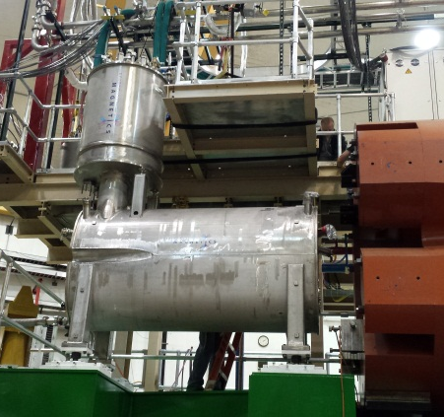
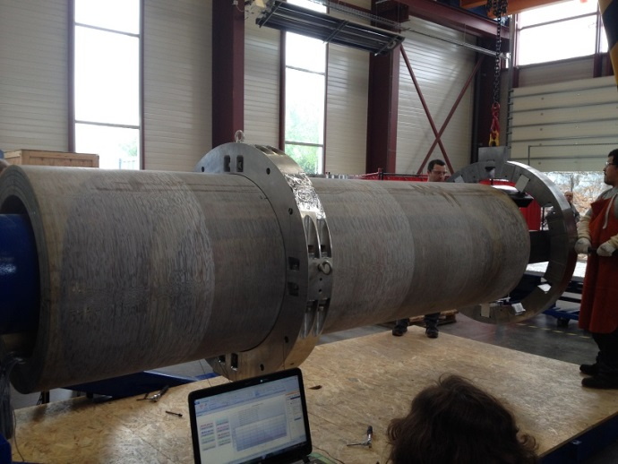
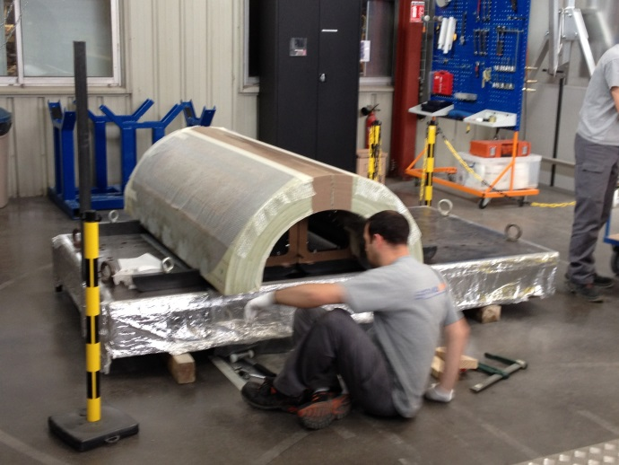
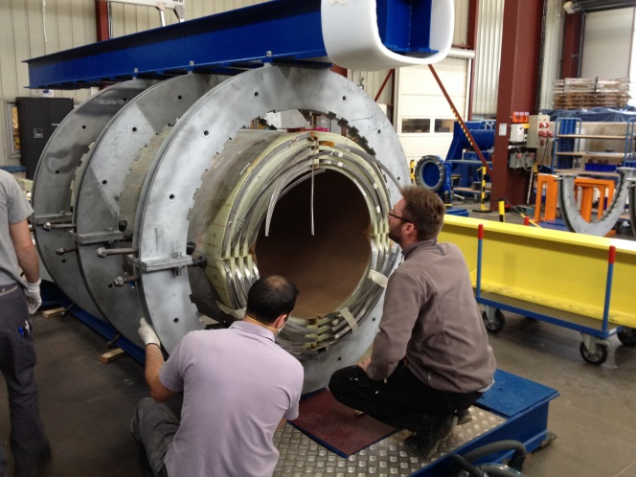
Hall C SHMS Magnets a Year Ago – June 2015
HB @ JLab
(MSU/FRIB)
Q1 @ JLab
(SMI, UK)
Dipole Trial Collaring
(Sigma Phi, France)
Q3 coil assembly
(Sigma Phi, France)
Q2 splicing
(Sigma Phi, France)

Slide 12
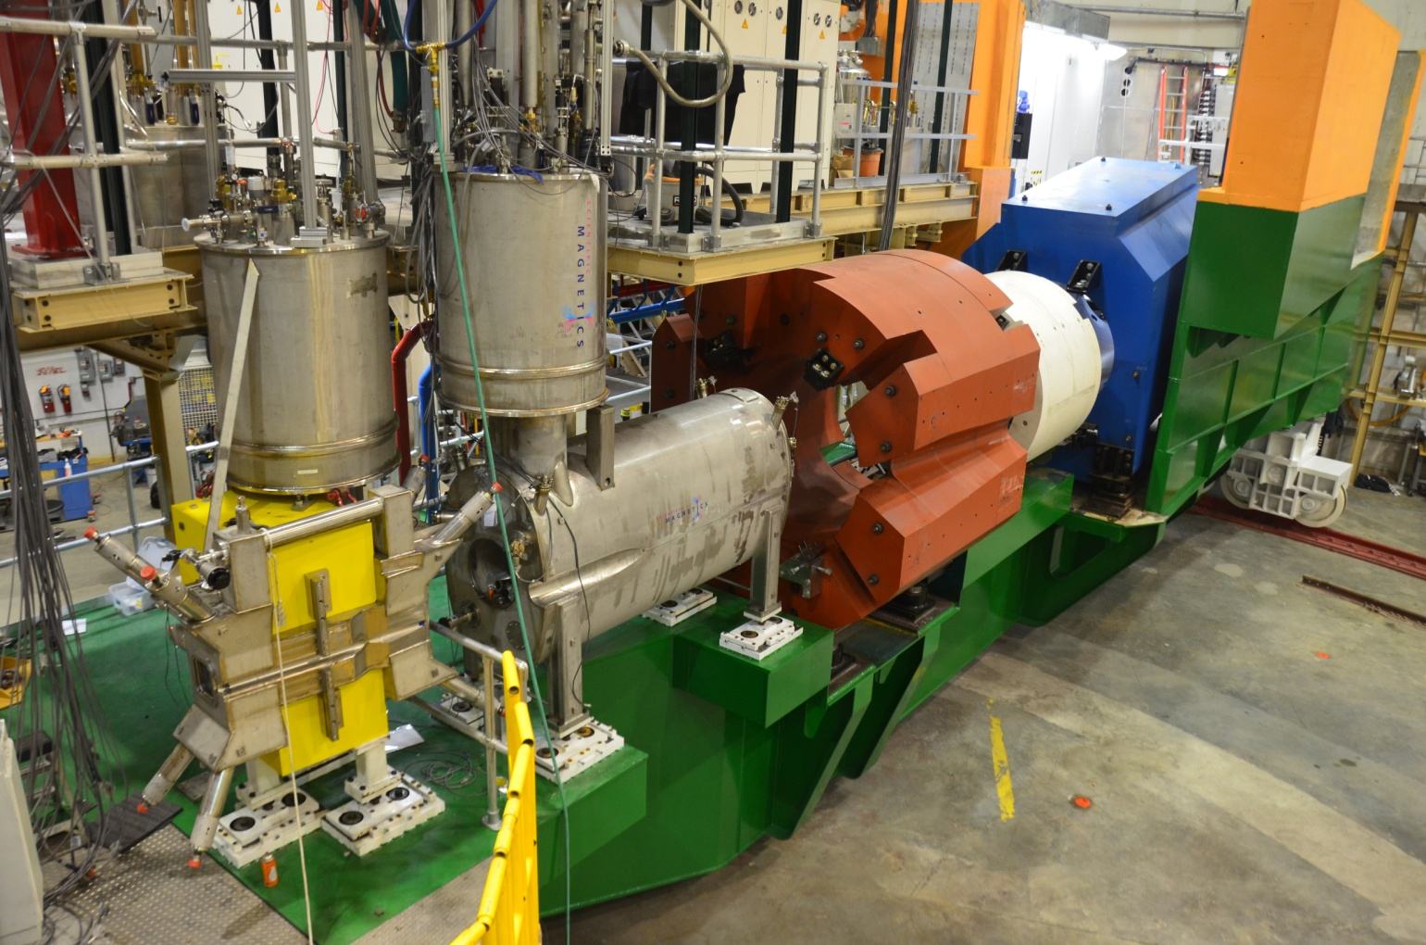
SHMS Q1 and HB Status
Q1:
  Installed on SHMS
  Cooled down
  Power test to 3000 Amps or 110% of operational current
  Accepted 2015
HB:
  Installed on SHMS
  Cooled down
  Power test to 4000 Amps or 102% of operational current
  Accepted 2016

Slide 13
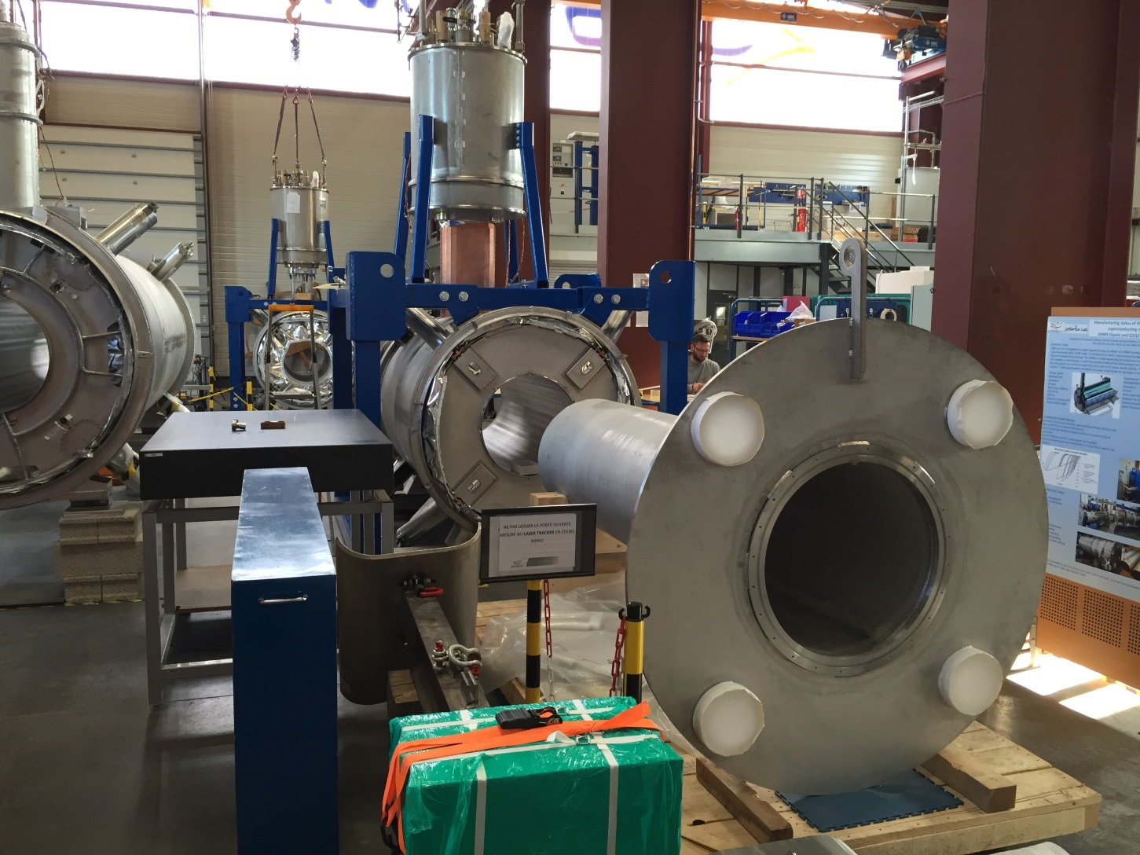
Dipole , Q2 & Q3 April 2016

Slide 14
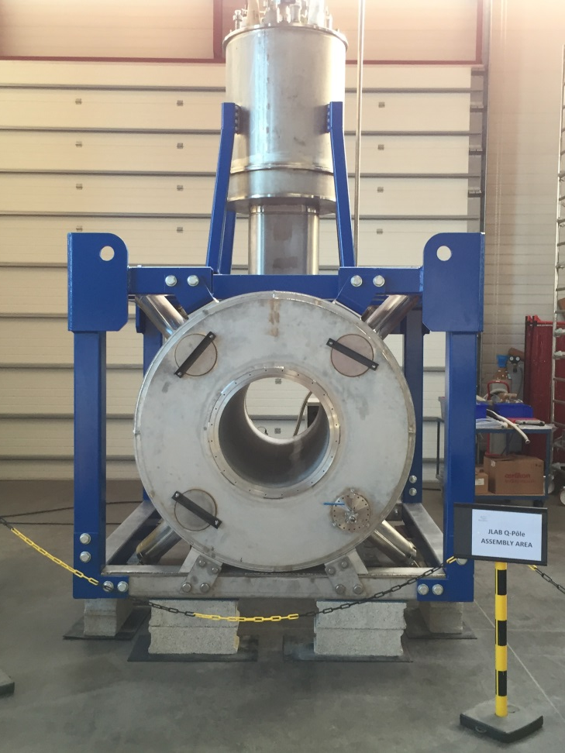
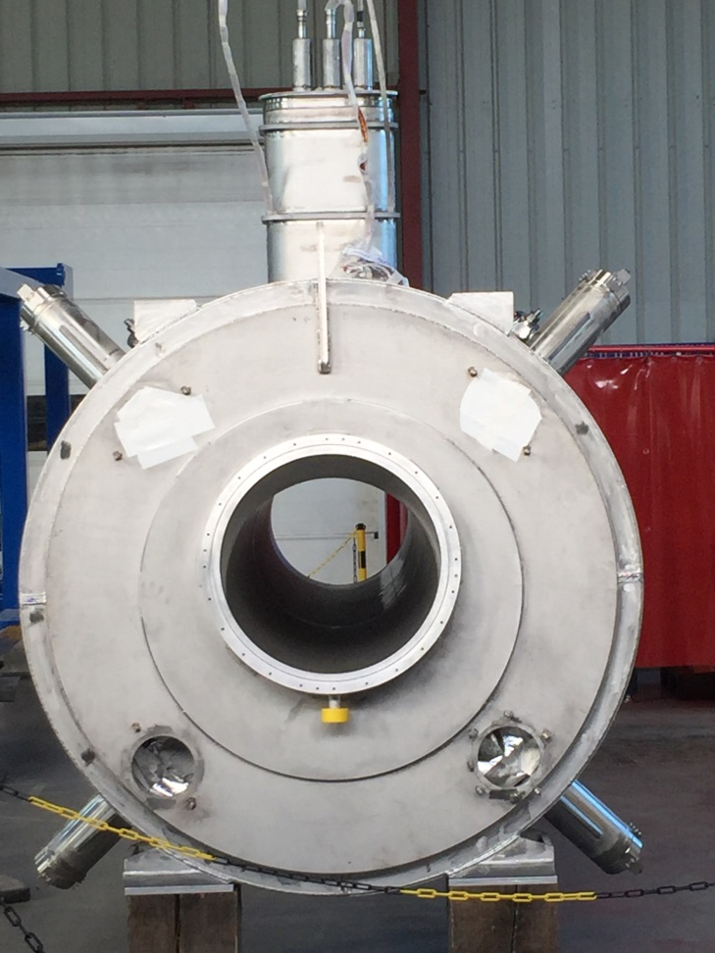
Q3 & Dipole June 2016

Slide 15
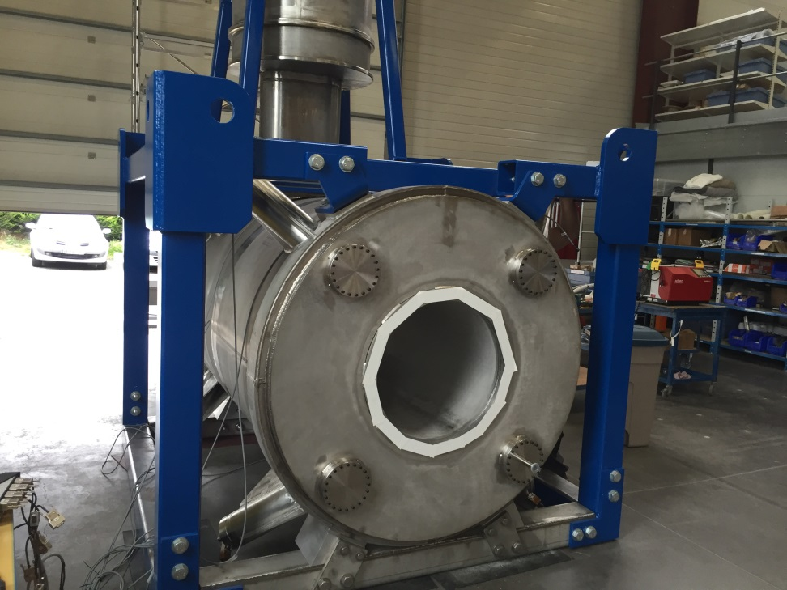
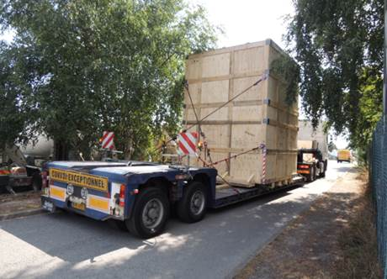
Q2 July & August 2016

Slide 16
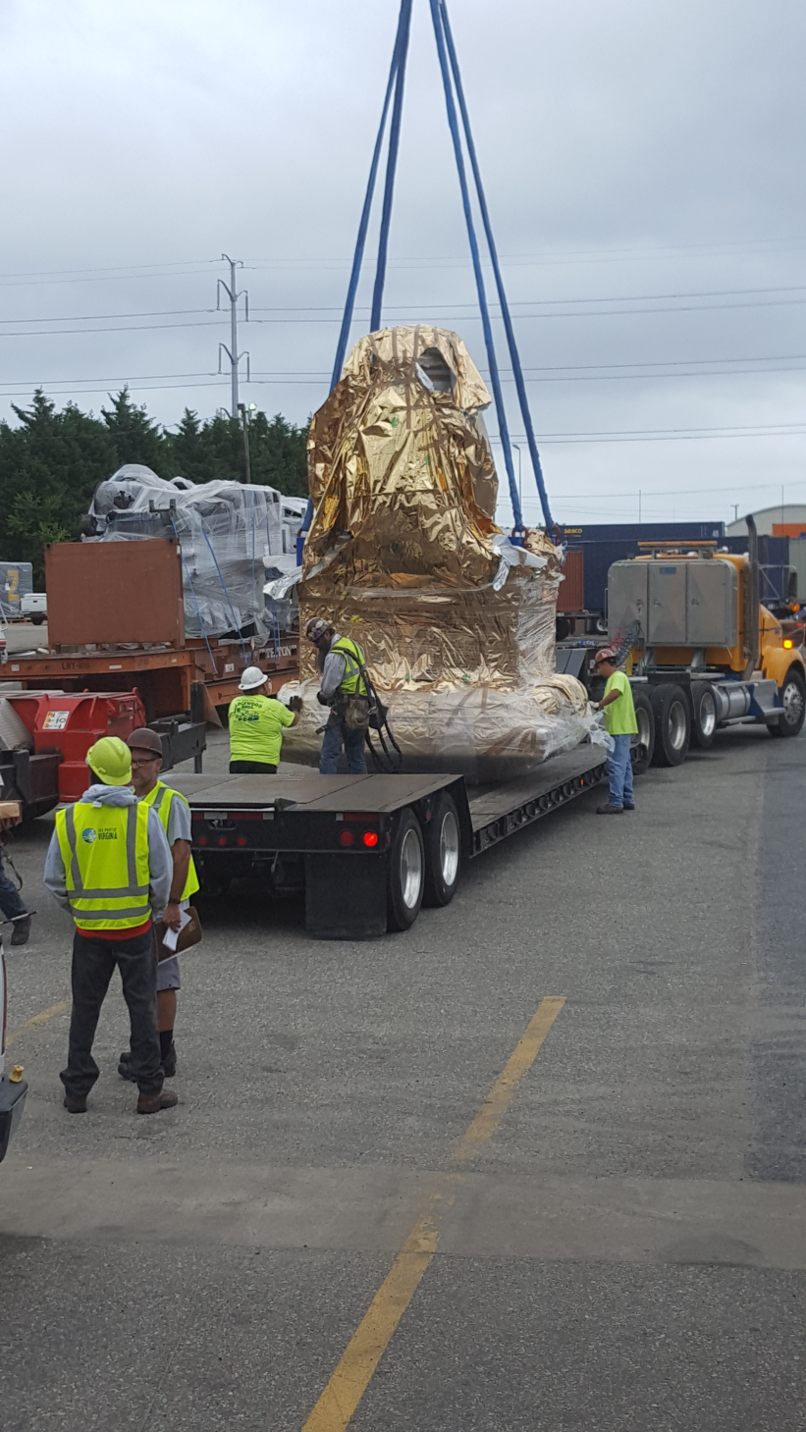
Q2 has landed! Norfolk VA 10/5/16

Slide 17
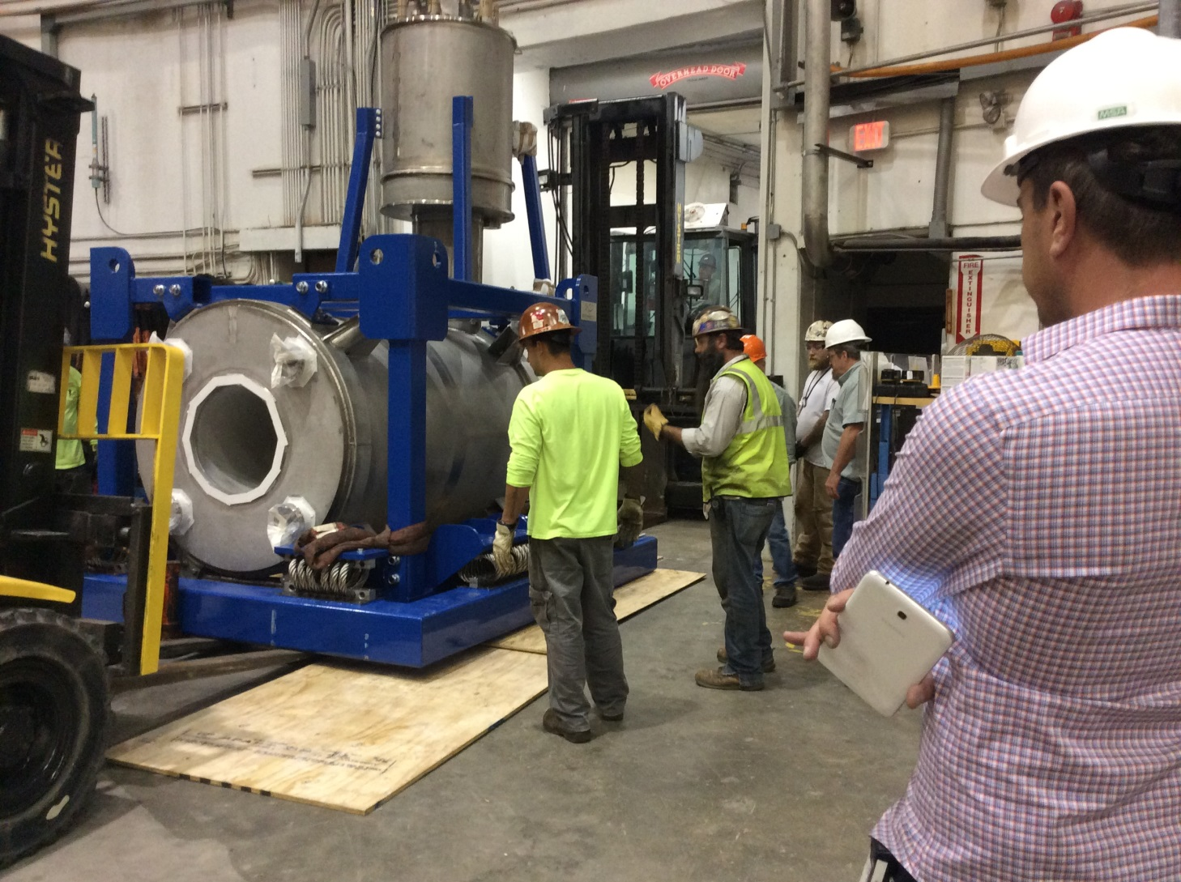
Q2 in JLAB Hall C 10/8/16

Slide 18
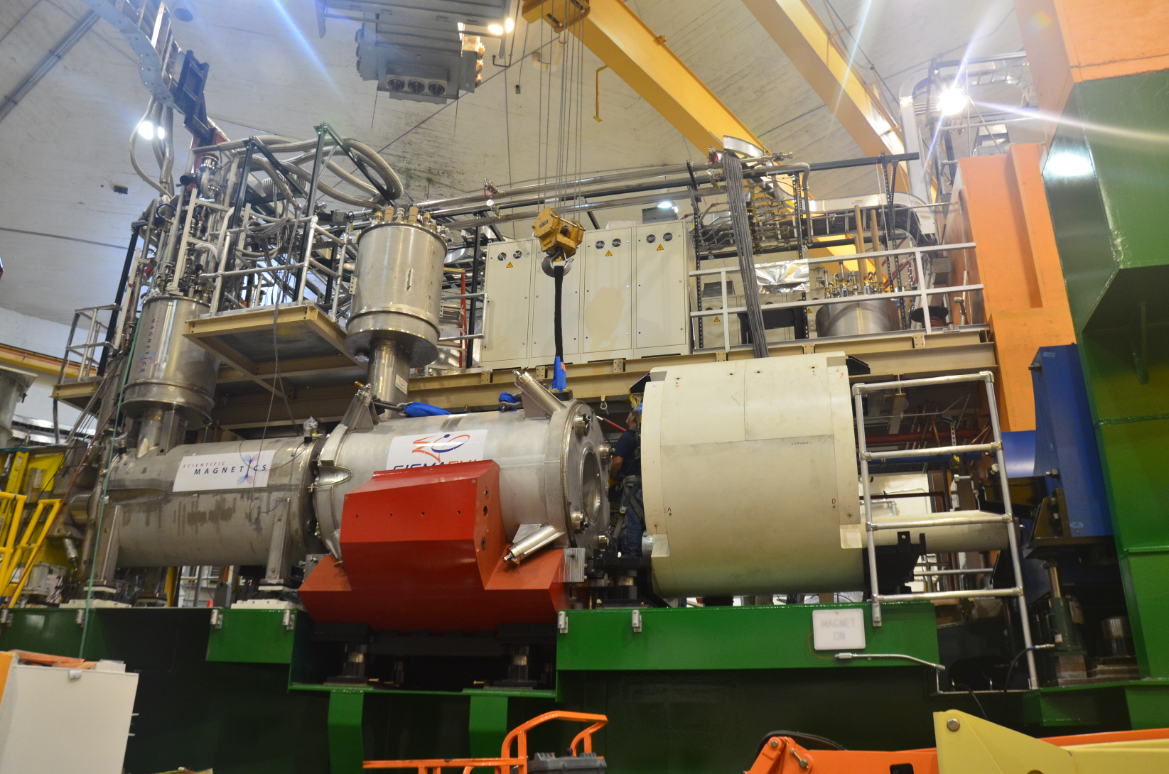
Q2 Mounted on the SHMS 10/9/16

Slide 19
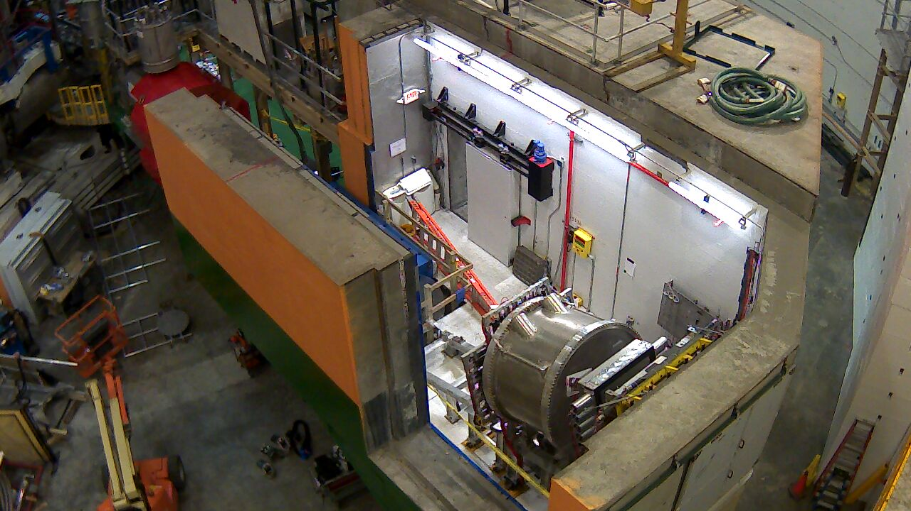
SHMS October 11, 2016
Q2 Installed with yoke

Slide 20
Q2Q3Dipole Status
Q2 is in JLAB Hall C installed on SHMS and under vacuum- Yoke and Platform assembly underway
Dipole is in Antwerp waiting for its ship- ETA Virginia is 10/28/16
Q3 is complete, leak tested and final welding underway – shipping date is 10/31/16
Documentation
  FDR Drawings, analysis, reports- Complete
  Dipole manufacturing Doc. ~ 90 % complete
  Q2Q3 manufacturing Doc.~ 80 % complete

Slide 21
Q2Q3 and Dipole Contracts
Two Fixed price Design Build Contracts placed with SigmaPhi as a result of a competitive “Best Vaaue” award process- world bidders list- Buy America Act
Bid documents included a JLAB Reference Conceptual Design(RCD) for both magnets including CAD models, TOSCA models, FEA, models, drawings, reports, test results
Dipole Contract awarded Aug 2010
Q2Q3 Contract awarded Oct 2010

Slide 22
Q2Q3Dipole Contracts
Q2Q3D were 4 year contracts now about 6 years
Q2Q3D fixed price contracts ~ 20% delta
  Extra scope items- consolidation and tests
  Productivity investments- extra tooling and shifts
  Storage of JLAB excess conductor and tooling
  Negotiated costs for extra work and problems

Slide 23
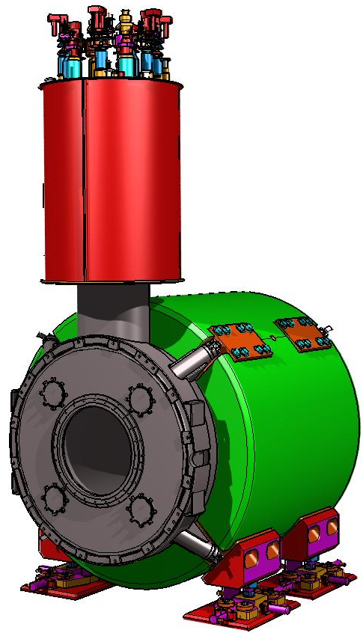
SHMS SC Magnet System Plan
DC Power System
Danfysik- Complete
Magnet Control System JLAB
Complete
Cryogenic Control
Reservoir
Meyer Tool
Complete
Ship to JLAB
HB, Q1, Q2 Complete
Dipole on the way
Q3 ETA 11/30/16
On Site assembly & Integration by JLAB
HBQ1 Complete
Q2 underway
Acceptance Testing at JLAB on SHMS
Q1,HB accepted
Q2Q3D TBD
Fixed Price Procurements
Q1 awarded SMI
HB awarded MSU
DQ2Q3 awarded Sigma Phi
FAB Magnets
Q1 accepted
HB accepted
Q2Q3 & Dipole Complete
Conductor Processing
HB & Q1 complete
Q2/Q3/D extrusion (FMM) Done
Wave soldering (AES) Done
Iron Yoke castings
Ningbo-Jansen
Complete Machining
Craft-Hampton VA
Complete
Magnet Support & Alignment
Complete
Testing at BNL Complete
SC Cable (DOE SSC surplus)

Slide 24
Scope of Work - JLAB
RCD provided by JLAB
Conductor
  Superconductor( surplus SSC outer 32 strand cable)
  Copper Stabilizer( copper channel extrusion - FreeportMcMoran
  Soldering( AES, Allentown PA)
Cryo-Control Reservoir(CCR)- Meyer Tool & Mfg.
Burnout Resistant Vapor Cooled Leads, Mfg. & Testing (AMI)
DC Power Supply (DCPSU)- Danfysik
Quench protection and Detection- Danfysik
PLC controls, instrumentation read out, logging-JLAB Hall C
Warm Yoke- Ningbao-Jensen & Craft Machine
All on site installation and assembly except soldering dipole SC bus-Hall C
All on site services for Acceptance Testing (labor, cryogenics, AC power)
Plus all the free advice the contractor can stand!

Slide 25
Scope of Work - SigmaPhi
Q2Q3 and Dipole Design and Analysis thru manufacturing drawings including ASME
Design & build all manufacturing tooling
Design all manufacturing processes
Design and perform all QA,QC, Inspections and Tests
Preliminary, Intermediate and Final Design reviews
Q2Q3D Documentation
Attend and present at ERR review ( today)
Integrate JLAB items (SC, CCR, VCL’s) into Q2Q3D
Attend Magnet Arrival Tests and Acceptance tests

Slide 26
Scope of Work SigmaPhi II
Manufacture Q2Q3D SC magnets
  Consolidate conductor ( contract mod)
  Wind coils
  Vacuum impregnate coils
  Assemble coils into cold masses
  Collar coils
  Magnet instrumentation( Volt Taps, LHE&LN2 Temp. sensors, strain gauges)
  ASME Code test and documentation- Apave
  Fabricate cryostats- SDMS
  Final magnet assembly
  Pack and ship to JLAB Hall C

Slide 27
Summary
Fixed price contracts for Q2Q3 and Dipole have born fruit!
Magnet installation has begun for Q2
Dipole is on its way and Q3 is ready to ship
Q2 Cool Down begins in ~ four weeks
Q2 Low Power Testing begins in ~ 6 weeks
Q3 Testing Jan 2017
Dipole testing Feb 2017

Slide 28
Appendix VCL test results

Slide 29
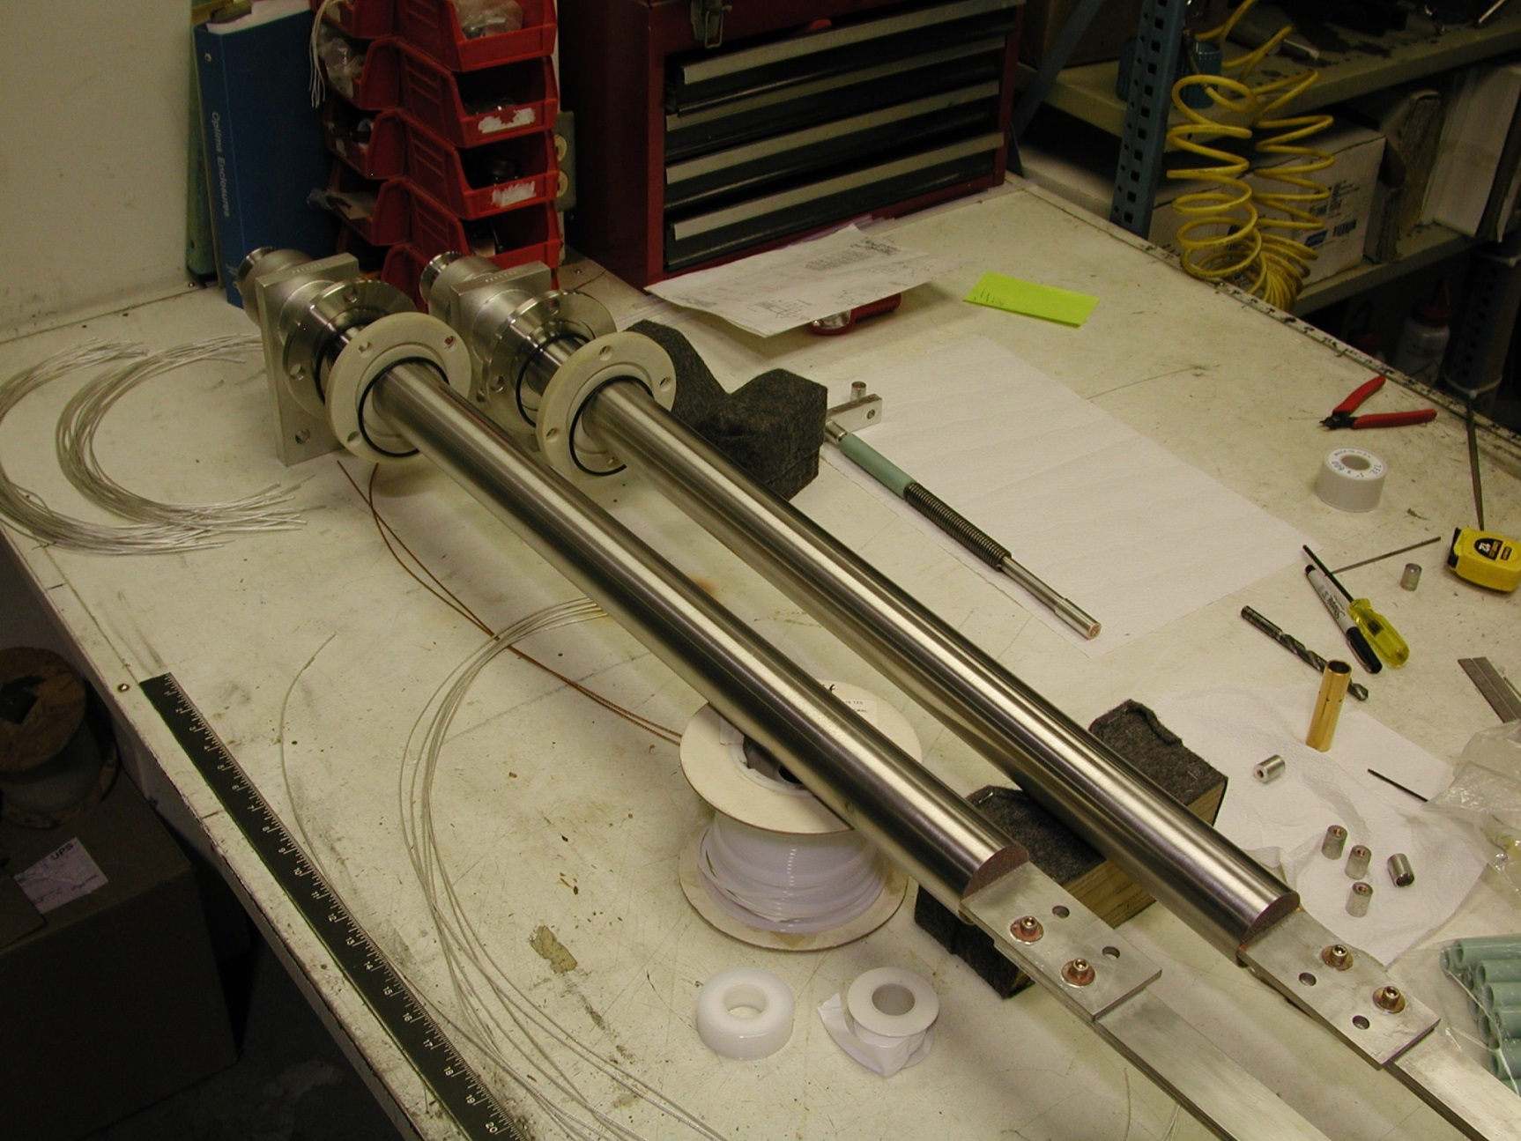
PIX of Burnout proof VCL’s

Slide 30
Development of Burnout Proof Current Leads for SHMS Magnets
AMI/JLAB 5000 AMP burnout proof re-optimized vapor cooled current lead (1.63 L/Hr/KA)
5 KA lead pair designed, built and tested by AMI
5000 A DC No Cooling for 11.3 minutes Safe
3700 A DC No Cooling Safe forever
33 minute (2.5 A/sec)slow dump no cooling safe
We required a safe 15 Minute slow dump non cooled discharge!

Slide 31
No burnout VCL 5 KA no coolant 11 min. test results

Slide 32
No burnout VCL discharge test results

Slide 33
Appendix 2 SSC Cable tests

Slide 34
SSC Outer Cable Tests
12 samples of SSC outer cable tested at BNL
Test Conditions ~ SHMS Magnets
Field Range B ( 6T, 7T, 8T)
Current 0 < I < 11,000
Tests at 4.2 K
Results compare favorably to nominal short sample curve Ic=31532(1-B/15)^2.315 L. Dresner
Typical Ic twice (or thrice) Io at constant B

Slide 35
SSC Outer Cable Measurements at 4.2 K

Slide 36
Cable Tests, Nominal SSC Outer Short Sample Curve & SHMS Dipole Peak Field Load line

Slide 37
SHMS Dipole and Q23 temp margins

Slide 38
SHMS Q1' and HB Temp margins

Slide 39
SHMS Operating Margins on Peak Field Load Line
 | Temp K | Current Ratio A Ic/Io | Field T | Energy J/M
HB | 3.31 | 3408 (1.77) | 2.91 | 0.088
Q1' | 3.86 | 4659 (1.46) | 3.92 | 0.213
Q23 | 2.18 | 1217 (1.24) | 1.43 | 0.480
Dip | 2.34 | 1552 (1.35) | 1.68 | 0.528

