Slide 1
SHMS Dipole Conductor Grading
Paul Brindza
July 26, 2013

Slide 2
Conductor Measurements, Grading and Dipole Coil Stress
A successful Dipole requires
Coil Clamped against magnetic forces at the operating current
Coil Yield Stress > Compressive azimuthal stress
Measure 10 stack coil sections at 300K , 80 K and 4 K
FEA of coil using TOSCA forces
Grade conductor to use best conductor in highest stress location

Slide 3
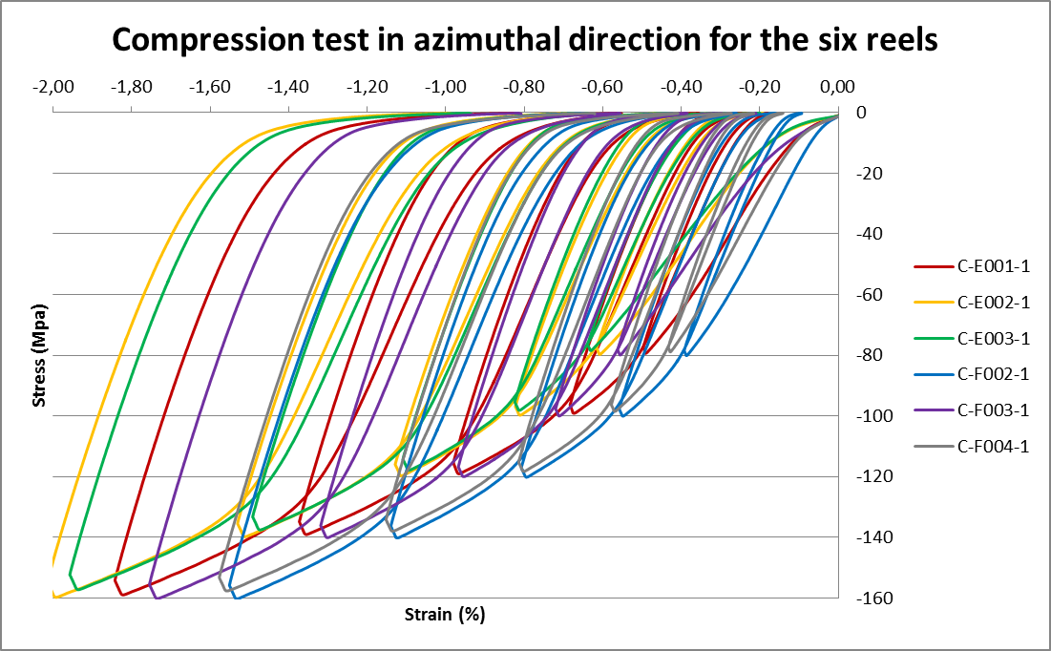
Compression tests
Tape thickness 0,25mm at half covering
10 MPa of precompression before molding
VPI with Epoxy resin CTD 101K
F4 / F2 / G GorF3 / G / Spare
118/112/?
E1 / F2 / G F4 / G / Spare
106/112/? 118/?/?
E1 has a lower soldering quality than F reels

Slide 4
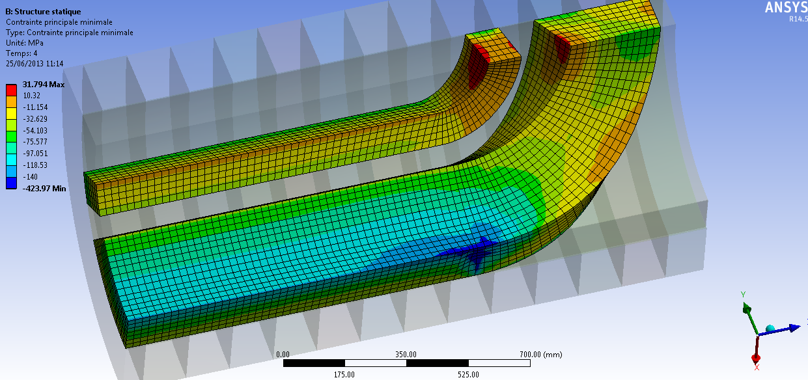
Cooldown 4K + forces– Minimum principal stress
Peak stress not relevant at the sharp edge, artefact due to the bad mesh shape ratio between the coil and the sharp end spacer

Slide 5
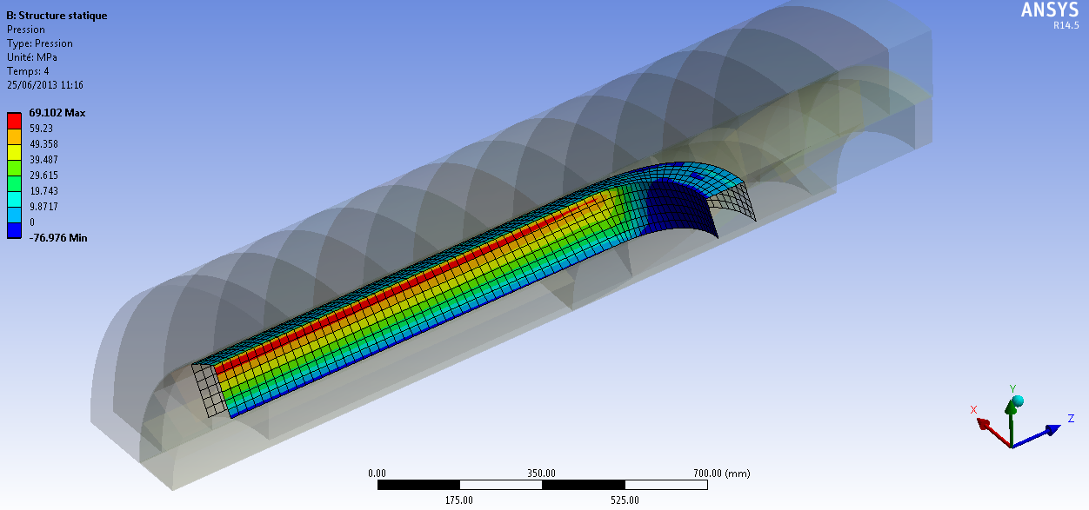
Cooldown 4K + forces– CONTACT PRESSURE BETWEEN CENTRAL SPACER AND COIL

Slide 6
Available Dipole Conductor
SHMS Dipole coil has three double pancake coils and thus requires 6 pieces of conductor
JLAB produced 12 Dipole length conductors
3 “E” lengths (inner)
3 “F” lengths (middle)
6 “G” lengths (Outer/longest)
E’s and F’s have been measured and G’s will be measured in Mid September

Slide 7
Effect of Conductor Grading Yield Stress from 10 stack composite coil sections
 | E1 | E2 | E3 | F2 | F3 | F4
Dipole Min. Prin. coil stress@ 11GeV Compressive-azimuthal | 120MPA | 120MPA | 120MPA | 120MPA | 120MPA | 120MPA
300K yield meas. | 106 | 114 | 114 | 112 | 120 | 118
80K yield ratio meas. | 127 | 137 | 137 | 134 | 144 | 142
4K yield (FEA) | 140 | 151 | 151 | 147 | 158 | 156
Yield/coil stress | 1.17 | 1.26 | 1.26 | 1.23 | 1.32 | 1.30
SigmaPhi and JLAB selected F3 and F4 for use in dipole innermost winding to get best margin ~ 31 %
“G” Dipole conductors samples in preparation for test will substitute for F3/F4 only if higher yield
Yield(80K)/Yield(300k) measured @ 1.20
Yield(4K)/Yield(300K) to be measured in September

Slide 8
Conductor Grading
Compressive coil stress in azimuthal direction equals conductor Yield at 300K
Margin on Yield at 4 K is ~ 30 %
Coil remains clamped > 5 MPA
Conclusion from this is that the Dipole should resist training and operations will be stable

