Slide 1
JLAB MEETING
FDR – April 23-24th 2013

Slide 2
Summary of the meeting objectives
Agree on Sigmaphi ‘s responsibility
Agree on cost
Schedule
Agree on technical decisions to complete the FDR

Slide 3
SIGMAPHI’S RESPONSIBILITY

Slide 4
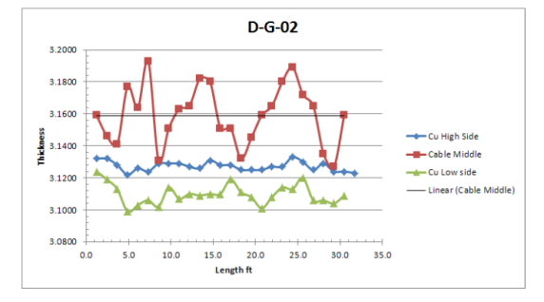
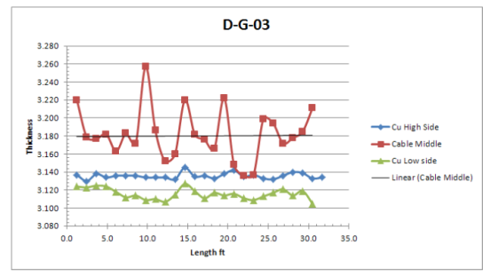
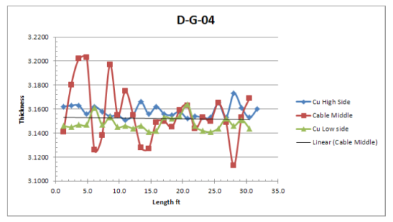
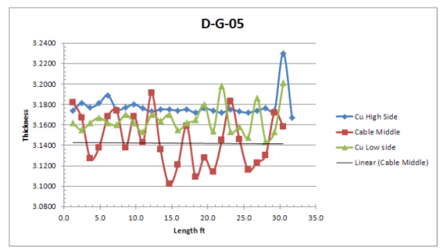
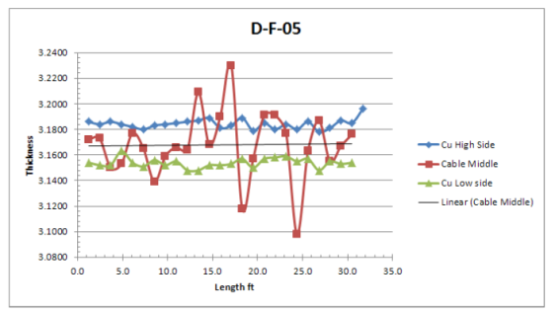
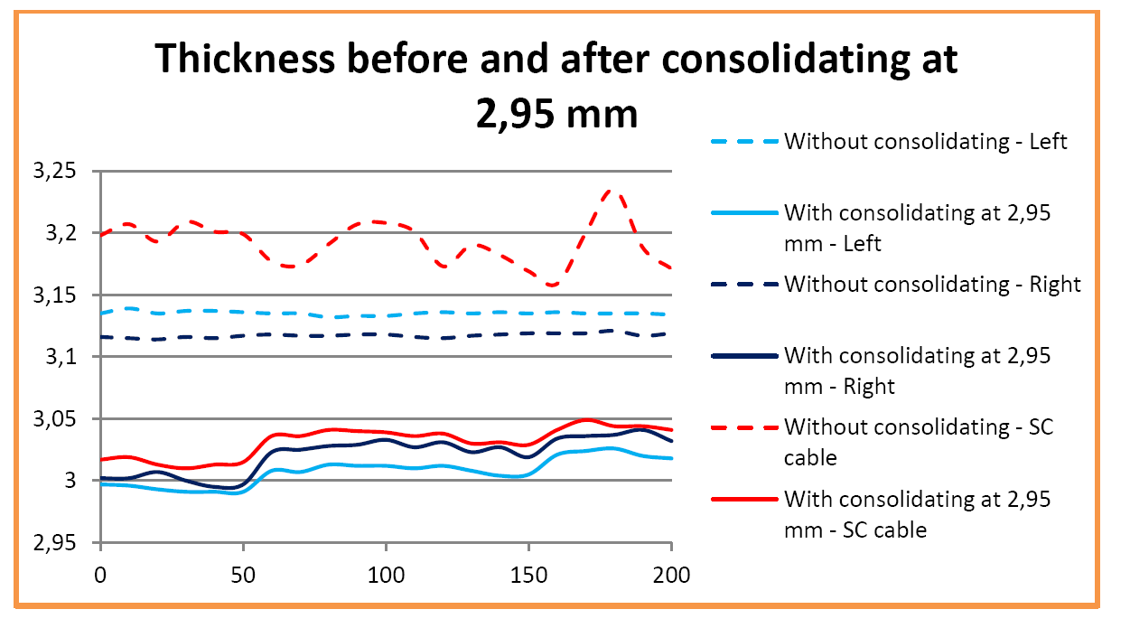
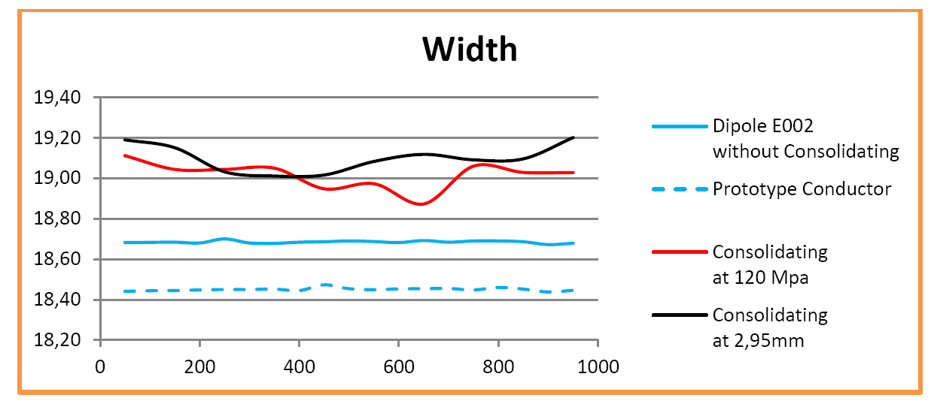
Conductor dimensions
Large variation of the SC cable height along the reel length: 3,10-3,25 mm
Might induce some unexpected variations on the conductor properties after consolidation

Slide 5
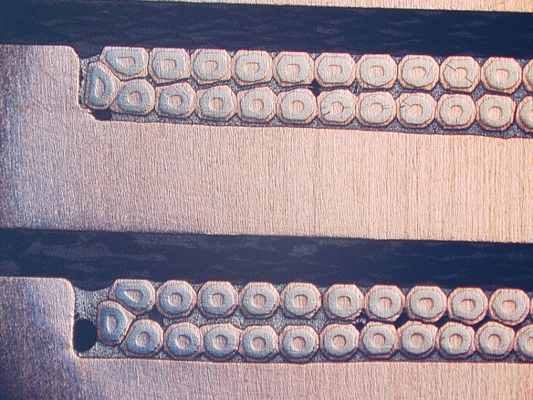
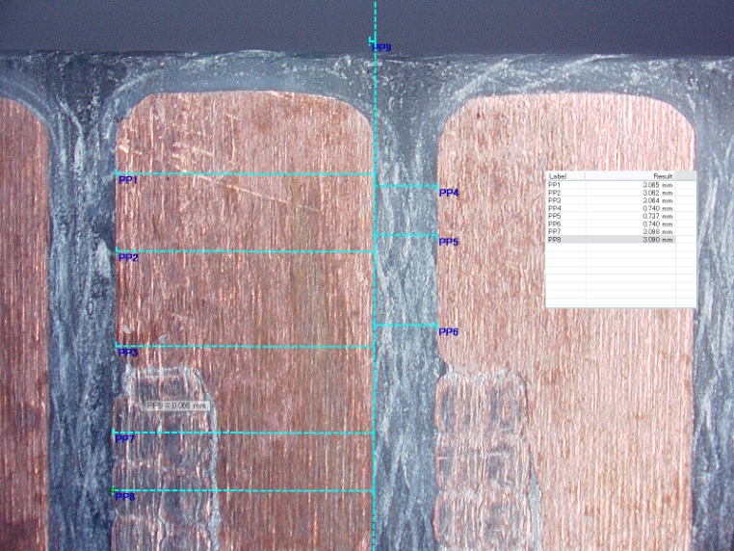
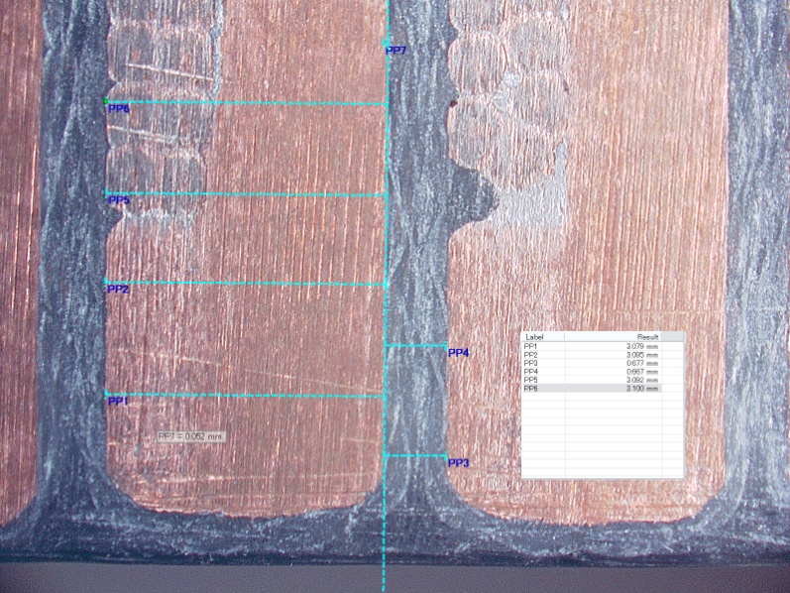
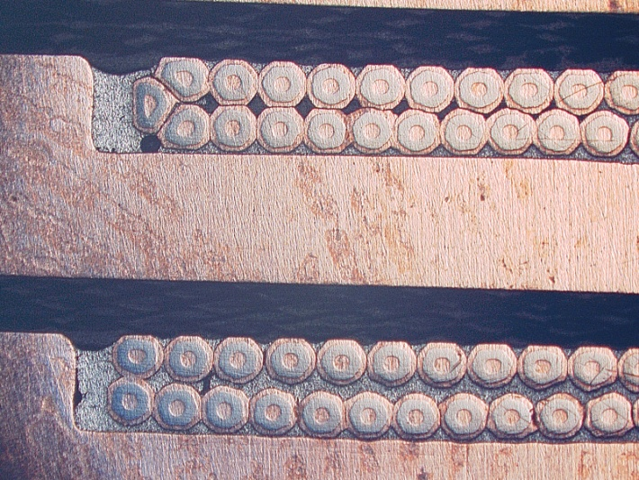
Micrography – Consolidated at 2,95 mm tested
crack
void
void
Courtesy of JLAB

Slide 6
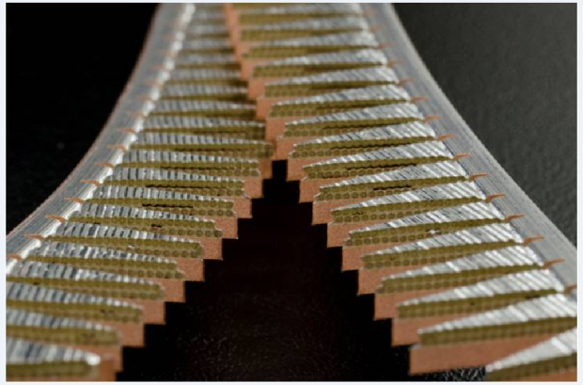
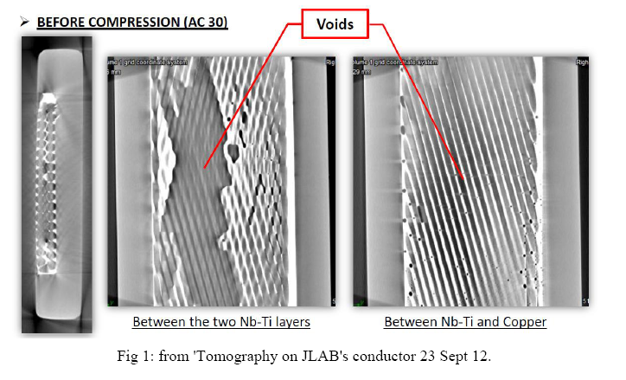
Conductor quality
Large lack of soldering between the SC layer, measured longer than 20mm in some location
Local soldering cracks, could get worse with the consolidation

Slide 7
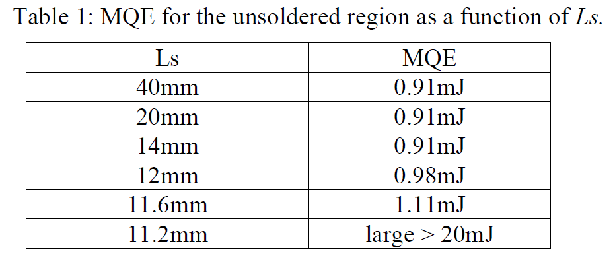
Conductor MQE
Void length similar to the calculated MPZ
MQE may vary between 20mJ and 1mJ
 |  | Void < 11mm | Void > 11mm
B | T | 4,5 | 4,5
I | A | 3500 | 3500
F | N/m | 15750 | 15750
Wire length | mm | 11 | 11
Magnetic force | N | 173,25 | 173,25
Displacement | mm | 0,1154 | 0,0058
Work | mJ | 20 | 1
MQE | mJ | 20 | 1
Theses calculations predict that a wire movement of 6 microns might be enough to trigger a quench…

Slide 8
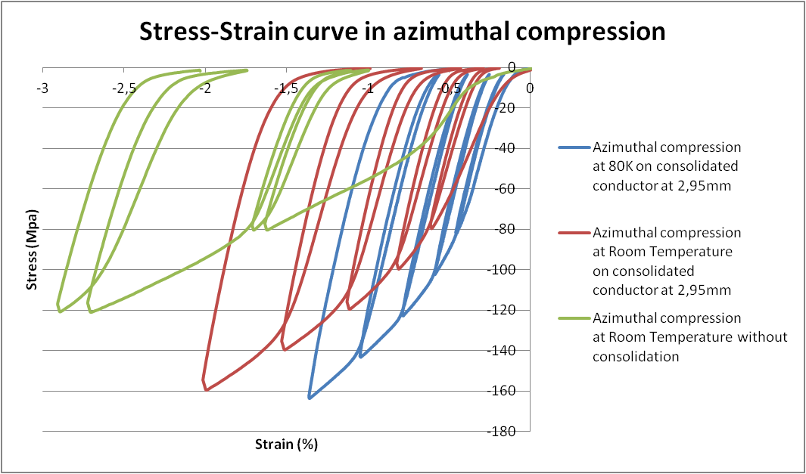

Slide 9
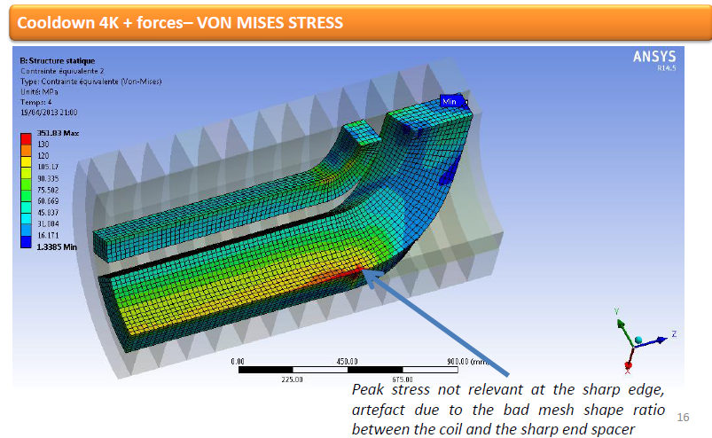
120 MPa
Ansys version 33
Collaring temperature: 90°C
100% Nominal current

Slide 10
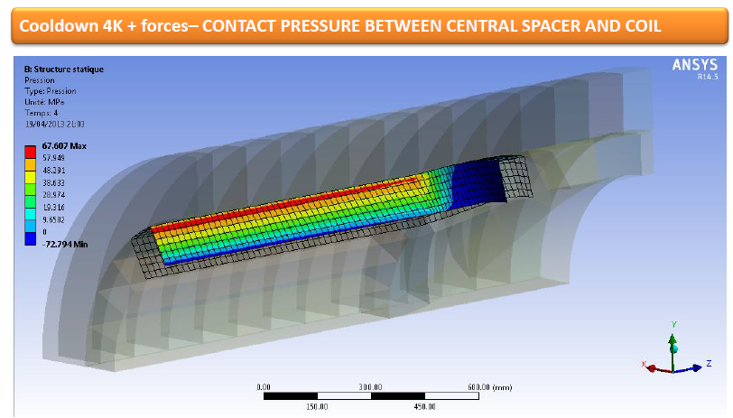
Zero contact pressure
Ansys version 33
Collaring temperature: 90°C
100% Nominal current

Slide 11
SIGMAPHI’S RESPONSIBILITY
The risks related to the conductor defaults might be serious and are not under Sigmaphi’s responsibility.
Nominal current generates a maximum stress similar to the yield stress with no safety margin to take account for conductor defaults.
We propose to build the magnet with the following agreement for the magnetic performances:
Maximum current set at 103%
Full Sigmaphi’s responsibility up to 60% of nominal current
Full JLAB's responsibility between 60% and 103% of nominal current.

Slide 12
Risk anlysis and sharing (done with JLAB during the FDR review)

Slide 13
COST

Slide 14
SCHEDULE

Slide 15
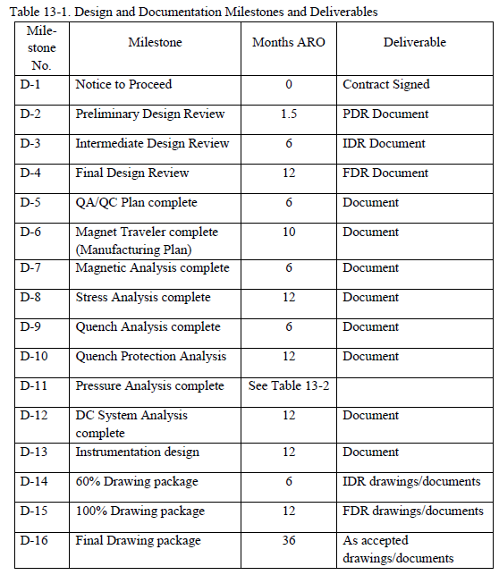
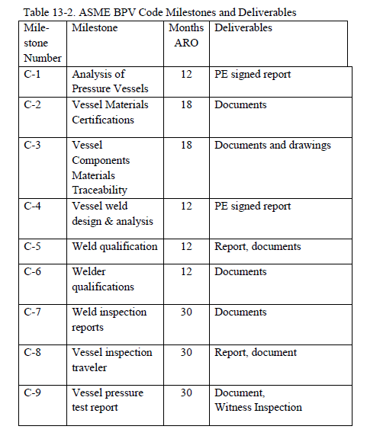
D4 – FINAL DESIGN REVIEW

Slide 16
D5 – QA/QC Plan

Slide 17
D5 – QA/QC Plan
TO DO LIST:
Update the documents with :
Conductor consolidating process
Coil vacuum impregnation process
Vessel parts subcontracting
Completion date: 19/07/2013

Slide 18
D6 – MAGNET TRAVELER
To be done
Completion date:19/07/2013

Slide 19
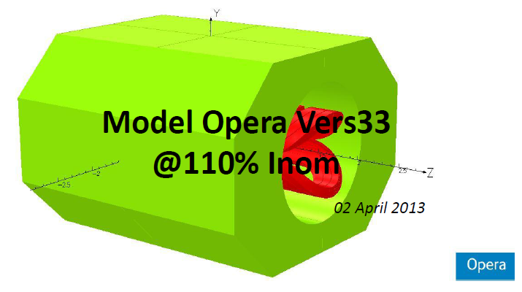
D7 – MAGNETIC ANALYSIS

Slide 20
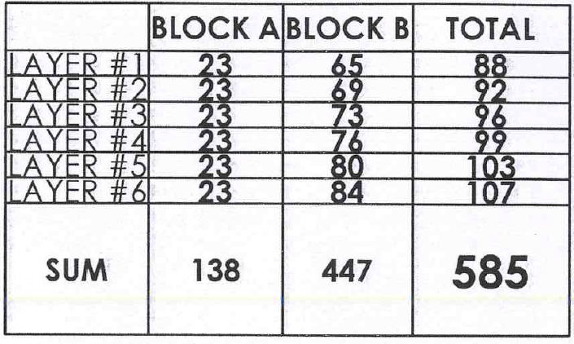
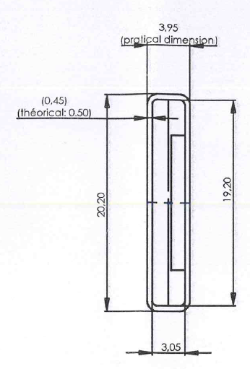
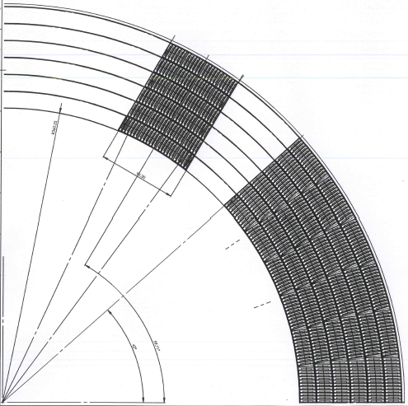
D7-Magnetic analysis
Conductor consolidated at 2.95mm
Insulation with 0,25 mm fiber glass overlap vacuum impregnated

Slide 21
 | JLAB Reference Design | Sigmaphi FDR
Conductor nominal thickness | 3,5 mm | Consolidated at 2.95mm: 3,00 -3,05 mm (3,17 mm *)
Conductor nominal width | 18,75 mm | Consolidated at 2.95mm: 19,00 – 19,20 mm (18,72 mm *)
Conductor insulation | Kapton 2x0,025 mm B stage 0,18 mm Total: 0,23 mm/side | Fiber glass 2x0,25 mm Vacuum impregnated Total: 0,50 mm per side
Insulated conductor thickness | 3,96 mm | 4.00 – 4.05 mm theoretical 3.95 mm practical
Insulated conductor width | 19,21 mm | 20,20 mm
Conductor Tensile modulus | 126 Gpa @ 300 K | 100 Gpa @ 300 K – 125 Gpa @ 80 K
Conductor tensile Yield stress 0,2% offset | 173 Mpa @ 4 K | 120 Mpa (70 Mpa*) @ 300 K - 170 MPa @ 80 K
Conductor pack compression modulus – | 43 Gpa @ 300 K | 20 Gpa @ 300 K 29 GPa @ 80 K
Conductor pack compression Yield stress 0,2% offset – 10 layers | 173 Mpa @ 4 K | 100 Mpa (55 Mpa *) @ 300 K - 120 MPa @ 80 K
Turns number per pole | 608 | 585
Max current Imax | 3500 A @ BL=12.3 T.m and Bo=4,25 T 2.128x10⁶ At/pole | 3685 A @ BL=12.066 T.m and Bo=4.25 T 2.15 x10⁶ At/pole
Nominal current Inom - Inom | 3150 A @ BL=11.07 and Bo=3.86 T | 3350 A @ BL=10.96 T.m and Bo=3.86 T
Sigmaphi Responsibility current | 110 % Inom | 60% Inom
Energy stored @ Imax | 16,2 MJ | 16,2 MJ
Inductance | 2.7 H | 2.4 H
* measured on the production conductor

Slide 22
D7-MAGNETIC ANALYSIS
TO DO LIST:
Update the Opera model with the turns layout based on the consolidated conductor dimensions to check the field harmonics
Completion date: 15 May 2013

Slide 23
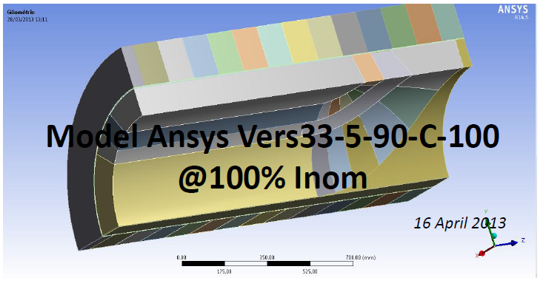
D8– STRESS ANALYSIS

Slide 24
D8-STRESS ANALYSIS
TO DO LIST:
Upgrade the Ansys model with the non linear stress/strain curve measured at 80K
Do the simulation at several collaring temperatures to simulate the pre loading tolerances
Completion date: 14 june 2013

Slide 25
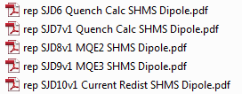
D9– QUENCH ANALYSIS

Slide 26
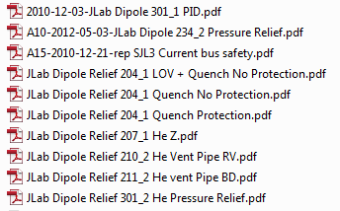
D10– QUENCH PROTECTION ANALYSIS

Slide 27
D11-PRESSURE ANALYSIS
C1-Analysis of pressure vessels
C4-Vessel weld design and analysis
C5 –Weld qualification
C6-Welder qualification

Slide 28
D11 – PRESSURE ANALYSIS
TO DO LIST:
Select the vessels parts subcontractor
Completion date: 15 May 2013
Complete the weld design review and analysis with the subcontractor
Update the vessels drawings
Complete the FEA calculations and do the design approval with Apave
Completion date: 19 July 2013
Do the welds qualification and welders qualification at the subcontractor facility
Completion date: 18 October 2013

Slide 29
D12-DC System analysis
D13-Instrumentation design
See the Sigmaphi Technical Specification

Slide 30
D15 – Drawings package

Slide 31
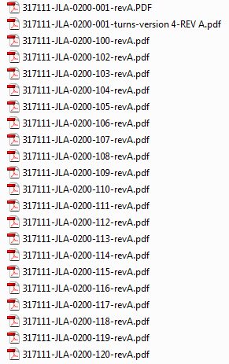
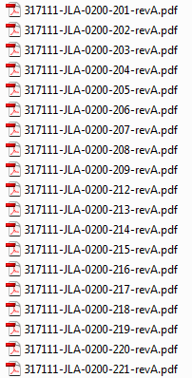
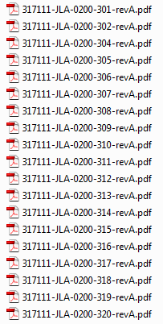
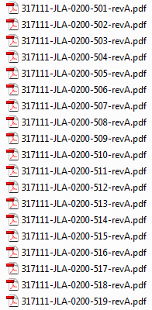
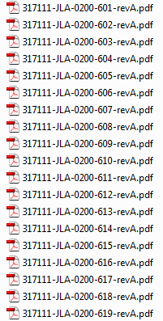
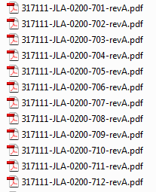
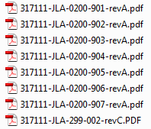
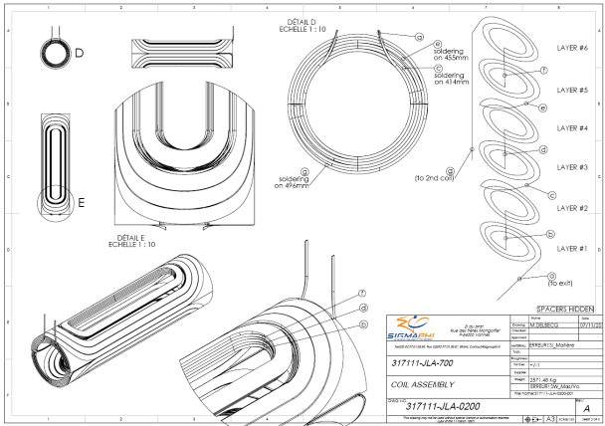
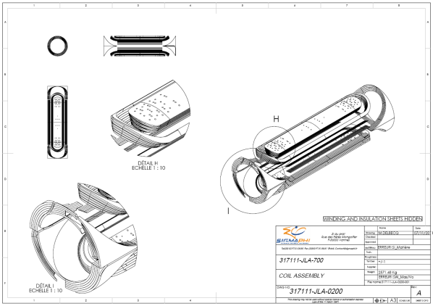
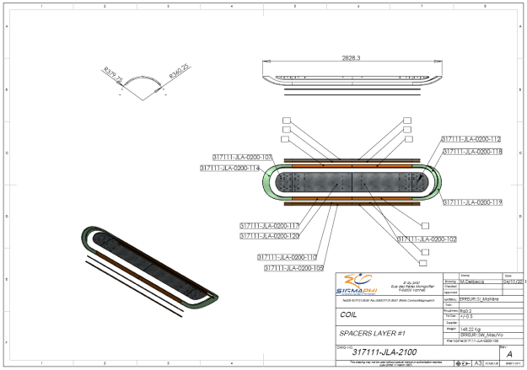
Drawings Package review
Coil drawings – References 200-XXX

Slide 32
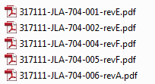
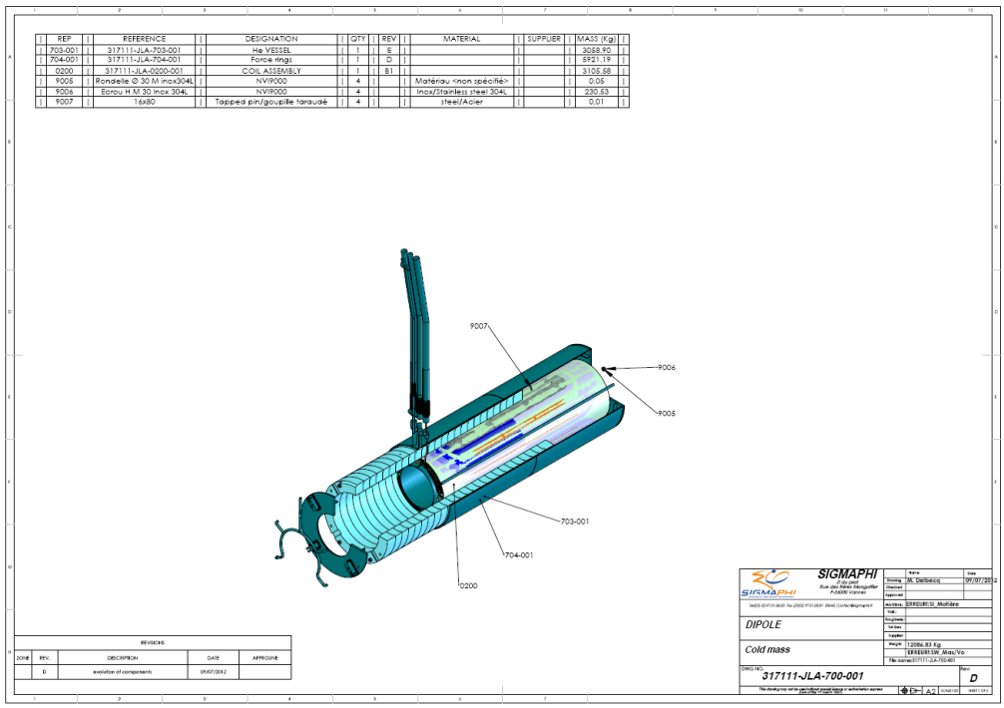
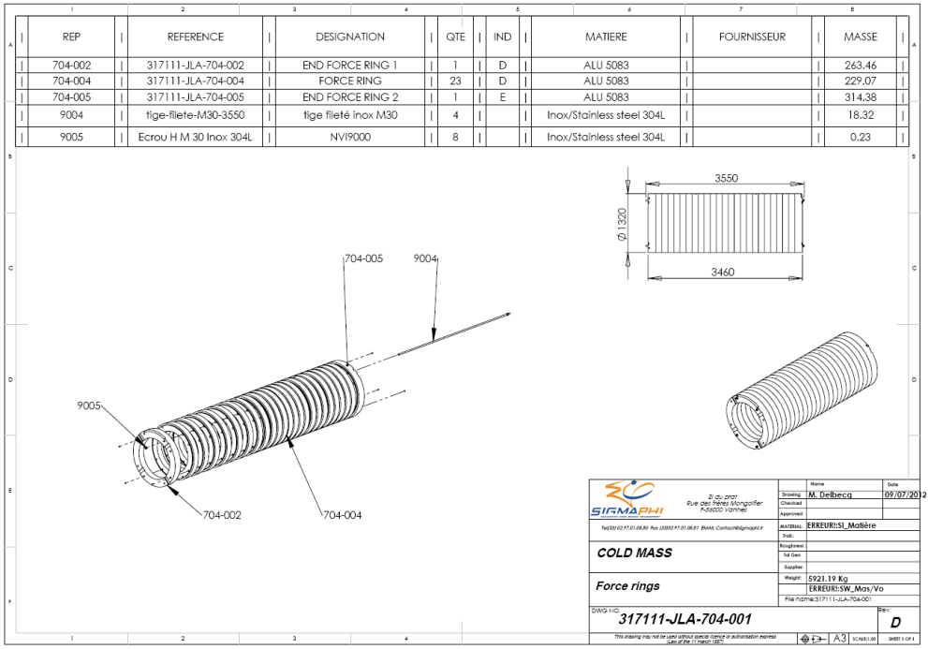
Drawings Package review
Collared coil– References 700-XXX and 704-XXX

Slide 33
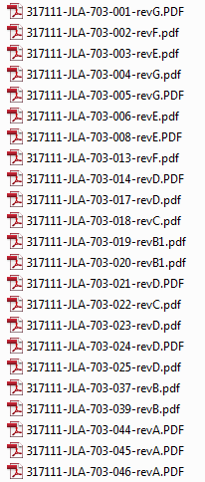
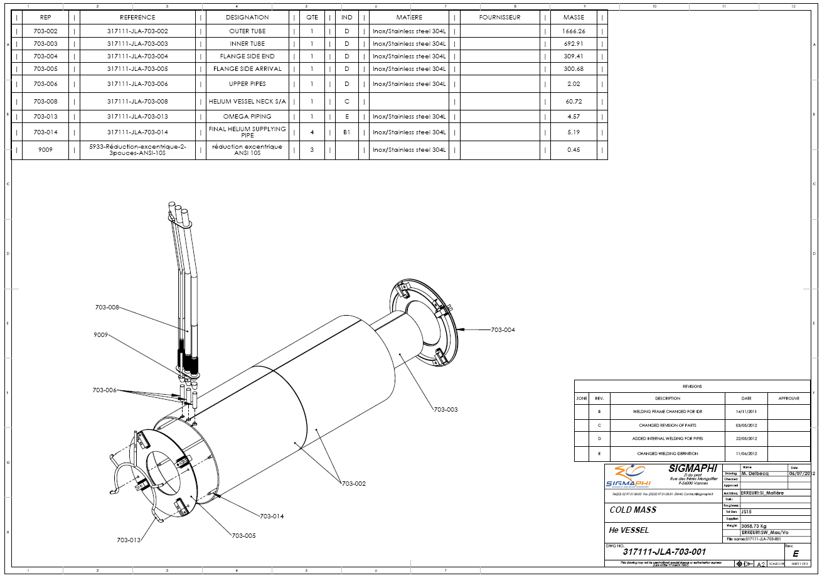
Drawings Package review
Helium Vessel drawings – References 703-XXX

Slide 34
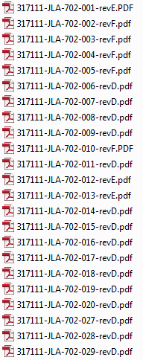
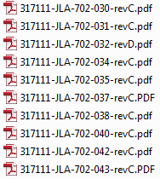
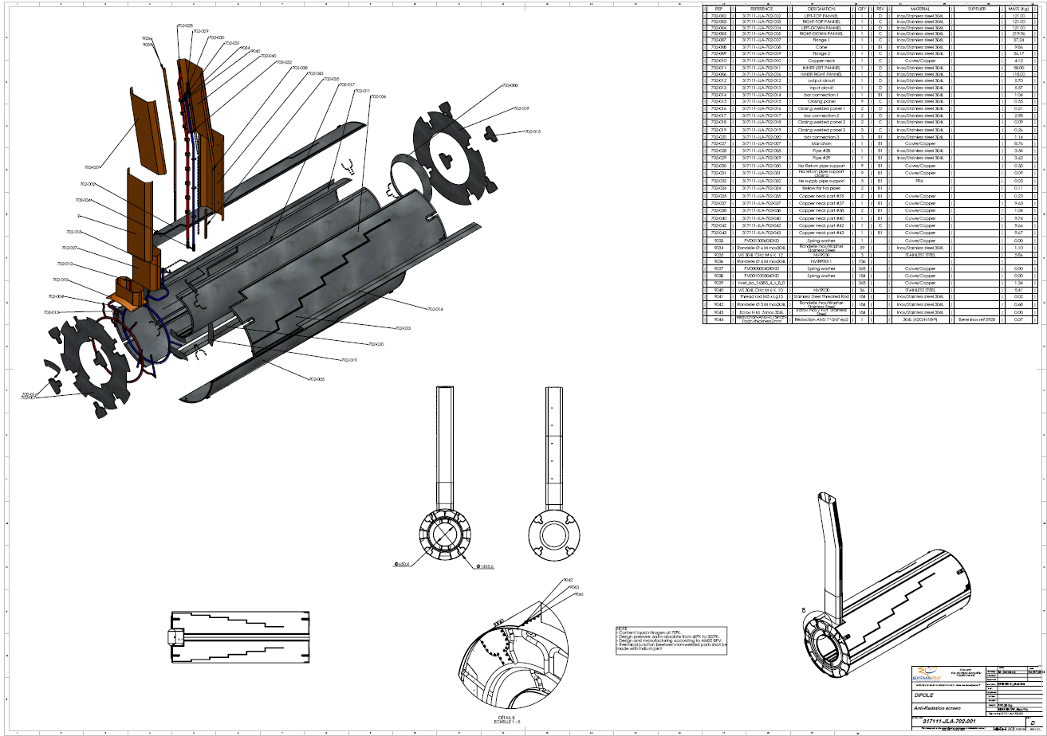
Drawings Package review
Radiation Screen drawings – References 702-XXX

Slide 35
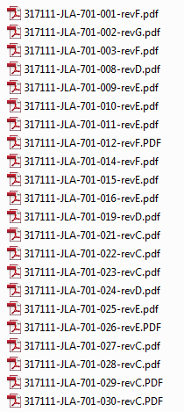
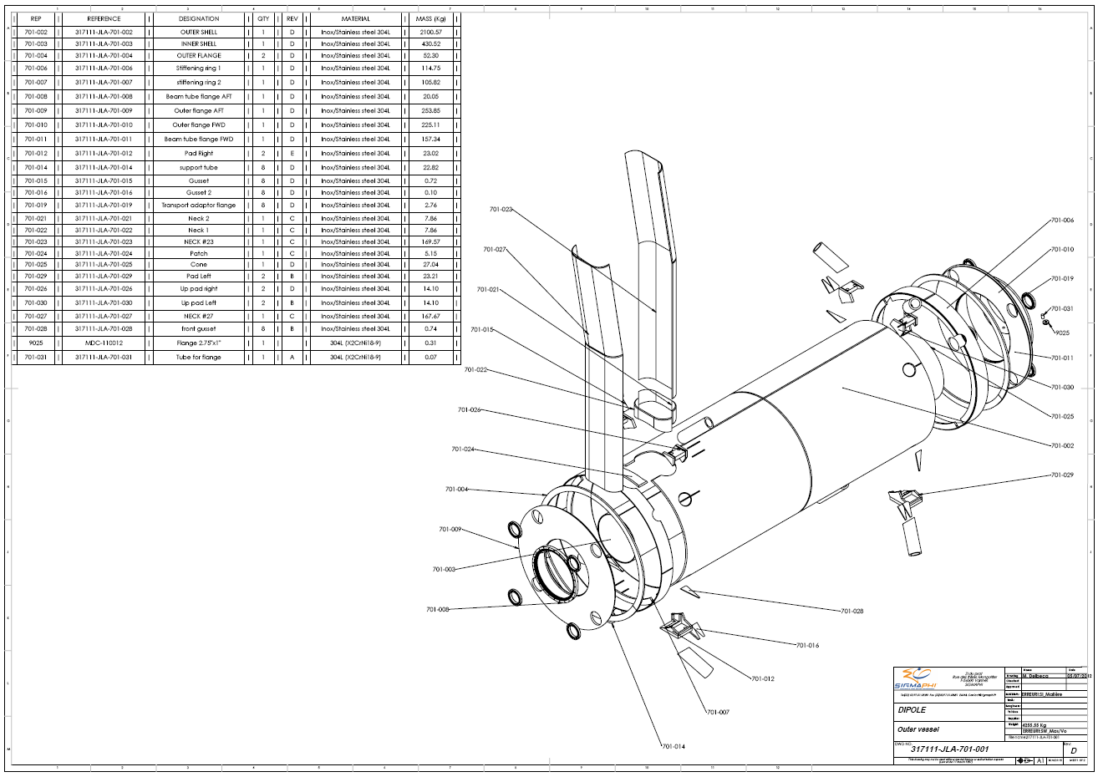
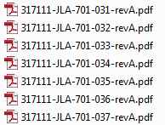
Drawings Package review
Outer Vessel drawings – References 701-XXX

Slide 36
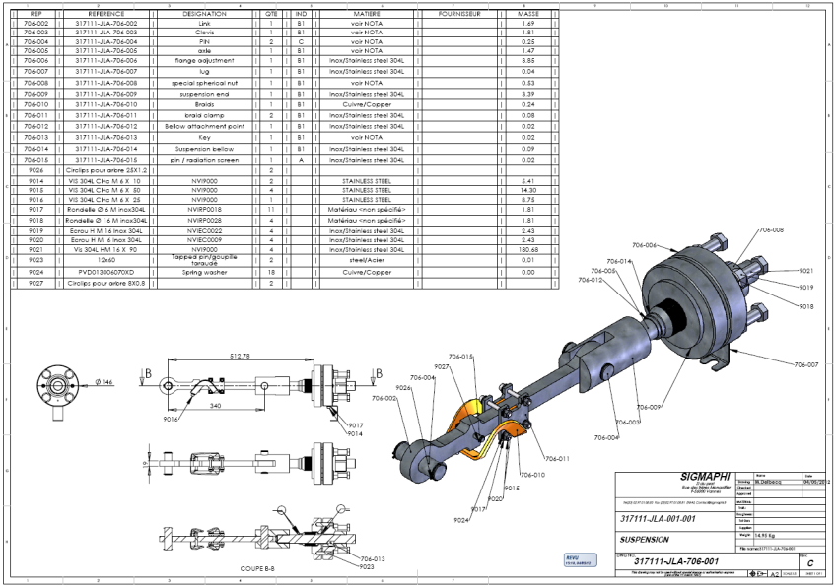
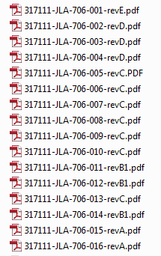
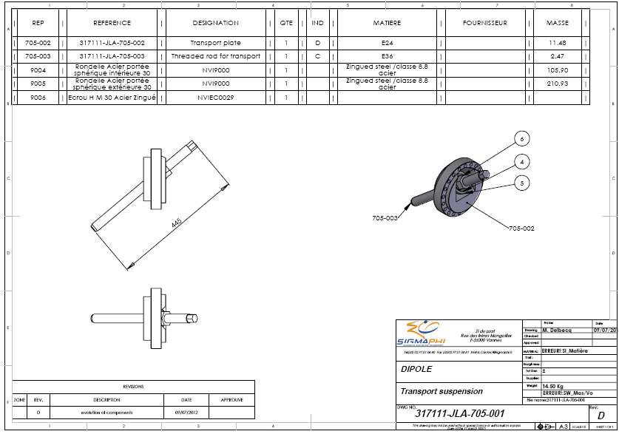
Drawings Package review
Suspension Links drawings – References 706-XXX and 705-XXX

Slide 37
Assembly drawings – References 001-001

Slide 38
D15-Drawings package
TO DO LIST:
Modify the spacers geometry to be consistent with the Opera model and the consolidated conductor dimensions
Completion date: 15 May 2013
Update the welds design with the vessels parts subcontractor
Validate the tolerances build up between the vessels inner bore
Completion date: 19 July 2013
Define some temporary collars to measure the real coil modulus and initial stress/strain lag
Completion date: 19 July 2013

Slide 39
Thank you for your attention

