Slide 1
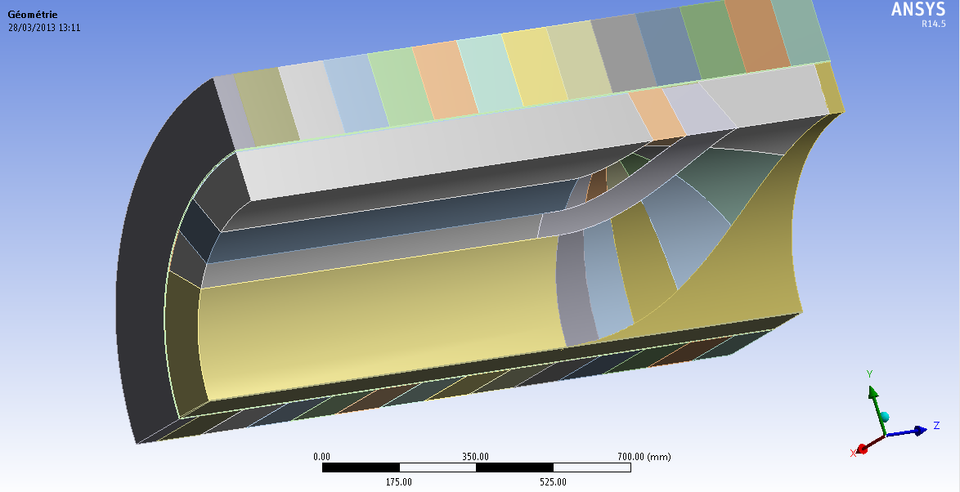
Model Ansys Vers33-5-90-C-100
@100% Inom
16 April 2013

Slide 2
Revision and Abstract
Description | Revision | Date
Creation | A | 19/04/2013-AS
ABSTRACT
This report presents calculation made by Sigmaphi.
This simulation was carried out with the following parameters:
Coil mesh 28mm
Spacer mesh size 28 mm
Temperature 90°c (Collar temperature 80°C- ambient temperature 22°C= preload temperature 68°C)
Spacer 2 and 3 copper
Orientation for conductor material + CTE

Slide 3
Data input of the model
Collar temperature 90°C (interference fit 90-22=68 K)
Coil material :
Young Modulus X axis : 20Gpa /Poisson ratio 0.31
Young Modulus Y axis : 20Gpa / Poisson ratio 0.31
Young Modulus Z axis : 100Gpa / Poisson ratio 0.31
Forces density imported from opera
Cooldown to 4K

Slide 4
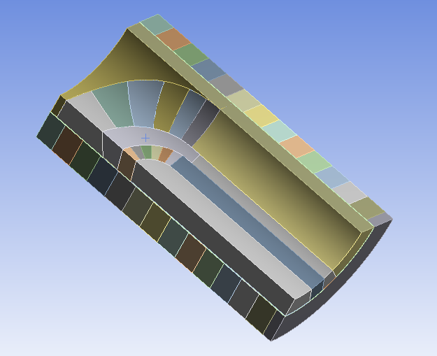
Material
Nema G11
Alu 5083
COPPER
304L

Slide 5
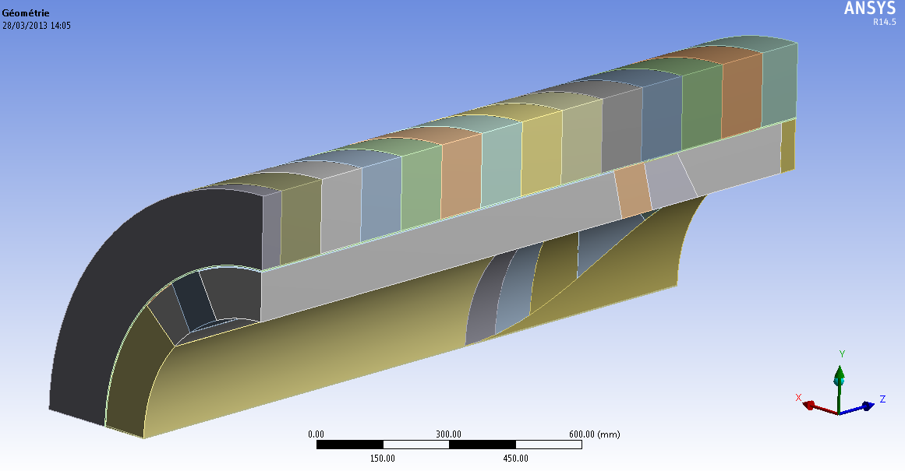
Opera and Ansys axis (Orientation of the model)
Y axis
Z axis
X axis

Slide 6
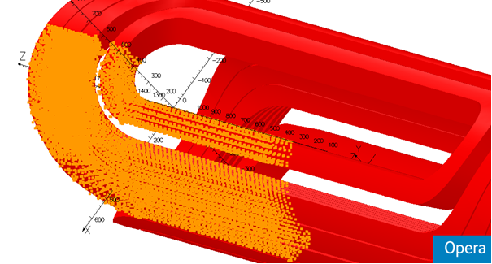
Localization of the forces density centroids

Slide 7
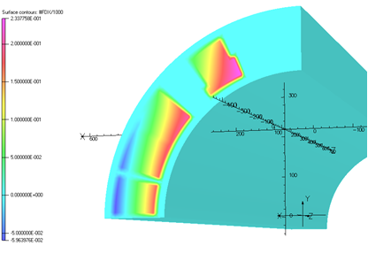
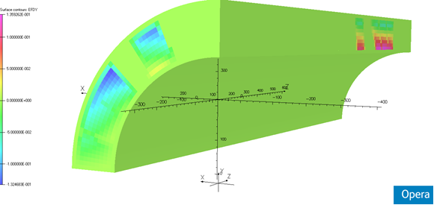
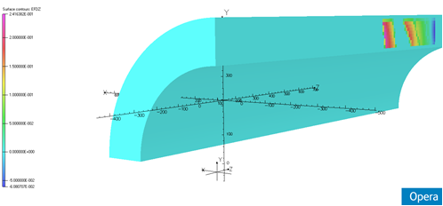
Density distribution of forces in the Opera model
X direction
Y direction
Z direction

Slide 8
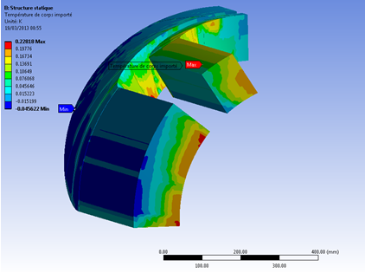
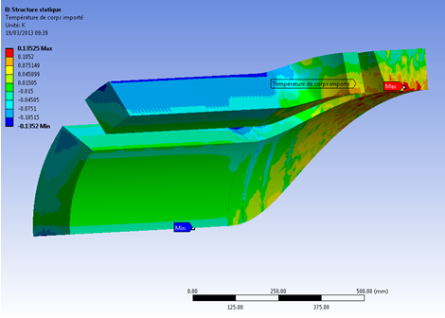
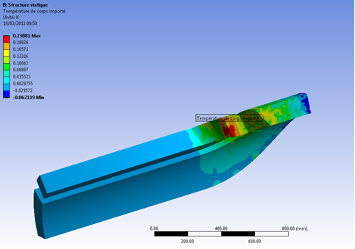
Density distribution of forces in the Ansys model
X Direction
Y Direction
Z Direction

Slide 9
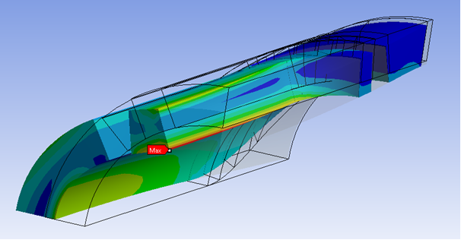
Distorted views of the coil (wired original geometry)

Slide 10
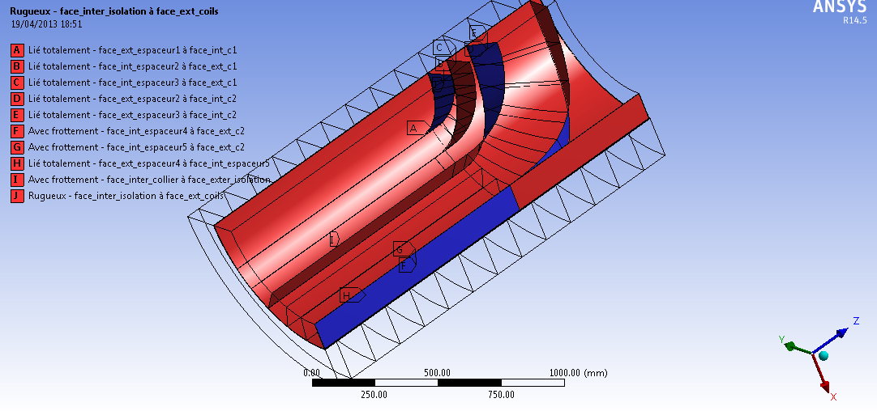
Contacts

Slide 11
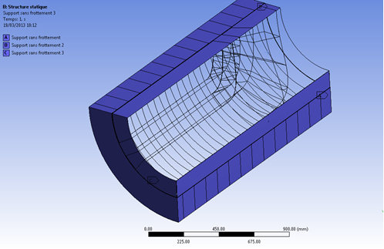
Supports

Slide 12
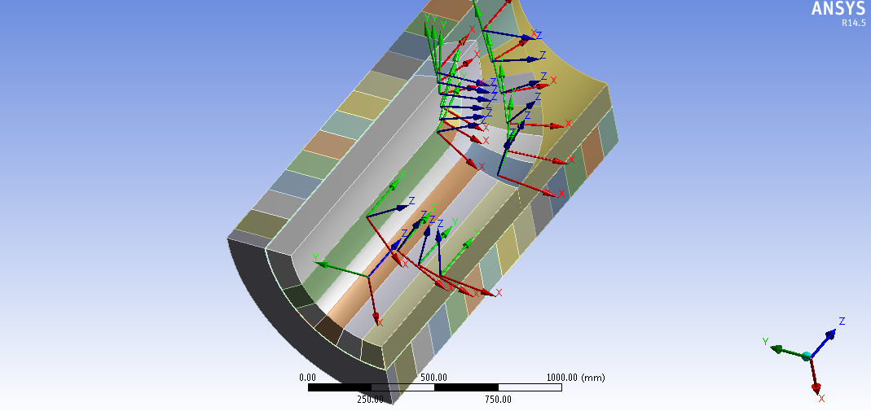
Orientation axis for the orthotropic material. (Coils)

Slide 13
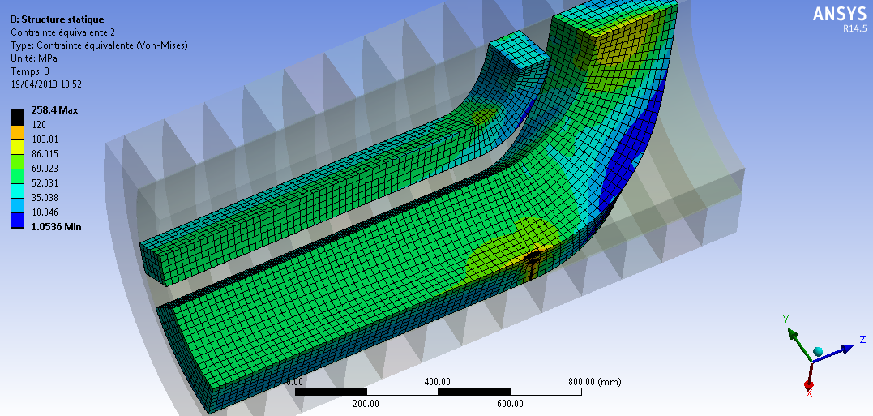
Cooldown 4K– VON MISES STRESS
Peak stress not relevant at the sharp edge, artefact due to the bad mesh shape ratio between the coil and the sharp end spacer

Slide 14
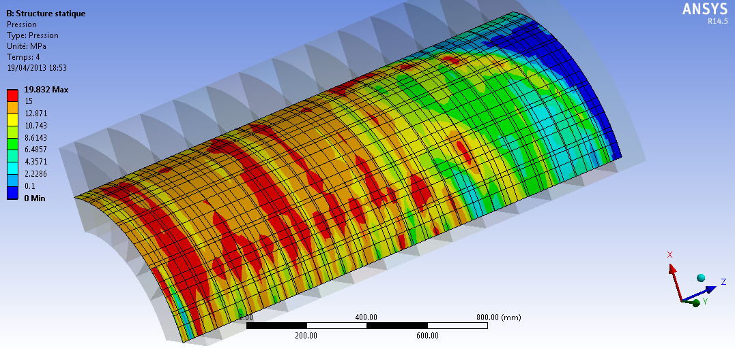
Cooldown 4K– CONTACT PRESSURE BETWEEN COLLARS AND COIL

Slide 15
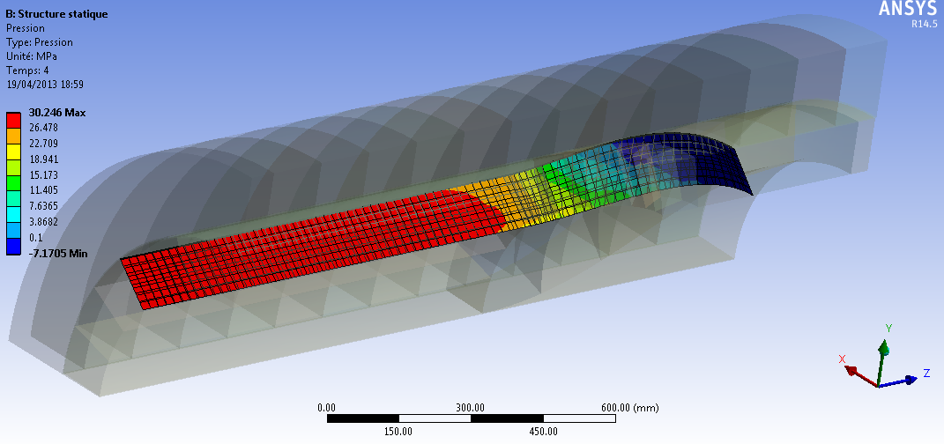
Cooldown 4K– CONTACT PRESSURE BETWEEN CENTRAL SPACER AND COIL

Slide 16
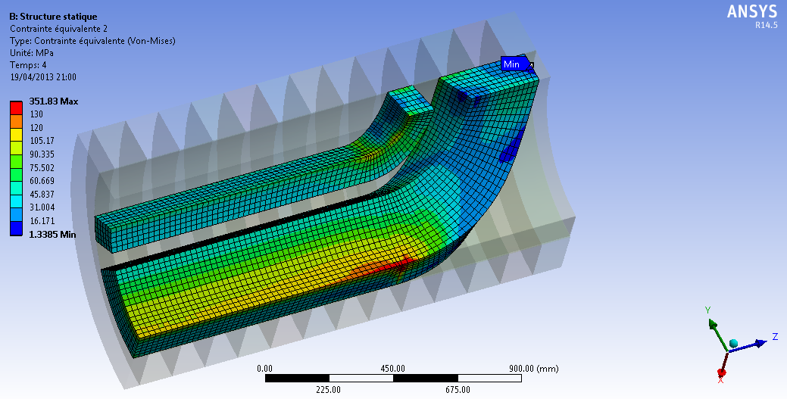
Cooldown 4K + forces– VON MISES STRESS
Peak stress not relevant at the sharp edge, artefact due to the bad mesh shape ratio between the coil and the sharp end spacer

Slide 17
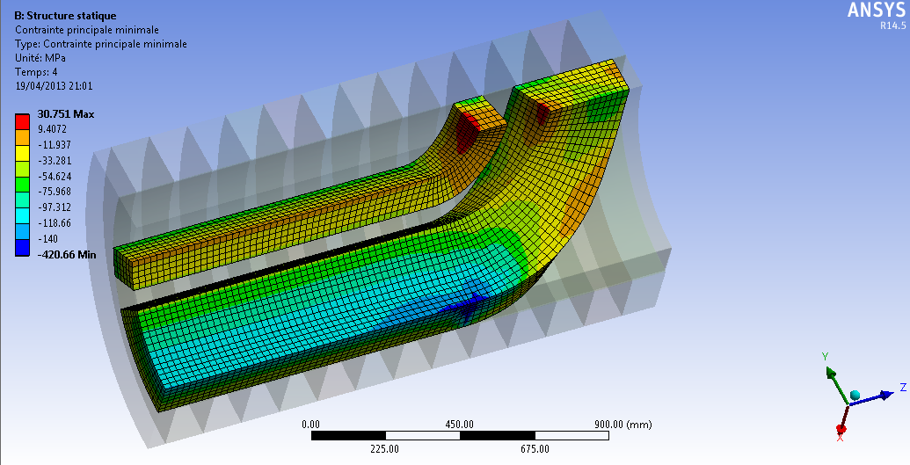
Cooldown 4K + forces– Minimum principal stress
Peak stress not relevant at the sharp edge, artefact due to the bad mesh shape ratio between the coil and the sharp end spacer

Slide 18
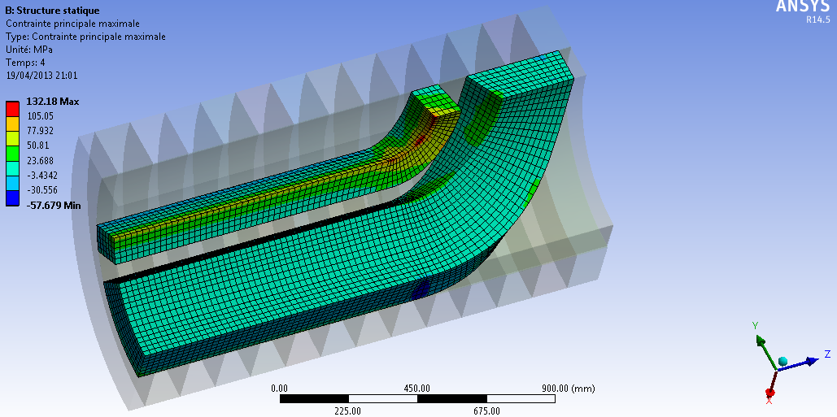
Cooldown 4K + forces– Maximum principal stress

Slide 19
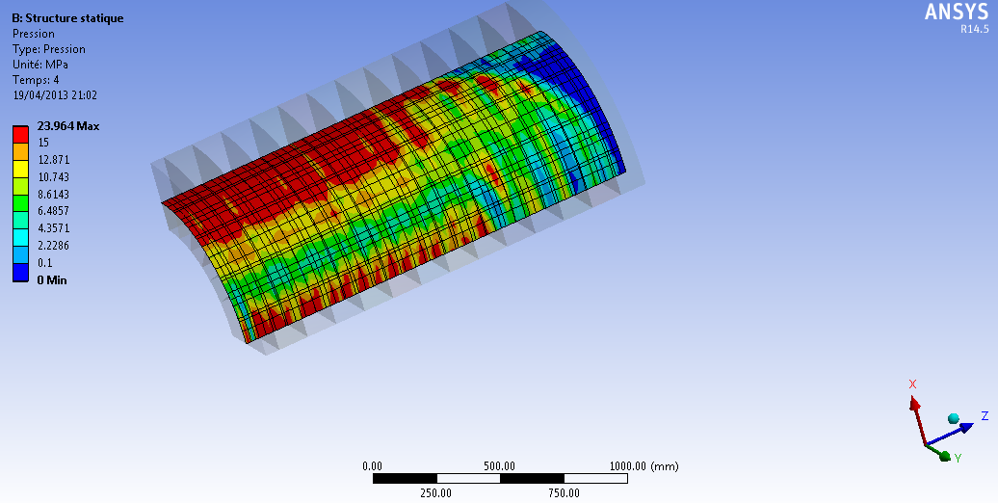
Cooldown 4K + forces– CONTACT PRESSURE BETWEEN COLLARS AND COIL

Slide 20
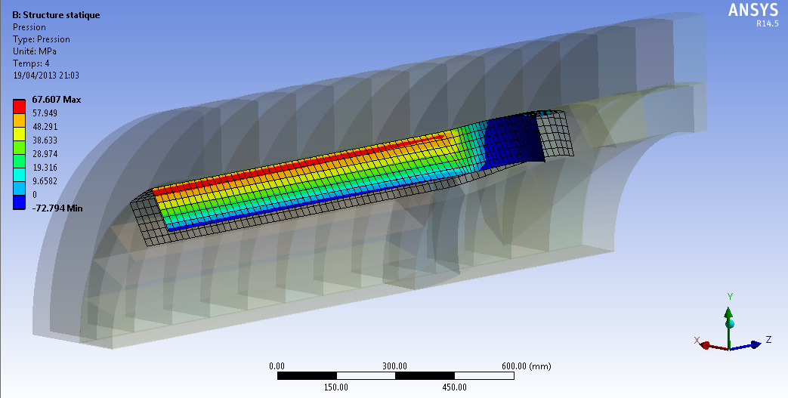
Cooldown 4K + forces– CONTACT PRESSURE BETWEEN CENTRAL SPACER AND COIL

Slide 21
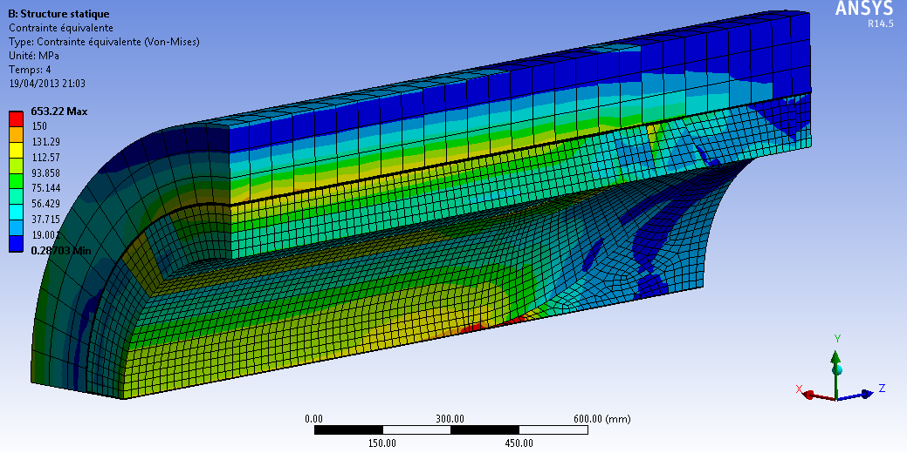
Cooldown 4K + forces– Stress (Von Mises) assembly
Peak stress not relevant at the sharp edge, artefact due to the bad mesh shape ratio between the coil and the sharp end spacer

