Slide 1
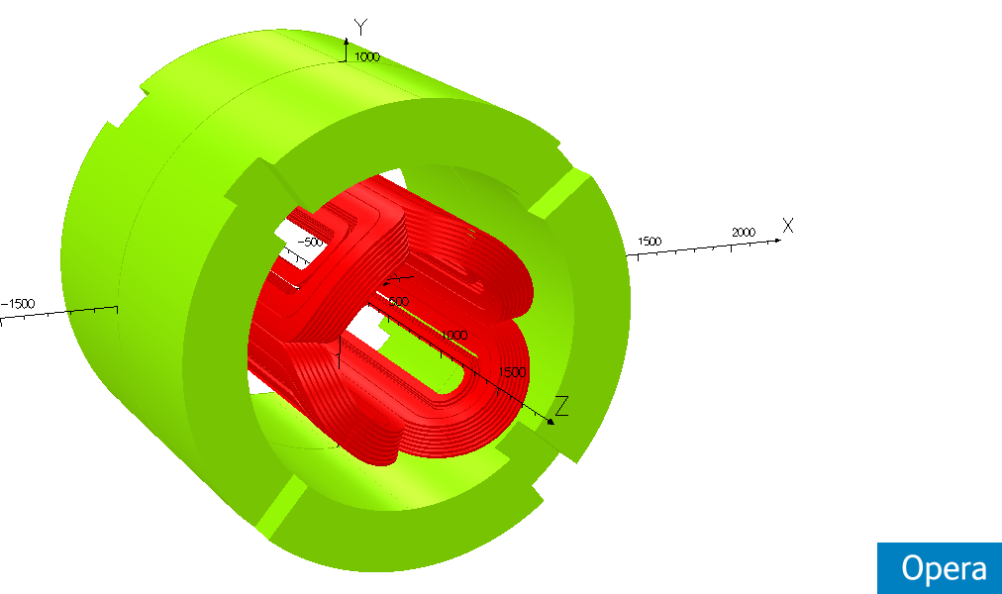
Model Opera 3D Analysis
Macro Model Vers-111 @ 4250 A
20 June 2013

Slide 2
Revision and Abstract
Description | Revision | Date
Creation | A | 20/06/2013-AS
update | B | 26/06/2013-AS
ABSTRACT
This report presents calculation made by Sigmaphi at 4250A (Imax)
Opera files:
318711-JLAB-Qpole-V111-OP3

Slide 3
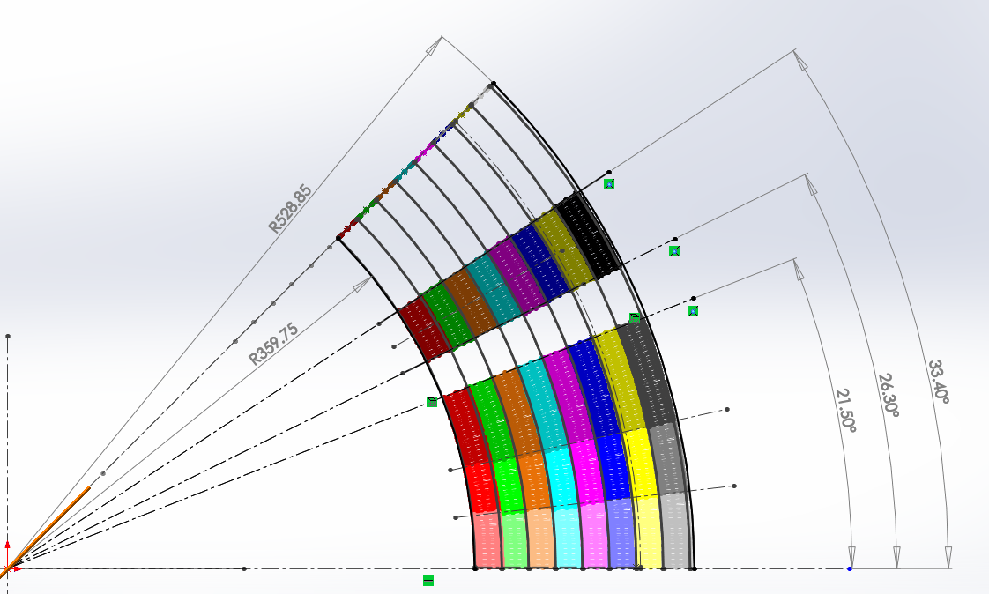
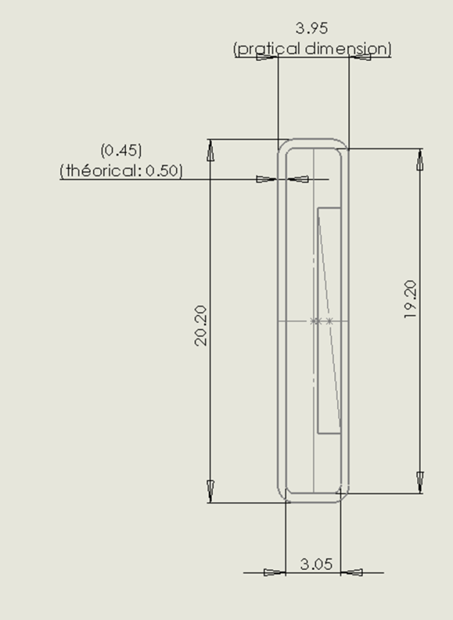
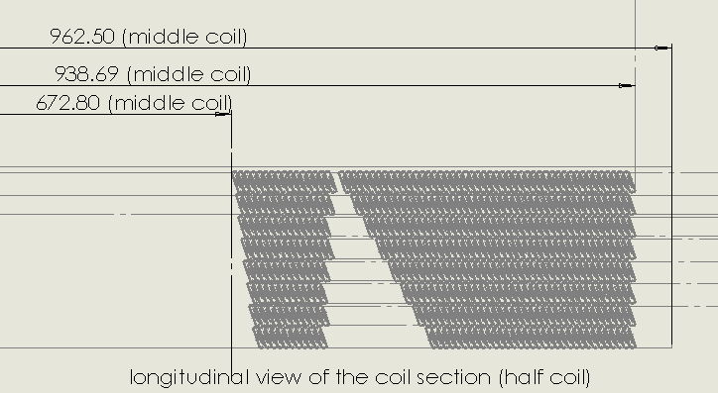
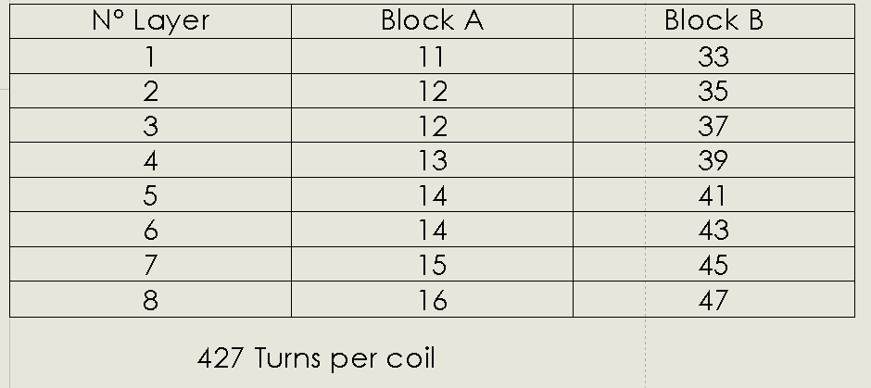
Solidworks geometry

Slide 4
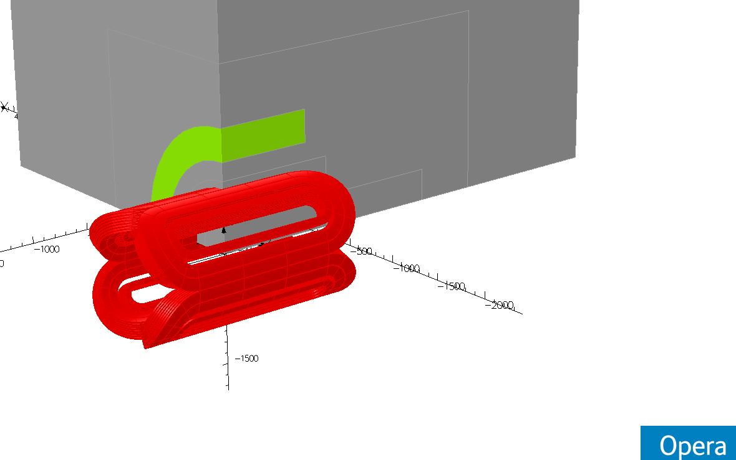
Opera Model

Slide 5
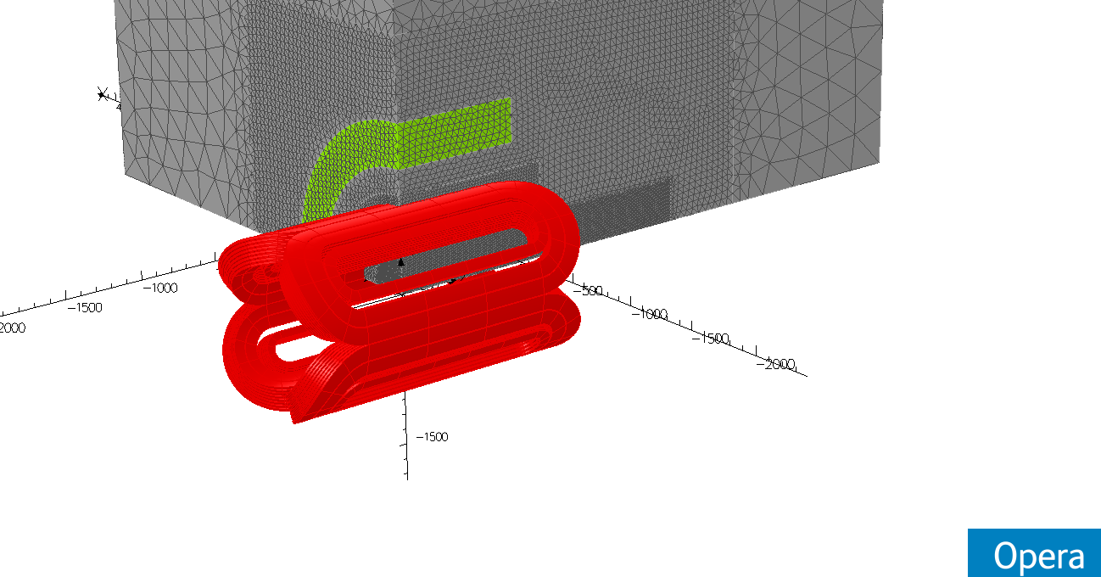
View of the mesh

Slide 6
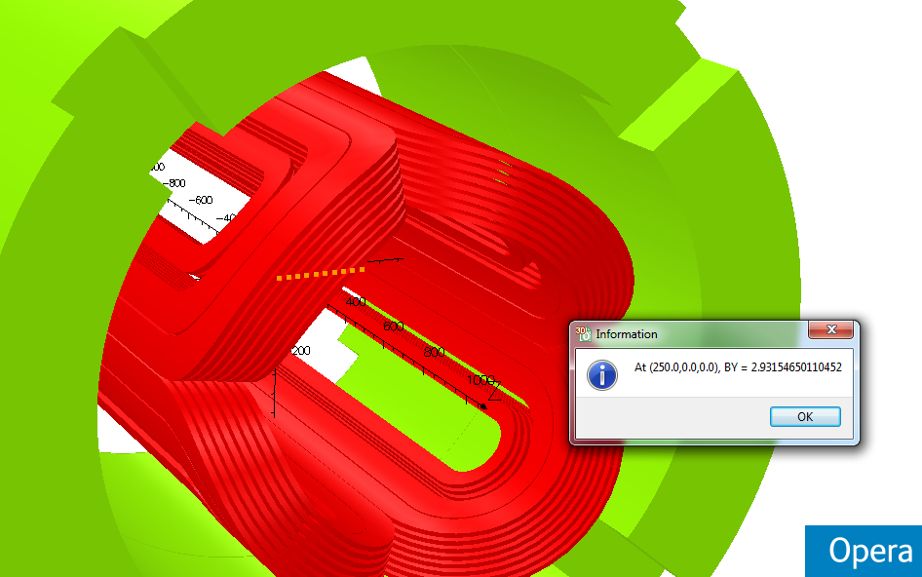
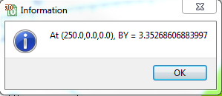
By at 250,0,0 (T) and gradient – Middle of the coil @ 4250A
Gradient T/M = 3.3526/0.250=13.414 T/M

Slide 7
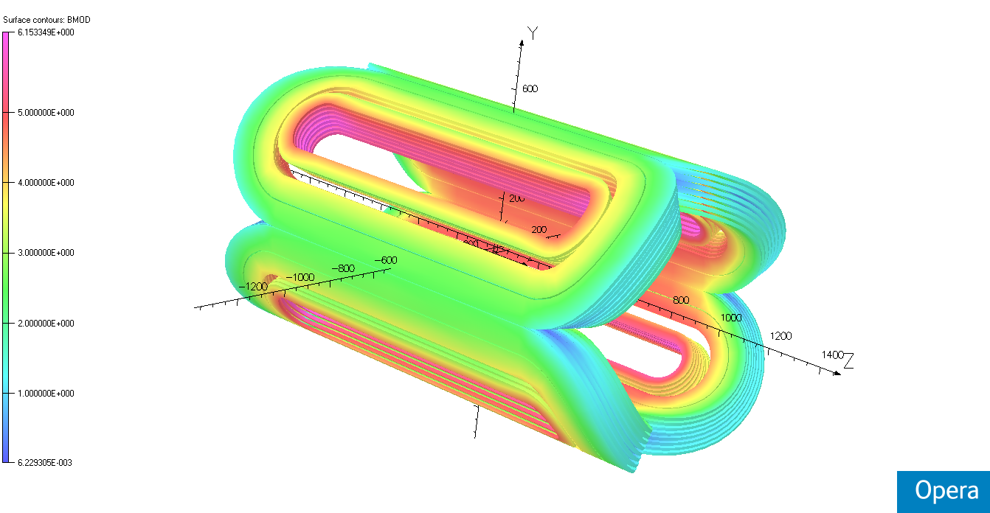
Field map on the coil surface@ 4250A

Slide 8
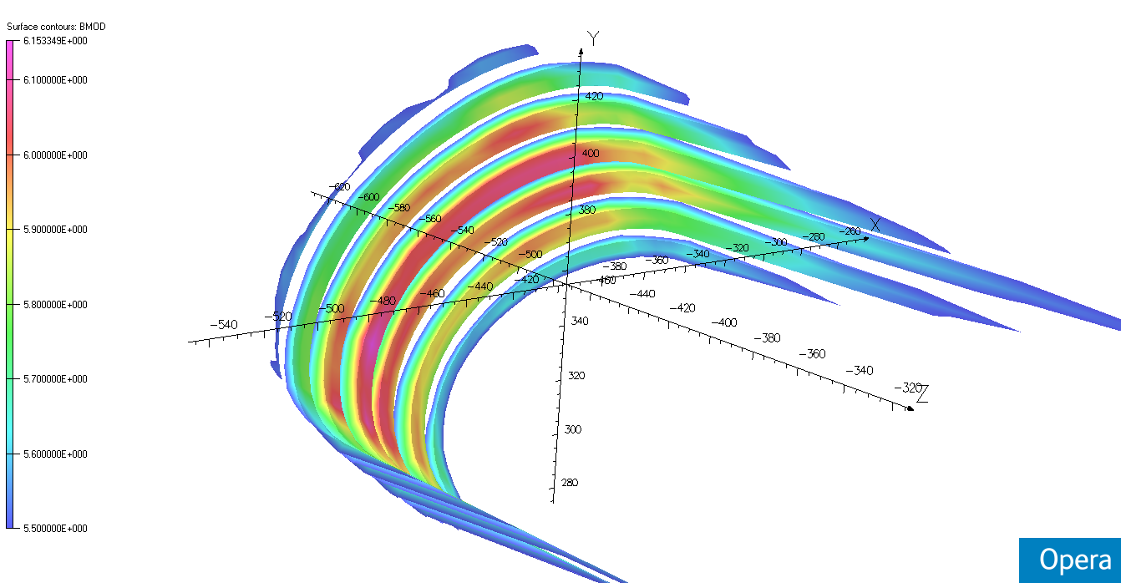
Field map on the coil surface@ 4250A

Slide 9
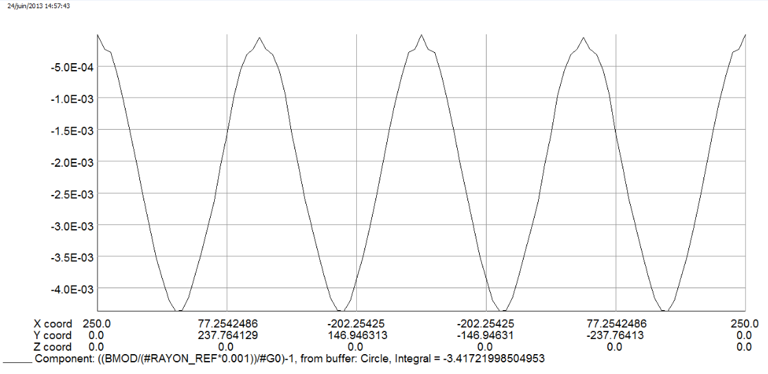
Field homogeneity on a circle Ø500 @ 4250A

Slide 10
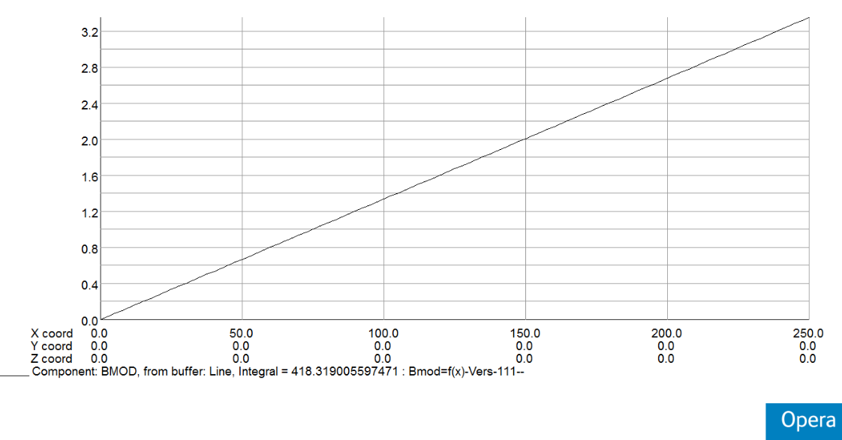
By = f(x) @ 4250A

Slide 11
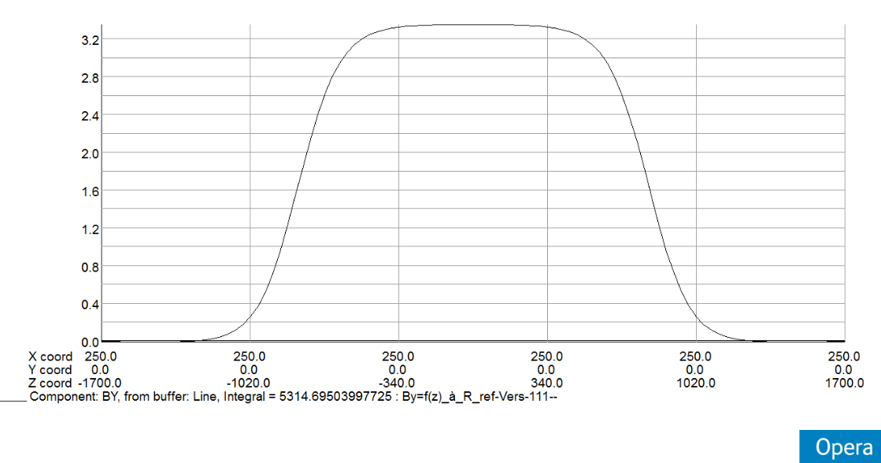
By = f(z) @ R=250mm @ 4250A

Slide 12
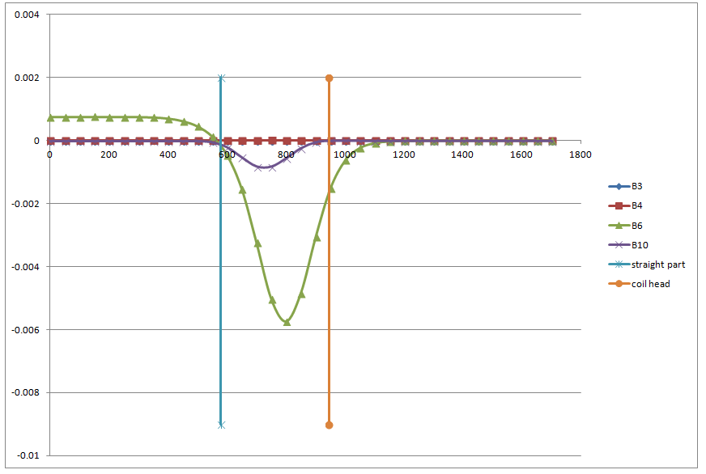
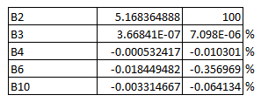
Harmonics –B3-B4-B6-B10 @ 4250A

Slide 13
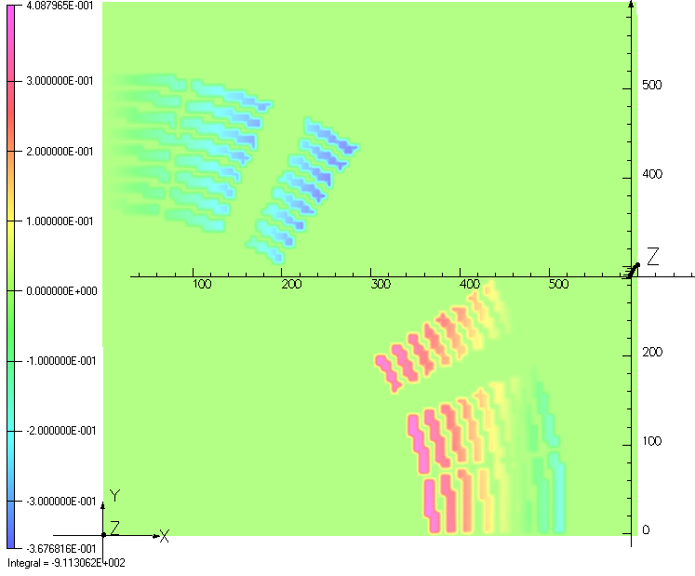
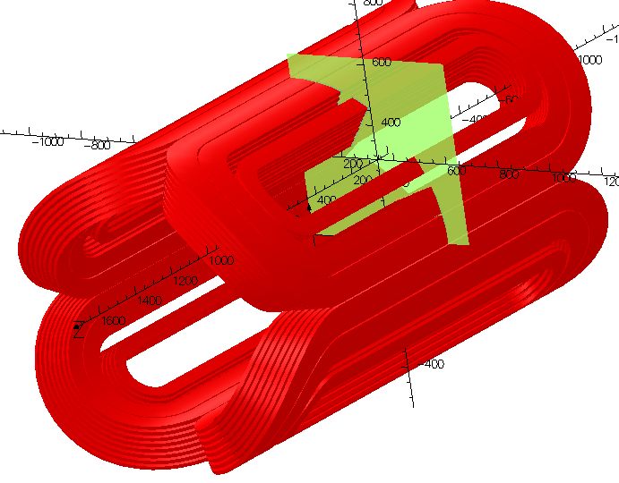
Fx force density in N/mm3 – 4250 A

Slide 14
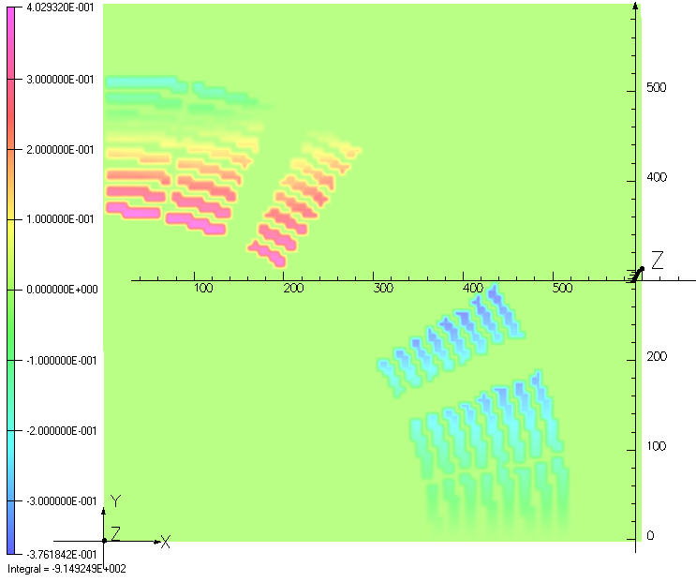
Fy force density in N/mm3 – 4250 A

Slide 15
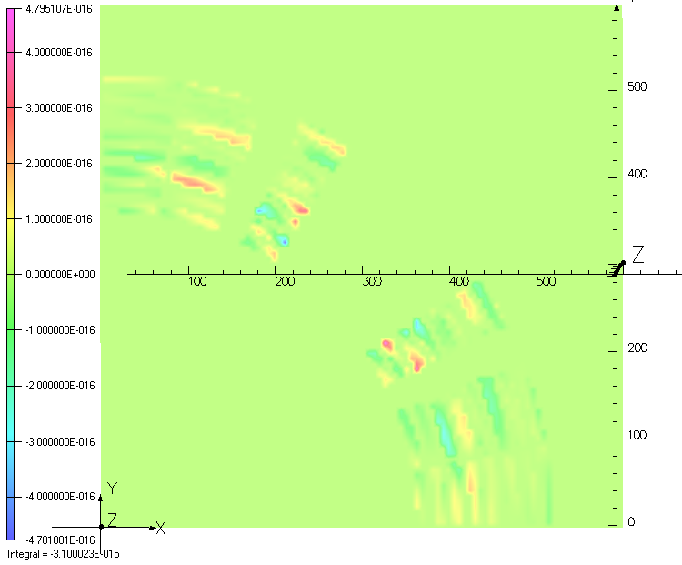
Fz force density in N/mm3 – 4250 A

Slide 16
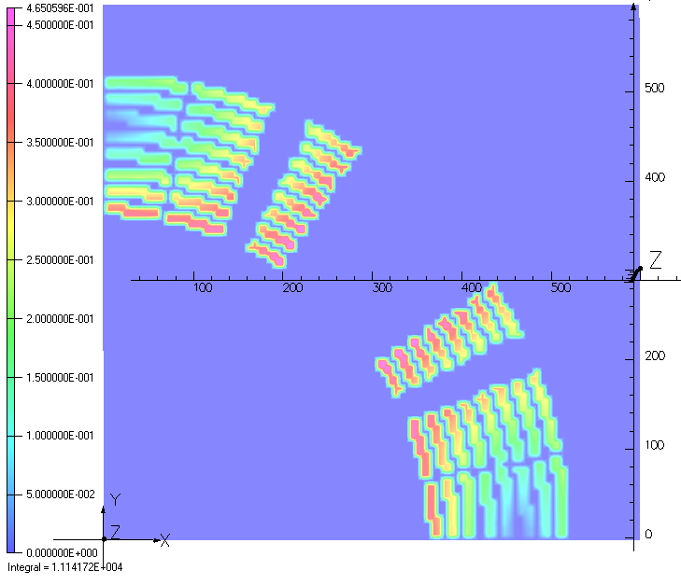
Fmod force density in N/mm3 – 4250 A

Slide 17
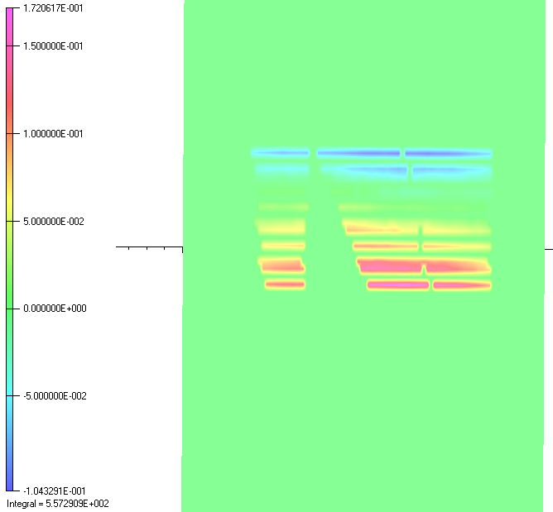
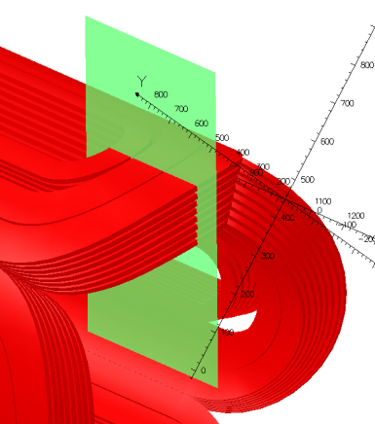
Fx force density in N/mm3 – 4250 A

Slide 18
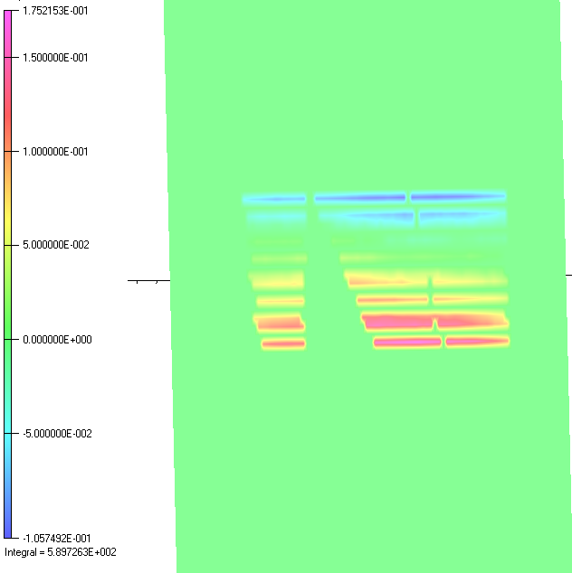
FY force density in N/mm3 – 4250 A

Slide 19
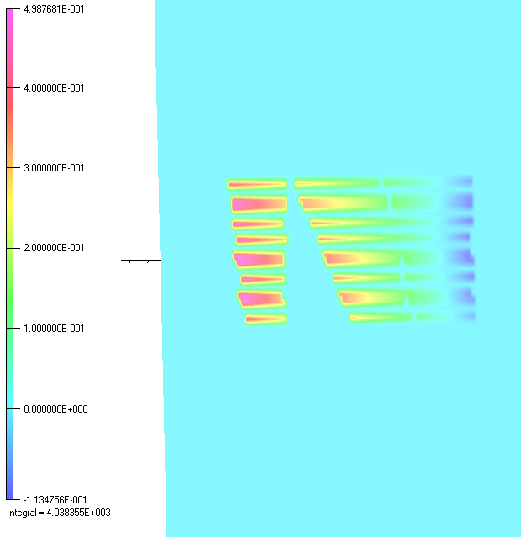
Fz force density in N/mm3 – 4250 A

Slide 20
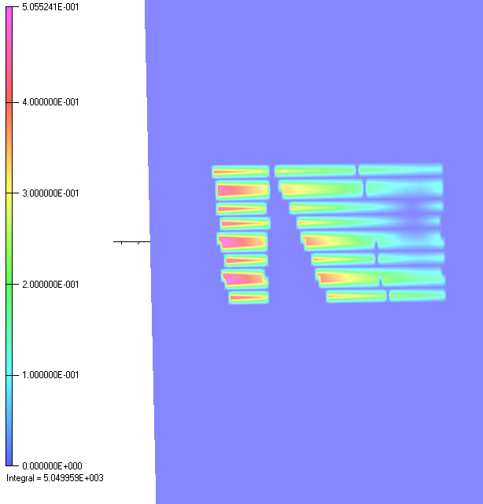
Fmod force density in N/mm3 – 4250 A

Slide 21
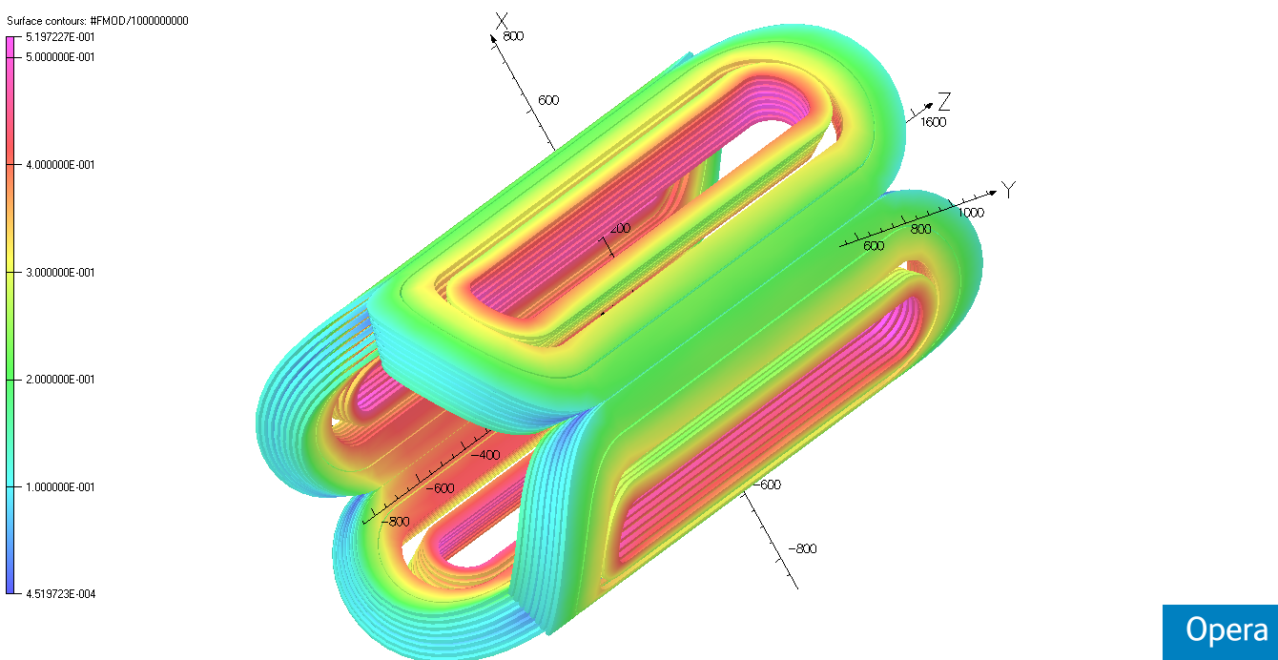
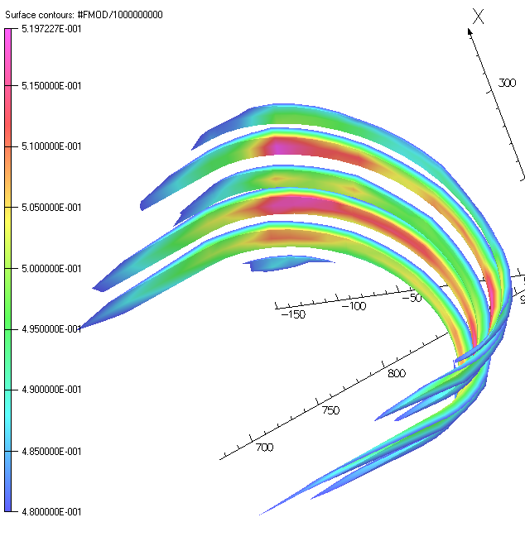
The peak lorenz force density in the coil N/mm3 – 4250 A

Slide 22
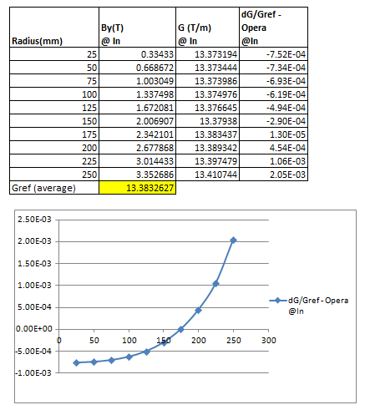
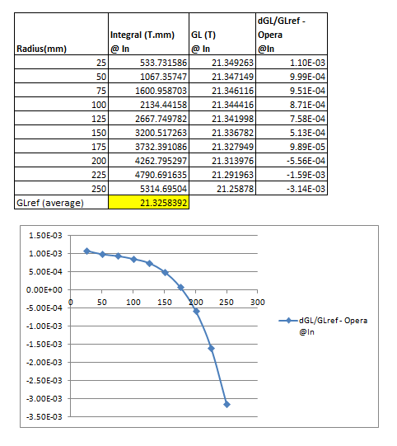
dG/G0 homogeneity an dGL/GL0 homogeneity– 4250 A
dG/G
dGL/GL

Slide 23
Opera calculation-Summary
 | Jlab Specification 7 December 2009 | Sigmaphi 3D calculation 318711-jlab-3D-vers111 @ 4250A
Amp-Turns Nb Turns | 6.818*10⁶ 423 Turns | 7.259*10⁶ 427 Turns
Gradient | 13.03 T/m | 13.414 T/m
Integrated Gradient | 21.4 T | 21.258 T
Lorenz force density –peak value at the coil (Vertical middle plan) | Not specified | Max fx density = 0.408 N/mm3 Max Fy density = 0.402 N/mm3
Lorenz force density –peak value at the coil (head) | Not specified | Max Fmod density = 0.520 N/mm3
Stored Energy | 9.21 MJ | 9.93 MJ
Field in the coil | Not specified | 6.153 Tesla
Integrated harmonics coefficients B3/B2 B4/B2 B6/B2 B10/B2 | 0.1% -0.05% -0.3% -0.1% | 7.098E-06 % -0.010301 % -0.356969 % -0.064134 %

