Slide 1
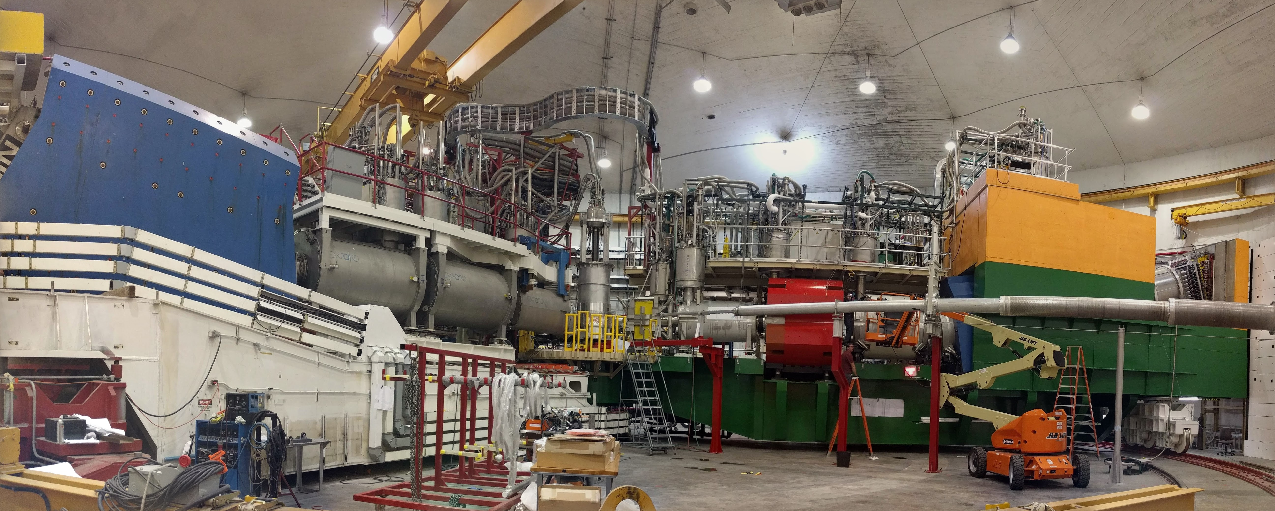
Overview: E12-06-105 (x>1) E12-10-008 (EMC)
Experimental readiness review
drhgfdjhngngfmhgmghmghjmghfmf
John Arrington
Argonne National Laboratory
June 8, 2017
Newport News, VA

Slide 2
Outline
Addressing charge items 3 and 6
Physics Overview
Emphasis on key requirements for kinematics, performance, etc…
Run plan
Collaboration Readiness
Documentation

Slide 3
Physics overview
Focus on experimental requirements
E12-06-105 (x>1): J. Arrington, D. Day, N. Fomin
QE scattering from high-momentum nucleons (>k_{F}) arising from hard, short-range N-N interactions to study short-range correlations (SRCs) in nuclei
DIS scattering at x>1: Probe distribution of super-fast quarks (SFQs) in nuclei
E12-10-008 (EMC): J. Arrington, A. Daniel, N. Fomin, D. Gaskell
DIS from range of nuclei to study Nuclear effects in parton distributions
Combined: Examine EMC-SRC correlation as function of A and N/Z
Several Common Requirements
Inclusive scattering with reasonable rates, modest backgrounds
Study wide range of nuclei to examine A-dependence and isospin-dependence of SRC contributions, nuclear pdfs
Scan range of angles to examine Q² dependence
Most observables focus on A/²H ratios; common systematics

Slide 4
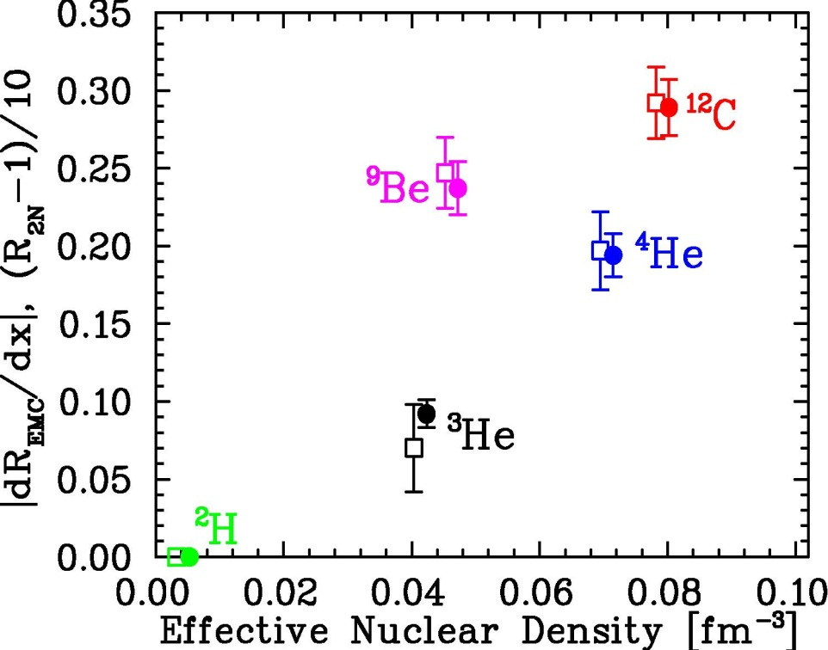
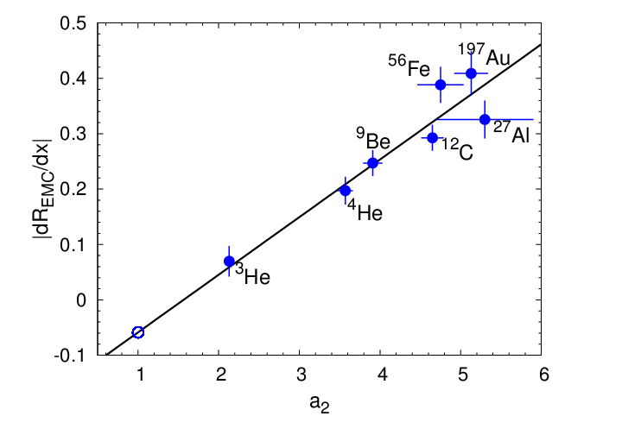
EMC-SRC correlation
How are EMC effect, SRCs related?
High-momentum vs. high-density?
EMC effect as small modification in all nucleons vs. large effect limited within SRCs?
JA, A. Daniel, D. Day, N. Fomin, D. Gaskell, P. Solvignon, PRC 86, 065204 (2012)
N. Fomin, et al., PRL 108, 092052 (2012)
L. Weinstein, et al., PRL 106, 052301 (2011)
J. Seely, et al., PRL103, 202301 (2009)

Slide 5
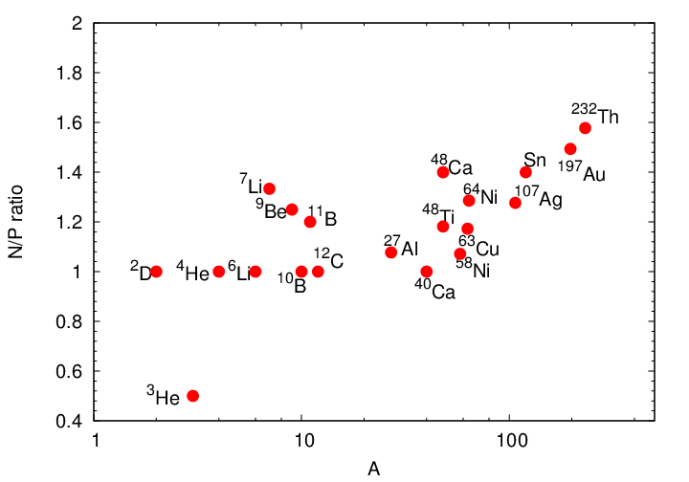
Run plan: Targets
Light nuclei: Reliable calculations of nuclear structure (e.g. clustering)
Both experiments use wide range of nuclear targets to study impact of cluster structure, separate mass and isospin dependence on SRCs, nuclear PDFs
Additional foil targets (dark blue) added to original proposal. No additional beam time required, no special target issues
All targets measured for SRCs, EMC effect at high-rate kinematics. Select targets run at higher Q² to study Q² dependence or extend kinematic reach
Nadia Fomin, Dave Meekins
will cover technical details
¹H
²H
³He
⁴He
^{6,7}Li
⁹Be
^{10,11}B
¹²C
²⁷Al
^{40*,48}Ca
⁴⁸Ti
⁵⁴Fe
^{58,64}Ni
^{64*}Cu
^{108*}Ag
^{119*}Sn
^{197*}Au
²³²Th
Heavier nuclei: Cover range of N/Z at ~fixed values of A

Slide 6
Run plan: Kinematics overview
Both experiments cover range of angles (20-55º) to examine Q² dependence of structure functions [angles shifted from proposal to increase compatibility]
Main PDF measurements at 20, 33º (EMC), or x≥1: modest pion backgrounds
High-x SRCs requires small angle
Need SHMS for E’ ≈ 11 GeV
Need ‘medium’ beam pipe
HMS: 20-55º, 1.4-6.4 GeV/c
SHMS: 8-33º, 1.4-10.6 GeV/c
All data taking at 11 GeV
Focus on target ratios
Light nuclei: cluster structure
Heavier nuclei: vary N/Z
EMC
x>1
EMC effect vs A, N/Z
Larger Q² pushes to highest x
PDFs at x>1
x, Q² dependence
A-dependence of SRCs

Slide 7
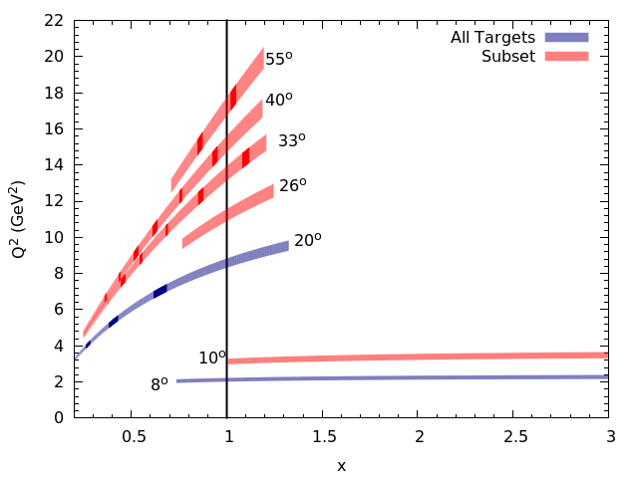
Run plan overview
Basic Run plan: 23 PAC days EMC, 32 days x>1
Assume 2 days will be completed during Hall C commissioning
7 days for EMC effect at 20º [all targets, HMS and SHMS in parallel]
6 (3) days for selected targets at 35 (40) degrees
6 days overhead, calibrations, …
4 days for x>1 at 8º [SHMS]
4 days for selected targets at 10º
17 days for high Q² x>1 (²H,C,Cu)
6 days overhead, calibrations, …
EMC
x>1
EMC effect vs A, N/Z
Larger Q² pushes to highest x
PDFs at x>1
x, Q² dependence
Notes:
Proposed 80uA; assuming 60uA
Single ladder with all solid targets
Start with ^{1,2}H, taking data with all targets; 1 day target changeover before running ^{3,4}He (+C, dummy)
A-dependence of SRCs

Slide 8
Manpower and analysis overview
Charge item 3
Confirmed participation
12 institutions (JLab, UVa, ANL, UT, UNH, JMU, MSU, Ohio - key collabs.)
Estimated participation of 40 Faculty/Staff, 10 Postdocs, 20 Graduate students (4 Thesis)
Analysis
Relatively simple analysis; key issues are similar for x>1 and EMC (inclusive scattering, rapidly varying cross sections, focus on target ratios)
Follows all the same procedures as 6 GeV “XEM” rungroup
Have calibration codes, cross section models, radiative corrections, etc…
Arrington/Day/Gaskell spokespersons for 6 GeV run
Daniel/Fomin were graduate students on EMC/x>1
Plan to treat both experiments as single analysis, with students focusing on different physics aspects
Calibrations, simulations, analysis, etc… will all be tested during F2p/F2d commissioning run
Expect 4 Thesis students: 2 focusing on x>1 physics, 2 on EMC physics

Slide 9
Experimental, analysis requirements
Charge item 6
Conventional trigger and efficiency studies: high efficiency, low background, modest rates
Working version of C++/ROOT analyzer exists (validated against 6 GeV code)
Full simulations (realistic cross section model, detailed radiative corrections, spectrometer models, etc….) exist now
SHMS spectrometer model checked during 2017 run
All aspects of x>1/EMC data taking and analysis will be tested during Hall C commissioning (small subset of targets being run with F2p/F2d due to significant kinematic overlap)
EMC and x>1 physics analysis will follow the same procedures as Tritium rungroup experiments.
Codes and procedures will be well tested, the collaboration includes most current experts, and the Tritium rungroup and Hall C commissioning data will provide many more experts

Slide 10
Responsibilities for running/analysis
Nadia will discuss hardware responsibilities
Run plan
Physics plan: Arrington, Fomin (+ Day, Gaskell, postdoc)
Calibrations: Gaskell, Fomin (+ Arrington, postdoc, Thesis students)
Online analysis
Will assign responsibility for detector checks, calibration monitoring, data quality checks, etc… to specific postdocs/students for each subsystems
Coordinated by Gaskell, local postdoc
Physics Analysis
Lead student will be identified for each spectrometer subsystem, other thesis students will verify quality of final calibrations, optics, etc… for their data sets
PhD students will perform basic cross section extraction for full data sets
Significant cross-checks
Extraction of physics results separate for x>1, EMC
Analysis is identical to what is required for F2p/F2d commissioning running

Slide 11
Documentation
Charge element 6
Experiments use only standard equipment except for new targets, most of which have no additional procedures or documentation requirements
Steve Wood is generating updated documentation
Will use the standard Hall C COO, ESAD, ERG
Greg Smith has identified the minimal additions to the Standard Equipment Manual needed for Helium targets
Will get full RSAD from Radcon (have prelim. calculations)
Standard OSPs, Operation manuals, etc…
Physics Div. Liaison assigned: Simona Malace

