Slide 1
Target Operator Training slides
The Polarized ³He Target Group

Slide 2
Members
Todd Averett
Jian-Ping Chen
Junhao Chen
Mingyu Chen
William Henry
Melanie Rehfuss
Murchhana Roy
Brad Sawatzky
Arun Tadepalli

Slide 3
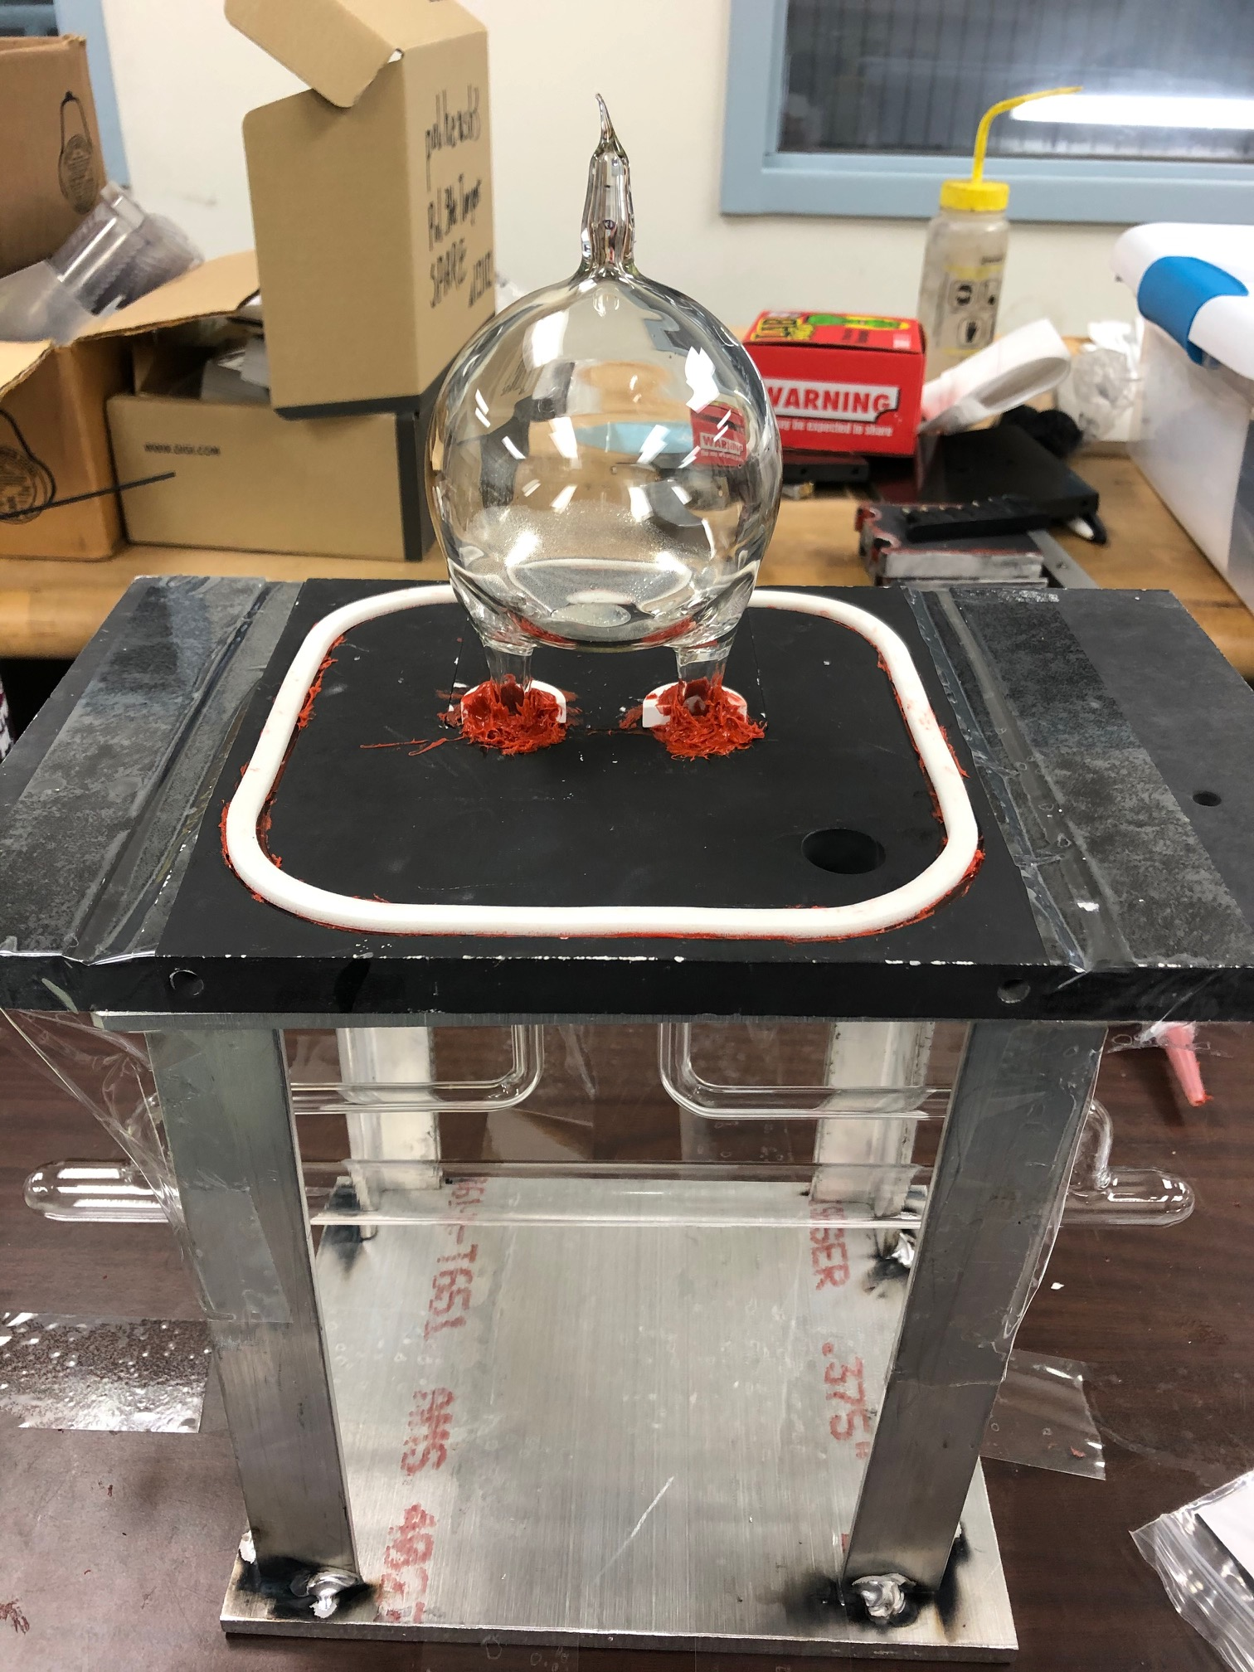
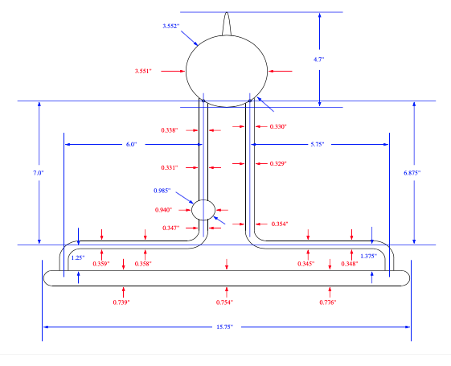
Target cell

Slide 4
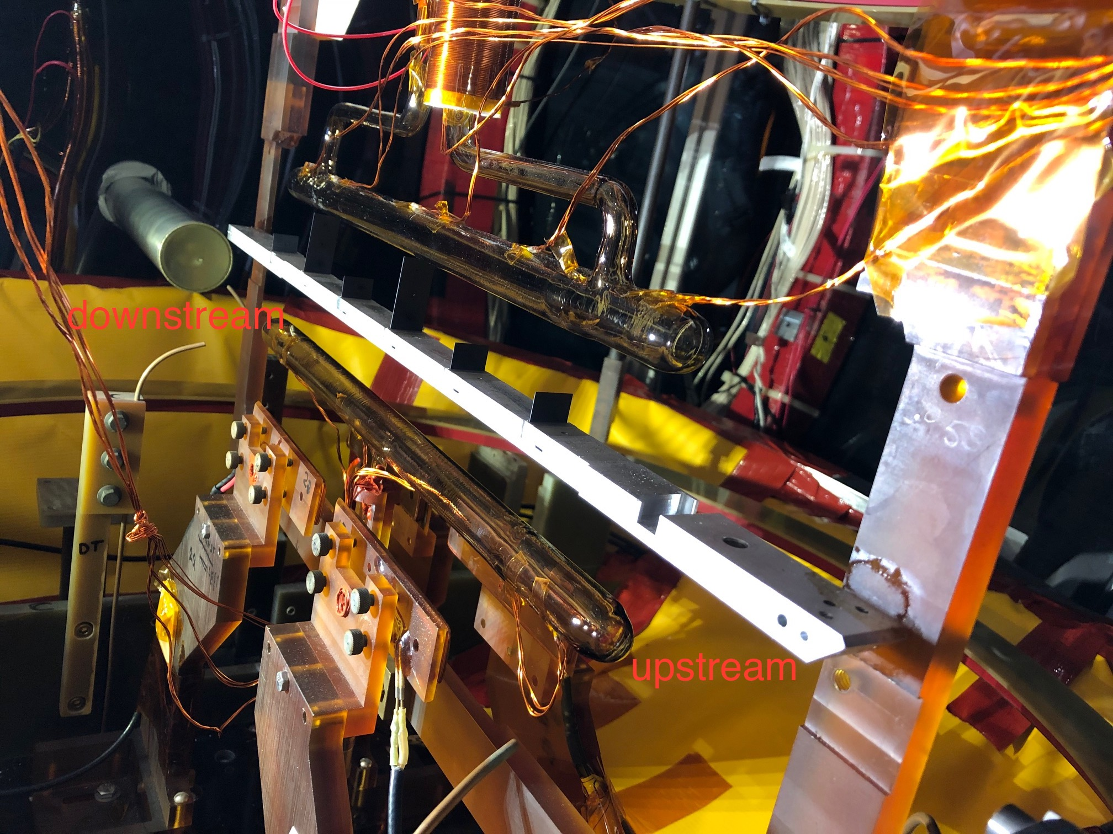
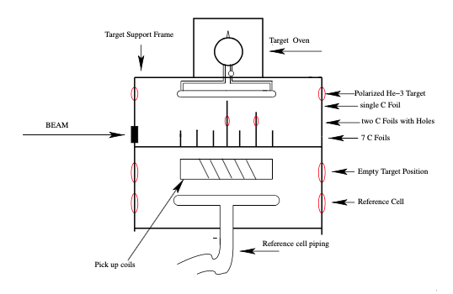
Target ladder
*Carbon foil configuration slightly different from picture shown above

Slide 5
Target enclosure

Slide 6
Main field Helmholtz coils
Vertical correction coils (to cancel HB field)
Horizontal correction coils (to create gradient)
V_{L}
V_{S}
H_{L}
V_{S}
V_{L}

Slide 7
Target Oven

Slide 8
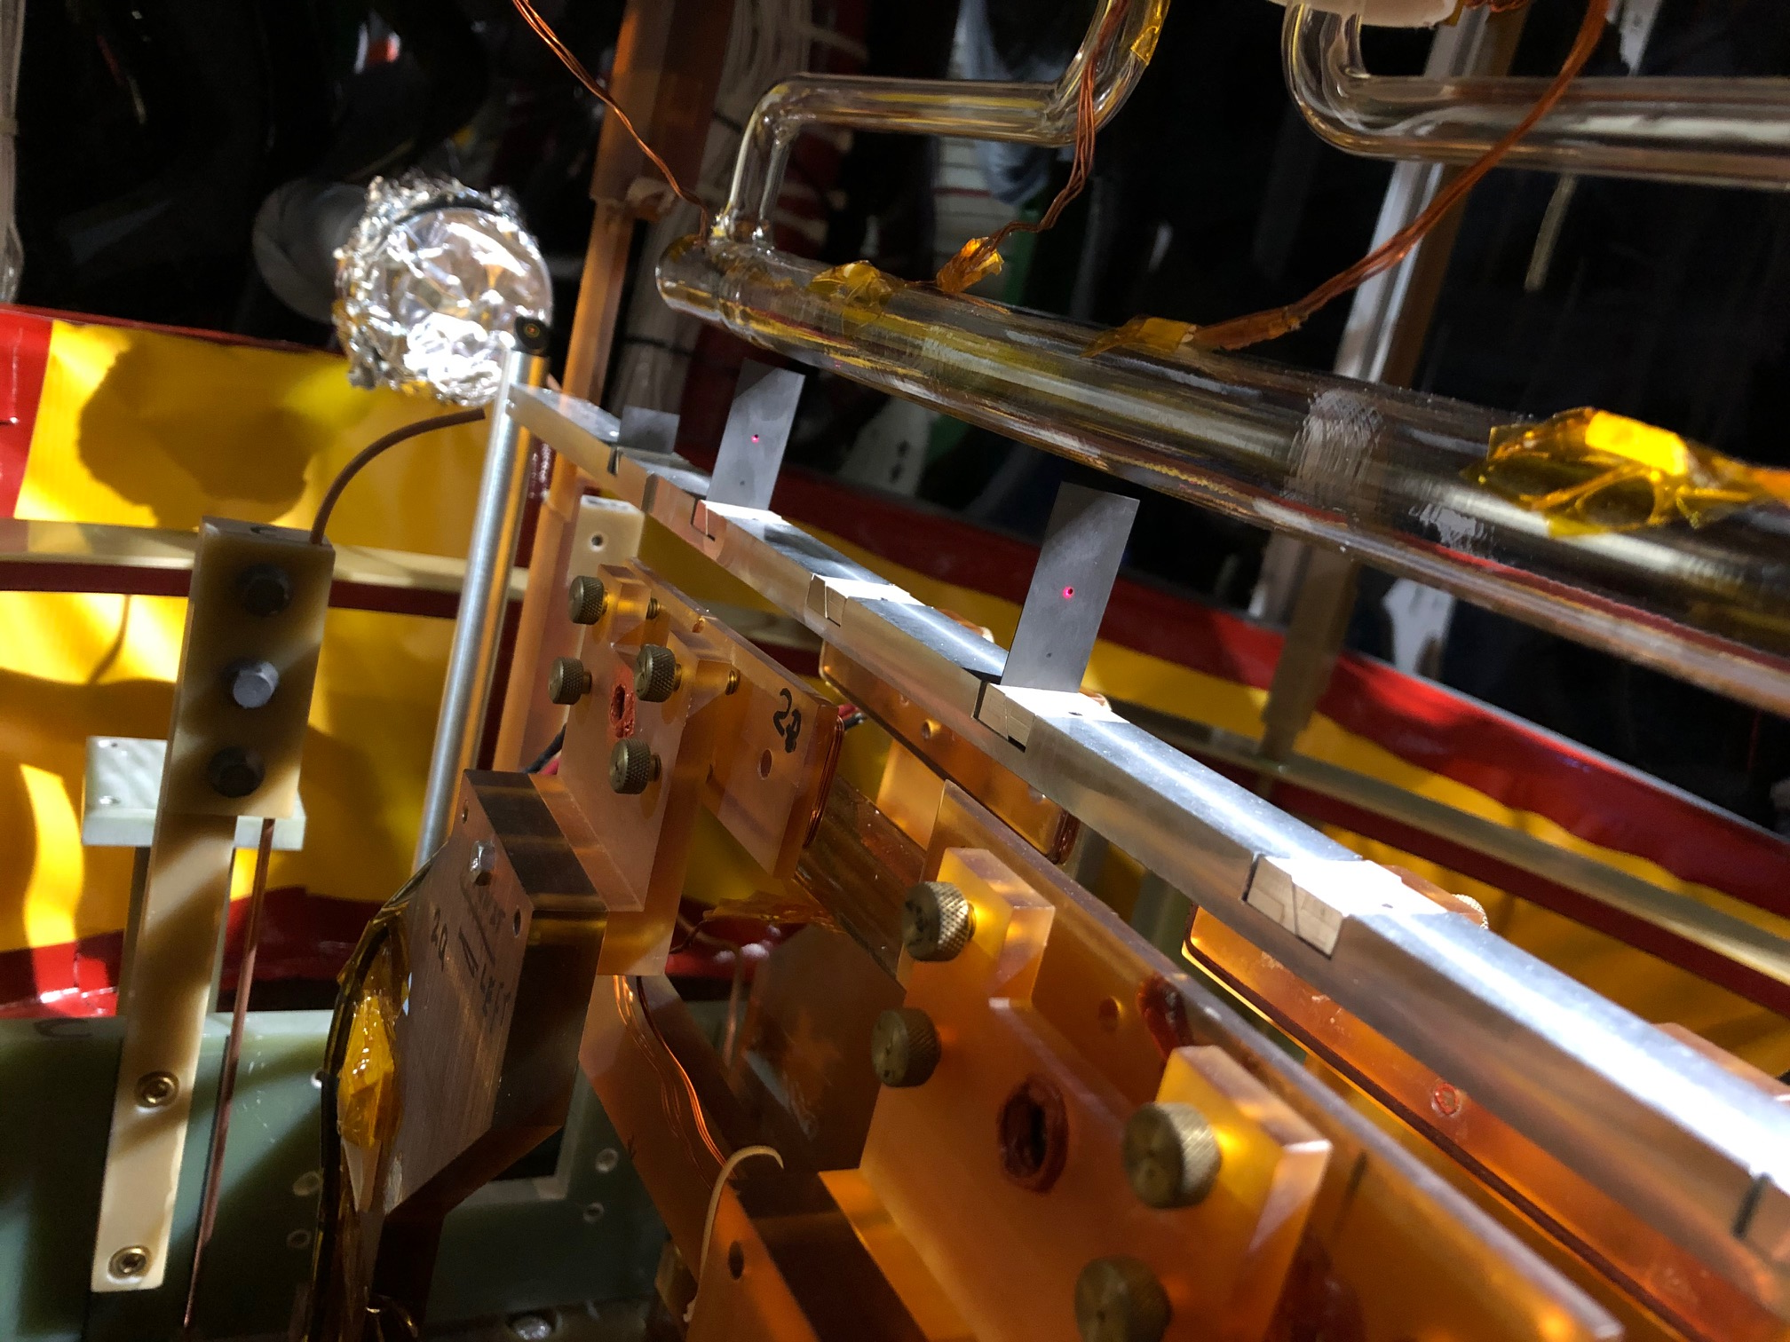
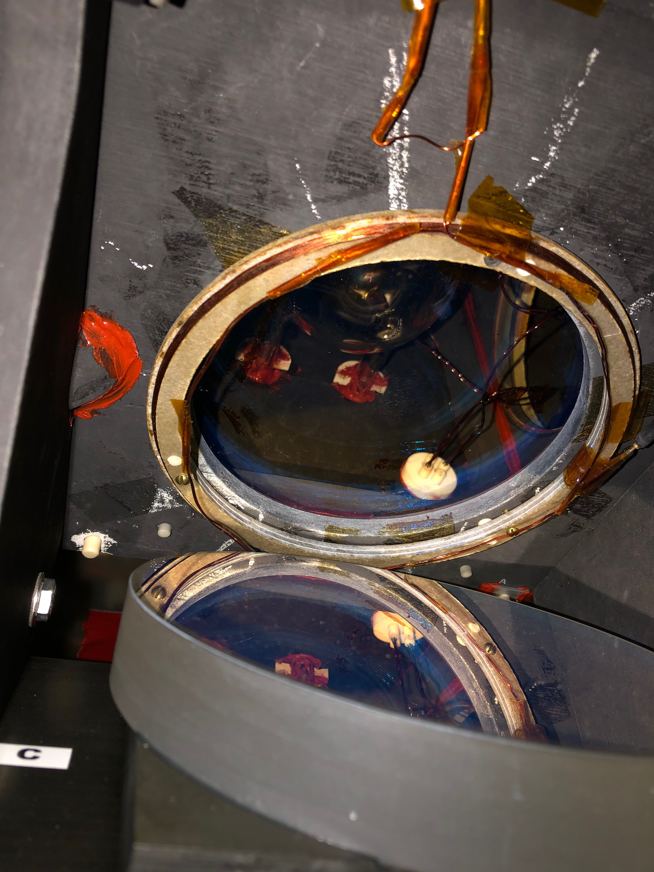
Pumping chamber pick up coil
Pick up coil position: target in between NMR coil legs

Slide 9
Reference cell
Same geometry as target cell
Look at the document titled “xxxx” while requesting reference cell runs

Slide 10
Reference cell

Slide 11
Carbon foils arrangement
Carbon optics
Carbon “hole”
Carbon foil

Slide 12
Introduction
High density polarized He3 gas at ~10 atm in a target cell along with Rb-K mixture
The target employs a spin-exchange process to polarize the He3
Rubidium vapor is polarized by optical pumping with circularly polarized laser light at 795 nm
The polarization is transferred from Rb to K and eventually to He3 nuclei which will be our effective “neutron target”

Slide 13
Target Operator Responsibilities
Monitor temperatures of the target cell, pumping chamber, transfer tube, oven and reference cell
Monitor temperatures for the laser fibers and fire safety interlock
Monitor cooling jets for the target windows and for beamline windows
Monitor pressure or vacuum of the reference cell
Move the target
Change oven temperature
Turn on/off the lasers, change power (current), monitor spectro-analyzer
Perform polarization measurements (NMR, EPR, pNMR)
Change target field directions, monitor current for main coils
Set current for correction coils corresponding to HB magnet angle/field
Set convention heater voltage
Service alarms, call target-on-call if necessary

Slide 14
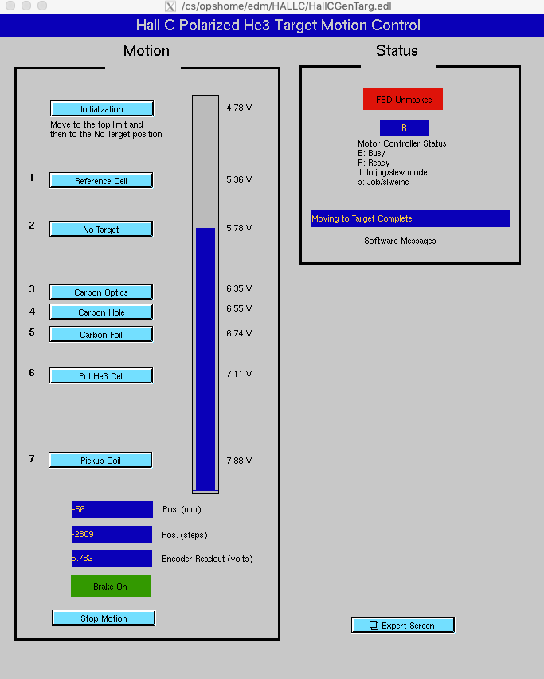
To move the target ladder
To move the target ladder
Call MCC
Tell them what target position you would like to move the target to
Make sure that the FSD is masked i.e. red tab in status box turns green
Make sure that the status box indicates “Moving to Target Complete”
Make a log book entry about the target move and post a screen shot of the current position
If the target ladder doesn't move, call the expert
Look at the procedure for taking the runs on reference cells ** confirm with Brad

Slide 15
Turn the Oven On/Off
Airflow should be on otherwise the heater trips off
You should be able to turn the oven on by clicking on “Run”
The heater should be tuned to the desired set point in small steps
Adjust the SP1 value on the set points box in the heater control software
Keep an eye on the Oven RTD temperatures
To turn the oven off, bring the temperature down to 20 degrees

Slide 16
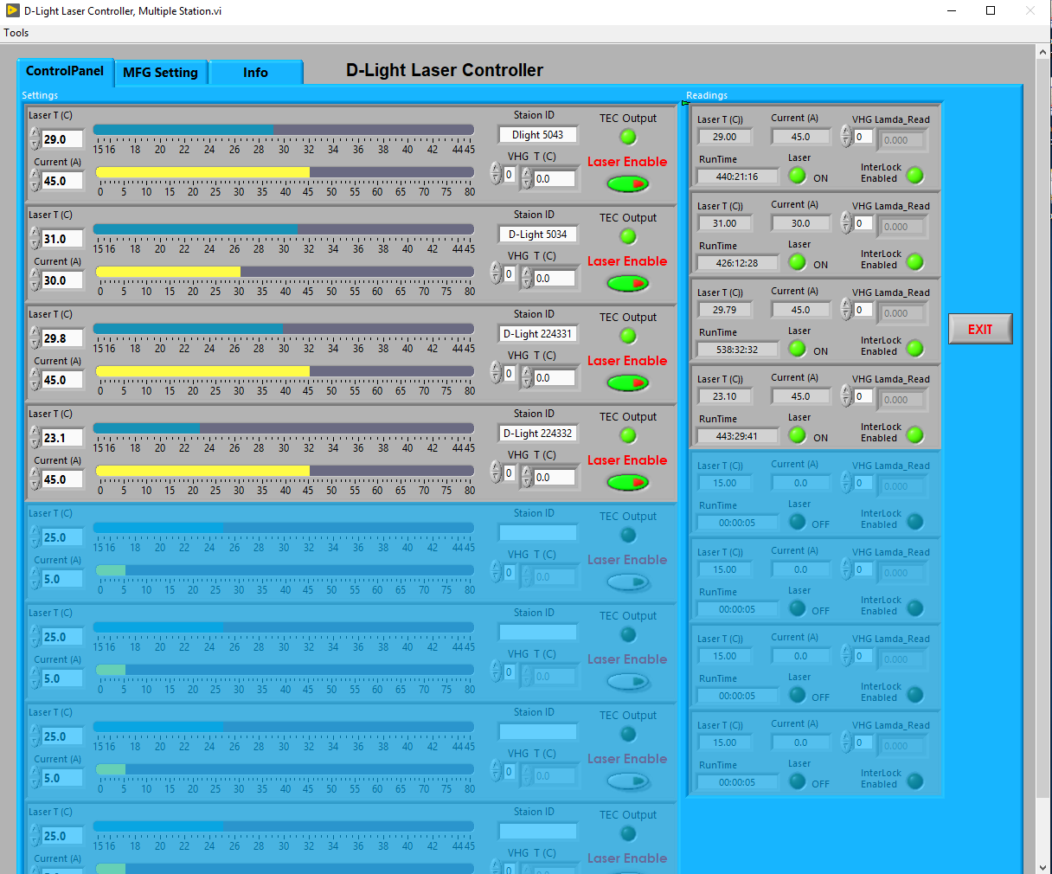
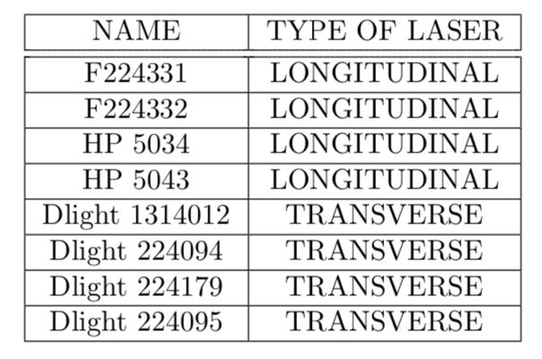
Turning lasers On/Off
The He3 target uses two types of lasers (Transverse and Longitudinal)
Confirm with Junhao and check paper if front of the target desk

Slide 17
Turning lasers On/Off
Click on Raytum D-Light Lasers icon on the Laser control desktop
Make sure all the lasers settings are loaded
After the loading is complete, click on the Adapter.vi software, minimize it and let it run in the background

Slide 18
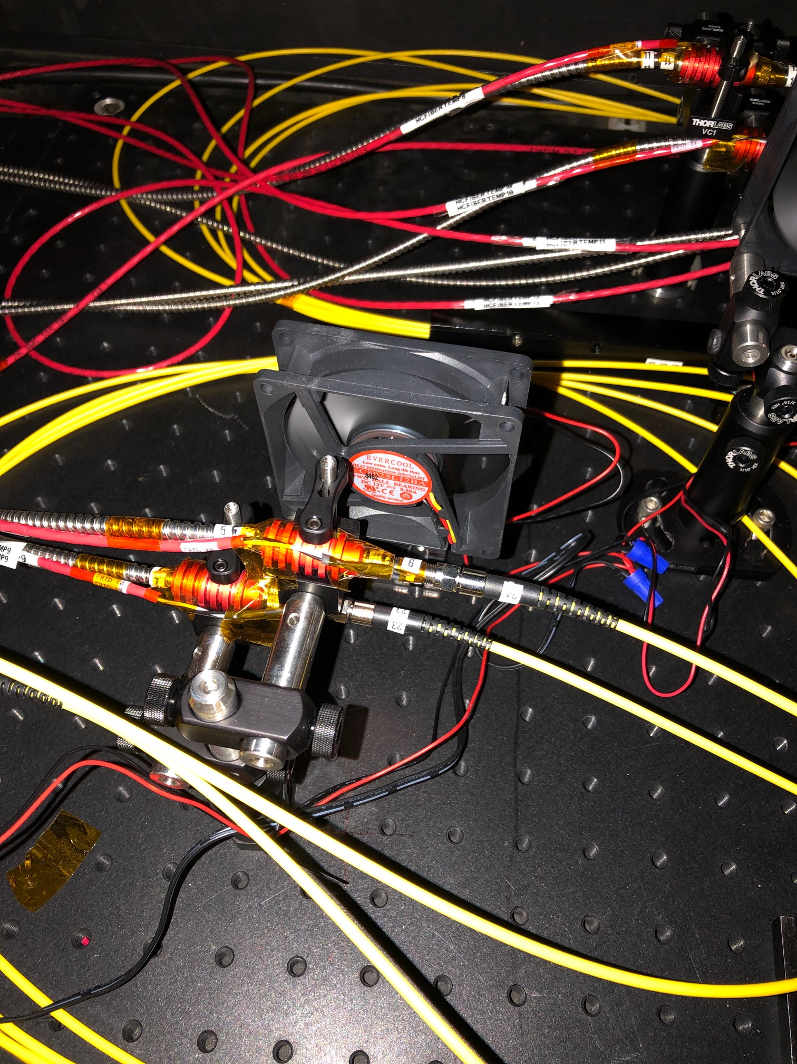
Turning lasers On/Off
Make sure that the Interlock Enabled light is green for all the lasers that you would like to turn on
Click on the Laser Enable button and make sure it turns green
The laser temperature and current should show up in the box on the left hand side of the laser control software
Slowly move the yellow bar to the desired currents and fine tune it with the up/down knobs
Make a logbook entry about the change and monitor the Laser RTD strip charts

Slide 19
Monitoring laser fiber RTDs
HcFiberTemp4 is the RTD at the 4-1 laser combiner.
RTDs: Resistance temperature detectors have been placed on the fiber tips of all the laser fibers
Monitor the laser fiber RTDs after turning the lasers ON and call the expert if you see a gradual rise in any of them

Slide 20
Target RTDs
The target cell has a total of 9 temperatures on it (5 on target chamber, 2 on transfer tubes and 2 on the pumping chamber
Report any general monotonic trends to the experts

Slide 21
Cooling jets
What are the nominal values??
Two sets N2 cooling jets for the beam entry and exit windows and for the target cell windows.
N2 should be continuously be flowing to these windows to cool them down
Make sure that these are within nominal values and any unusual trends should be reported to the experts.

Slide 22
Oven RTDs
There should be air flow to the oven, if not the heater trips off
Make sure the oven temperature sensors are within nominal values

Slide 23
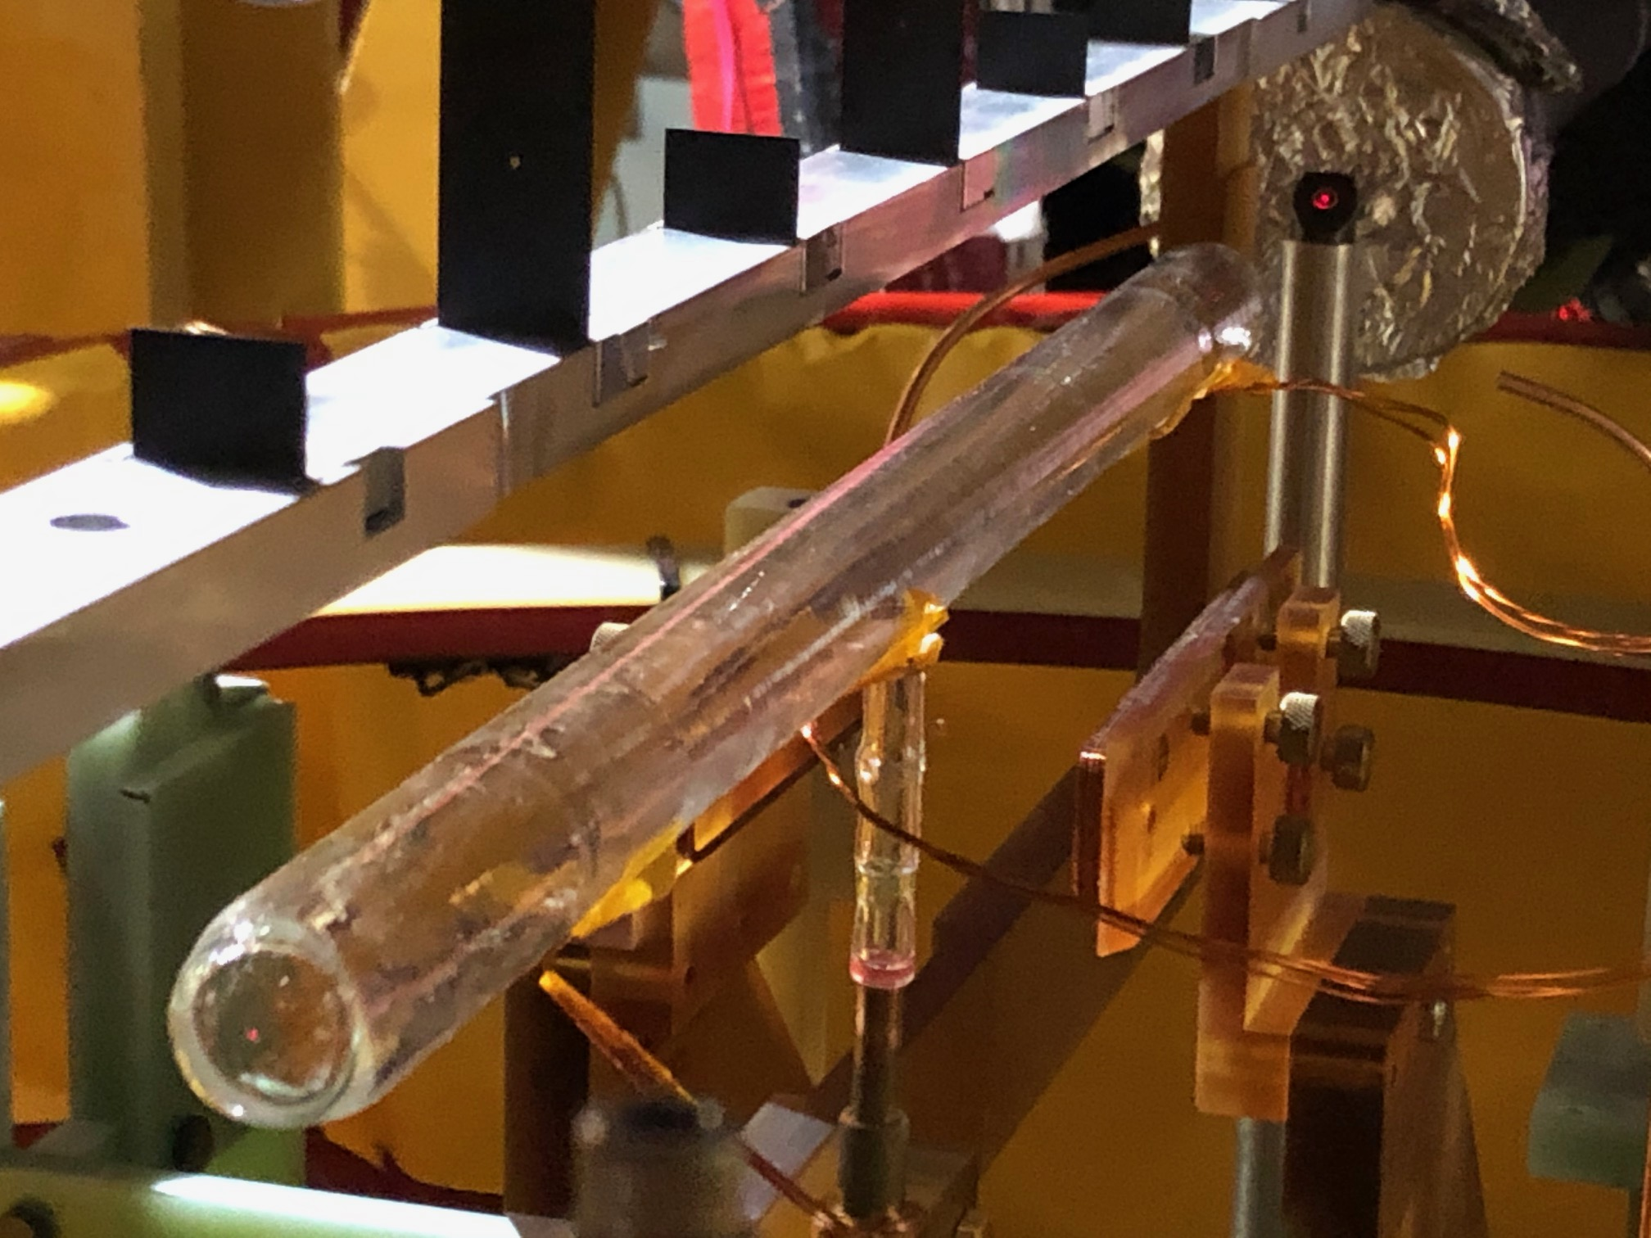
Three RTDs are placed along the length of the reference cell. Make sure the reference cell RTDs are within nominal values set in the alarm handler box. The ADC readouts are noisy. Report any downward overall trend in these charts to the experts.
Reference cell RTDs

Slide 24
NOTE
All the Labview programs are in “A1nD2n_SlowControl” folder located on the target desktop of polhe4 computer
Click on the right arrow icon on the top left of each Labview program to run it
Call the target experts in case of any problems
Communicate all changes to the shift leader and ask S.L. regarding configuration changes which requires a change in correction coil settings
Any changes made to the target/lasers should be followed by a logbook entry and a screenshot of the current settings

Slide 25
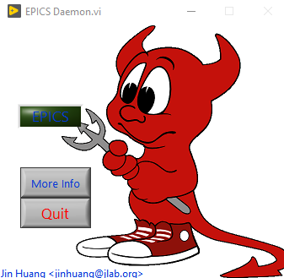
Start the EPICS daemon
Start the EPICS_daemin.vi script which can be found in “A1nD2n_SlowControl” folder located on the target desktop of polhe4 computer

Slide 26
Rotating the Holding field
To rotate the main holding field, click on the “Present Angles” drop down menu and load the setting (longitudinal+, longitudinal-, transverse+ or transverse-)
Click on the yellow “Load” button
Click on the blue “Start Rotation”
Make sure that the yellow line in the screen rotates to the desired angle
Make a logbook entry about the change

Slide 27
Monitoring the Holding field currents
To monitor the holding field KEPCO currents, click on current_meter_monitor.vi program
Make sure that the currents are indeed stable around the nominal values which posted on the table in the counting house in front of the target computer
Call the experts if the currents drop by more than 0.1 A

Slide 28
Adjusting the correction coil currents
Communicate with the shift leader on the momentum and HB settings and acquire the right correction coil currents for the momentum settings
The correct settings for the correction coils should be available here *****
Open the Field_Correction_A1nD2n.vi program
Enter the desired values in the “Correction Coil settings” box
Click on Set Correction Coils button
Click on “Read Correction Coils” and make sure that they are consistent with the entered values
Remove the expert mode - Junhao

Slide 29
Adjusting the convection heater current
Open the Convection_Heater_A1nD2n.vi program
Enter the desired values in the “Convection Coil settings” box
Click on Set Convection PS button
Click on “Read Convection PS” and make sure that they are consistent with the entered values

Slide 30
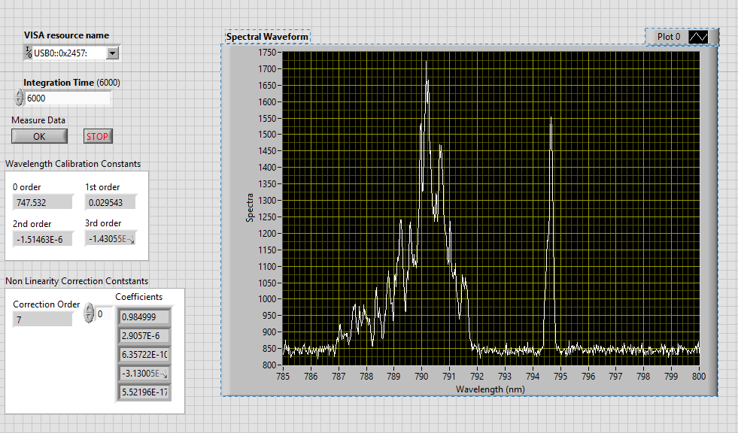
Monitoring the spectro-analyzer
Open the Laser Spectro Monitor.vi program
Click on the Run button
You should see two peaks: one broad peak at around 790 nm and the second narrow peak at 794.66 nm.
Call the experts if you find that the second peak has disappeared or is “significantly” higher than the first one
How should the peak positions be?? Ask JP, Junhao or Mingyu

Slide 31
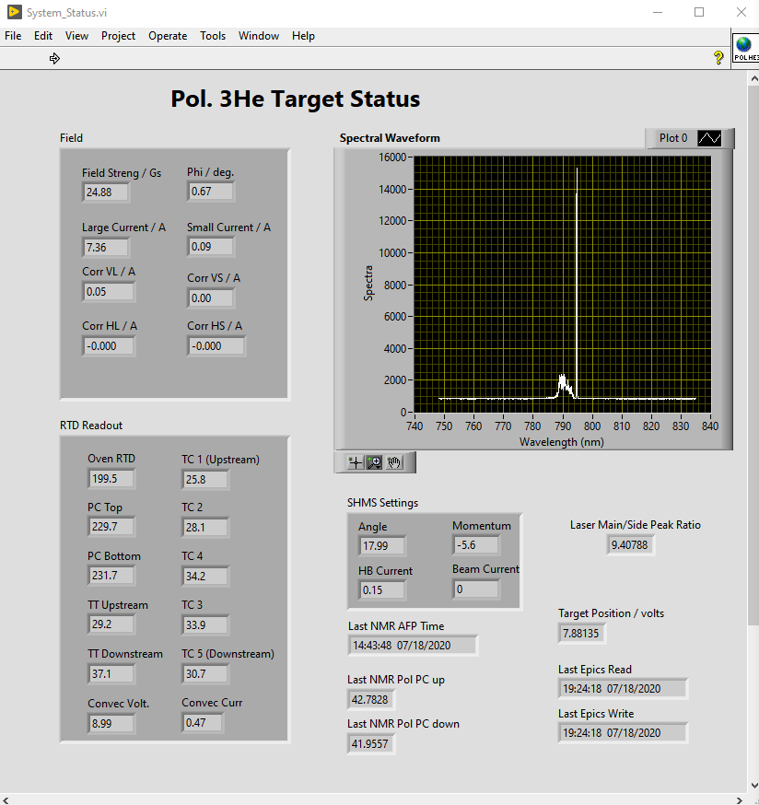
Start the system status program
Start the System_Status.vi script which can be found in “A1nD2n_SlowControl” folder located on the target desktop of polhe4 computer

Slide 32
Polarization measurements
Target operator should perform
pNMR
Wait for 20 seconds
NMR
MAKE LOG BOOK ENTRIES ON THE POLARIZATION MEASUREMENTS AND THE FITTING PROGRAM

Slide 33
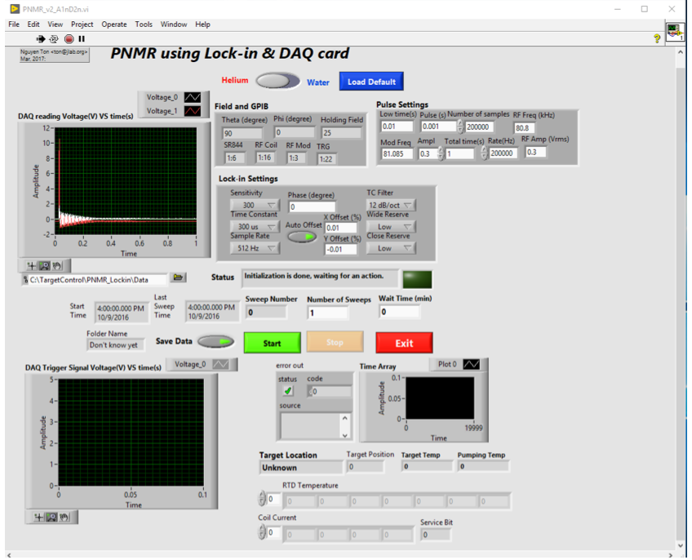
How to do pNMR
Make sure that the pulse frequency and reference frequency in the pulse settings box are the values that correspond to the correct field direction
Move the target to the pick up coil position
Open the PNMR_v4_A1nD2n.vi program
Click on the right arrow icon on the top left to run the program
Make sure that the button indicates “Helium” and not “Water”
After making sure the settings are pulse correct, click on “start”
Make make a log book entry

Slide 34
How to run the pNMR fitting program
Open the Polarization_PNMR_v4.vi program
Load the file in C:\TargetControl\PNMR_Lockin\Data\pNMR_He_****\file_name.dat that has the recent pNMR measurement
Type in the correct calibration constant for this field setting which can be found on the table near the target computer
Click on the white arrow which runs the program and make a log entry with screenshots

Slide 35
How to do NMR
Move the target to the pick up coil position
Open the NMR_FieldSweep_v15_A1nD2n.vi program
Click on the right arrow icon on the top left to run the program
Make sure that the button indicates “Helium” and not “Water”
Click on Load Default
Make sure that the status box indicates “Initialization is completed” and “waiting for action”
Check that the “High Field” value is 32 and the sample rate is 128 Hz

Slide 36
How to do NMR
For a single NMR measurement, the “Number of Sweeps” box should indicate 1
Click on the green Start button
After the sweep is completed, the status box should indicate “Sweeps Completed”
Just cancel the “comments” box that comes up after the sweep
Note the folder name where the recent data is saved for polarization analysis

Slide 37
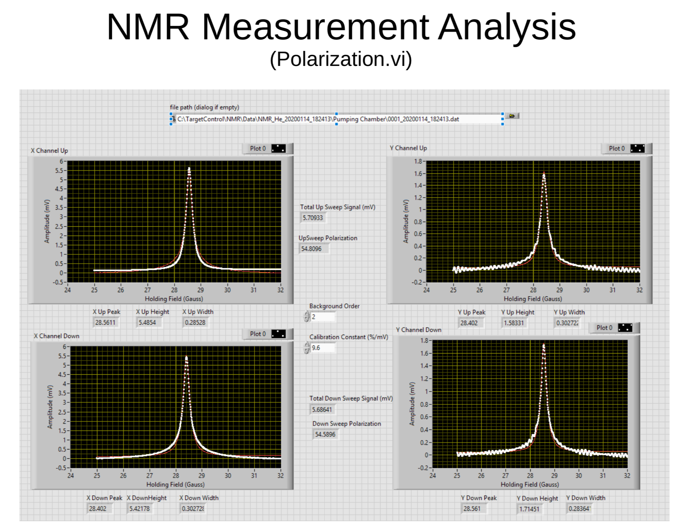
Polarization measurements
To get the polarization value, open Polarization.vi
Load the file in C:\TargetControl\NMR\Data\NMR_He_****\Pumping_Chamber\file_name.dat that has the recent NMR measurement
Enter the calibration constant value (check elog for the most recent NMR calibration constant)
Click on the right arrow to run the program
Check the most recent hclog for the calibration constant for different settings?

