Slide 1
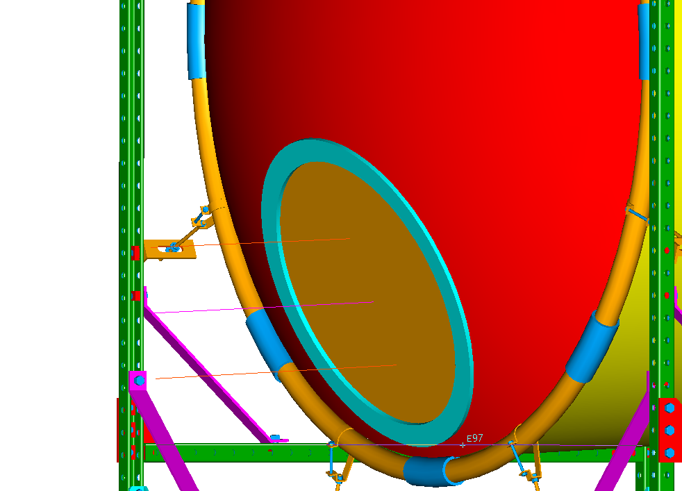
2.2 degree beam deflection
2.8 degree
beam deflection
SANE Window rotated 2.5 degrees downward

