Slide 1
UNH Target Lab Update
7/19/24

Slide 2
Reliquifier Commissioning
Reliquifier commissioning was attempted in June
Unfortunately, a large portion of atmosphere got into the system which we’ve been debugging since
We think this came from a combination of 1/3 of the cylinders not being properly clean on arrival + having the ballast open on the roots pumps

Slide 3
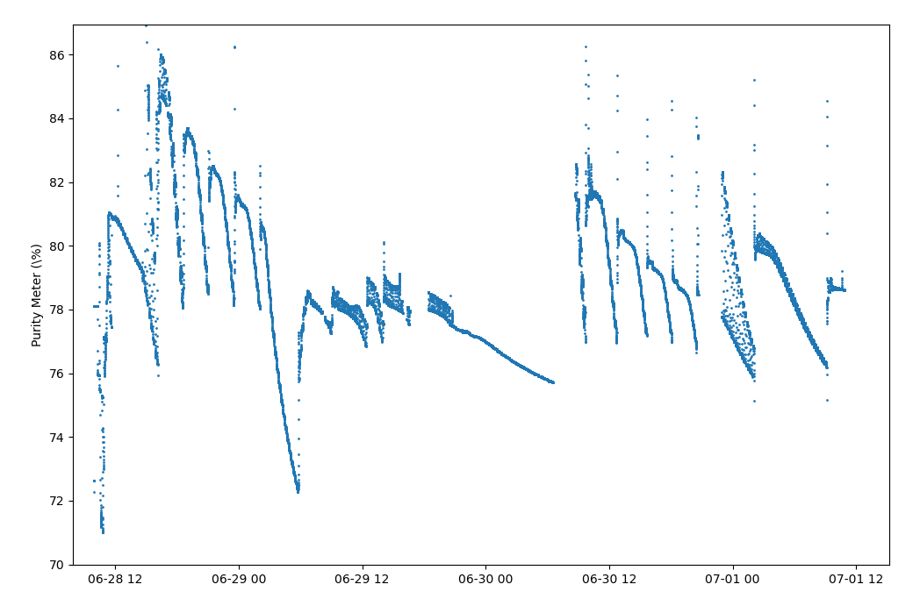
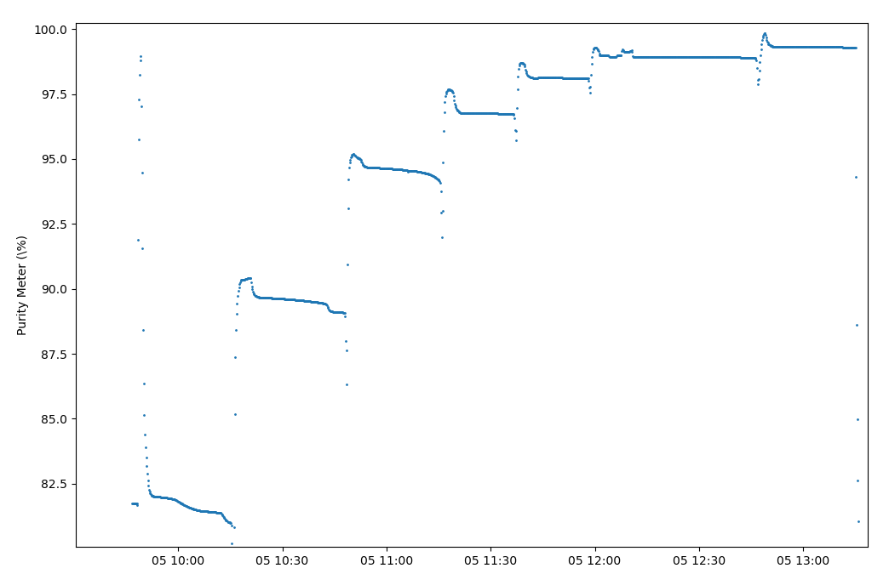
Reliquifier Commissioning
Purity (%)
86%
Cryo purifiers could not handle the ~75% purity helium in our system
Spent ~2 weeks attempting to clean it.
Minor success w/ small # of cylinders, but loss rate of ~90%
QT recommended a membrane filter before the cryo filters if we want to clean <90% purity helium
78%
16 Cylinders
70%
100%
90%
1 Cylinder
82.5%

Slide 4
Reliquifier Commissioning
We have since emptied & cleaned 1/3 of our recapture cylinders
We successfully tested reliquification
Mother dewar → transfer dewar → gas bag → liquid
Recovery rate was ~91%
We successfully tested UHP gas helium recovery in our system w/ capture purity >99%
Magnet boil-off
Fridge boil-off
Separator pumps
Roots pumps
As of 7/18/24, we believe we have fixed the problem

Slide 5
Reliquifier Commissioning

Slide 6
Reliquifier Commissioning
We still need to either vent or clean the ‘junk’ helium in 2/3 of the storage tanks
Once complete, we are ready for physics running again
Expect to start physics running in ~1-2 weeks

