Slide 1
HMS Quad PSU Reset after Turning on 480VAc
Aug, 23, 2021
Steven Lassiter

Slide 2
Quick Instructions
HMS Quad’s new PSU’s dump switch is a motor contactor that has a delay in resetting itself when power is initially applied to it.
Turn on the 480Vac switch located on top pf the PSU.
Using the HMI, bring up the PSU screen and put PSU in remote mode.
Go to interlock page and perform a fast discharge.
Reset the Dump Switch, bottom left of interlock page.
Should hear a mechanical closing noise if next to PSU.
Reset interlocks, center-top of interlock page.
Close Interlock page and verify operation on PSU page.

Slide 3
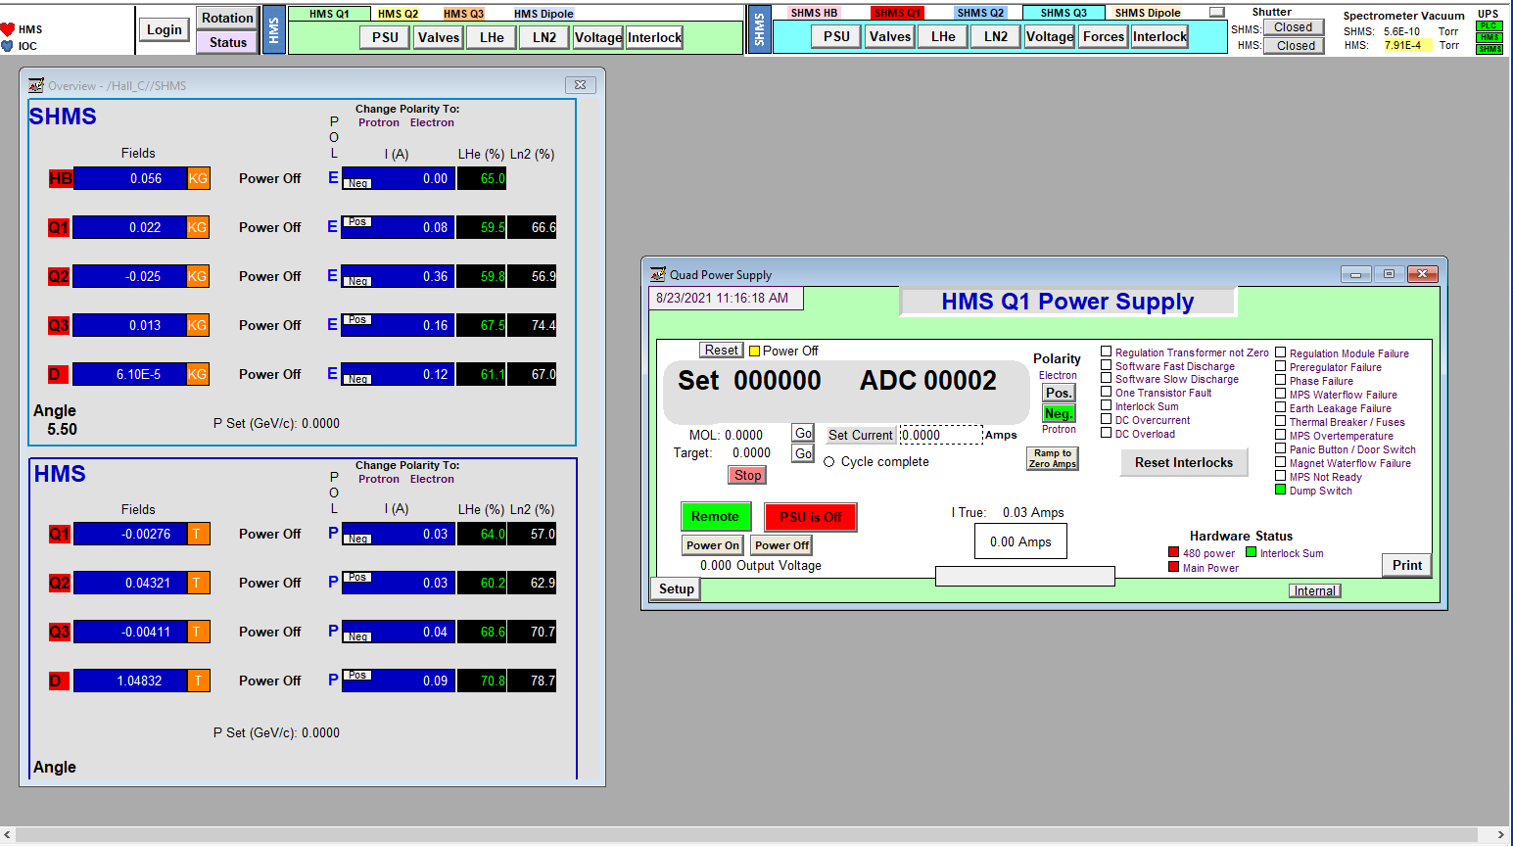
Initial Screen Before Turning on 480Vac power
Pressing in either of these boxes will pop up this the PSU screen

Slide 4
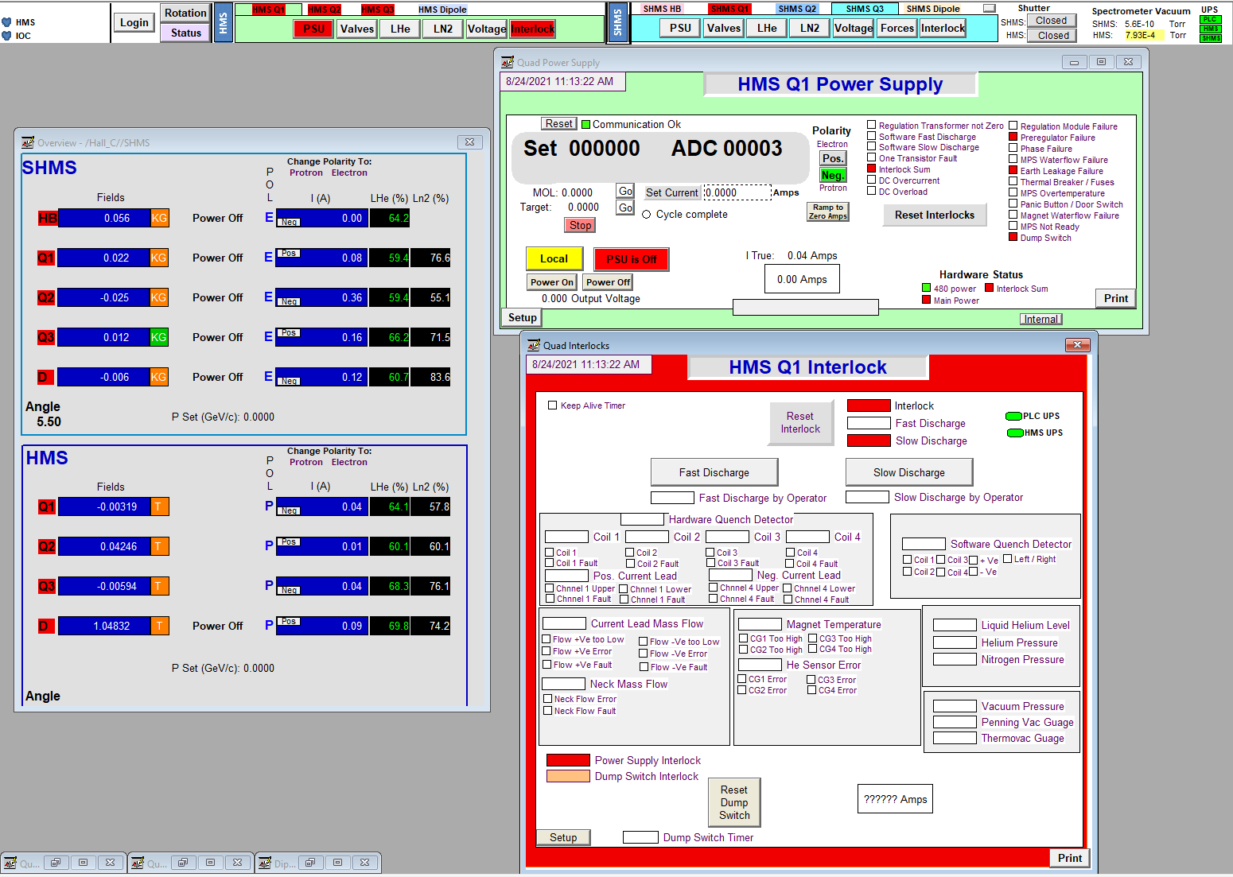
After turning on 480Vac power switch on top of PSU
Communication should be green
Many interlocks may be present
Both ascii and hardware
Press the local box to put controls in remote
480 power should be green

Slide 5
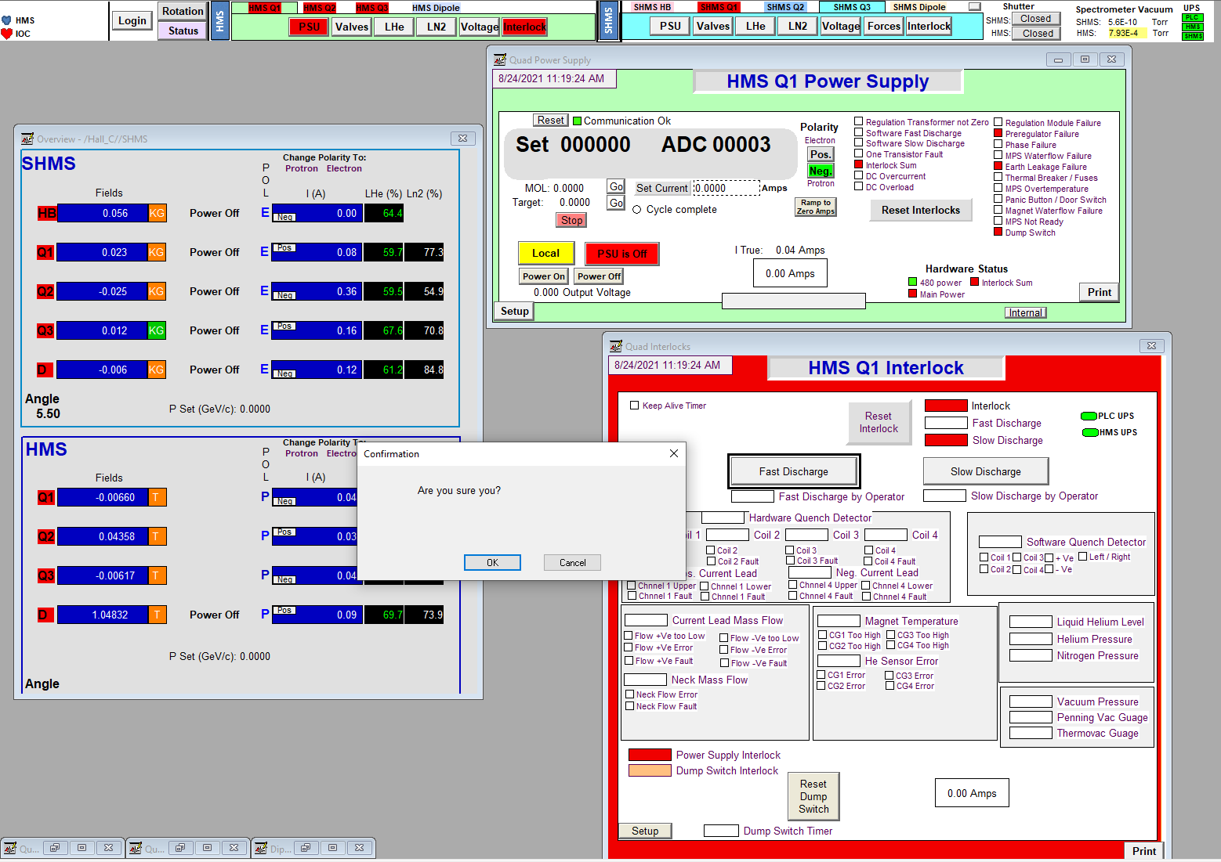
Fast Discharge to initially arm Dump Switch
The Dump Switch is also labeled as Preregulator Failure Interlock
Do a Fast Discharge and click on the are you sure button

Slide 6
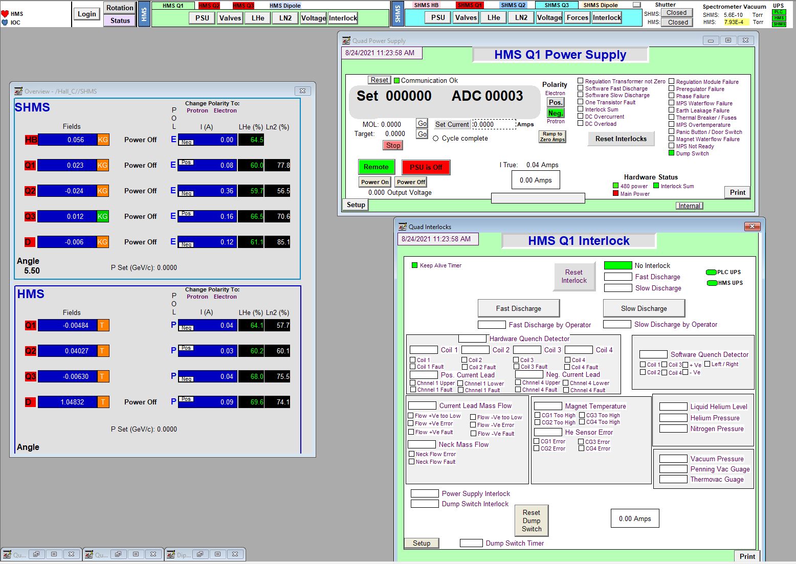
Cleared Interlocks
First Reset the Dump Switch then Rest Interlocks
After resets, all interlocks should be green

Slide 7
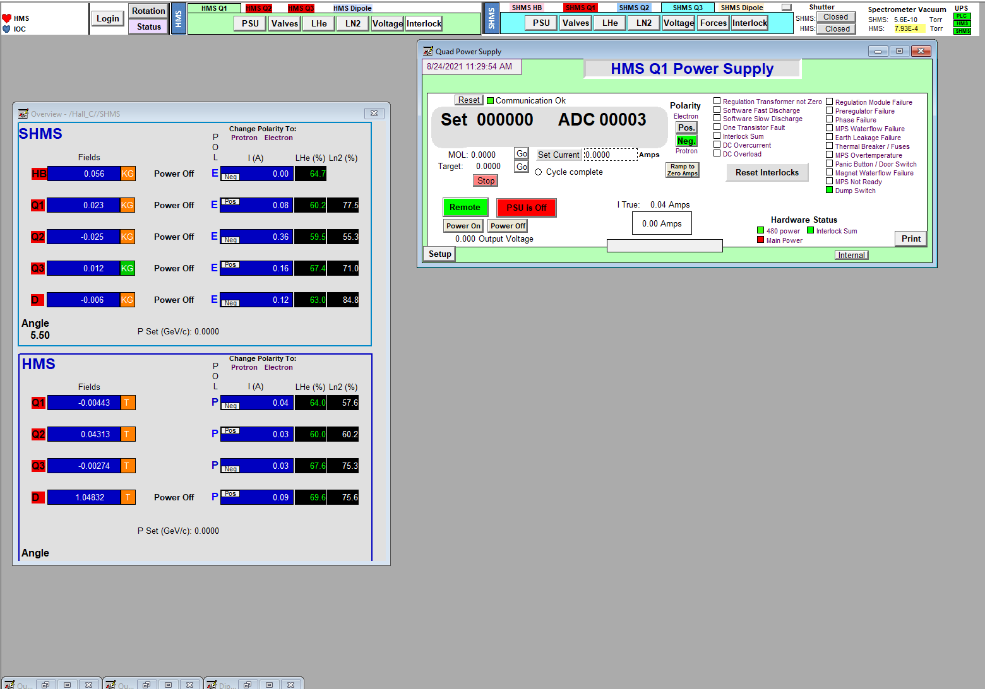
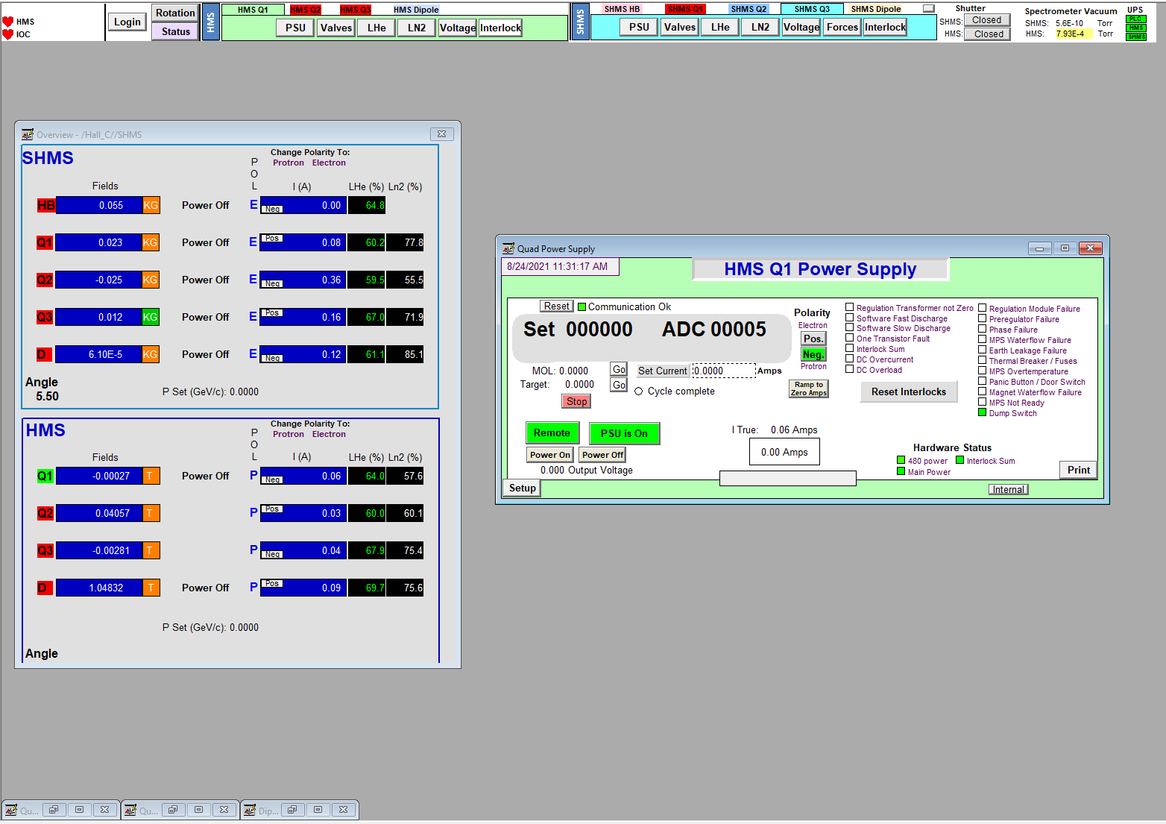
Turning on PSU mains
F= PSU off does this first to make sure PSU is off or PSU will hang up if it is on and the N command goes out. Needs to see a change in the command
N= PSU on command
Wa ## sets ramp rate - predefined.
Press “PSU On” to turn on current to the magnet – under “Remote”
Watch for commands to go out to PSU “F” then “N” then “WA ##”

